Slide 1
Software Processes
Greeshma K V
Assistant Professor & HOD Department of Computer Science Carmel College, Mala

Slide 2
Software Processes
Software process models
Process activities
A software process – A structured set of activities required to develop a software system
Specification – defining what the system should do;
Design and implementation – defining the organization of the system and implementing the system;
Validation – checking that it does what the customer wants;
Evolution – changing the system in response to changing customer needs.

Slide 3
Software Process Model
A software process model is an abstract representation of a process.
The process descriptions may also include:
Products, which are the outcomes of a process activity;
Roles, which reflect the responsibilities of the people involved in the process.
Pre- and post-conditions, which are statements that are true before and after a process activity has been enacted or a product produced.

Slide 4
Process activities
Processes are inter-leaved sequences of activities with the overall goal of specifying, designing, implementing and testing a software system.
The four basic process activities of software development are:
specification,
development,
validation and
evolution
are organized differently in different development processes depending on the
application being developed.

Slide 5
Software specification
What are the services required by the software?
What are the constraints on system operation?
Requirements engineering process
Feasibility Study – Technical and Financial
Requirements elicitation and analysis – Expectation from the system
Requirements Specification – Defining requirements
Requirements Validation – Checking validity of the requirements.

Slide 6
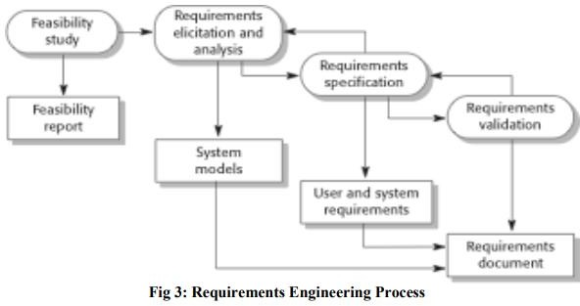
Requirements Engineering Process

