Slide 1
SOFTWARE ENGINEERING BASICS
GREESHMA K V
Assistant Professor Carmel College, Mala

Slide 2
INTRODUCTION
Software engineering is an engineering branch associated with development of software product using well-defined scientific principles, methods and procedures. The outcome of software engineering is an efficient and reliable software product.
Software Engineering Tutorial delivers basic and advanced concepts of Software Engineering.
Software Engineering provides a standard procedure to design and develop a software.

Slide 3
What is Software Engineering?
The term software engineering is the product of two words, software, and engineering.
The software is a collection of integrated programs.
Software subsists of carefully-organized instructions and code written by developers on any of various particular computer languages.
Computer programs and related documentation such as requirements, design models and user manuals.
Engineering is the application of scientific and practical knowledge to invent, design, build, maintain, and improve frameworks, processes, etc.

Slide 4
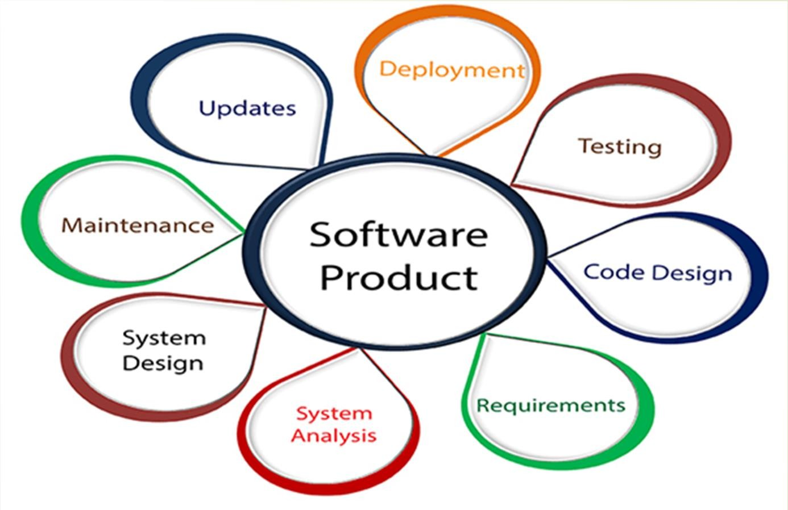

Slide 5
Importance of Software Engineering
Reduces complexity
To minimize software cost
To decrease time
Handling big projects
Reliable software
Effectiveness

Slide 6
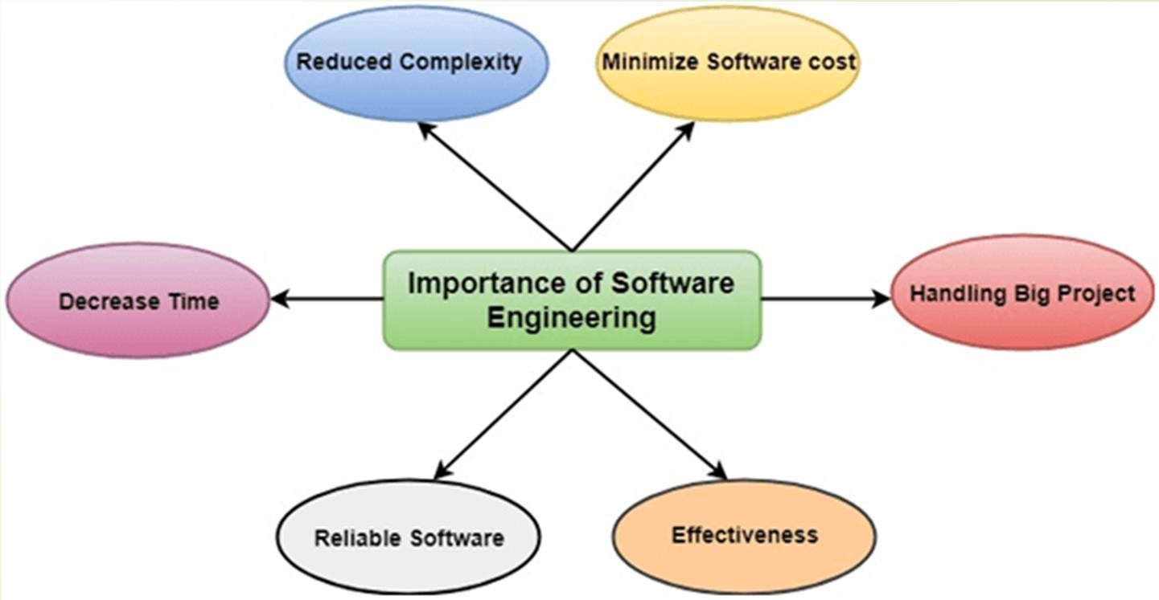
Importance of Software Engineering

Slide 7
THANK YOU

