Slide 1
Software Engineering Overview
GREESHMA K V
Assistant Professor Carmel College, Mala

Slide 2
SOFTWARE & ENGINEERING
Software is more than just a program code. A program is an executable code, which serves some computational purpose. Software is considered to be collection of executable programming code, associated libraries and documentations. Software, when made for a specific requirement is called software product.
Engineering on the other hand, is all about developing products, using well- defined, scientific principles and methods.

Slide 3
SOFTWARE DEVELOPMENT PROCESS TRANSFORMATIONS

Slide 4
SOFTWARE ENGINEERING
Software engineering is an engineering branch associated with development of software product using well-defined scientific principles,
methods and procedures. The outcome of efficient and reliable software product.
software engineering is an

Slide 5
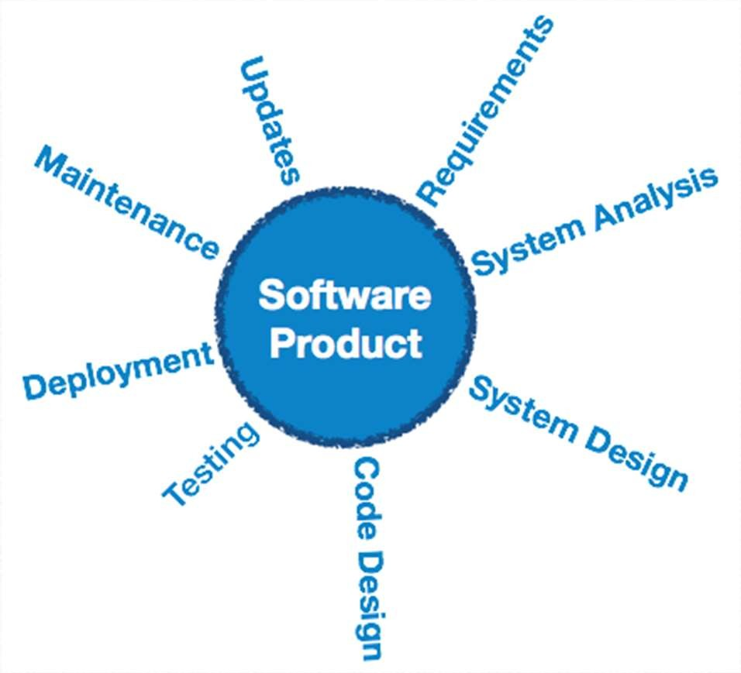
SOFTWARE PRODUCT

Slide 6
DEFINITION
Fritz Bauer's Early Definition of Software Engineering
“The establishment and use of sound engineering principles in order to obtain economically software that is reliable and works efficiently on real machines.”
IEEE defines software engineering as: (1) The application of a systematic,
disciplined, quantifiable approach maintenance of software;
to the development, operation and that is, the application
of engineering to software.

Slide 7
SOFTWARE EVOLUTION
The process of developing a software product using software engineering principles and methods is referred to as software evolution. This includes the initial development of software and its maintenance and updates, till desired software product is developed, which satisfies the expected requirements.

Slide 8
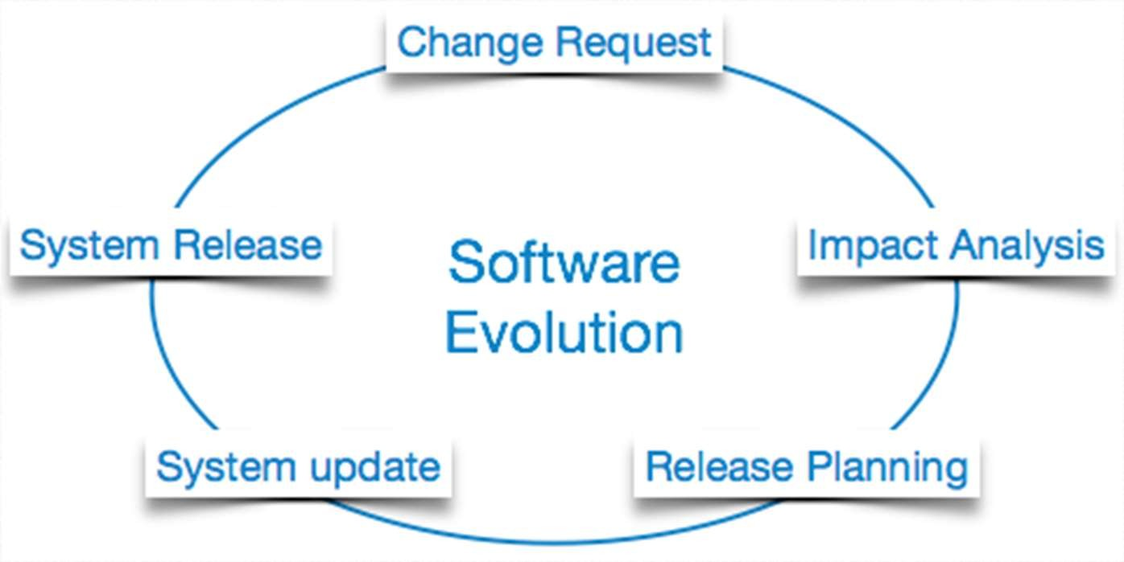
SOFTWARE EVOLUTION

Slide 9
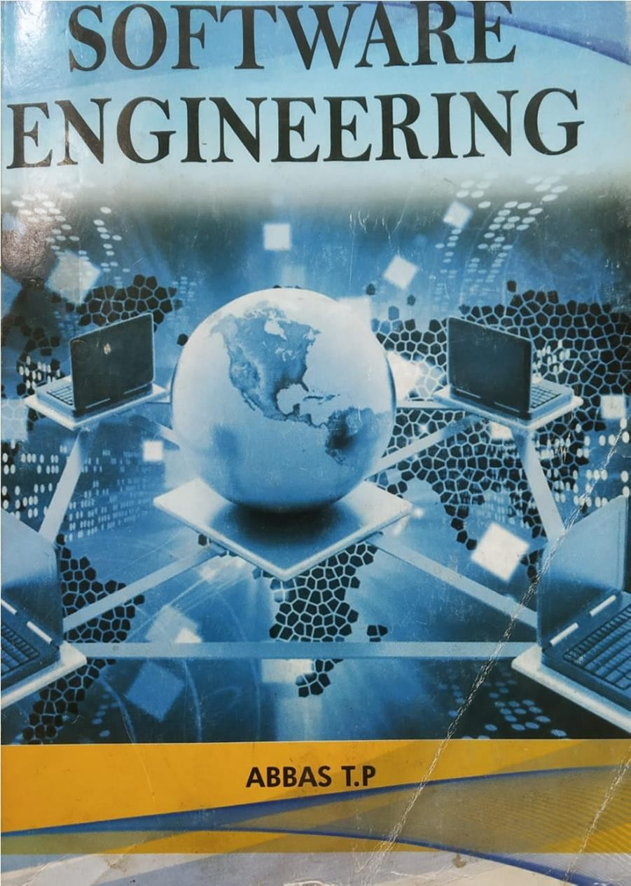

Slide 10
THANK YOU

