Slide 1
Dr. Femy K. Haneef Department of Botany Semester: PG- I Sem Subject: MICROBIOLOGY Date: 2/7/19

Slide 2
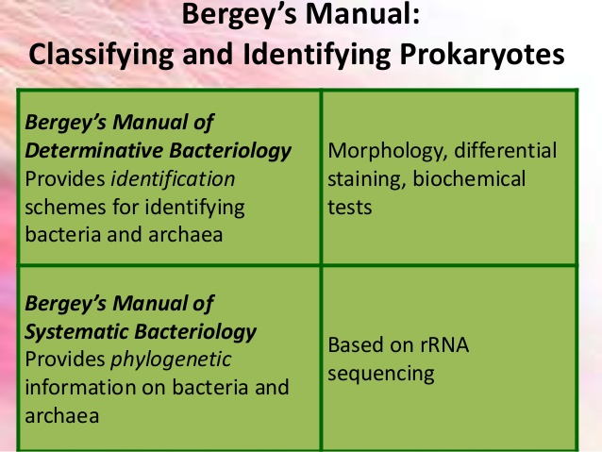

Slide 16
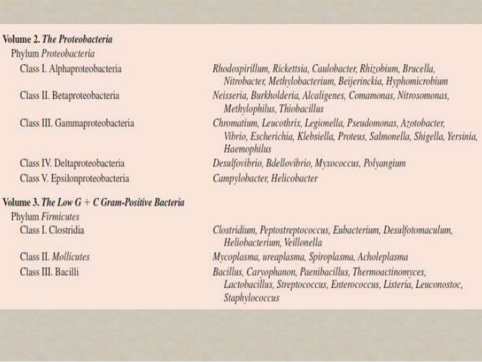

Slide 17
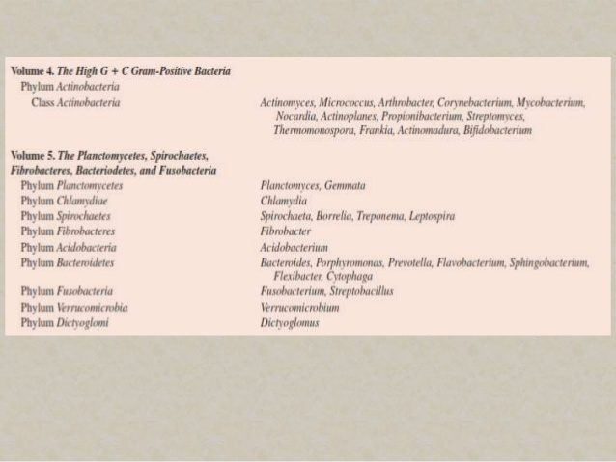

Slide 18
Thank you

