Slide 1
Plant virus
Dr. Femy K. Haneef Department of Botany Semester: PG- I Sem Subject: MICROBIOLOGY Date: 22/7/19

Slide 3
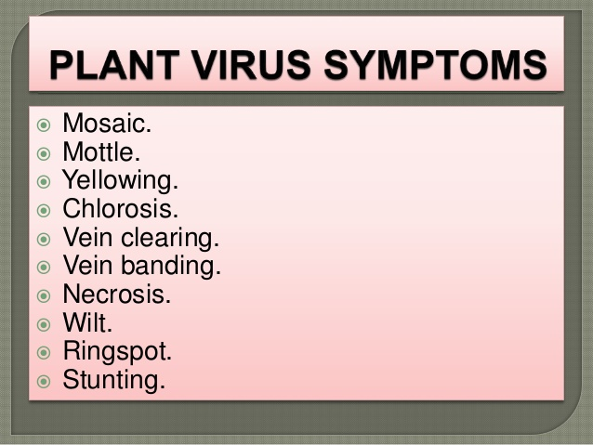

Slide 16
Thank you

