Slide 1
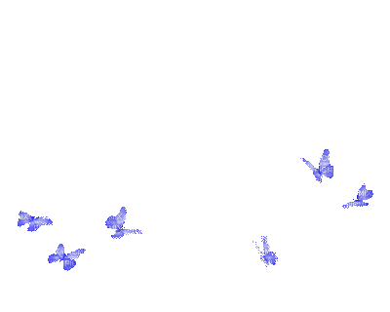
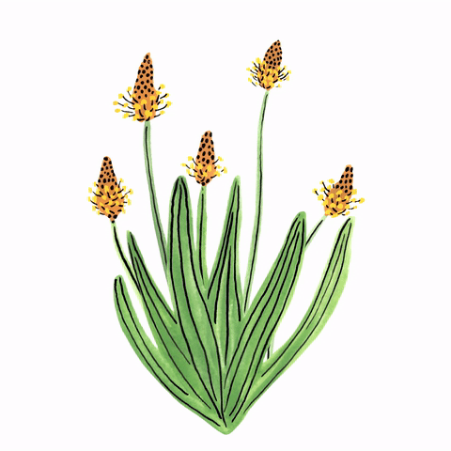
Pollination & Fertilization
Dr.Sr. Kochuthressia K P
PG Department of Botany

Slide 2
pollination
Pollination is the transfer of pollen from a male part of a plant to a female part of a plant, later enabling fertilisation and the production of seeds.
Most often by an animal or by wind.
Pollinating agents are animals such as insects, birds, and bats; water; wind; and even plants themselves, when self-pollination occurs within a closed flower.
Pollination often occurs within a species.
When pollination occurs between species it can produce hybrid offspring in nature and in plant breeding work.

Slide 3
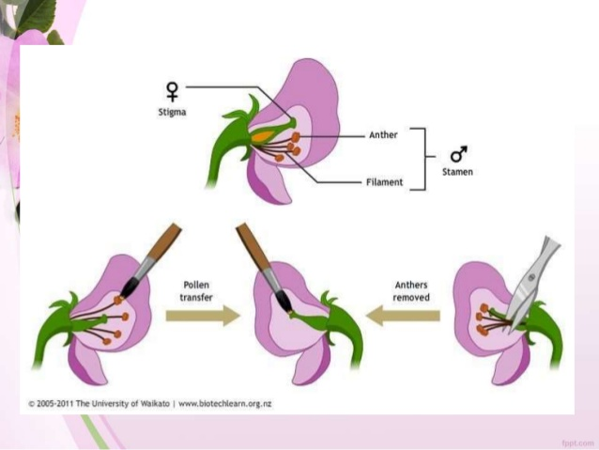
Types of pollination
Natural pollination : naturally occuring
Self pollination
Cross pollination
Artificial/ induced : hybridization

Slide 4
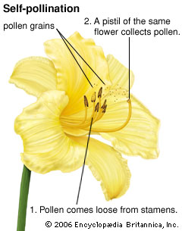
Self pollination
Self-pollination
Pollen from the anther is transferred to the stigma of same flower.
Common among cultivated plants, weeds and crop plants.

Slide 5
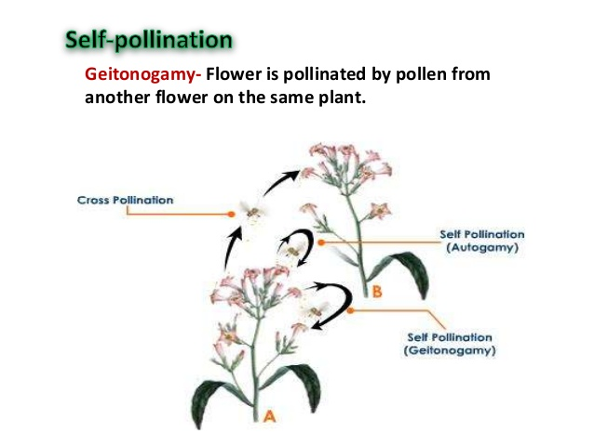
Types of self pollination
Autogamy : pollen grains are transferred from the anther to stigma of same flower.
Geitonogamy : pollen grains transferred from the anther of a flower to stigma of another flower in same plant.

Slide 6
Self pollination
Advantages
Disadvantages
Less dependence on external agents.
No wastage of pollen grains.
Greater reliability and least chance of failure.
Does not involve mixing of different genomes.
Does not promote genetic variability, adaptability and evolutionary potentials.
Production of weaker and less adapted plants.

Slide 7
Contrivances for self pollination
Homogamy
Simultaneous maturation of anthers and stigmas of same flower, or those of different flowers of same plant.
E.g., Mirabilis, Catharanthus, Argenemone
Cleistogamy
Closed nature of flower prevent cross pollination.
E.g., Commelina, Oxalis, Lycopus, Drosera

Slide 8
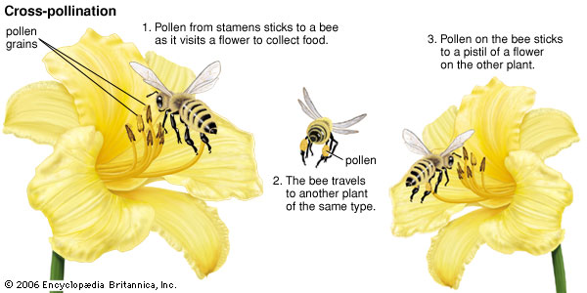
Cross pollination
Pollen from the anther of one plant is transferred to the stigma of a different plant.
Occure in unisexual as well as bisexual flowers
Xenogamy : between flowers of different genotype (genetically different plants).

Slide 9
Cross pollination
Merits
Demerits
Promotes genetic recombinations, variability, adaptability, survival value and evolutionary potentials.
Production of large, healthy, resistant and quickly germinating seeds.
Depends on external agents.
Has higher chance of failure.
Wastage of pollen grains.

Slide 10
Contrivances for cross pollination
Unisexuality /dicliny
Dichogamy
Self sterility / self incompatibility
Herkogamy
Heteromorphism
heterostyly

Slide 11
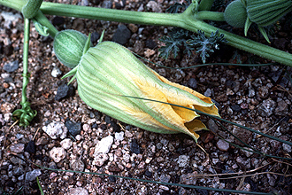
Unisexuality/ dicliny
Flowers are unisexual.
Male and female flowers born in different plants.
E.g., coconut, date palm, mulberry, cucumber
dichogamy
Maturation of period of androecium and gynoecium of same flower different.
Protandry : androecium mature first. E.g., sunflower
Protogyny : gynoecium mature first. E.g., michelia, annona, magnolia

Slide 12
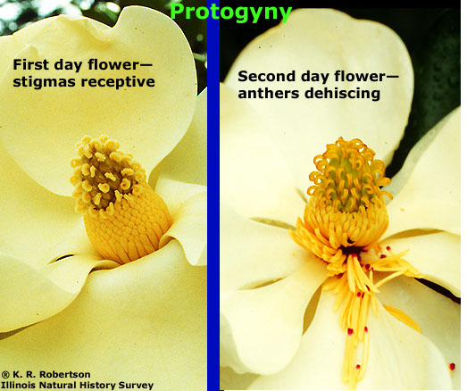
protogyny

Slide 13
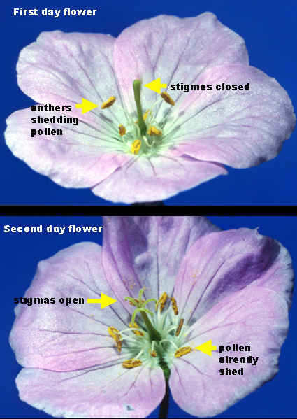
protandry

Slide 14
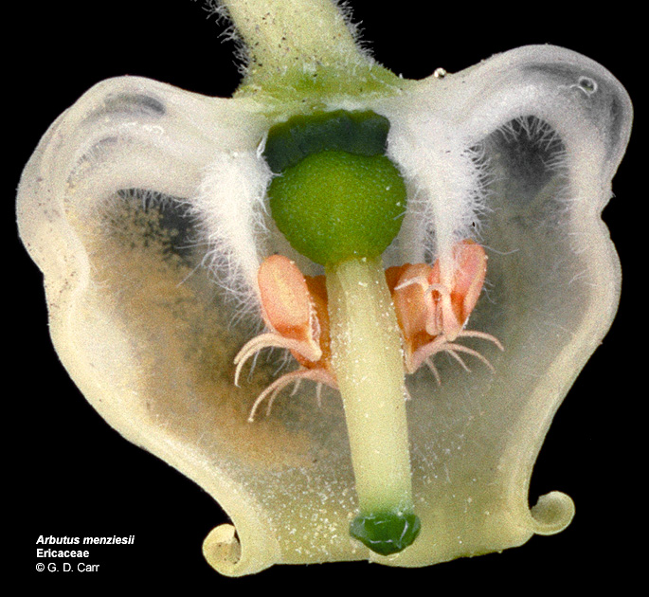
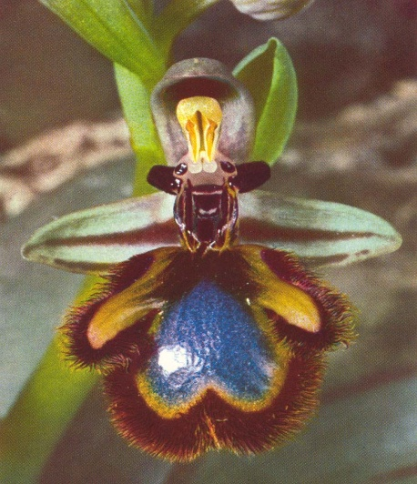
Self sterility/ self incompatibility
Stigma will be sterile to pollen of same flower but, fertile to pollen from another flower.
E.g., potato, tobacco, passiflora.
herkogamy
Prevention of self pollination by physical barriers in bisexual flowers in which maturation period will be the same for both sex organs.
E.g., Calotropis, Orchids etc.

Slide 15
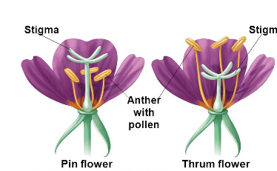
heteromorphism
This is the condition in which flowers of a plant are different in relation to the length of style and type of anther.
E.g., Oxalis, Jasminum
Heterostyly
heterandry
heterostyly
Dimorphic flowers- have styles of different length.
E.g., primula, polygonaceae, rubiaceae.

Slide 16
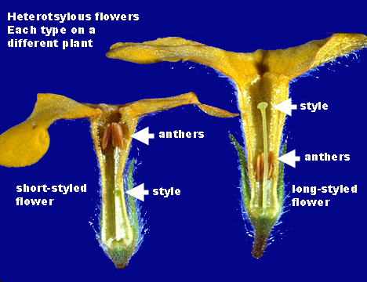

Slide 17
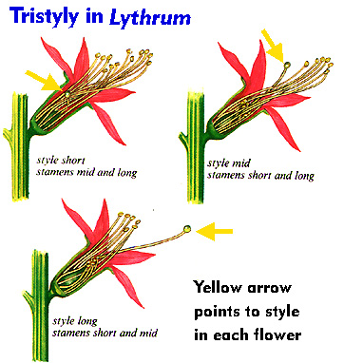

Slide 18
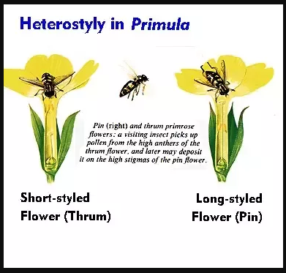

Slide 19
Methods of pollen transfer
Autogamy : self pollination in which Pollen from the anther is transferred to the stigma of same flower.
Geitonogamy : pollen grains transferred from the anther of a flower to stigma of another flower in same plant.
Xenogamy :cross pollination involves transfer of pollen grains from the anther to stigma of another flower of different plant of the same species but, not the clone.
Allogamy : the cross pollination involves transfer of pollen grains from anther to the stigma of another flower of same or a different plant of same species. Geitogamy + xenogamy.

Slide 20
Types of pollination

Slide 21
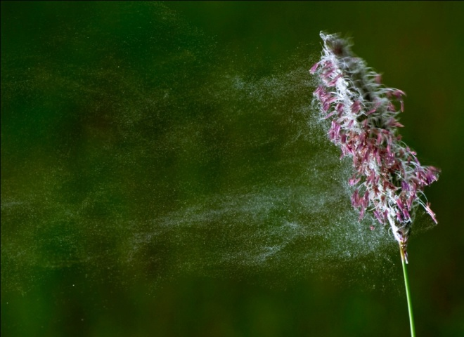
Anemophilly
Some 98% of abiotic pollination is anemophily, pollination by wind.
This probably arose from insect pollination, most likely due to changes in the environment or the availability of pollinators.
The transfer of pollen is more efficient than previously thought; wind pollinated plants have developed to have specific heights, in addition to specific floral, stamen and stigma positions that promote effective pollen dispersal and transfer.
E.g., pine, palm, maize, bhang, many grasses.

Slide 22
Adaptation of anemophilous flowers
Flowers very small, inconspicuous and unisexual.
Flowers not coloured, showy, scented and nectar producing.
Petals very small / absent.
Male flowers are more numerous than female flowers.
Anthers project out of corolla.
Large, branched and feathery stigma to catch pollen from air.
Pollen produced in large number to compensate heavy loss during wind transport.
Pollen – small, light weight, smooth walled and non sticky.
Winged pollen - pine

Slide 23
Wind Pollinated Flowers
Feature | Reason
small petals, often brown or dull green | no need to attract insects
no scent | no need to attract insects
no nectar | no need to attract insects
pollen produced in great quantities | because most does not reach another flower
pollen very light and smooth | so it can be blown in the wind
anthers loosely attached and dangle out | to release pollen into the wind
stigma hangs outside the flower | to catch the drifting pollen
stigma feathery or net like | to catch the drifting pollen

Slide 25
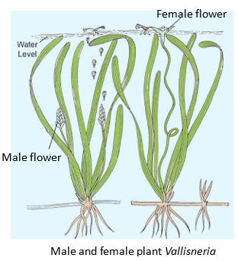
Hydrophily
Pollination by water, hydrophily, uses water to transport pollen, sometimes as whole anthers; these can travel across the surface of the water to carry dry pollen from one flower to another.
E.g., Zostera, Vallisneria, Hydrilla, Ceratophyllum, Najas.

Slide 26
Adaptations of hydrophilous flower
Flower small, inconspicuous without bright colouration, fragrance and nectaries.
Pollen grains sticky.
Stigma is funnel shaped and exposed well above the perianth to trap floating pollen.
If the female flower submerged pollen grains will be of higher mass than water.
If female flowers are floating gravity of pollen will be lower than water.
Gravity of pollen depend on amount of starch grain in it.

Slide 27
Types of water pollination
Epihydrophily /Surface pollination
Hypohydrphily /Submerged pollination
Transitional phase between wind pollination and true hydrophily.
Pollen floats on the surface and reaches the stigmas of the female flowers
Vallisnaria, Hydrilla, Callitriche, Ruppia, Zostera, Elodea, Potamogeton as well as some marine species.
Species exhibiting true submerged hydrophily include Najas, where the pollen grains are heavier than water, and sinking down are caught by the stigmas of the extremely simple female flowers, Posidonia australis orZostera marina and Hydrilla.

Slide 28
Epihydrphily in Vallisneria spiralis
Male and female flowers are submerged.
Unopened male flower floats to the surface of the water, and, upon reaching the surface, opens up and the fertile anthers project forward.
Female flower project to surface by uncoiling its stalk for pollination.
The female flower, also floating, has its stigma protected from the water, while its sepals are slightly depressed into the water, cup shaped corolla of female flower, allowing the male flowers to tumble in.
After pollination stalk of female flower recoil.
Fruit development take place under water.

Slide 29
Hypohydrophily of Ceratophyllum
Dioecious plant
Male flower- 12-16 stamens.
In each anther, there is a prolonged and double – horned aerenchymatous process which serves as a float.
When stamens separate from flower, they float upward.
Anthers rupture during this upward movement, releasing pollen.
Gravity of pollen is almost same as water
Pollens get freely distributed in water
Pollen caught on sticky lower surface of stigma
Pollination happens

Slide 30
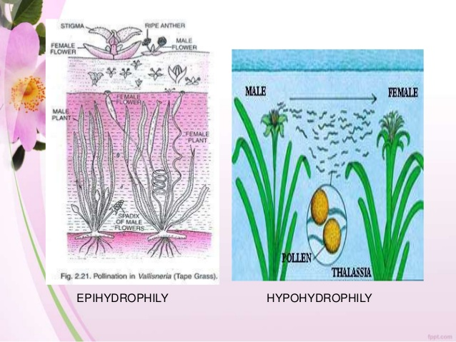

Slide 31
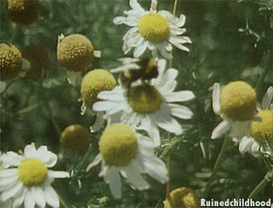
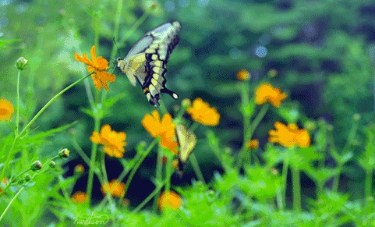
Entomophily
Insect pollination.
Pollinating agents : Moths, bees, butterflies, beetles etc.
Phalaenophily : moth
Psychophily : butterflies
Mellittophily : bees
Cantharophily : beetles

Slide 32
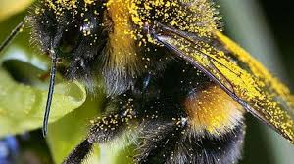
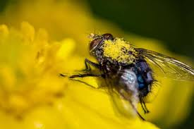
Entemophily pollen transport
Nototribic : on the back of insect
Sternotribic : on the underside
Pleurotribic : on the flanks
Pleurotribic
Nototribic

Slide 33
Insect pollinated flowers
Sometimes the corolla of insect pollinating flowers are very small, in such case certain other parts of flower become large and attractive.
E.g., attractive large bracts of Bougainvillaea, spathe of Musa
Some flower emit a strong odour at night, being pollinated by moths.

Slide 34
Insect Pollinated Flowers adaptations
Feature | Reason
large, brightly coloured petals | to attract insects
often sweetly scented | to attract insects
usually contain nectar | to attract insects
moderate quantity of pollen | less wastage than with wind pollination
pollen often sticky or spiky | to stick to insects
anthers firm and inside flower | to brush against insects
stigma inside the flower | so that the insect brushes against it
stigma has sticky coating | pollen sticks to it

Slide 35
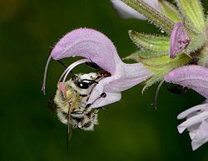
Staminal lever mechanism
Male digger bee probing a male-stage flower of Salvia hierosolymitana. The stamens deposit pollen on the bee's back.
It consists of two stamens and the two thecae on each stamen are separated by an elongate connective.
It is the elongation of the connective that enables the formation of the lever mechanism.
Sprengel (1732) was the first to illustrate and describe the nototribic (dorsal) pollination mechanism in Salvia. bilabiate corolla of the flower helps in pollination.
When a pollinator probes a male stage flower for nectar, (pushing the posterior anthertheca) the lever causes the stamens to move and the pollen to be deposited on the pollinator.
When the pollinator withdraws from the flower, the lever returns the stamens to their original position.
In older, female stage flowers, the stigma is bent down in a general location that corresponds to where the pollen was deposited on the pollinator's body.

Slide 36
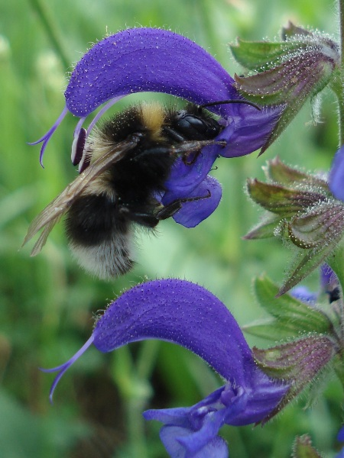

Slide 37
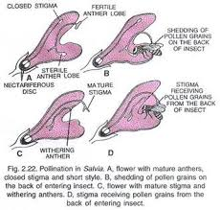

Slide 38
Life cycle of fig tree and relation to pollinator (fig wasp)
There are 2 types of fig trees.
One produces edible fruits and the other produces only small, hard and inedible fruits.
Receptacle is in the form of a hollow flask- shaped structure which opens externally through small terminal pore.
Later serves as incubator for larvae of pollinator.

Slide 39
Female wasp lays eggs inside ovary of female flower of inedible figs.
Eggs hatch into larvae → metamorphose to wasp.
Wasps eat their way out of ovary and mate inside .
Male wasp eventually dies.
Female wasp escape through pores.
Pollination happens.

Slide 40
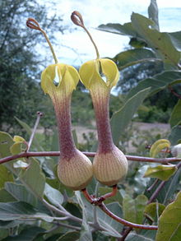
Trap pollination
pollination traps or trap-flowers are plant flower structures that aid the trapping of insects, mainly flies, so as to enhance their effectiveness in pollination.
The structures of pollination traps can include deep tubular corollas with downward pointing hairs, slippery surfaces, adhesive liquid, attractants (often deceiving the insects by the use of sexual attractants rather than nectar reward and therefore termed as deceptive pollination), flower closing and other mechanisms.
Ceropegia rhynchantha, trap flower

Slide 41
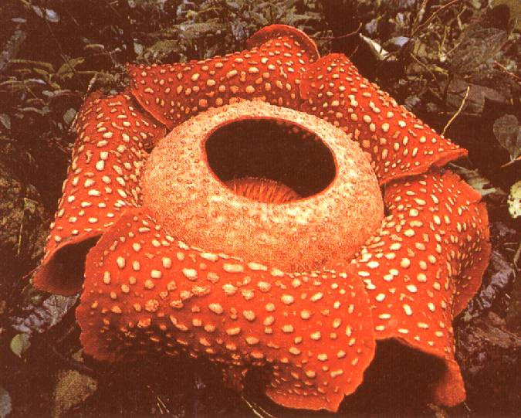
Slipper orchids have smooth landing surfaces that allow insects to slide into a container from which a window of light leads the insect outwards through a narrow passage where the pollen transfer occurs.
The structures found in large flowers such as those of Rafflesia and some Aristolochia are also evolved to attract and trap pollinators.

Slide 42
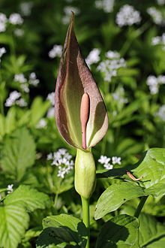
Trap-flowers that produce deceptive sexual chemicals to attract insects may often lack nectar rewards.
Many members of the genus Arum trap pollinators and the specific mechanisms vary with the insects involved.
Arum with trap chamber at base

Slide 43
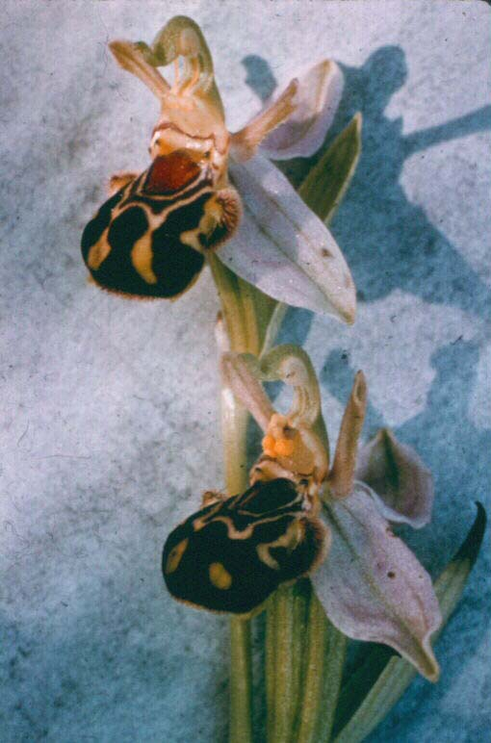
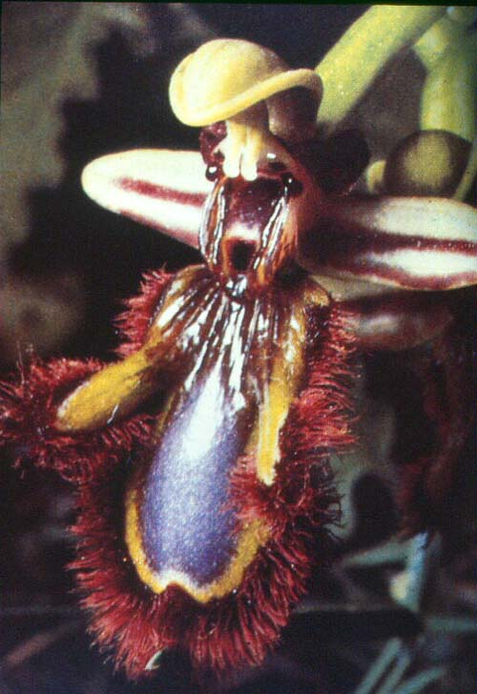
Sexual Mimics
Flowers that mimic female bees or wasps
Look like females
Smell like females: chemical mimicry.
Sexual mimic
orchids

Slide 44
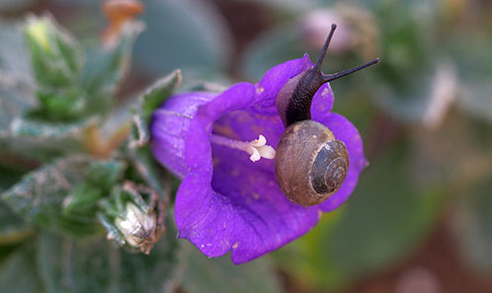
Malacophily
Snail pollination
The flowers of Colacasia –spadix
Snail visit flower attracted to the smell and colour of spathe.

Slide 45
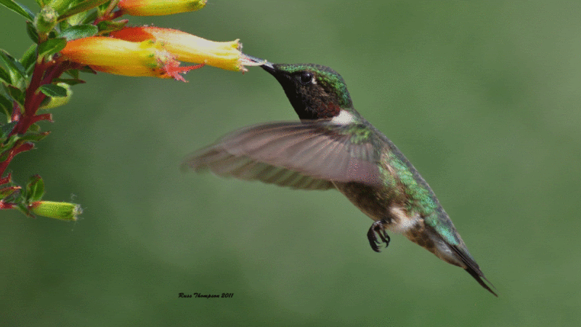
Ornithophily
Bird pollination
Pollinaters : sun bird, humming birds, etc.
Visit for nectar.
Specialization of flower:
Large size
bright colour
nectar producing
Long tubed with deep-seated nectaries
Funnel shaped corolla

Slide 46
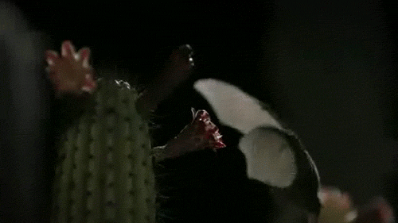
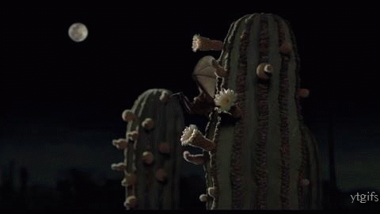
Chiropteriphily
Bat as pollinating agent.
Many tropical flowers are night-blooming, specializing in attracting bats.
flowers are typically white, cream, or pale green in color, making them easier to see in the dark.
They usually have a musky, fermented odor - like that of the bat - or sometimes a fruity odor. They have a large, sturdy, open shape with long, bushy anthers so that the bat's head and chest get coated in pollen when it visits.
In return for the bat pollinating the flower, the flower provides the nectar that these high-energy flying mammals need.

Slide 47
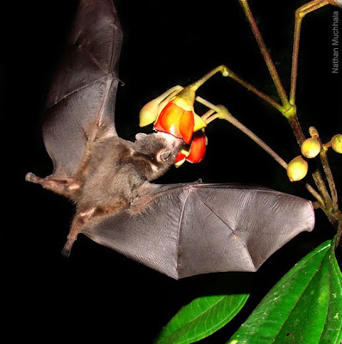
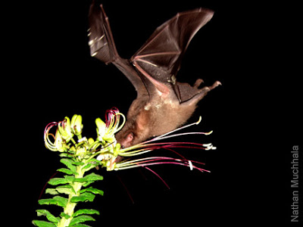
Bat pollinated species include banana, baobab, durian, and bread fruit.

Slide 48
Significance of pollination
Essential pre-requisite for fertilization, seed-setting and propagation.
Cross pollination promotes genetic recombination, genetic variation, adaptability, survival value and evolutionary potentiality.
Cross – pollination may result in the formation of healthy, resistant and highly yielding plants.
Pollination stimulates the growth of ovary, promotes fruit development and prevents the premature abscission of ovary.

Slide 49
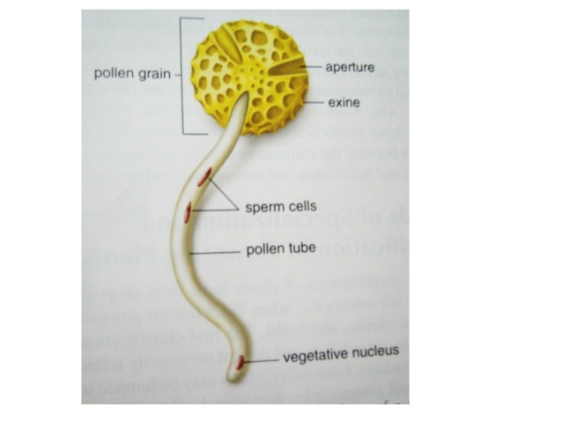
Pollen viability
Ability of pollen to deliver male gametes to embryo sac and also complete post pollination events and fertilization.
Quality of pollen often assessed based on their viability.
It is the index of the quality, vigour and vitality of pollen.
Duration of pollen viability varies with species.

Slide 50
Longevity of pollen may ranges from few minutes to few years.
It depends on taxonomic status of plant and the abiotic environmental conditions.
Loss of pollen viability may occur due to deficiency of respiratory substrate, inability to withstand desiccation, loss of membrane integrity, and so on.
Based on longevity, pollen grains of different species can be grouped under 3 categories
Short living pollen
Pollen with moderate life span
Long living pollen

Slide 51
Short living pollen
Pollen with moderate lifespan
long living pollen
Pollen with short period of viability.
E.g., Poaceae, Cyperaceae, Alismataceae, Junceaceae, Commelinaceae, Asteraceae, etc.
Pollen of Sorghum, wheat and several others lose viability with in 30minutes under dry condition.
Pollen with viability last for 1 to 3 months.
Solanaceae,
Rutaceae,
Cruciferaceae,
Liliaceae,
Ranunculaceae.
In many Gymnosperms.
Angiosperms: Leguminosae, Rosaceae, Anacardiaceae, Arecaceae etc.

Slide 52
Pollen pistil interaction
Pollen grains are deposited on the stigma either due to closeness of the anthers to the stigma or by pollinating agents (biotic or abiotic).
This unique feature brings about pollen-pistil interaction between the male gametophyte, the pollen grains, with the massive sporophytic tissue.
pollen grains landed on stigma, obtain nutrients from the stigmatic exudates and undergo germination.
During this pollen tube makes its way through the stylar matrix and ovary, gets into embryo sac, and discharge sperm cells.

Slide 53
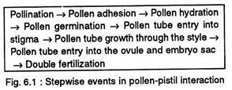
Pollen pistil interactions generate appropriate signals which elicit the specific responses in pollen and pistil.
A successful pollination brings about sequential events in the pollen-pistil interaction that ultimately ends up by the discharge of the male gametes in the embryo sac.

Slide 54
Significance of pollen pistil interaction
Play role in successful sexual reproduction and seed formation.
It is highly species specific- ensure reproduction within members of a species.
Pollen-pistil interaction is unique in flowering plants and plays a significant role in sexual reproduction and seed formation.
Screening and selection of male gamate for quality is achieved through pollen pistil interaction.

Slide 55
The pollen grains carrying the male gametes do not have a direct access to the female gamete.
Thus they need to be deposited on the stigma and it’s pollen tube has to grow through the massive sporophytic tissues of the stigma and style prior to release of male gametes near the egg.
The pistil has developed a unique mechanism to recognize pollen grains and thereby permit the growth of pollen tube in compatible cases.
Incompatible tube is thus effectively prevented from reaching the embryo sac.
The barrier to fertilization is restricted to the sporophytic tissues of the pistil.
At the same time there is no chance of unsuccessful fertilization ones the male gametes have been released near the egg.

Slide 56
Pollen pistil interaction - significance
In seed plants, male gametes are not released to the surrounding medium, as is done in lower plants and animals.
In them pollen grains act as vehicle for the transport or transmission of male gametes.
In gymnosperms, pollen grains are deposited in the pollen chamber and a short pollen tube is not directly involved in the transfer of sperms – it act as haustorium for drawing nutrients from surrounding sporophytic tissue of ovule.

Slide 57
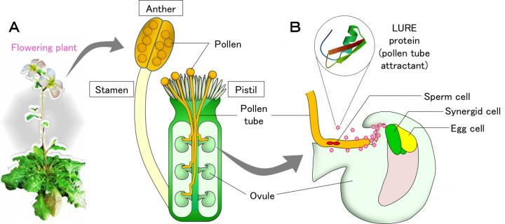

Slide 58
Fertilization
Fusion of male gamete with a female gamete.
pollination
Major stages of fertilization
Pollen tube extends through the style
Reaches the ovary
pollen germination
enters in to ovule
growth of pollen tube
gets in to embryo sac
discharge sperms to the vicinity of egg
entry of pollen tube in to ovule
Sperm 1 + egg
sperm 2 + secondary nucleus
zygote
primary endosperm nucleus

Slide 59
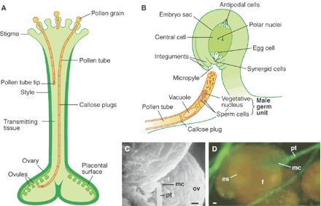

Slide 60
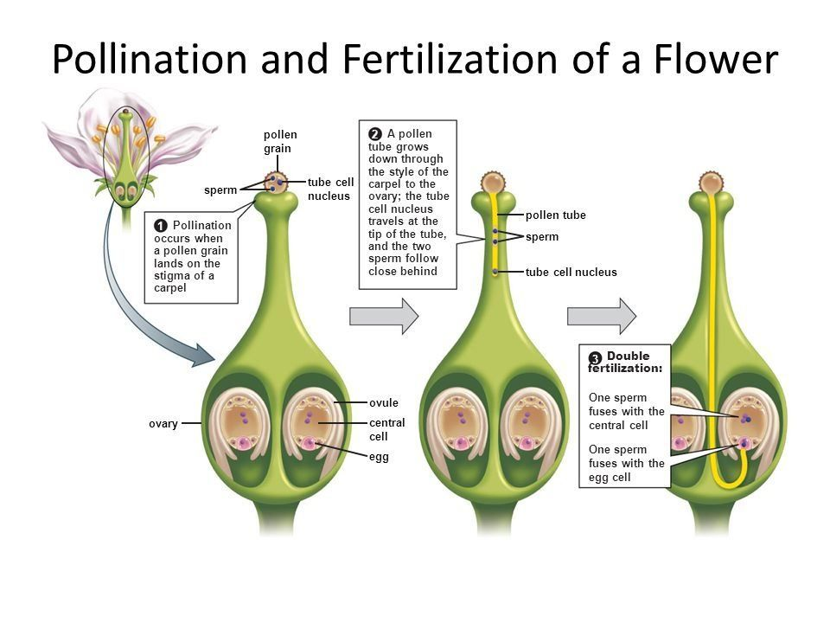

Slide 61
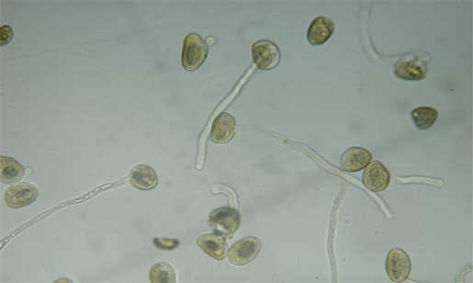
Pollen germination
Formation and growth of pollen tube.
Occur soon after pollen landed on stigma.
Epidermal cells of stigma secrete a fluid contains lipids, sugars, gums and resins.
It provide ideal medium for germination . Also stimulate production of male gametes.
Boron content of stigma and style also stimulate pollen germination.
Many enzymes : alkaline phosphatases, ribonucleases, esterase and amylase, present mostly below the aperture region of pollen helps in germination.
Stigmatic papillae, cutinase : helps in pollen tube penetration.
Cutinase degrade cutin on stigma.
Usually pollen grains are monosiphonous : produce only one pollen tube.
Pollen stigma interaction also help pollen germination. Which involves pollen recognition by stigmatic surface.
Incompatible pollen evoke rejection response by stigma

Slide 62
Growth of pollen tube
After Pollen germination pollen imbibes water, swells up and rupture.
Intine gives out germ tube through germ pore of exine grows down through stigma and style as long pollen tube.
Finally enters ovule.
Pollen tube secretes some enzymes – digest reserved food stored in stigma and style.
The digested food absorbed and utilized by pollen tube.
Growth of pollen tube is stimulated by auxins produced by gynoecium.
The tube is attracted to the ovule by chemicals - Chemotropic movement, negatively aerotropic.
Growth of pollen tube is primarily restricted to its tip where most cytoplasm concentrated.
Remaining part of pollen tube and pollen grain are occupied by vacuoles.

Slide 63
Cytoplasm is restricted to the tip of pollen tube by callose plug.
New plugs form continuously through out the growth.
Plugs grow and finally fill the tube.
Pollen tube wall – cellulose & pectin.
Chemotropic substances leach out of filiform apparatus of synergids and attract the pollen tube towards embryo sac.
In many case, entry of pollen tube into micropyle is facilitated by obturator on placenta and the funiculus/ integuments of ovule.
Once pollen tube is fully formed, the contents of pollen flows to it.
Generative cell divides mitotically, forming 2 motile male gametes.
Precocious germination :formation of male gamete before pollination. E.g., some cereals

Slide 64
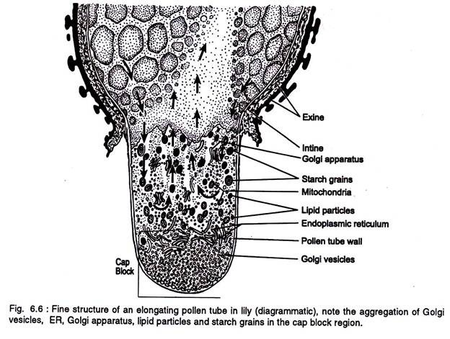

Slide 65
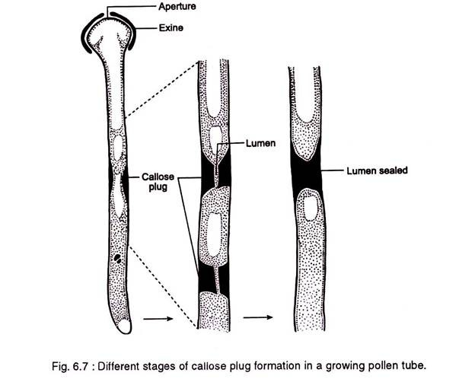

Slide 66
Entry of pollen tube in to ovule
Porogamy : entry through micropyle. Commonest method. It is believed that substance secreted by filiform apparatus responsible for porogamy. Also occur in embryo sac without synergids.
Chalazogamy : entry through chalazal end. E.g., Casuarina, Betula, Ostrya, etc.
Mesogamy : through integument. Usually enters the ovule along the side of integument close to placenta. E.g., Cucurbita, Populus.

Slide 67
Entry of pollen tube into embryo sac
Pollination ―›pollen tube entry to ovule ―› pollen tube growth through nucellar tissue ―› penetrate embryo sac through micropylar end.
Entry of pollen tube into embryosac
Between wall of embryo sac and one of the synergids
Between egg and one of the synergids
Between the two synergids
Directly into any one of the synergids

Slide 68
Usually only one single pollen tube enters the embryo sac.
In some instance 3-5 pollen tubes may enters the same embryo sac.
After entrance tip of the pollen ruptures, discharging whole contents to embryo sac.
Contents : cytoplasm, vegetative nucleus/ its remains and the two sperms.
1 male gamete + egg → diploid embryo zygote } true fertilization/ syngamy.
2nd male gamete + secondary nucleus (2n) → endosperm zygote/ primary endosperm (3n) } triple fusion
Together called double fertilization

Slide 69
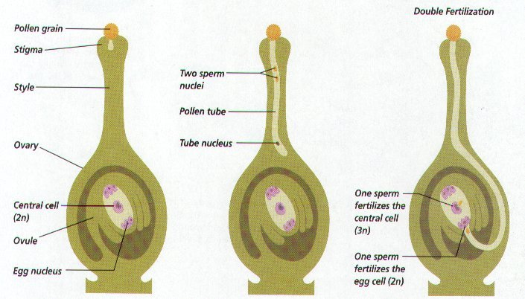

Slide 70
Double fertilization
In angiosperms there are 2 sexual fusions, one for the formation of embryo, and the other for the formation of endosperm.
First observed by Nowaschin in Lilium and Fritillaria.

Slide 71
X- bodies
After the discharge of pollen tube contents into embryo sac; 2 darkly stained bodies have been observed in the synergids, or in vicinity of egg apparatus.
Termed by Nowaschin.
They have been interpreted as decomposition products of vegetative nucleus, supernumery male gametes, or discharged cytoplasmic sheaths of male gametes.
Ultrastructure : contain DNA, and are therefore nuclei.
One of xbodies represent degenerated vegetative nucleus and the other remains of synergid nucleus.

Slide 72
Polyspermy
In many cases, more than 2 sperms are released into an embryo sac.
It may result either due to the presence of more than two sperms in a pollen tube or due to the entry of more than one pollen tube into embryo sac.
Polyspermy brings about the fusion of sperms with cells other than egg, such as synergids, antipodals, etc.
Results in the formation of more than 1 embryo.
Heterofertilization : sperms fusing with the egg and polar nuclei belong to different pollen tubes.

Slide 73
Sexual incompatibility
Mismatching between male and female flowers, gametes, or plants and the failure in producing seed after pollination.
Carpel bearing functional gametes, pollinated with viable and fertile pollen produce no seeds.
Interspecific incompatibility
Intraspecific incompatibility

Slide 74
Intraspecific/ self incompatibility
This is the sexual incompatibility between the members of the same species.
In large number of plants, successful fertilization takes place only by pollen from other plants.
Self incompatibility is an effective natural method to prevent self pollination.
Based on mating type morphology self incompatibility :
Homomorphic
Heteromorphic

Slide 75
Homomorphic self incompatibility : intraspecific incompatibility, occuring when all mating types of a species are morphologically similar. Such plants can be identified only by breeding test.
Heteromorphic self incompatibility : intraspecific incompatibility, occurring when 2 or more distinctly different morphological mating types are present within a species. Such types usually differ from each other in structure and position of stigma and anther.

Slide 76
Barriers to fertilization
Pollination : the diferent methods adopted by plants to check self pollination are dichogamy, hercogamy and unisexuality.
Progamic phase : the inhibition occurs at any stage from pollen germination to discharge of male gametes to the vicinity of egg.
On the stigma : pollen fails to germinate, or the pollen tube can not penetrate into stigma. E.g., Brassicaceae, Poaceae
In the style : pollen tube fails to grow through the full length of style. E.g., Liliaceae, Solanaceae

Slide 77
Physiology and biochemistry of sexual incompatibility
Physiology and biochemistry of sexual incompatibility is due to 2 reaction
Recognition : occurs at molecular level. Carpel recognizes whether a pollen grain is compatible and aceptable.
Rejection : starts with pollination. Occur either on stigma or in style. On stigma it inhibit pollen germination. In style it inhibit pollen tube growth.

Slide 78
Role played by pollen in sexual incompatibility
Pollen wall play great role.
Pollengrains on hydration, release some hydrolytic enzymes help in pollen stigma interaction.
Sexual incompatibility is associated with the recognition proteins that are held extra- cellularly in the pollen wall. These sporophytically and gametophytically derived proteins, held in pollen wall, are released on the hydration of pollen.
- Lewis et al.

Slide 79
Stigma surface inhibition
Since recognition and rejection reaction occur on stigma, direct introduction of pollen into style will yield normal fertilization.
Stigma is the barrier of pollen germination.

Slide 80
Stigmatic surface features
The rejection reaction exhibited by incompatible stigmas lack copious exudates. Stigma remains dry. These stigmas possess an extremely active and hydrated layer over cuticle – pellicle. Pellicle is composed of lipids and variety of proteins which have esterase activity.
Pollen, after landing on stigma, stimulates the exudation of water by papillate cells. In return, the hydrated stigma stimulates the outflow of exine bound proteins.

Slide 81
The released exine proteins are received by the pellicle proteins and exine proteins, resulting in incompatible reaction.
Stigma-rejection reaction with an incompatible pollen is the appearance of the callose plugs just below the pollen contact point. Rejection reaction of stigma is absolutely localized and will not inhibit the germination of neighbouring pollens.

Slide 82
Stylar inhibition
Reasons
Cells of the style secrete some specific proteins which induce incompatibility reactions.
In plants like Nicotiana alata, high activity of peroxidase-10 can be seen in styles with incompatible pollen tubes. It can be persumed that peroxidase 10 has a role in rejection reaction.

Slide 83
In Petunia hybrida, the degeneration of tube cytoplasm and the thickenings of the walls of pollen tube are indicative of incompatibility.
In Lilium longifolium, tip of pollen tube with incompatible styles shows different structure. It is unable to absorb the secretion of pistil, and exhibit retarded growth.
Lycopersicon peruvianum exhibit high RNAase activity in its incompatible styles. This RNAase enters pollen tube cytoplasm and checks the growth of pollen tube.
Incompatible style also shows various types of abnormal behaviour, such as branching of tip of the pollen tube, development of callose plugs, restricted growth of pollen tube, etc. These also indicate incompatibility due to stylar inhibition.

Slide 84
Post fertilization changes
Embryogeny : Zygote / oospore undergoes mitotic divisions and develops to a multicellular embryo.
Primary endosperm nucleus divides repeatedly and give rise to the endosperm to supply nourishment to the developing embryo.
Embryo sac expands to accommodate developing embryo and growing endosperm.
Nucellus gets mostly used up by embryo, and its remnant forms perisperm. Now, the whole space inside integument becomes filled with endosperm and embryo.

Slide 85
Outer integument of ovule becmes testa, and the inner one becomes tegmen. Together form seed coat.
Ovule develops to seed, integuments form seed coat, ovary becomes fruit, ovarian walls forms fruit wall/ pericarp.
Funiculus persists, or fall off leaving scar on seed, called hilum. Sometimes ridge may be formed on seed – raphe
Corolla, stamens, style and stigma fall off. Calyx may persists or fall off.

Slide 86
