Slide 1
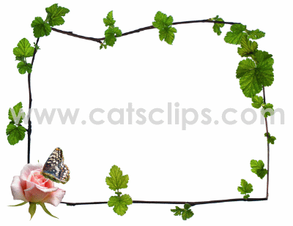
Embryo development
Reproductive Botany
Dr.Sr. Kochuthressia K P
PG Department of Botany

Slide 2
Embryo development
Embryogeny
Predetermined, genetically programmed and metabolically regulated development of the embryo from the zygote.

Slide 3
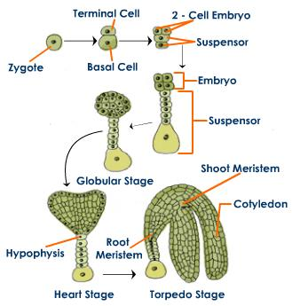
Embryogeny in Angiosperms
Zygote (2n)
2 celled pro-embryo
terminal cell
Basal cell
embryo
suspensor
Cordate embryo

Slide 4
Function of suspensor : to push embryo in to endosperm for absorbing nutrients.
Polyembryony : development of more than one embryo inside an embryo sac. It is common among gymnosperms.

Slide 5
Changes in zygote
Embryonic development starts from syngamy.
Zygote then enter in to a state of dormancy.
Length of dormancy varies with species.
Large vacuole in zygote starts shrinking.
Zygote decreases in size.
It cause accumulation of cytoplasm at chalazal end. First division of zygote occur there.
Towards the end of dormancy, number of ribosome, dictyosome, polysomes get increased.
Dictyosome helps for wall formation.
Polysome helps for protein synthesis and metabolism.
After dormancy zygote is ready to divide.

Slide 6
Changes in zygote after dormancy
Zygote is highly polarised and isolated cell.
Completely enveloped by zygote wall.
Plasmodesmatal connection with neighbouring cells become blocked.
Nucleus is surrounded by plastids and mitochondria.
The nucleus occupies the chalazal end.
Micropylar region gets occupied by vacuoles.
Cell organelles are very few.

Slide 7
Embyogenesis
First division of zygote is transverse and unequal.
It results small apical cell and large basal cell.
Apical cell projects into the emryo sac.
Basal cell lies close to micropyle.
In loranthaceae first division is longitudinal.
In some first division is oblique.
From this stage to differentiation of organs it is called pro-embryo.

Slide 8
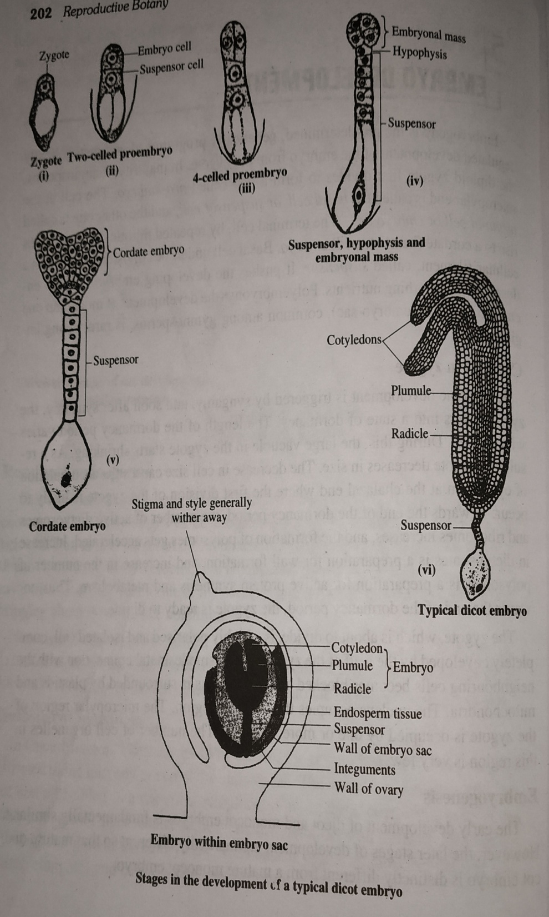
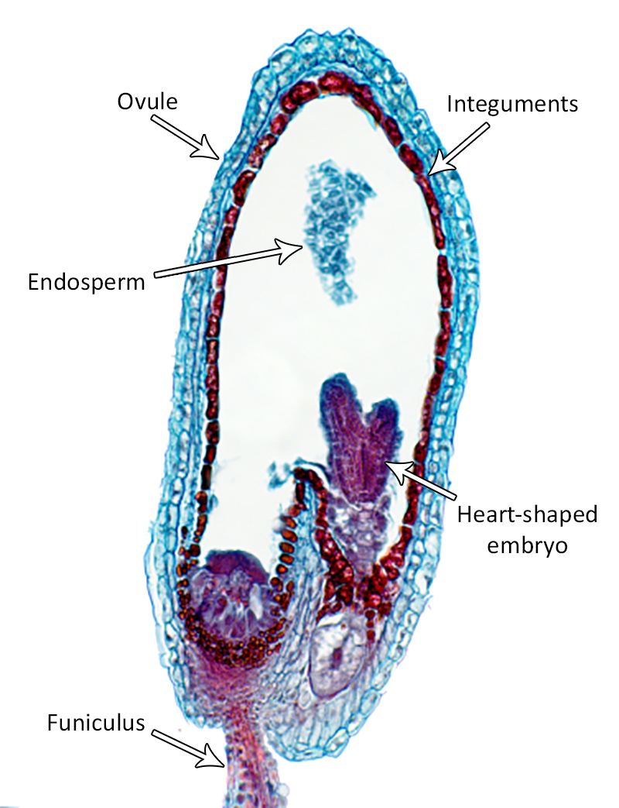

Slide 9
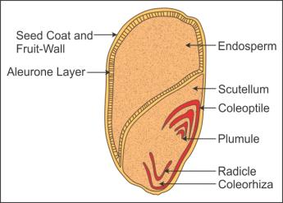
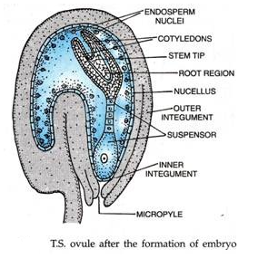
Fully formed embryo
Fully formed embryo consists of elongated embryonal axis and 1 or 2 cotyledons.
Scutellum :The cotyledon of monocots is shield like.
Cotyledons : acts as food depots. They grow using endosperms. Endosperm disappear.
Cotyledonary node : point of attachment of cotyledon to embyonal axis.
Epicotyle : portion of axis above cotyledonary node.
Hypocotyle : portion of axis below cotyledonary node.

Slide 10
Plumule : upper tip of epicotyl. Shoot primodium.
Radicle :lower tip of hypocotyl. Root primodium.
The developing emryo remains embedded in growing endosperm, and both this remains within nucellus.
Exalbuminous/ exendospermous seeds: seeds without endosperm. Pea, gram, groundnut, mustard etc.
Albuminous/ endospermous seeds: seeds with endosperm. Castor, coconut, rubber, cereals, etc.
Perisperm : unused nucellus.

Slide 11
Embryo development in dicotyledons
Changes in 2- celled pro-embryo Apical cell of pro-embryo divides transversely/ longitudinally. Basal cell may remain undivided/ divide transversely.
On the basis of cellular changes in embryo at 4- celled configuration differ.

Slide 12
Types of embryogeny reported by Maheswari(1950)
Crucifer/ onagard type : brassicaceae, srophulariaceae, ranunculaceae, annonaceae, onagraceae, etc.
Asterad type : asteraceae, balsaminaceae, vitaceae, etc.
Solanad type : solanaceae, companulaceae, linaceae, etc.
Caryophyllad type : crassulaceae, caryophyllaceae, fumariaceae, etc.
Chenopodiad type : chenopodiaceae, boraginaceae, etc.

Slide 13
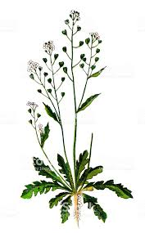
Development of dicot embyo -Capsella type
Hanstein and Famintzin(1870)
Zygote divides in a transverse plane to form terminal cell and basal cell .
2- celled pro-embryo formed.
Basal cell divides transversely to form two longitudinal cells.
Terminal cell divides vertically to form longitudinal cells.
4- celled pro-embryo formed.
Quadrant stage : Two terminal cells then divide vertically to first division, resulting 4 cells.

Slide 14
All 4-cells divide to form 8-celled octant stage.
4 upper epibasal/ anterior octants & 4 lower hypobasal/ posterior octants.
Octants become 16- celled stage through periclinal division.
8 outer cell >>> dermatogen
8 inner cell >>> outer periblem and central plerome
Periblem >>>cortex
plerome >>>stele

Slide 15
Basal cells >>> suspensor
Suspensor pushes embryo to endosperm.
Upper cell of suspensor >>> haustorium
Lower cell is known as hypophysis.
Upper and lower initial cells divides to form root cap, root epidermis, cortex and radicle.

Slide 16
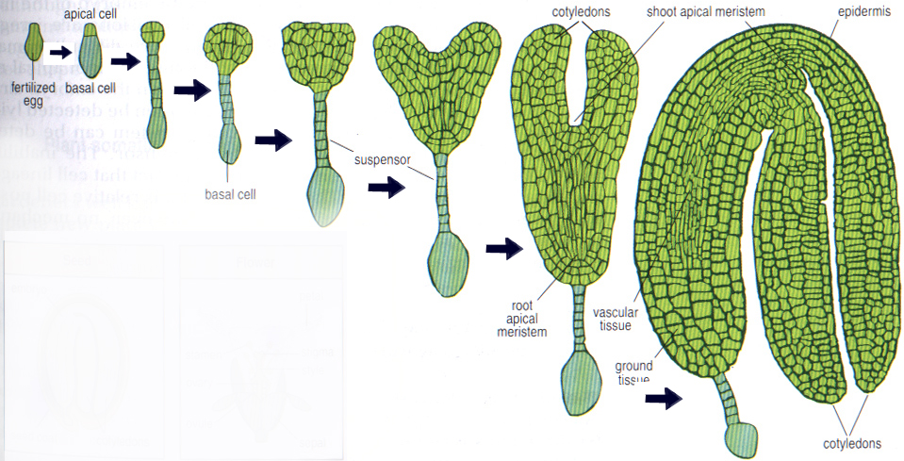
Globular embryo >>> cordate heart shaped embryo >>> horse shoe shaped embryo

Slide 17
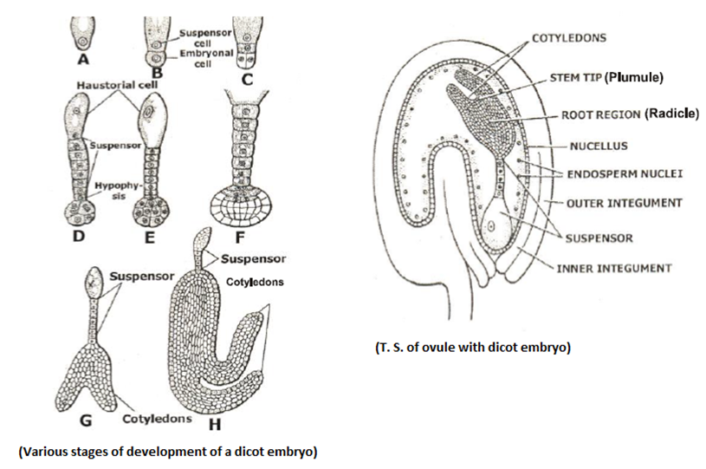

Slide 18
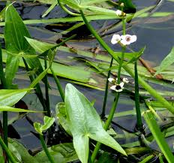
Monocot embryogenesis Sagittaria type
Embryonal axis has 1 lateral cotyledon.
Development is similar in dicot and monocot up to globular stage.
Then number of cotyledons differentiate both.
A few dicotyledons such as Ranunculus ficaria and some members of Apiaceae, have single cotyledon.

Slide 19
Structure of monocot embryo in the mature seed is complex than mature dicot embryo.
There are 4 stages in monocot embryogenesis.
Pro-embryo stage
Globular stage
Scutellar stage
Coleoptile stage

Slide 20
Zygote
transverse division
apical/terminal cell
large basal cell
Divide transversely
Enlarges
3-celled pro-embryo
vesicular cell
lower cells
Middle cell
upper cell
transverse division
vertical division
upper cell
lower cell
Quadrant stage
Transverse division
hypocotyl, root tip, suspensor
lateral shoot apex
octant stage
periclinal division
8 outer cells
8 inner cells
dermatogen
periblem
plerome

Slide 21
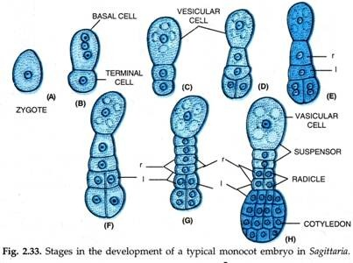

Slide 22
Differences between dicot and monocot embryos
Dicot embryo
monocot embryo
2 lateral cotyledons
Plumule is distal and located symmetrically between cotyledons.
2 diagonally opposite cells of terminal quadrant give rise to cotyledons
Plumule is terminal and coleoptile and coleorrhiza are absent.
1 terminal cotyledon
Shoot apex occupies laterally, cyllindrical embryo and cotyledon is terminal.
Cotyledon formed by 2, 3, or all 4 cells of terminal quadrant.
Plumule is lateral surrounded by coleoptile, radicle by coleorrhiza.

Slide 23
Polyembryony
Development of more than one embryo inside an embryo sac. It is common among gymnosperms.
In normal development additional embryos will degenerate sooner or later.
In some plants it persists.
citrus, mango etc.

Slide 24
Classification of polyembryony
True polyembryony : multiple embyos are formed in the same embryo sac.
False polyembryony : multiple embyos are formed in different embryo sac in same ovule.
Cleavage polyembryony : multiple embyos are formed by cleavage of zygote or zygotic embryo.
Adventive polyembryony : multiple embyos are formed asexually from somatic tissues out side embryo sac along with sexual embryos.
Polyembryony in which multiple embyos are formed from the embryo sac cells, other than egg cells.

Slide 25
Cleavage polyembryony
Zygote divides irregularly to form a mass of cells. The cells are at chalazal end grows to form multiple embryo
Pro-embryo gives out small buds which functions as embryos.
Filamentous embryos become branched and each branch becomes embryo.

Slide 26
Development of embyos from the embryo sac cells, other than egg cells
Emryos develops in 3 ways.
Develops from synergid cells.
Develops from antipodal cells.
Develops from endosperms.

Slide 27
False polyembryony
multiple embyos are formed in different embryo sac in same ovule.
Emryos develops in 3 ways.
As the derivatives of same megaspore mother cells.
As the derivatives of 2 or more megasporic mother cells.
As the derivatives of nucellar cells : apospory

Slide 28
Adventive polyembryony
Development of embryos from extra- embryo sac tissue, out side embryo sac.
It can develop from maternal sporophytic tissues: nucellus & integument.
Common in Citrus & Mangifera.
In Citrus Adventive polyembryony results from proleferation of nucellar cells. Nucellar embryos then pushed in to embryo sac.
Presence of endosperm promote development in micropylar end, but represses in chalazal end.

Slide 29
Causes of polyembryony
Necrohormone theory: (Haberlandt-1922) hormone released by degenerating cells of nucellus stimulate development of Adventive polyembryony.
Recessive gene theory: (Leory-1946) monoembryonic condition is due to dominant gene, whereas polyembryony due to recessive gene.
Hybridization : (Baker-1960) polyembryony due to Hybridization.
Age, nutritional state, fruit set& branching pattern:(Frusato)
Hormone: ethanol, IAA, ABA &GA influence in citrus.

Slide 30
Parthenocarpy
Means virgin fruit
Natural/ artificial production of seedless fruits with or without pollination and fertilization.
Stenospermacarpy: seeds are actually produced, but are soon aborted at early stage of development.
Natural parthenocarpy occurs as mutation, pollination by other species without fertilization. Banana, guvava, papaya, tomato, etc.
Artificial parthenocarpy: gene manipulation, application of low Con. Of synthetic growth – promoting substances: auxins gibberellins, cytokinins,NAA, etc. . Grapes, orange, water melons, etc.

Slide 31
Based on natural stimulation parthenocarpy is 2 types.
Stimulative : requires pollination/ natural stimulations.
Vegetative : no requirement of stimulation. Seedless cucumber

Slide 32
Significance of parthenocarpy
Some fungivorous birds and mamals prefer seedless fruits. This serves as decoy defence against seed predation.
The ability of plants to produce seedless fruits, when pollination is unsuccessful, is advantageous in that it can provide food for seed-dispersers. In absence of a fruit crop, seed dispersing animals may starve, or may migrate to other place. This adversely affect seed dispersal.
Desirable trait of edible fruit. Commercially important.
Advantageous to crops in which pollination and fertilization are difficult.

