Slide 1
FOSSIL PTEREDOPHYTES
Ms. Gopika V D
PG Department of Botany

Slide 2
Principles of Paleobotany & Importance
Source of fossils
Fossil plants in the classification of vascular plants
Paleobotany-study of fossils......live million yrs ago-now extinct
▪Source of fossils-
➢Igneous rocks
➢Sedimentary rocks
➢Metamorphic rocks

Slide 3
Volcanoes lava magma
Igneous rocks
Sedimentary rocks
Chemical changing
Metamorphic rocks

Slide 4
Sedimentary rocks
bears
Plant fossils

Slide 5

Layer
STRATUM
Layers
STRATA sing LURE
STRATigraphy

Slide 6
STRATigraphy
LITHO-STRATigraphy
CHRONO--STRATigraphy
BIO--STRATigraphy
POLLEN---STRATigraphy

Slide 7
FOSSIL
4.6 BILLION YRS AGO EARTH-----
670 MIL.YRS AGO VEGITATION
FOSSIL-------WORD-------LATIN------FODERE-------DIGOUT

Slide 8
METHODS OF FOSSIL FORMATION
FORMATIONS DEPENDS
➢DECAY
➢HYDROLYSIS
➢MECHANICAL ACTION
➢ACTION OF WATER
➢WIND
➢SOURCING OF SAND
➢ROLLING STONE
➢ANTICEPTIC SUBSTANCES
➢TEPMRATURE

Slide 9
❖ Butaminous coal
Lignite
Anthracite
Carbon
Petroleum
Marine
Phyto, Zoo, Nano planktons
Hydrocarbons

Slide 10
Classification of vascular plants
Angiosperms---
Mono, dcotyledons
Gnetales, coneferals, cordaites, Ginkgoals, cycadeoidales, cycadels, Pteredospermae
Pteropsida
Gymnosperms---
Spermatophyta

Slide 11
Filicineae
Filicineae ---
Filicales, Marattials, ophioglossiales, Coenopteridales,
Pteridophyta

Slide 12
Sphenopsida- Articulatae
Sphenopsida- Articulatae Equisetales,
Calomitales, Sphenophyllales, Pseudoborniales, Heynials
Pteridophyta

Slide 13
Lycopsida
Lycopsida
Isotales,
Pleuromeiles, Lepidodendrales, Selaginellales, Lycopodials.
Pteridophyta

Slide 14
Silopsida
Silopsida
Silotales,
Silophytales.
Pteridophyta

Slide 15
ANCIENT VASCULAR PLANTS
The “embryophytes” (bryophytes + tracheophytes
= Kingdom Plantae, if chlorophyte algae are excluded as in our text) are thought to be monophyletic and evolved from an organism resembling Coleochaete. The exact evolutionary relationships of the major groups are unknown, as they can not be reconstructed from available fossils or living organisms.

Slide 16
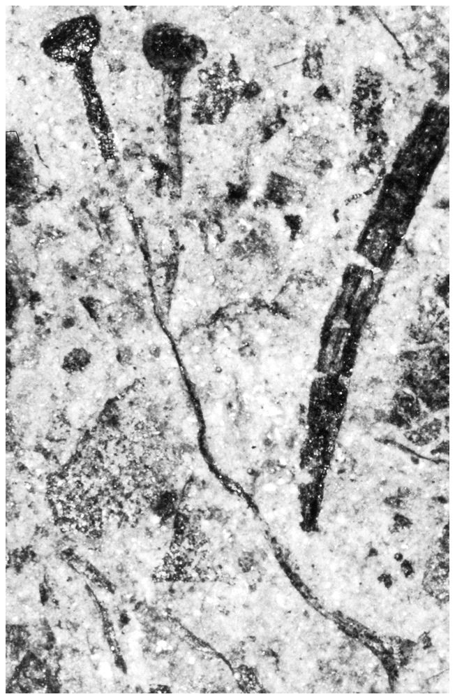
The oldest vascular plant
The oldest known vascular plant is Cooksonia, from the late Silurian (414-408 MYA). At this time, so much was happening that the transitions to vascular plants must have arisen earlier, but not been preserved, or not yet discovered. This fossil is from New York state.

Slide 17
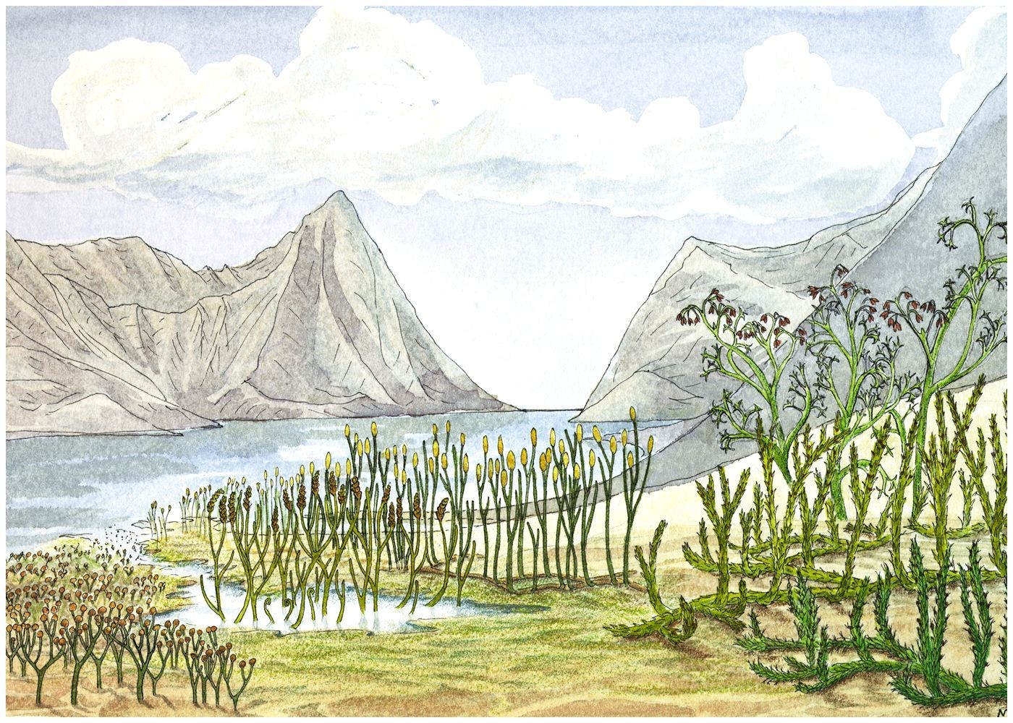
On the right are later (middle Devonian) plants: one trimero- phyte (rear) and two Lyco- phytes.
Cooksonia, Zosterophyllum, Aglaophyton ^{Psilophyton}
Drepanophycus Protolepidodendron
[Ordovician? to Silurian colonizers]

Slide 18
"Protracheophytes"
Developing vascular systems didn’t happen all at once
From the early Devonian are fossils of Aglaophyton (formerly placed in Rhynia). These are not vascular plants (unlike true Rhynia, which is), and are now sometimes called "Protracheophytes". Their vascular tissues contain cells resembling the hydroids of mosses (not tracheids).

Slide 19
Where were they found?
Cooksonia, Aglaophyton, Rhynia and many other plant fossils of the early Devonian (ca. 400 MYA) are found preserved (petrified, or mineralized) in chert (SiO₂ =
quartz, flint, agate, etc.) in Rhynie, Scotland. A similar formation occurs in Labrador, Canada.

Slide 20
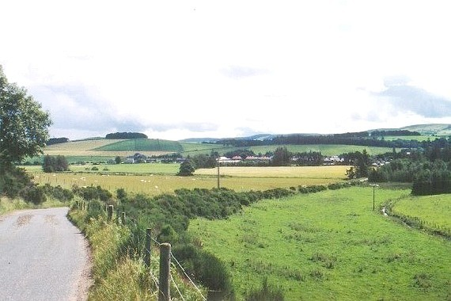
Near Rhynie, Scotland (photo from http://www.xs4all.nl/~steurh/ by Hans Steur, Ellecom, The Netherlands

Slide 21
Cooksonia [see Fig. 17-1]
Cooksonia was erect and dichotomously branched, with terminal sporangia. Note: this and all subsequent vascular plant fossils are sporophytes; in most cases the gametophyte stage is unknown, which limits our ability to determine their evolutionary relationships.

Slide 22
Rhynia and Agalaophyton [see Fig. 17-2]
Rhynia (Rhyniophyta) and Aglaophyton (protracheophytes) had erect, photosynthetic branches (dichotomously branched) from prostrate (absorptive, mycorrhizal with Glomeromycota - endomycorrhizae) branches (rhizomes, with rhizoids), had stomata on cuticularized surfaces, and terminal, elliptical sporangia. Aglaophyton ("Rhynia") major was 50 cm tall!

Slide 23
On the right are later (middle Devonian) plants: one trimero- phyte (rear) and two Lyco- phytes.
Cooksonia, Zosterophyllum, Aglaophyton ^{Psilophyton}
Drepanophycus Protolepidodendron
[Ordovician? to Silurian colonizers]

Slide 24
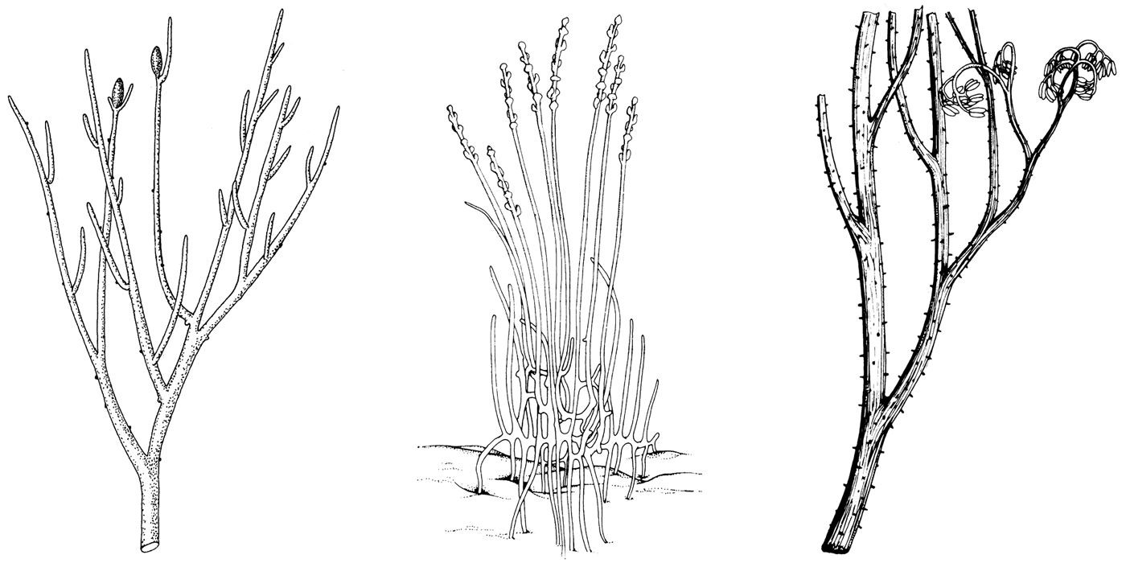
Left to right: Rhynia (Rhyniophyta), Zosterophyllum
(Zosterophyllophyta) and Psilophyton (trimerophyes)

Slide 25
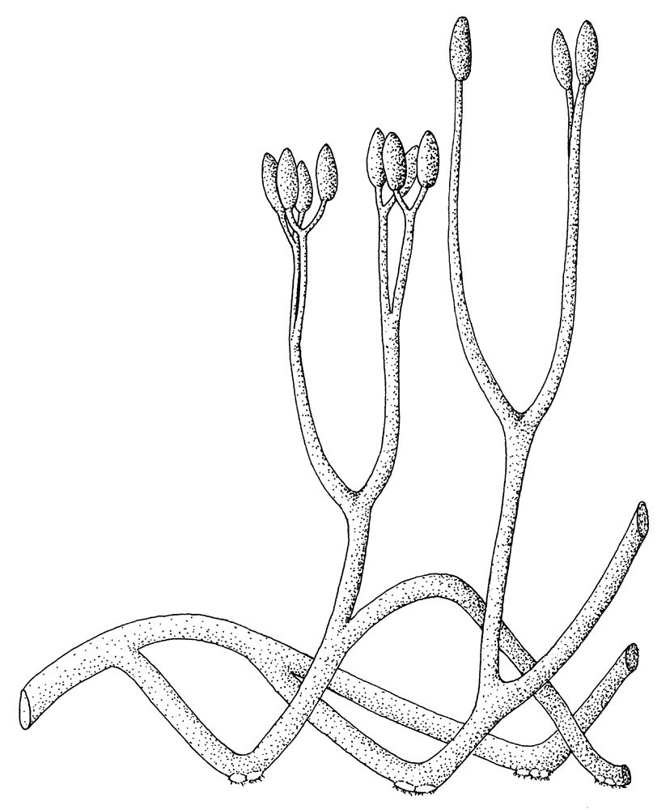
Aglaophyton (Rhynia) major (protracheophytes)

Slide 26
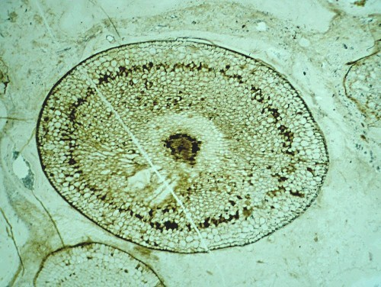
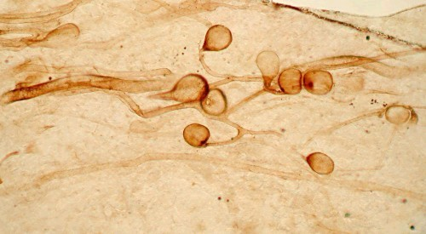
http://www.xs4all.nl/~steurh/engrhyn/eglomit.html#glomites
This is a fungus of the genus Glomites, which lived in symbiosis with Aglaophyton and Rhynia. The fungus was living in the dark ring visible in the transverse sections of the stems. It is a relative of the the extant fungus Glomus.
Aglaophyton major. Diameter 4 mm. Groningen. The lightcolored cells around the central strand formed the phloem. In the dark ring 3 or 4 cells from the epidermis lived a symbiotic fungus.
Hans Steur, Ellecom, The Netherlands

Slide 27
Zosterophyllophyta
Zosterophyllophyta (e.g., Zosterophyllum, Sawdonia) were also found in early Devonian (408-370 MYA)
had lateral, not terminal, sporangia that opened laterally, like purses
they also had rhizomes and rhizoids, and were mycorrhizal with Glomeromycota.

Slide 28
On the right are later (middle Devonian) plants: one trimero- phyte (rear) and two Lyco- phytes.
Cooksonia, Zosterophyllum, Aglaophyton ^{Psilophyton}
Drepanophycus
[Ordovician? to Silurian colonizers]
Protolepidodendron

Slide 29
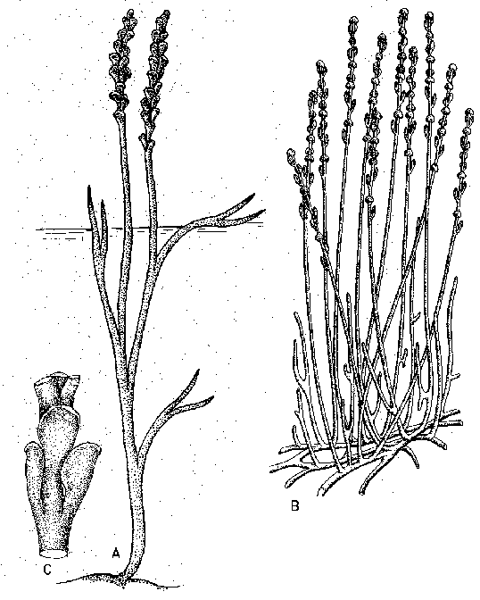
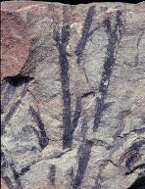
Zosterophyllum (left) and Sawdonia (below)

Slide 30
Lycophyta (clubmosses):
turn up in the late Silurian-Devonian (414-380 MYA, e.g., Drepanophycus and Baragwanathia, Asteroxylon), and have both microphylls and axillary sporangia
Lycopods became trees ca. 390-290 MYA and were the dominant components of Carboniferous vegetation (340 MYA) and left beautiful fossils, then the tree forms disappeared during Permian, to be replaced by Lycopodium (200 spp.), Selaginella (700 spp.) and Isoetes (75 spp.), which are nowhere really dominant.

Slide 31
On the right are later (middle Devonian) plants: one trimero- phyte (rear) and two Lyco- phytes.
Cooksonia, Zosterophyllum, Aglaophyton ^{Psilophyton}
Drepanophycus Protolepidodendron
[Ordovician? to Silurian colonizers]

Slide 32
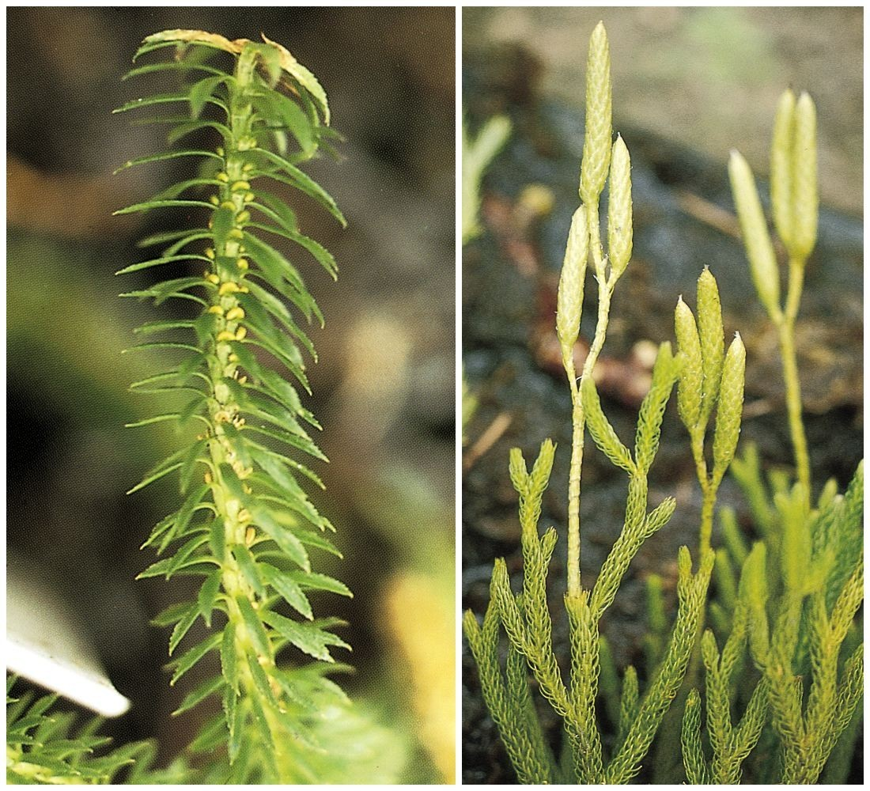

Slide 33
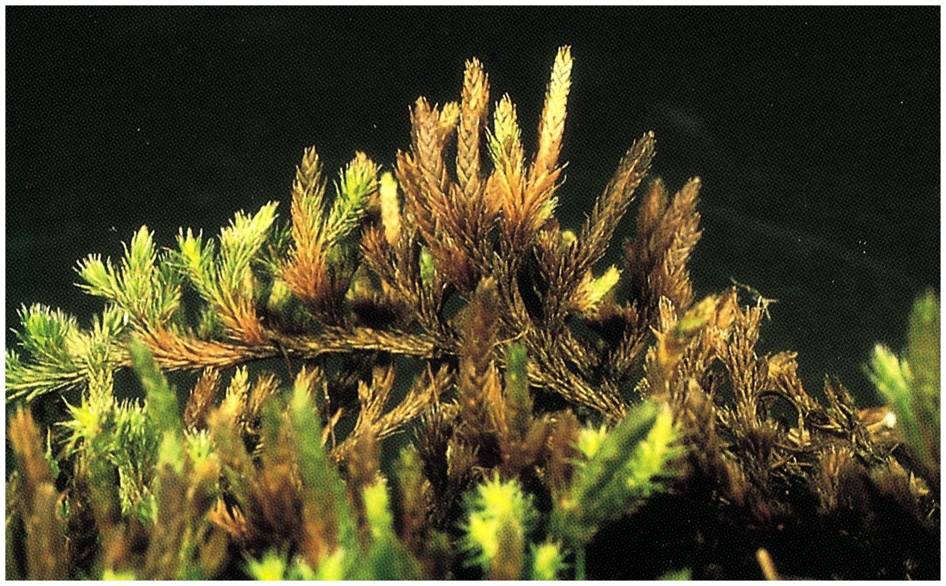

Slide 34
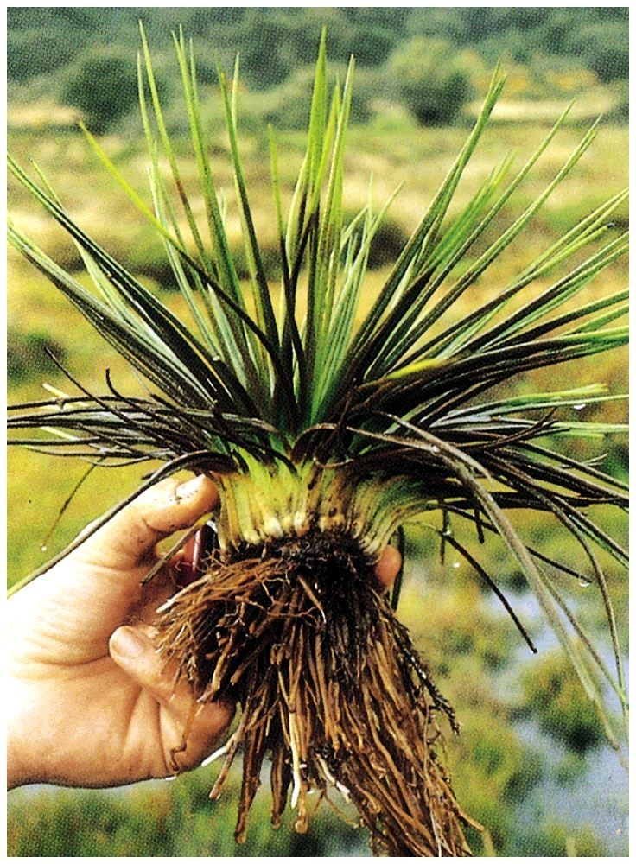

Slide 35
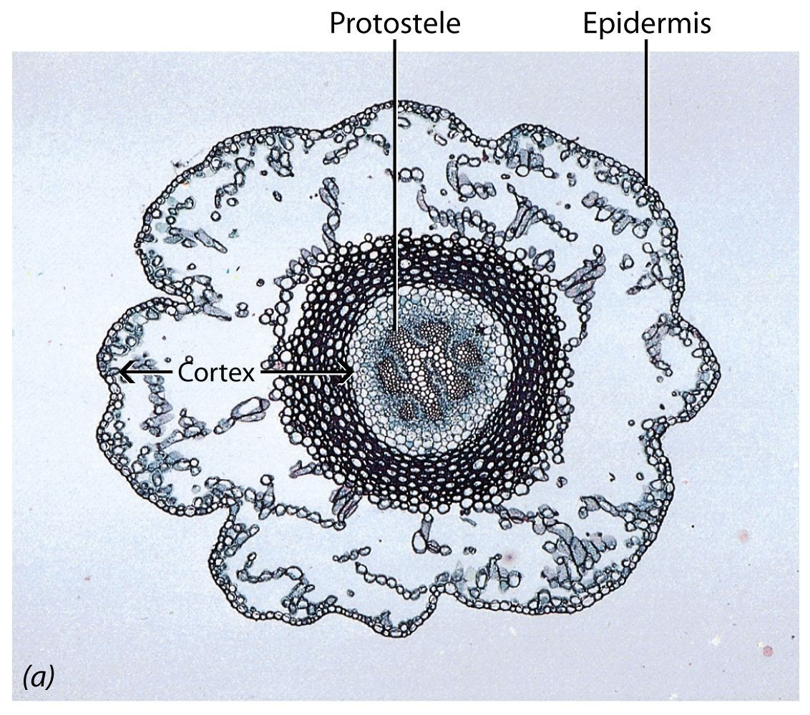
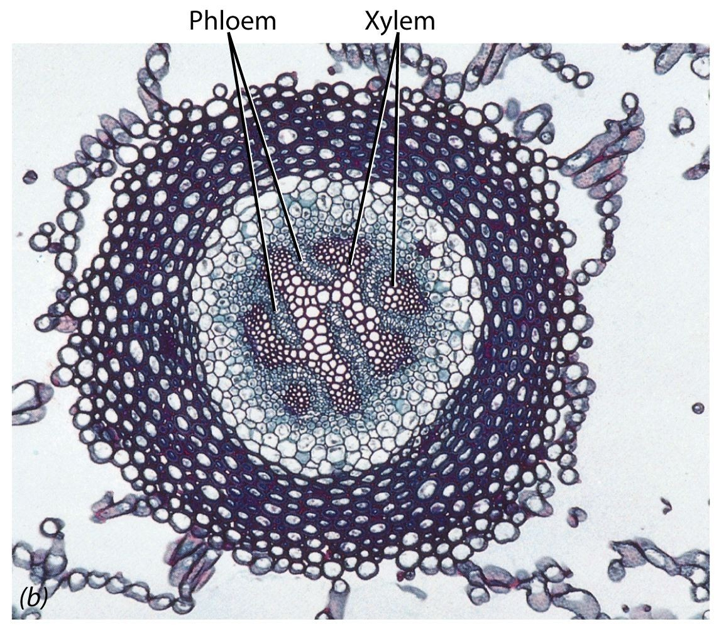
Protosteles showing phloem and xylem in a living representative of the Lycopodiaceae, Diphasiastrum complanatum

Slide 36
Lepidodendrales
Tree lycopods are known as Lepidodendrales (e.g., Lepidodendron and Sigillaria), some were up to 45 m tall (vs. tallest trees of present day, the redwoods at 100m; tallest Ontario trees, white pines, are 40m); trunks were close and formed dense forests (some disagreement with Fig. 18-1). Cones of Lepidodendron are called Lepidostrobus, and roots are called Stigmaria (see caption to Fig. 18-1, "stigmarian roots"), but they are all one plant.

Slide 37
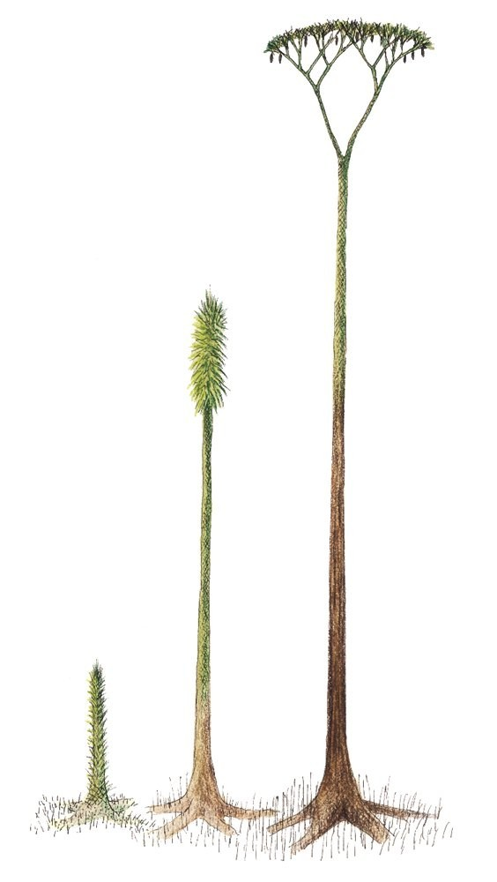

Slide 38
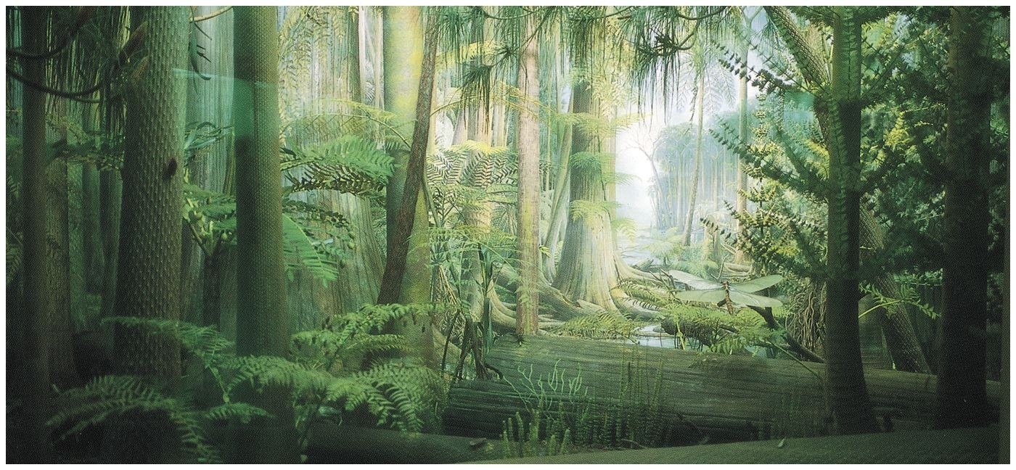
Reconstruction of a Carboniferous period (~340 MYA) swamp forest

Slide 39
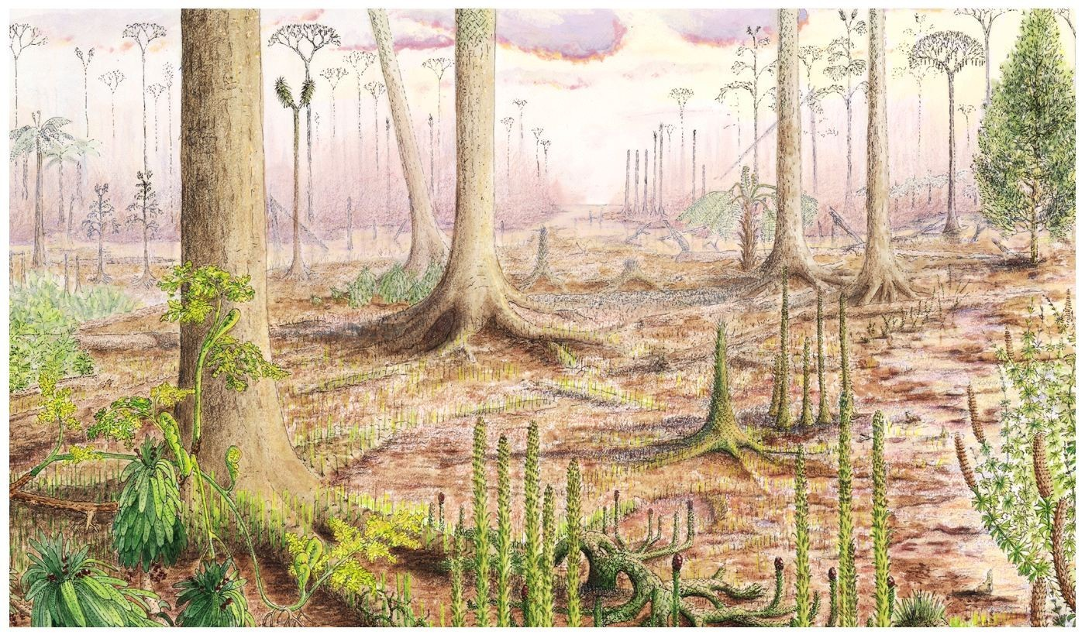

Slide 40
Trimerophytes
•
Trimerophytes (e.g., Psilophyton) are on the "other branch" (vs. Rhyniophytes) that leads to the ferns, horsetails and seed plants.
These were more monopodial, with lateral branches that branched freely and di- or even trichotomously.
These lasted only 20 MY during the Devonian (395-375 MYA.
Psilophyton was described by Dawson (a quack) from the Gaspé of Canada; he made a composite description from 3 unrelated fossil bits, one of which turned out to be a zosterophyll.
Psilophyton dawsonii was named after him.
•
•
•

Slide 41
On the right are later (middle Devonian) plants: one trimero- phyte (rear) and two Lyco- phytes.
Cooksonia, Zosterophyllum, Aglaophyton ^{Psilophyton}
Drepanophycus Protolepidodendron
[Ordovician? to Silurian colonizers]

Slide 42
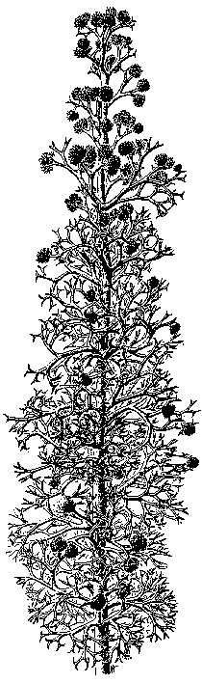
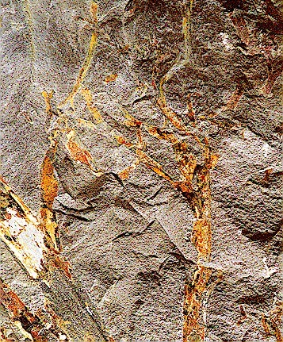
Pertica quadrifaria: Maine's State Fossil

Slide 43
Equisetales (horsetails)
Equisetales [= Sphenophyta (= Equisetophyta)] also date back to the Devonian; our new edition now places them in the Pteridophyta
Counting fossils, there were once 5 orders and 12 genera, now only 1: Equisetum, with 15 species worldwide!
The stem is the dominant organ; it is jointed at nodes, where there are scale-like leaves, at first photosynthetic, soon drying to brown. Stem is high in silica, and photosynthetic; may be branched (horsetails) or unbranched (scouring rushes).

Slide 44
Equisetales II
Stem contains a eustele between nodes, but siphonostele, with no leave gaps at nodes (therefore, leaves are microphyllous). During the late Devonian and Carboniferous periods (370-300 MYA), the tree-like Calamites was a dominant member of the forests (see Fig. 20-1), along with Lepidodendron and Sigillaria (lycopods).

Slide 45
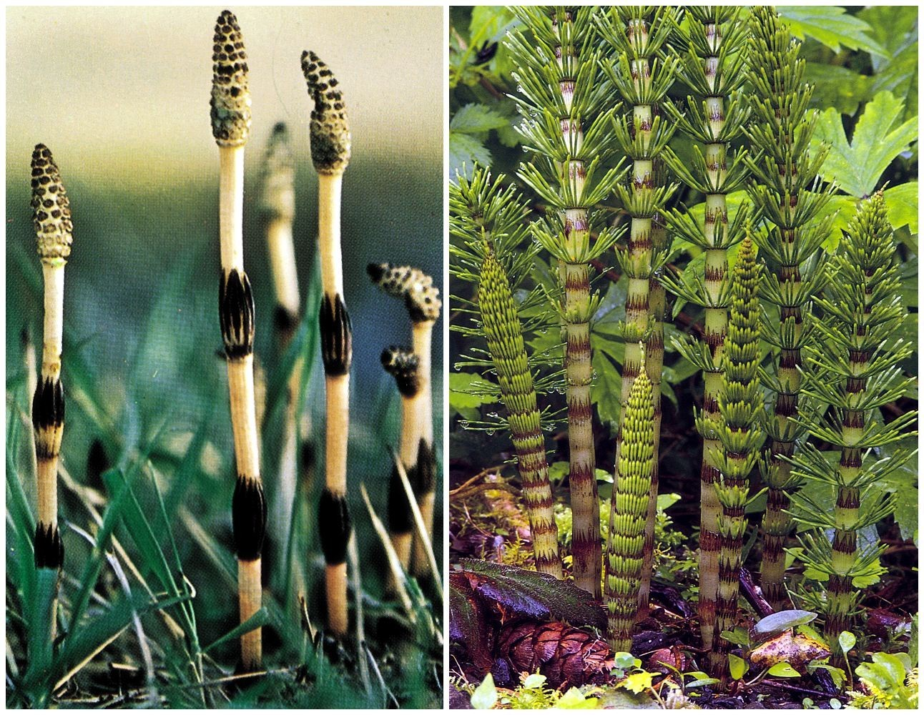

Slide 46
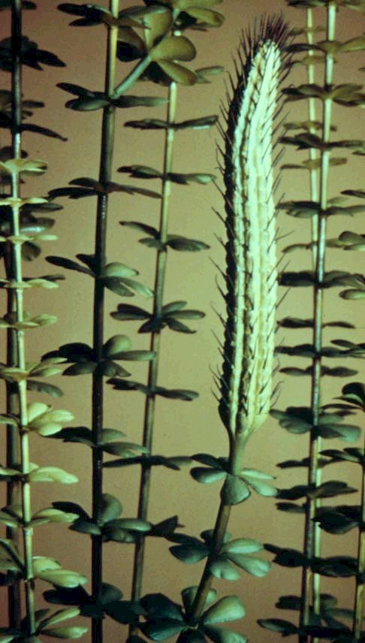
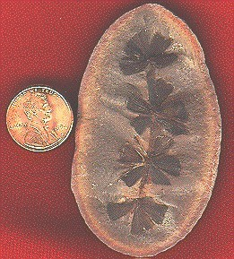
Sphenophyllum

Slide 47
Pteridophyta (the ferns)
Pteridophyta (= Pterophyta) appeared in the Carboniferous (ca. 350 MYA), and the late Carboniferous (320-290 MYA) is known as the "Age of Ferns".
One tree-like fern of the Marattiales (eusporangiate and homosporous), Psaronius, was particularly abundant at that time.

Slide 49
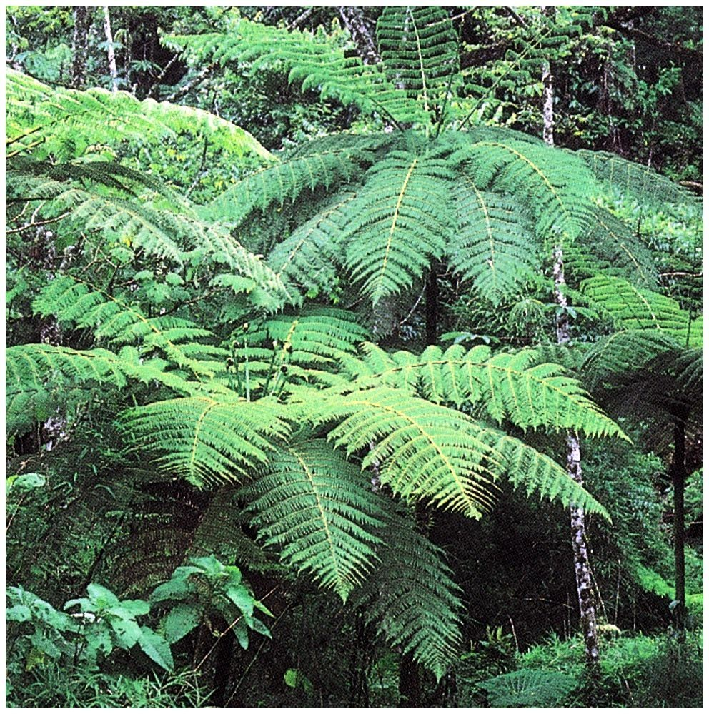

Slide 50
Progymnosperms:
Progymnosperms: also appeared in the Devonian (380 MYA).
These resemble trimerophytes but produced bifacial vascular cambium (see Fig. 20-6 and paragraph above it), which produces secondary phloem and xylem - i.e., true wood.
Examples are Aneurophyton and Archeopteris (= Callixylon, the name for its trunks); the latter formed large trees in southern Ontario (more later).
What's missing? Seeds!

Slide 51
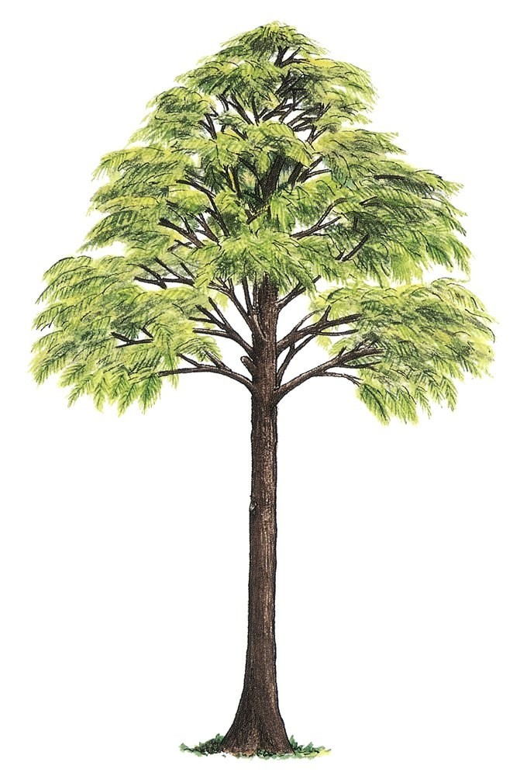

Slide 52
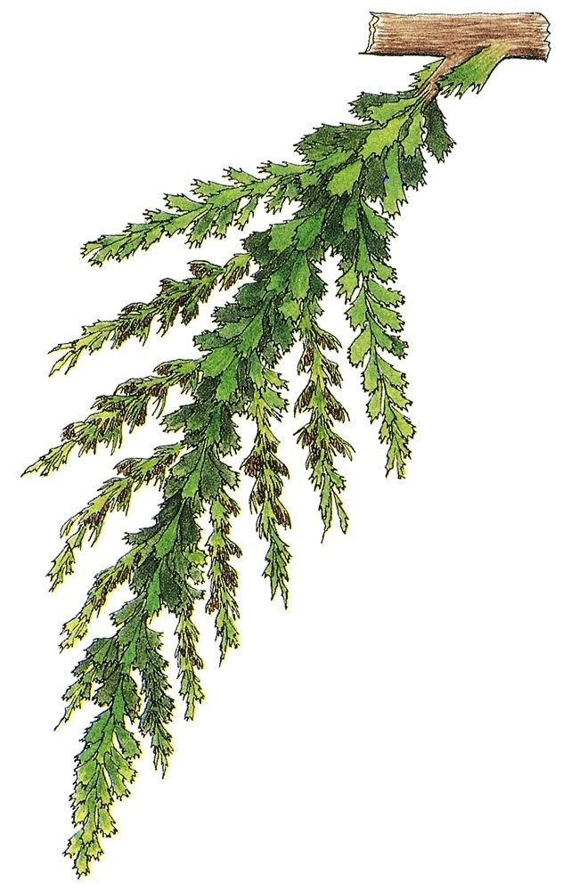

Slide 53
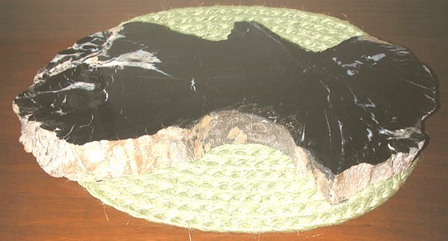
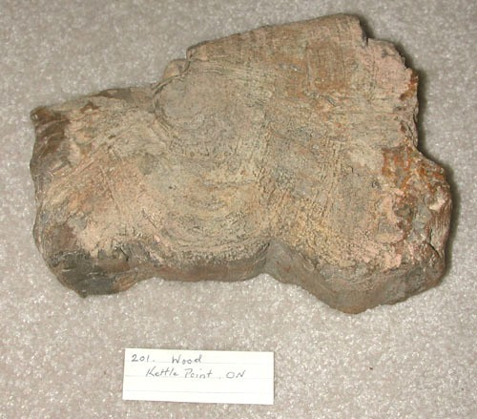

Slide 54
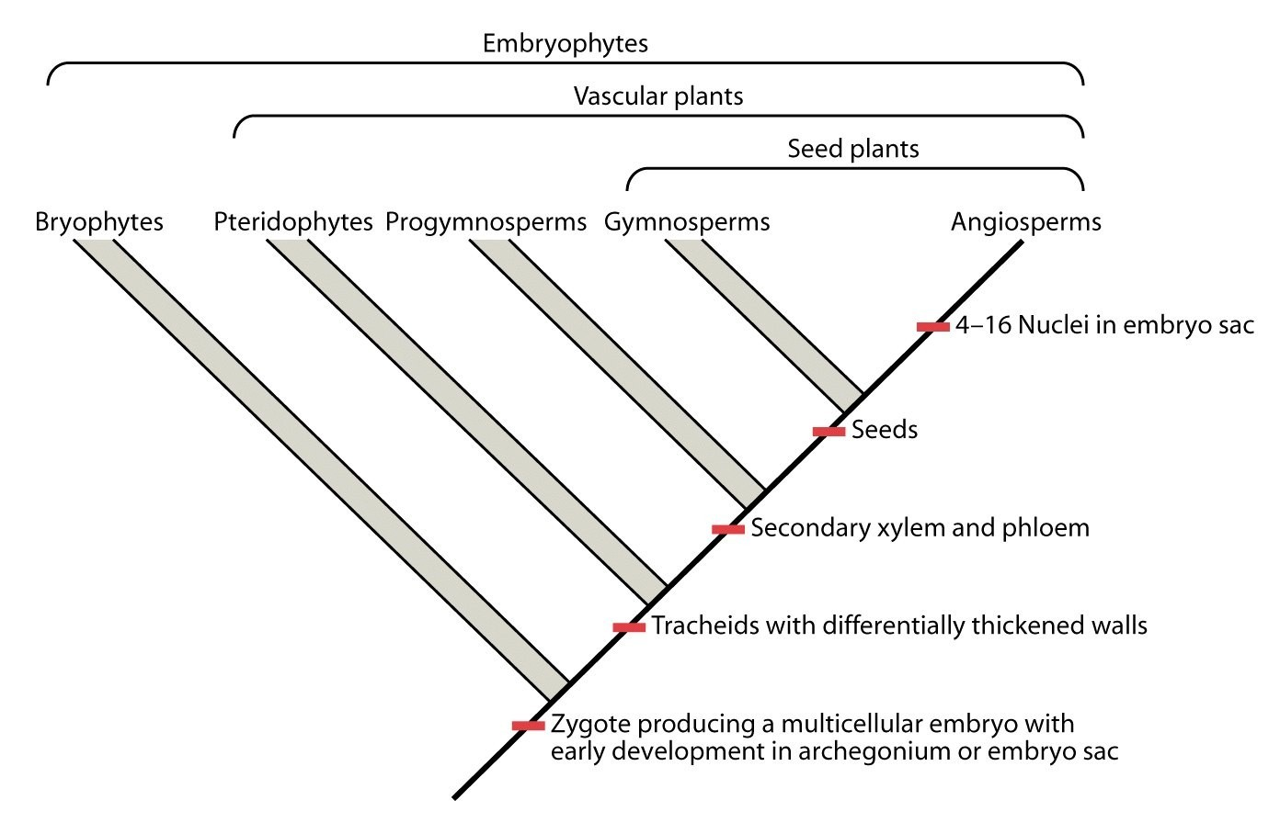

Slide 55
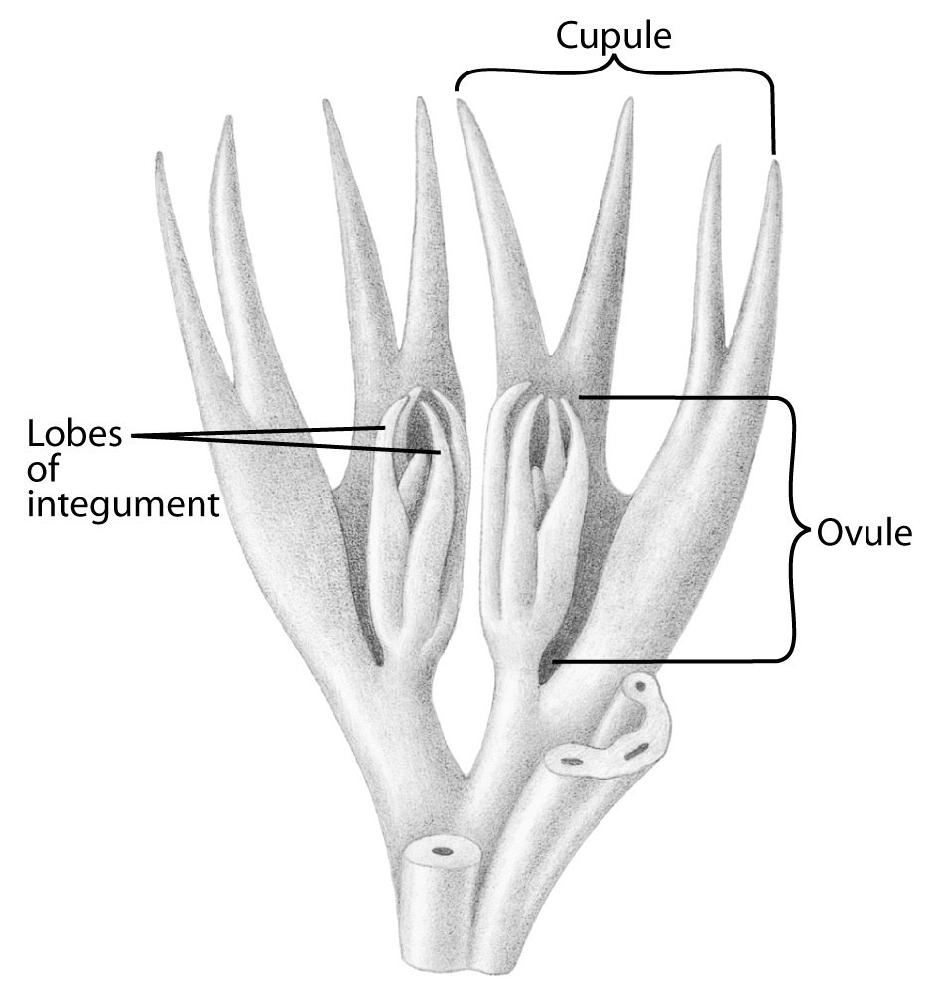
Pteridospermophyta (seed ferns)
Pteridospermophyta (e.g. Elkinsia, Archeosperma) also appeared in the Devonian (365 MYA)! The Devonian was a busy time.
Medullosa (Carboniferous) looked like a tree fern, but produced seeds in cupullate ovules.

Slide 56
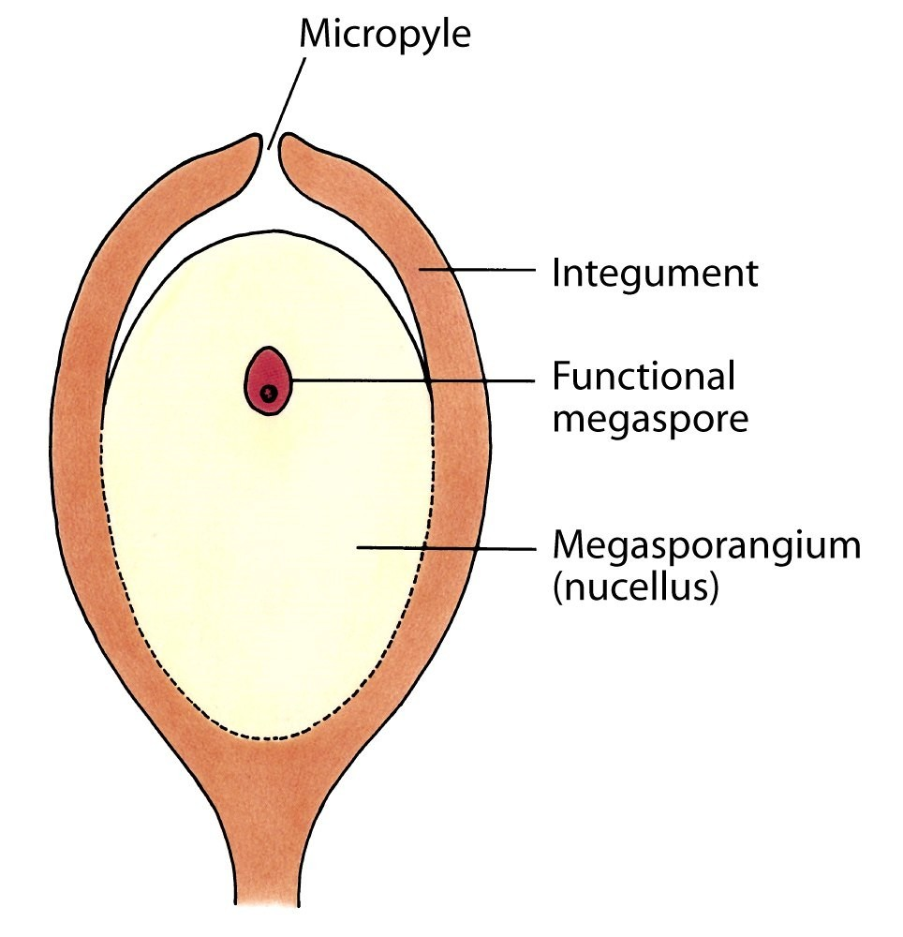

Slide 57
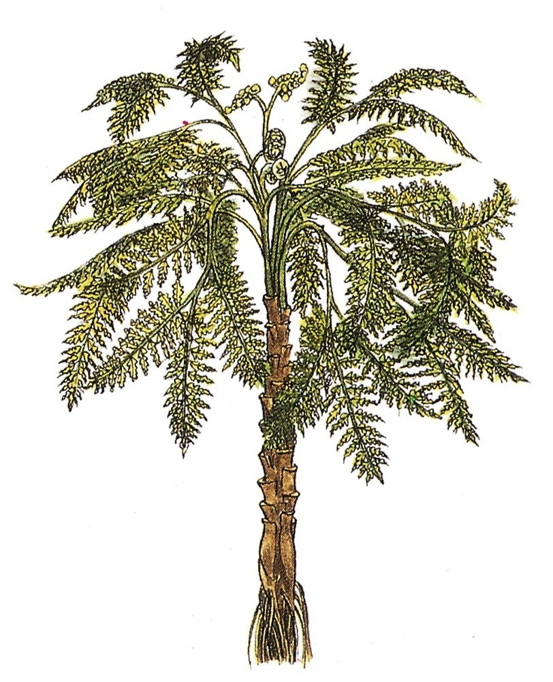

Slide 58
Gymnosperms
Cordaites is regarded as a primitive member of the Coniferophyta; it also is present in the late Devonian (300 MYA).
Two of the remaining "gymnosperm" phyla, Cycadophyta and Ginkgophyta, appeared in the Permian (290-245 MYA); the Gnetophyta appear to have come later.

Slide 59
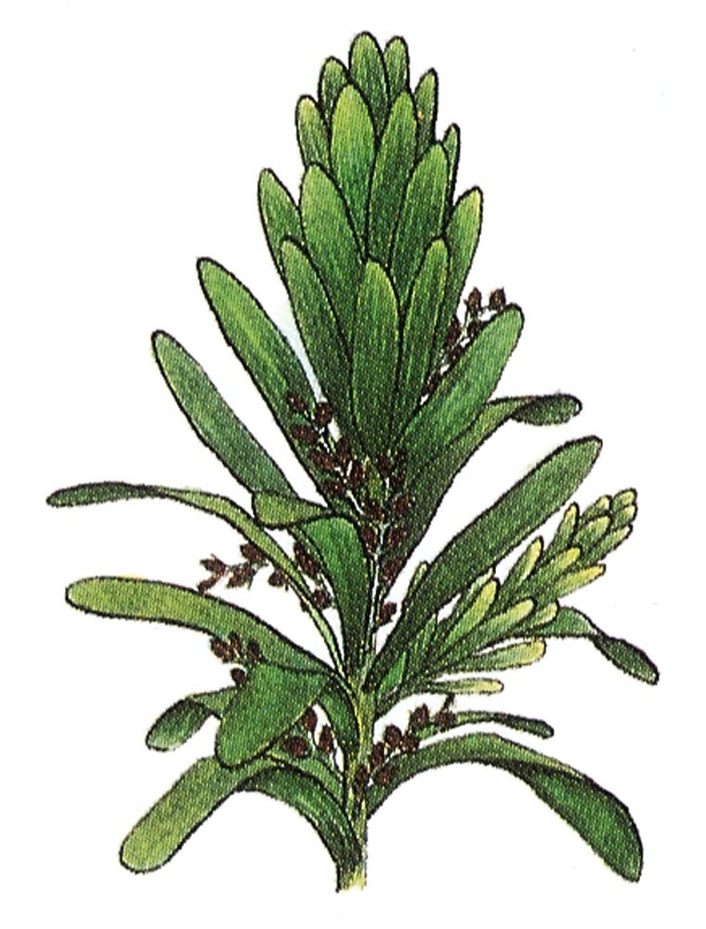

Slide 60
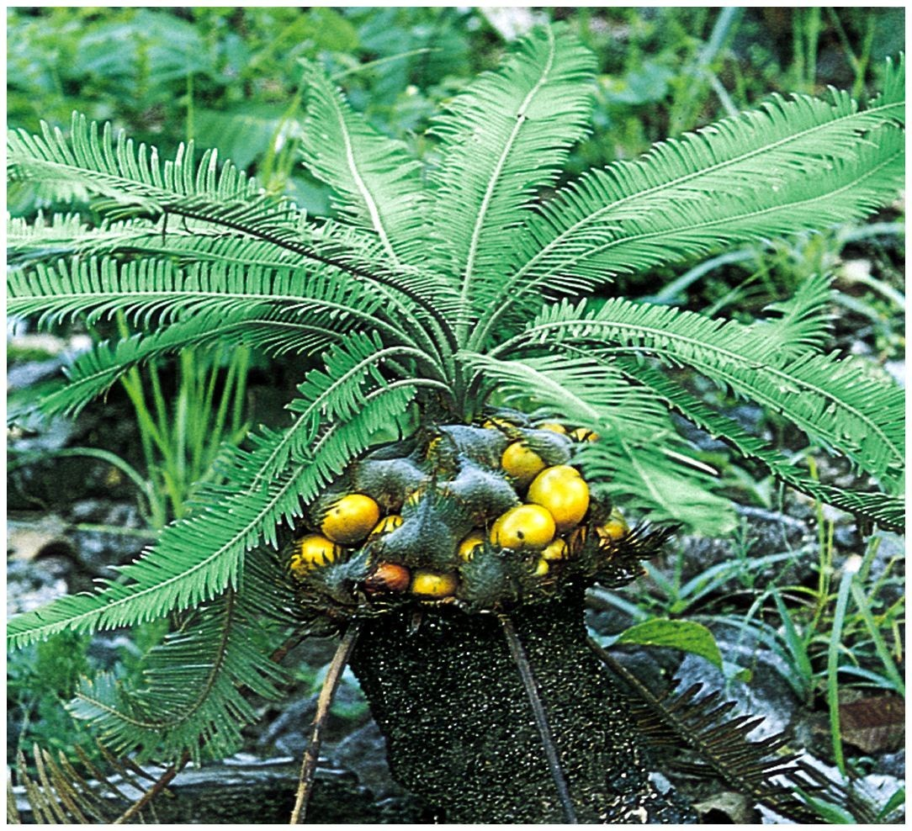

Slide 61
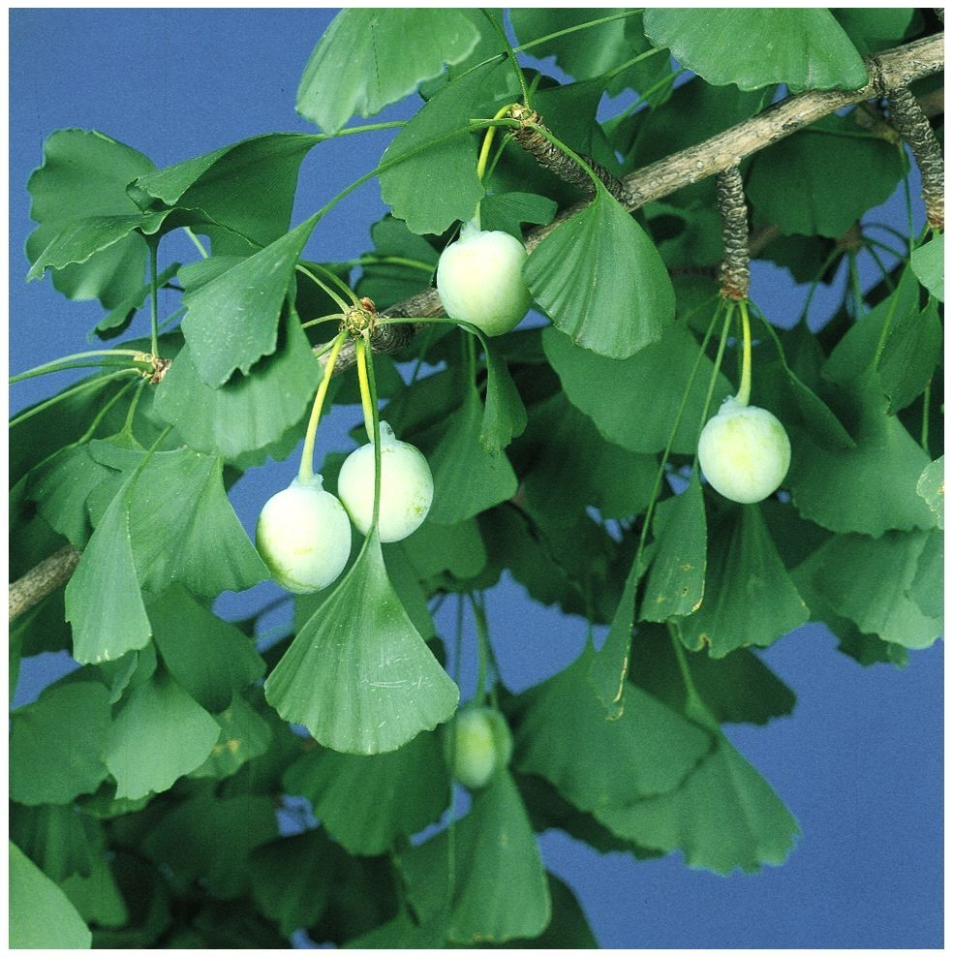

Slide 62
