Slide 1
Chromatography
Dr. Vidya Francis
PG Department of Chemistry

Slide 2
Chromatography is a physical method of separation in which the components to be separated are distributed between two phases
one of which is stationary (stationary phase) while the other (the mobile phase) moves through it in a definite direction.
The chromatographic process occurs due to differences in the distribution constant of the individual sample components.

Slide 3
Chromatography
Is a technique used to separate and identify the components of a mixture.
Works by allowing the molecules present in the mixture to distribute themselves between a stationary and a mobile medium.
Molecules that spend most of their time in the mobile phase are carried along faster.

Slide 4
Classification of chromatography according to mobile phase:
1- Liquid chromatography: mobile phase is a liquid. (LLC, LSC).
2- Gas chromatography : mobile phase is a gas. (GSC, GLC).

Slide 5
Classification based on the mechanism of phase
distribution:
1. Adsorption chromatography eg: LSC and GSC.
2. Partition chromatography
eg : LLC and GLC.

Slide 6
Classification based on the operational technique:
Column chromatography (CC): stationary phase
is packed in a glass column
Adsorption column : solid adsorbent column
Partition column : solid adsorbent holding a liquid fixed and immobile

Slide 7
Planar chromatography :
Thin layer chromatography (TLC): the stationary phase is a thin layer supported on glass, plastic or aluminium plates.
Paper chromatography (PC): the stationary phase is a thin film of liquid supported on a paper strip.

Slide 8
Adsorption Column Chromatography (CC)
This includes chromatographic methods in which:
The stationary phase is packed into an adsorbent column like silica gel , alumina or cellulose .
The mobile phase is a moving liquid like ptroleum ether , acetone benzene etc.

Slide 9
Differential migration of the components along the column of the stationary phase, effecting separation.
The component most weakly adsorbed by the stationary phase emerges out of the column first and that most strongly adsorbed comes out last.

Slide 10
Column Chromatography
Column chromatography
Stationary phase is held in a narrow tube through which the mobile phase is forced under pressure or under the effect of gravity

Slide 12
Applications
1. Separation of organic components a. Separation of position isomers
b. Separation of geometrical isomers.
c. Separation of enantiomers .
2. Identification and purification of natural compounds.
3. Purifying individual proteins.

Slide 13
Partition chromatography
Solid phase is liquid bonded on the surface of inert solid like cellulose , silica gel , etc.
Mobile phase is liquid immiscible with the stationary liquid

Slide 15
Partition coefficient
K = Cs / Cm
C_{s} = con.in the stationary phase
C_{m} =con.in the mobile phase
Compound with the highest K value is retarded most by the stationary phase while that with the least K carried out most quickly.

Slide 16
1. Separation of mixture of acetylated aminoacids.
S.P – water on silica gel
M.P – chloroform with little butanol.
2. Separation of mixture of cobalt and nickel
S.P – water on cellulose
M.P – acetone with little HCl

Slide 17
Applications
1. Quantitative separation of mixture of organic
and inorganic substances.
2. Purification of products of reaction in the laboratories and industries.
3. Identification of organic and inorganic compounds of a mixture.
.

Slide 18
Paper Chromatography
A method of partition chromatography using filter paper strips as carrier or inert support.
The factor governing separation of mixtures of solutes on filter paper is the partition between two immiscible phases.
One is usually water adsorbed on cellulose fibres in the paper (stationary phase).
The second is the organic solvent flows past the sample on the paper (stationary phase).

Slide 22
APPLICATIONS
1. To separate a mixture of dyes
eg: congo red , phenol red ,bromophenol blue
using butanol-ethanol-ammonium hydroxide mixture as solvent
2.To separate components which are closely related chemically
eg: mixture of amino acids using butanol-ethanol –water 3.to control the purity of food products
4. For the separation and identification of metallic cations present in a solution.

Slide 23
Thin layer chromatography (TLC)
The stationary phase:
is a thin layer of adsorbent (usually silica gel or alumina) coated on a plate.
The mobile phase:
is a developing liquid which travels up the stationary phase, carrying the samples with it.

Slide 24
Components of the samples will separate on the stationary phase according to
how much they adsorb on the stationary phase versus how much they dissolve in the mobile phase.

Slide 26
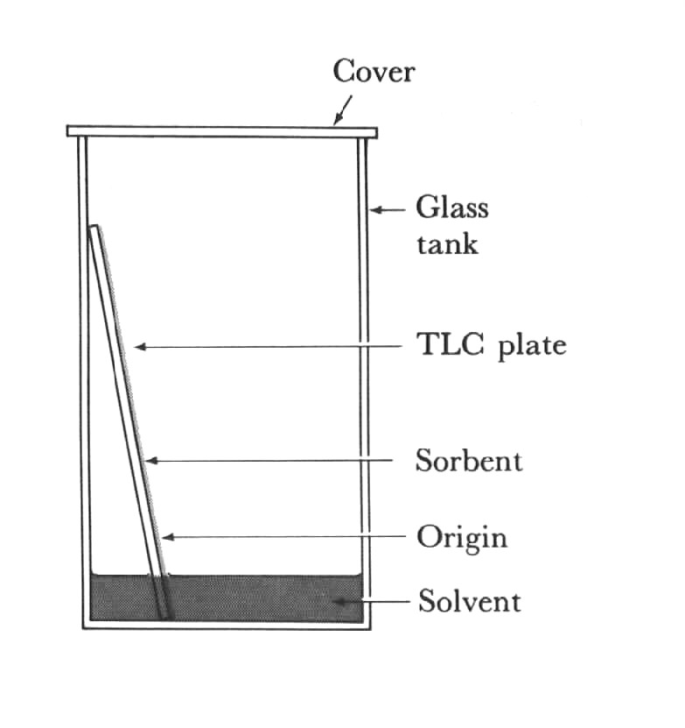
Thin Layer Chromatography (TLC)

Slide 27
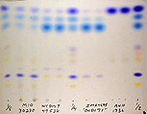
TLC

Slide 29
Applications
1. To separate components which are
closely related chemically
2. Identification and separation of drugs.
eg: mixture of paracetamol ,aspirin , caffeine and ibuprofen spoted on TLC Pplate of silica gel using ethyl acetate as solvent.
3. Identification and separation of plant extracts.
4. To check the purity of samples.

Slide 30
Ion Exchange Chromatography

Slide 31
Ion Exchange Chromatography
Principle
Process by which ions of an electrolyte solution are brought into contact with an ion exchange resin.
The ion exchange resin are insoluble cross-linked long chain organic polymers having functional groups suitable for the ion-exchange purpose.
In water, the counter-ions move more or less freely in the framework & can be replaced by ions of the same sign present in the surrounding solution.
The "matrix" (framework) of a "cation exchanger" is considered as a crystalline non-ionized "polyanion" & the matrix of an "anion exchanger" as a non-ionized "polycation".

Slide 32
Cation Exchangers
Active ions (counter ions) are cations.
The polar groups attached to the matrix are acidic (sulphonic acids, carboxylic acids, phenols, phosphoric acids) e.g. a cation exchanger in the free carboxylic acid form:
X-COO⁻ H⁺
X = Frame work (matrix)
-COO⁻ = Fixed charge (anionic),
Non-exchangeable
H⁺ = Counter ion (cation), Exchangeable

Slide 33
Anion Exchangers
Active ions (counter ions) are anions.
The polar groups attached to the matrix are tertiary or quaternary ammonium groups (basic).
e.g. Anion exchanger in the quaternary ammonium form:
X. NR3⁺OH –
X = Framework (matrix)
-NR3 ⁺ = Fixed charge (cationic)
Non exchangeable
-OH– = counter ion (anion), Exchangeable

Slide 35
Applications
1. Separation of lanthanide ions
2. Separation of anions like chloride, thiocyanide, sulphate and phosphate
3. Amphoteric metal ions like aluminium and zinc can be separated from other metal ions in a mixture .

Slide 36
4.To separate aminoacids obtained by the hydrolysis of proteins.
5. Cations causing interferance in the estimation of anions can be removed.
6.concentration of traces of an ion in adilute solution can be acheived by the intelligent application of ion-exchange chromatography.

Slide 37
GAS LIQUID CHROMATOGRAPHY
Principle
Mobile phase : gas like helium ,argon, nitrogen or carbon dioxide (carrier gas)
Stationary phase : liquid immobilized on the surface of an inert solid support.eg: methyl silicone or polyethylene glycol on solid like diatomaceous earth or coated on a glass or in a fused silica column.

Slide 40
1. Number of peaks correlates with the number of components
2. Area under each peak correlates with the relative concentration of that component in the sample.
3. If standard information is available , the retention time under different conditions can be used to identify each component.

Slide 43
Applications
1. As an efficient separation technique
to separate the components in complex organic ,organometallic and biochemical systems.
2. Qualitative analysis of mixture of organic compounds such as natural products.
3. Used to confirm the presence or absence of a suspected compound in a mixture of organic compounds.

Slide 44
4. Peak areas are proportional to the concentration of the concerned components and thereby reveal quantitative informaton.
5.To check the criteria of putiry of organic compounds.

Slide 45
Gel Permeation Chromatography (GPC)
This type is also known as:
Size Exclusion Chromatography (SEC)
Molecular Exclusion Chromatography (MEC)
Molecular Sieve Chromatography (MSC)
Gel Filtration Chromatography (GFC)
Gel Chromatography.

Slide 48
Stationary phase
Porous polymeric matrix: formed of spongy particles, with pores completely filled with the liquid mobile phase (gel).
The gels (polymers) consist of open, three-dimensional networks formed by cross-linking of long polymeric chains.
The pore size varies with the degree of cross-linking.
The diameter of the pores is critical as separation is based on that molecules above certain size are totally excluded from the pores because they can not enter the gel.
The interior of the pores is reached, partially or wholly, by smaller molecules.

Slide 49
Applications of GPC
1. In the analysis, characterization and development of synthetic polymers.
2. In the analysis and characterization of natural polymers.
3. In clinical ,biochemical and pharmaceutical research.
4.In toxicological studies.

Slide 50
HIGH PERFORMANCE LIQUID CHROMATOGRAPHY
It is a special field of liquid chromatography designed to separate quantify and analyse components of a chemical mixture.
On account of the use of high pressure it is also known as high pressure liquid chromatography.

Slide 51
In HPLC higher separation efficiency is achieved by using:
1. Packing with particle diameters as small 5-10 µm and
2. High pressures of 40-400 bar for the mobile phase in order to ensure a reasonable flow rate
Stationary phase: column like silica gel or alumina.
Mobile phase : acetone , benzene or petroleum ether .

Slide 53
Column , 10-30 cm long and 4-10 mm diameter is made up either of heavy –walled glass tubing or stainless steel tubing.
It is enclosed in a thermostat or oven to maintain the desired temperature of separation.

Slide 54
Applications
1. In pharmaceutical industry
a. In quality control
b. in bioavailability studies
c. in pre-clinical trials
2. In clinical studies
3. In the resolution of racemic mixtures.
.

Slide 55
4. In chemical and biochemical research.
5. In food analysis
a. quantification of natural components
b. Quantification of food additives.

