Slide 1
Postmodernity
Ms. Linda p joseph
Assistant professor
Department of english
Carmel college, mala

Slide 2
POSTMODERNITY
Refers to the highly industrial Western societies of the late 20th C.
The postmodern condition that became the immediate context for Cultural Studies as it evolved from 1970s and 80s.
Modernity – Dominant role of machinery in production
Postmodernity- concern with the generation and control of information

Slide 3
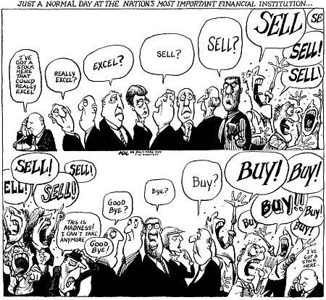
POSTMODERNITY
1970s- crisis faced by fordist model
Mass production flooded markets with commodities
Crisis of overproduction
Economies of Japan, Korea, Singapore and China began to pose serious threats to Euro-American monopoly over the world market

Slide 4
POSTMODERNITY
Emergence of alternative model
Small batch customization
Focus on flexibility and niche marketing
Products were manufactured and delivered only
on demand – JIT stock management
Labour was more multi-skilled
Collapse of job demarcation

Slide 5
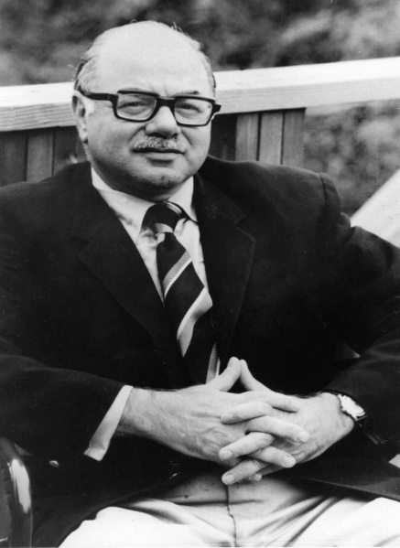
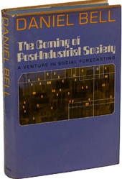
Daniel Bell The Coming of Post-Industrial Society (1973)
Post –industrial society emerged from changes in the social sector only
– influence of economy and occupational scheme rather than politics/culture
Changes resulting from shift from industrial to post-industrial societies
Reduction in industrial labour
Increase in industrial output due to increased mechanization
Increase in wealth due to higher productivity, and inducing newer needs of leisure and other services
New job opportunities in the service industry

Slide 6
POSTMODERNITY
Shift from factory-industrial to service –industry
Resulted in battle/game between people based on information
Note: In pre-industrial, battle was between people and nature and in Industrial, between people and fabricated nature
Service work is based on information about the clientele, the client’s needs, paying capacity and demands
Professionals (research, health, education) – is the new intelligentsia

Slide 7
POSTMODERNITY
ICTs transformed production processes
Finance capital is now global – interlinking of the world’s major stock exchanges and banks
Agents and governments can deal with exchanges across national boundaries
Cash flow are now information flows and money is data

Slide 8
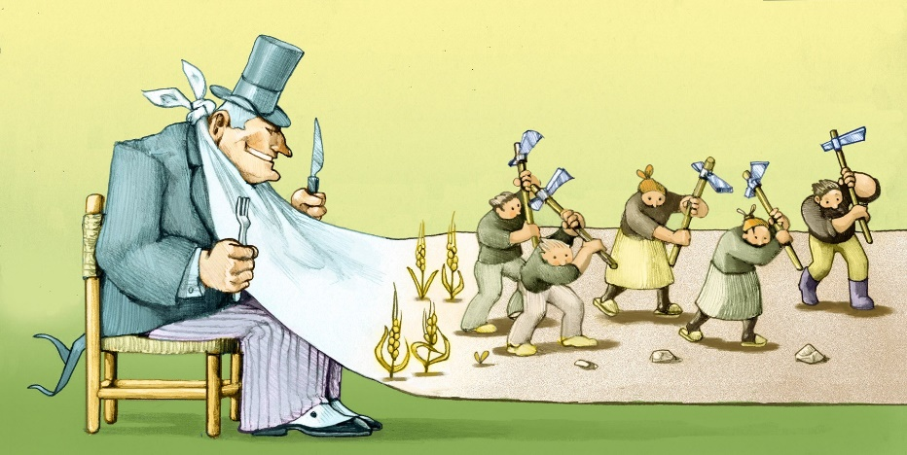
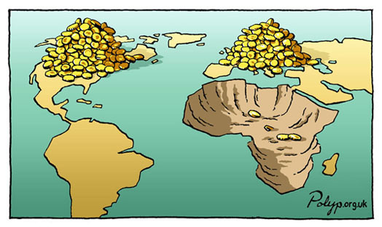
POSTMODERNITY
No geopolitical specificity/localization of finance sources, labour, sources of raw material/the factory site any more
Contemporary production processes are fragmented
‘Disorganized Capitalism’
Factory frequently located in so-called Third World countries – potential supply of cheap labour
Control of finances by offices/banks headquartered in countries in an entirely different continent
De-concentration of capital through globalized production, financing and distribution

Slide 9
POSTMODERNITY
Manuel Castells – identified 4 forms of labour – visible in any country in varying quantities
The producers of high value- based on informational labour
The producers of high volume – based on low-cost labour
The producers of raw materials- based on natural endowments
The redundant producers- based on devalued labour
These types are connected globally, where one MNC can coordinate all 4 types all over the globe

Slide 10
POSTMODERNITY
Niche Marketing – breaks up market into increasingly smaller groups
Eventually every individual can find a commodity to suit her/his exact specification
Information economy – on each visit to the store the individual’s data is recorded for future use
Information feedback into the production system and the product with the specifications of that individual full filled, arrives at the store
Particularization is possible with ever-faster information flows in cyberspace
Each user thus become active participants in (technological) innovation

Slide 11
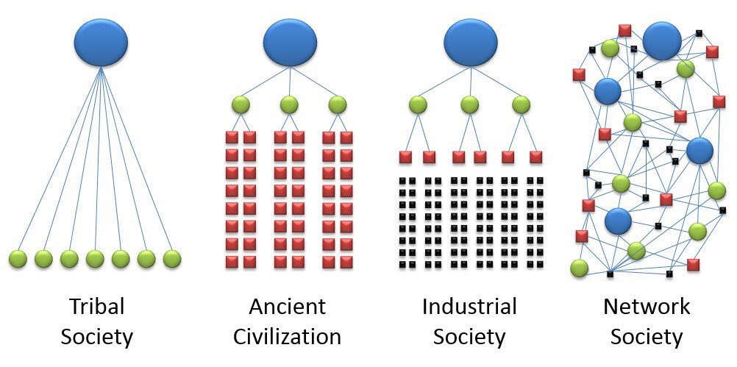
POST-INDUSTRIAL SCENE
The rise and expansion of a service economy, where more people are employed in services such as banking
The formation of knowledge-elite (white-collar occupation) – especially technical elites in universities, research institutes , govts. And economic enterprises.
Rise of new social movements
Information as a product and process
Information networks and wired societies
Centralized control but decentralized production units
Uneven global development – industrial mass production occurs at the ‘periphery’ and knowledge production occurs in the western center

Slide 12
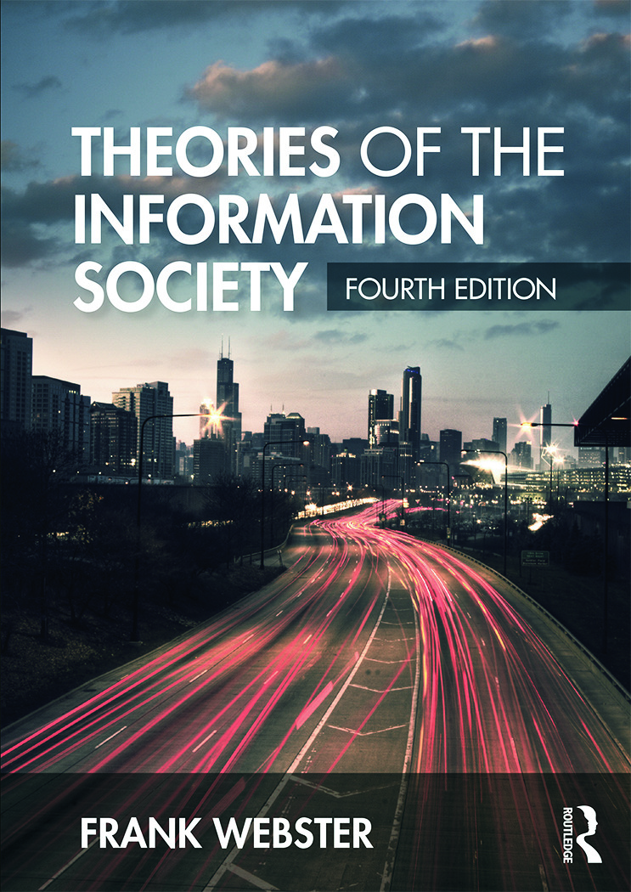
The Information Society
Frank Webster (1995) – defined the ‘information society’ in 5 ways
Technological: Increasing application of IT in everyday life; Convergence of telecommunications and computing and increasing linkage between banks, homes, offices, factories shops and educational institutions - results in a networked society.
Economic: Information-based society is an ‘information economy’ where economic values can be easily placed on information
Occupational – Shift in occupations from industrial labour to desk-bound information dealers (‘white collar society’)

Slide 13
The Information Society
D. Spatial: Networks mark the information society; Transborder movements of information along electronic information highways radically alter notions of territory; Dispersion of business corporation – financial centre and production unit can be in different continents
E. Cultural: Predominance of information in everyday life: movies, radio, television and internet. In a media-driven culture, there are a surfeit of signs- resulting in hyperreality

