Slide 1
CULTURAL STUDIES - MODERNITY
MODULE I
MS. LINDA P. JOSEPH
ASSISTANT PROFESSOR
DEPARTMENT OF ENGLISH
CARMEL COLLEGE, MALA

Slide 2
MODERNITY
Used to distinguish the Christian present from the ‘pagan’ past
Often associated with European Enlightenment in the 17th and 18th C.
European intellectual movement of the 17th and 18th centuries in which ideas concerning God, reason, nature, and humanity were synthesized into a worldview that gained wide assent in the West and that instigated revolutionary developments in art, philosophy, and politics. Central to Enlightenment thought were the use and celebration of reason, the power by which humans understand the universe and improve their own condition. -
https://www.britannica.com/event/Enlightenment-European-history

Slide 3
18th C.
Brought about decisive shift in ways of thinking
Emphasized Reason and empiricism over sentiments and faith
Resulted in ‘Age of Reason’ (18th C) – Marked by the belief that Reason could ensure human progress

Slide 4
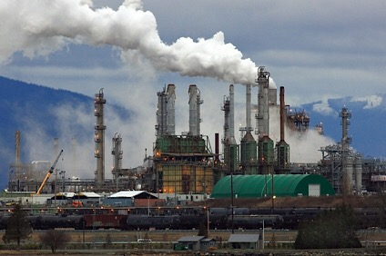
19TH C.
Modernity – associated with industrialization and the spread of the capitalist mode of production
Capitalist/Industrial modernity
Characterized by differentiation
Labour is more specialized – divided among specific lines of expertise and tasks

Slide 5
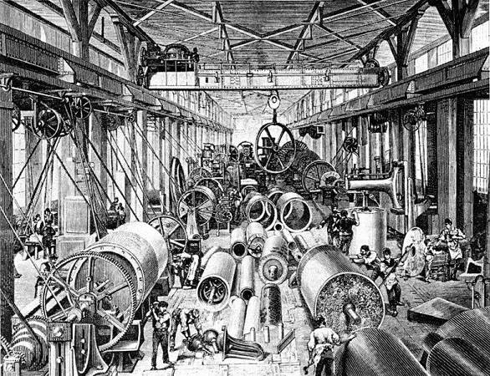
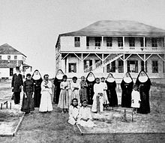
20th C.
Work, home, religion and leisure- separate spheres
Nuclear families
Educational instruction/healthcare once undertaken by the
Church are allocated to schools, hospitals and specialized institutions
Massive increase in production of commodities – resulted in increased consumption

Slide 6
Rationalization process of MODERNITY
Regulation of work and other spheres of life through rules and norms
Rationalization of bureaucracy and administration-, automation of household functions, coordination of timings, regulation of movement
Precision- a much sought-after quality
Thus, anything classified as ‘deviant’/’inefficient ’ gets excluded from the process/system

Slide 7
Rise of modernity is linked to . . .
Massive surveillance and regulatory technologies
Sites of regulation- prison (criminal), old-age home (economically non-productive old), hospital (sick), asylum (insane)
Thus these structures of power generated a set of ideas and beliefs about age, sickness and sanity

Slide 8
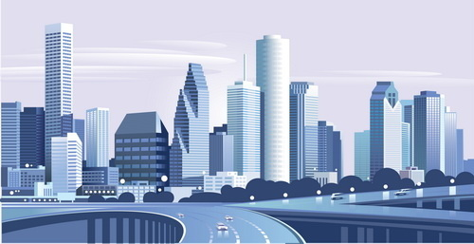
The modern city
The city – industrial and commercial ‘logos’ of the nation-state
The Cultural Centre – where leisure, recreation and cultural life are concentrated
Massive structures of regulation – to control space and spatial behavior
Pavements – designed spaces for walking
Lines – divide road for drivers
Signals – regulate movement of vehicles
Spaces – allotted for parking
Sites – demarcated for shops/gardens/schools

Slide 9
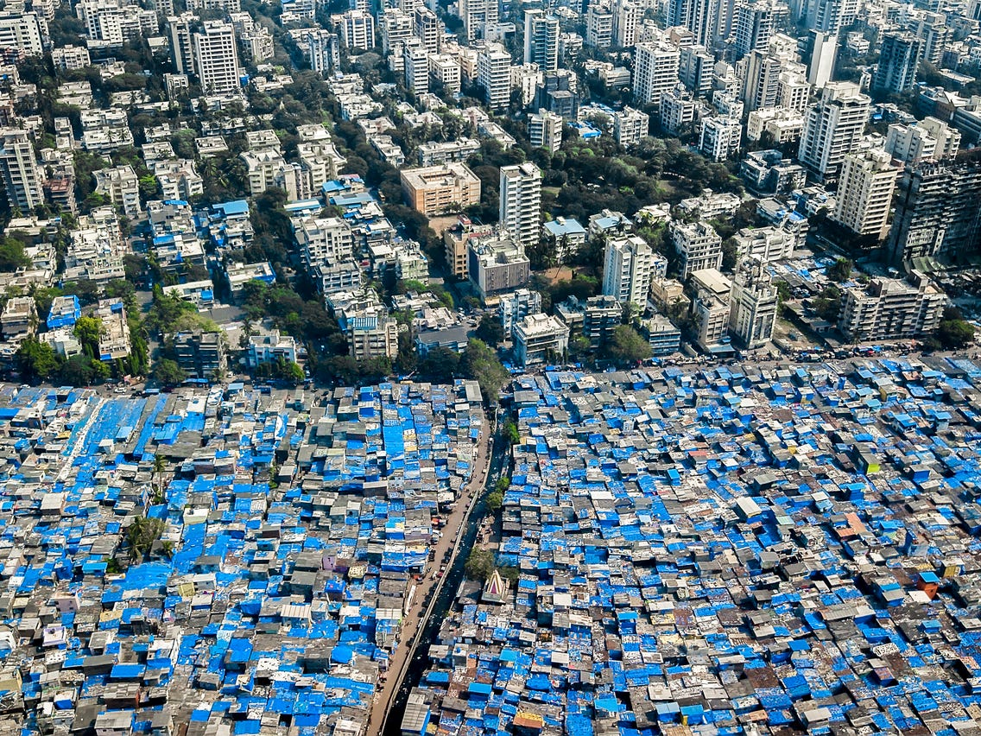
MODERN CITY
‘Ghettoization’ of cities – distinguishable as ‘poor’ and ‘posh’
(Refer page-89 - last para., and page 90 - first para.)
Sense of elitism marks the clash of ‘modernities’
Modernization as a continuous process
Desire for the mobility from the ‘poor’ to the ‘posh’-
closely aligned with the culture of consumption

Slide 10
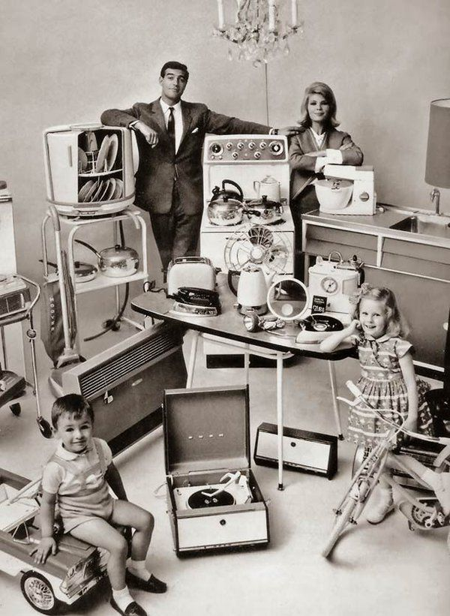
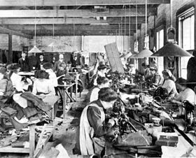
MODERNITY
Consumerism and enormous range of commodities – central to capitalism
Culture of capitalism often conceals from visibility the exploitative structures
(cheap and unorganized labour behind the production)

Slide 11
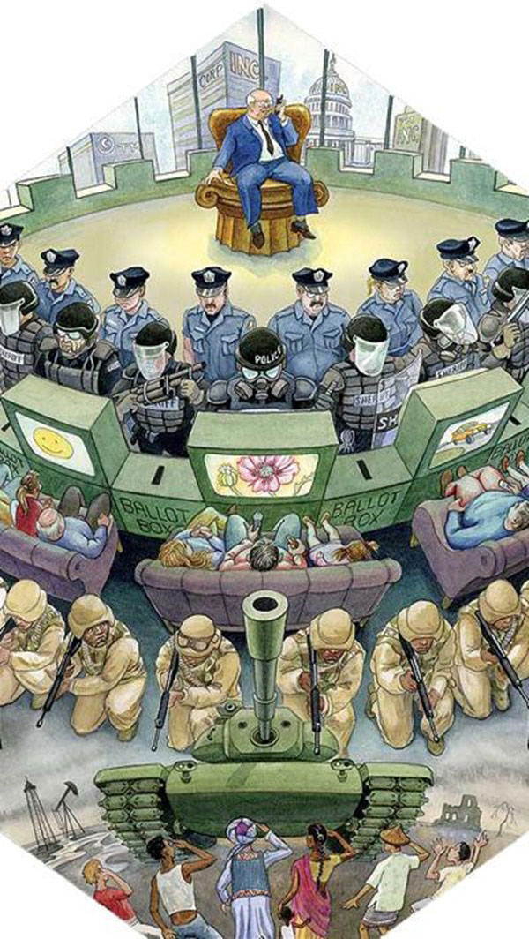
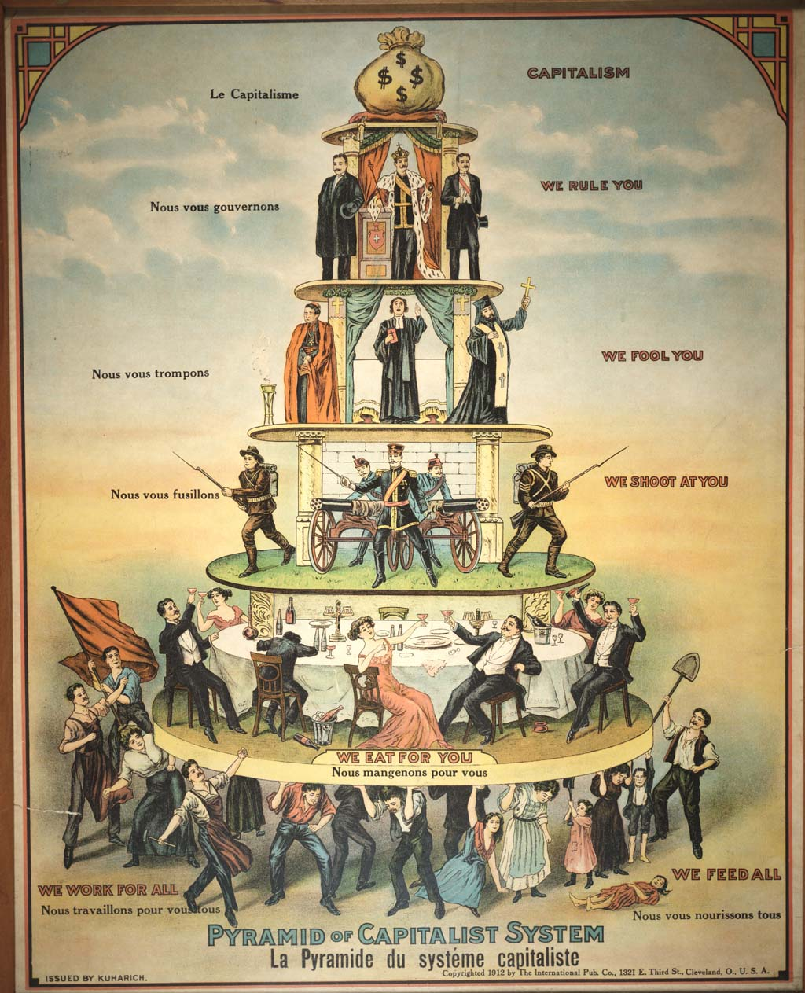
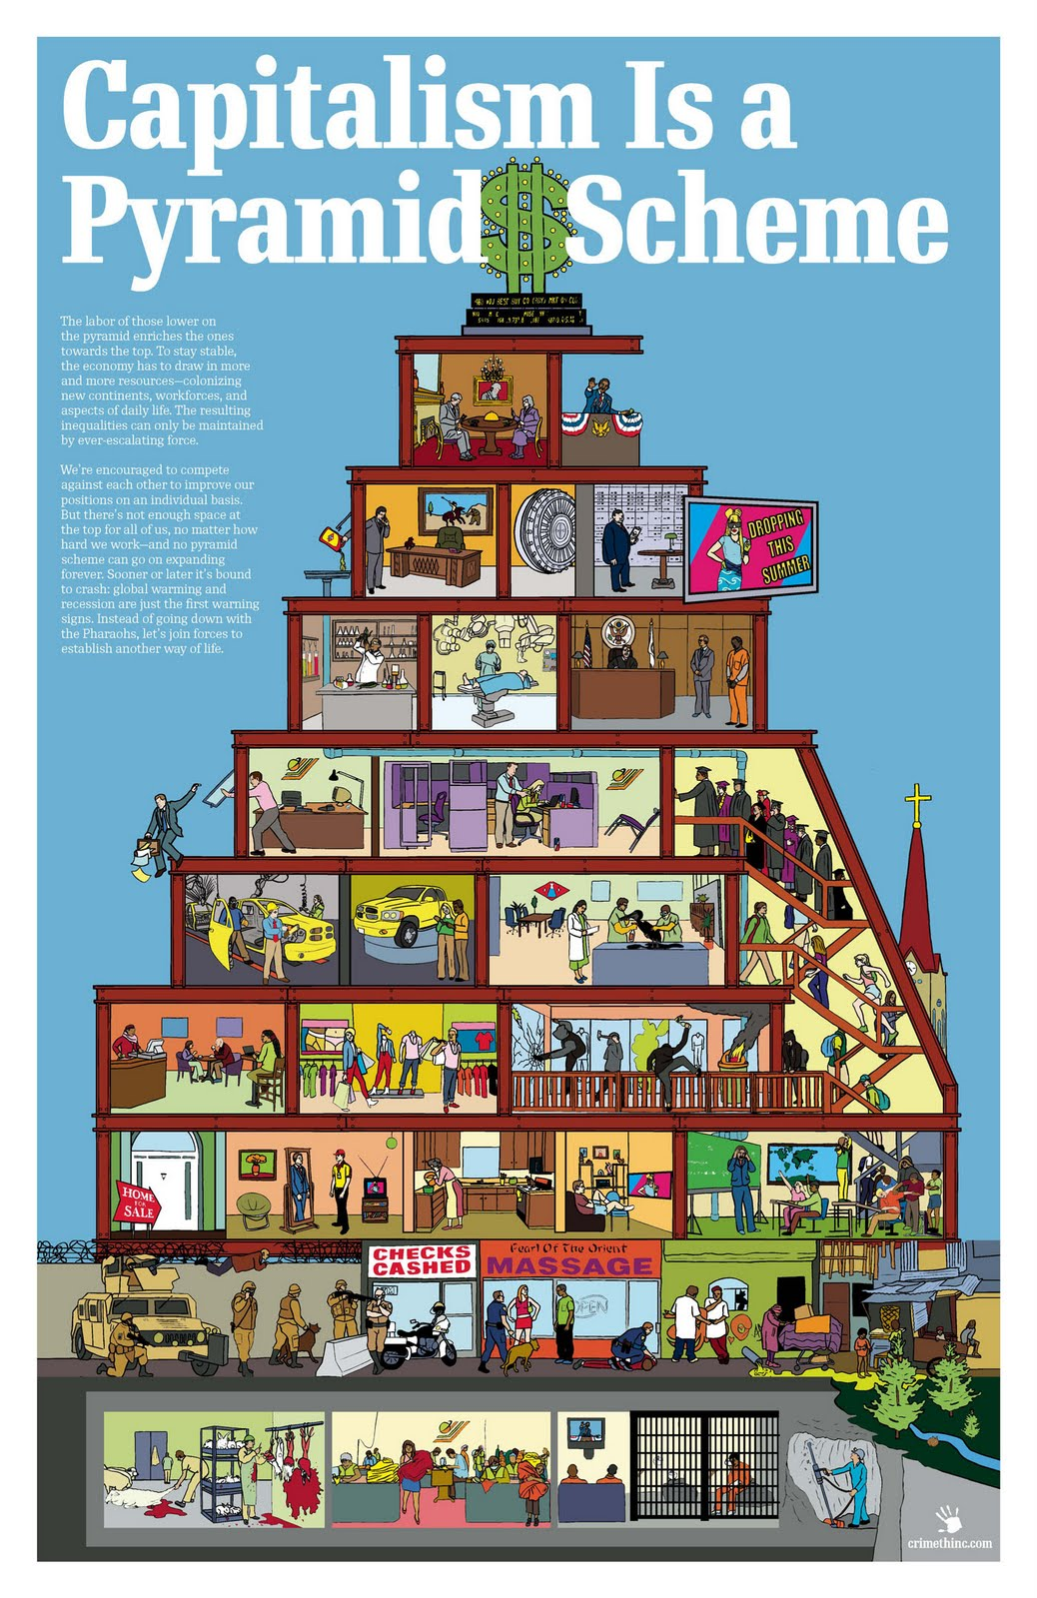

Slide 12
Modernity is . . .
Marked by an uprooting from tradition
Ties of family, kinship, neighborhood and community began to disappear
With increasing mobility, people moved away from their families-
- makes them more unstable, without moorings/strong local ties
Results in increasingly rootless individuals
Social life is divided into spheres without traditional rules
Each systems thus become self-referential

Slide 13
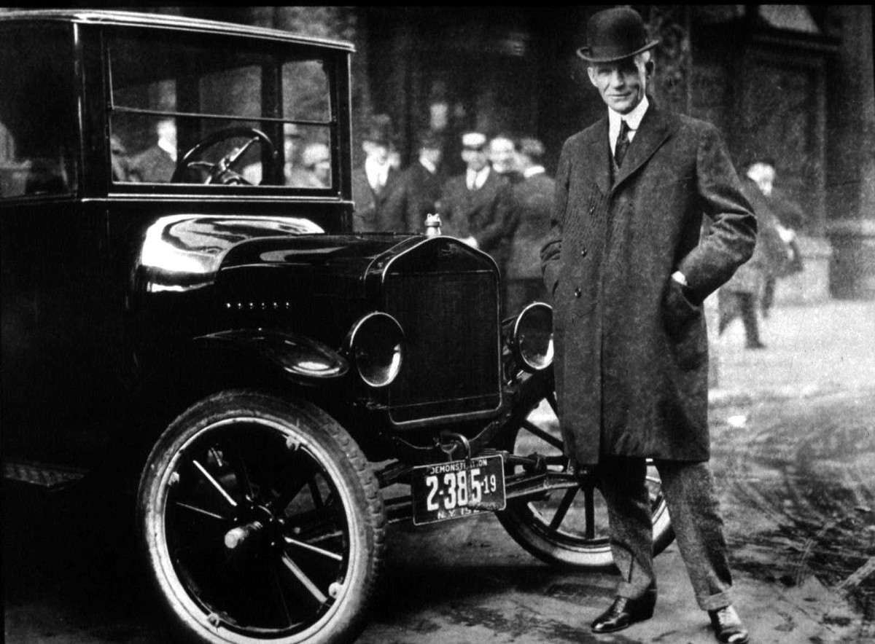
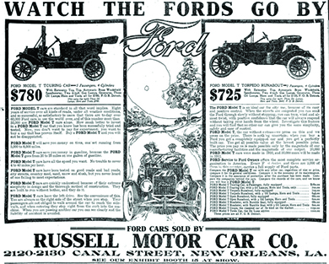
POST 1945
Mass production and consumption- hallmark of economic practice
Rationalization of production process
Emergence of ‘Fordism’ – Assembly system of production-
- tasks are broken down into its component parts, labour allocated and careful monitoring of the process
Resulted in standardization of products and commodities
Unprecedented trend in mass production

Slide 14
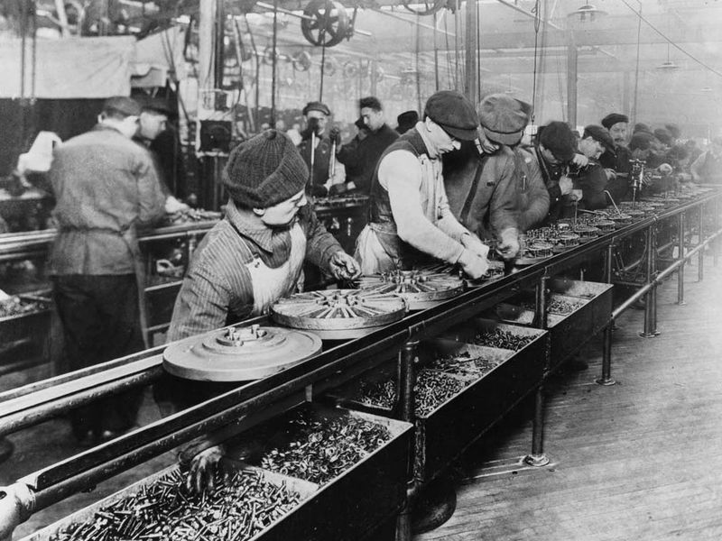
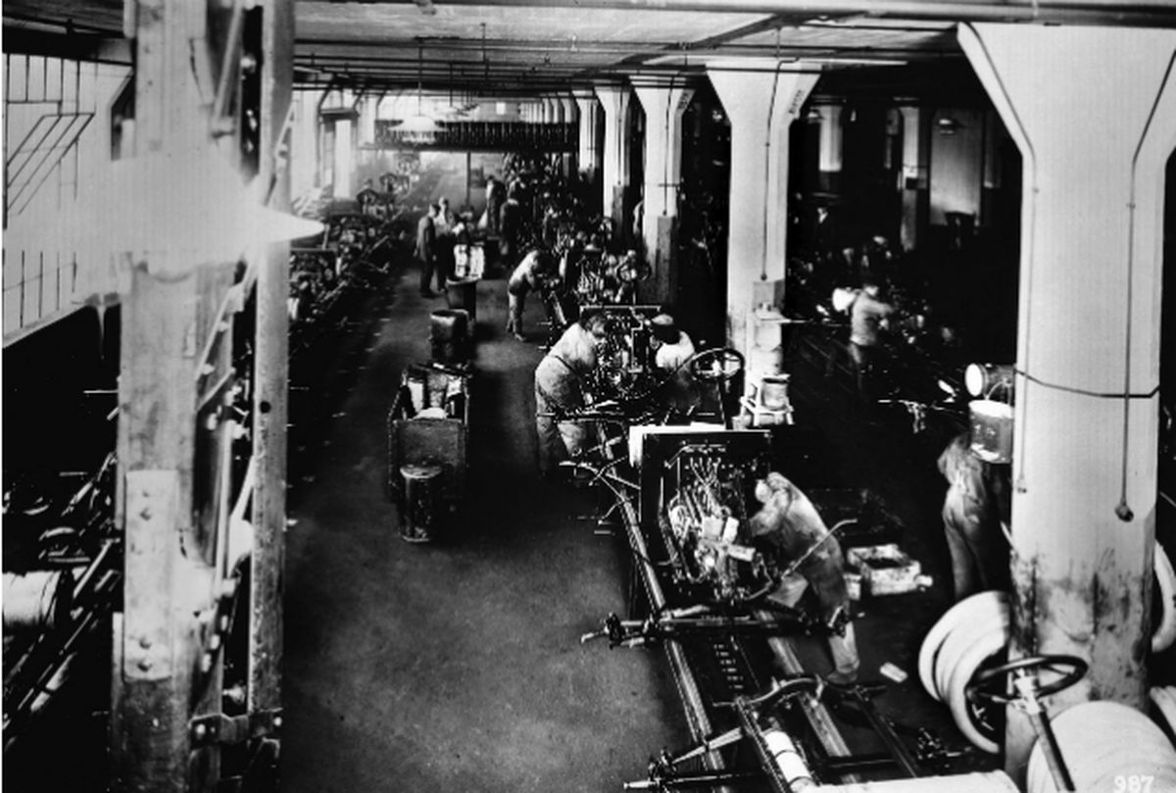
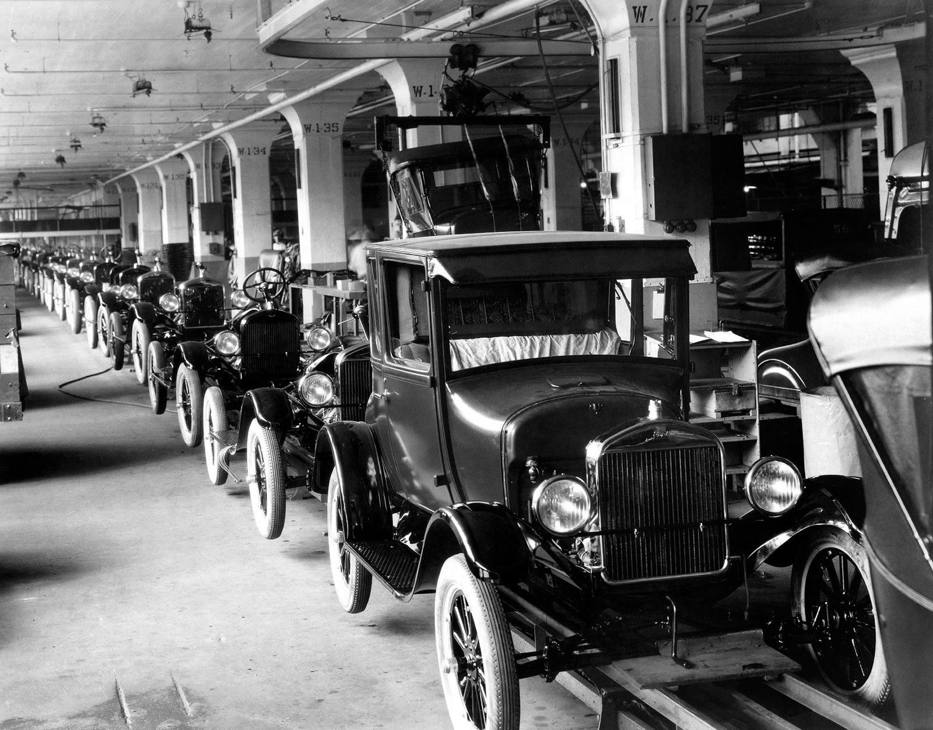
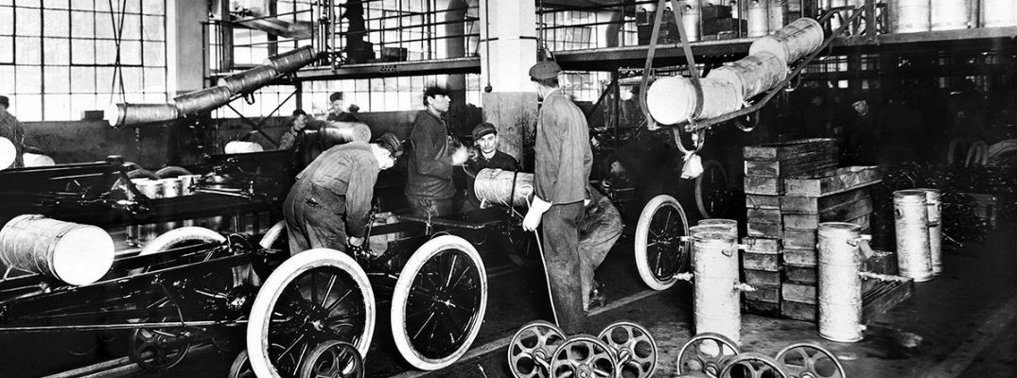
FORDISM

