Slide 1
NEW MEDIA
Presentation by
Ms. Keerthy Sophiya Ponnachan
Assistant Professor
Department of English
Carmel College, Mala

Slide 2
New Media
1980- relied primarily Newspaper, Magazine, T.V, Radio
Last 40 years- rapid change
Internet- Computers
New Media used extensively
Interactivity- Central Concept to understand New Media
Many-to Many – Style of Communication

Slide 3
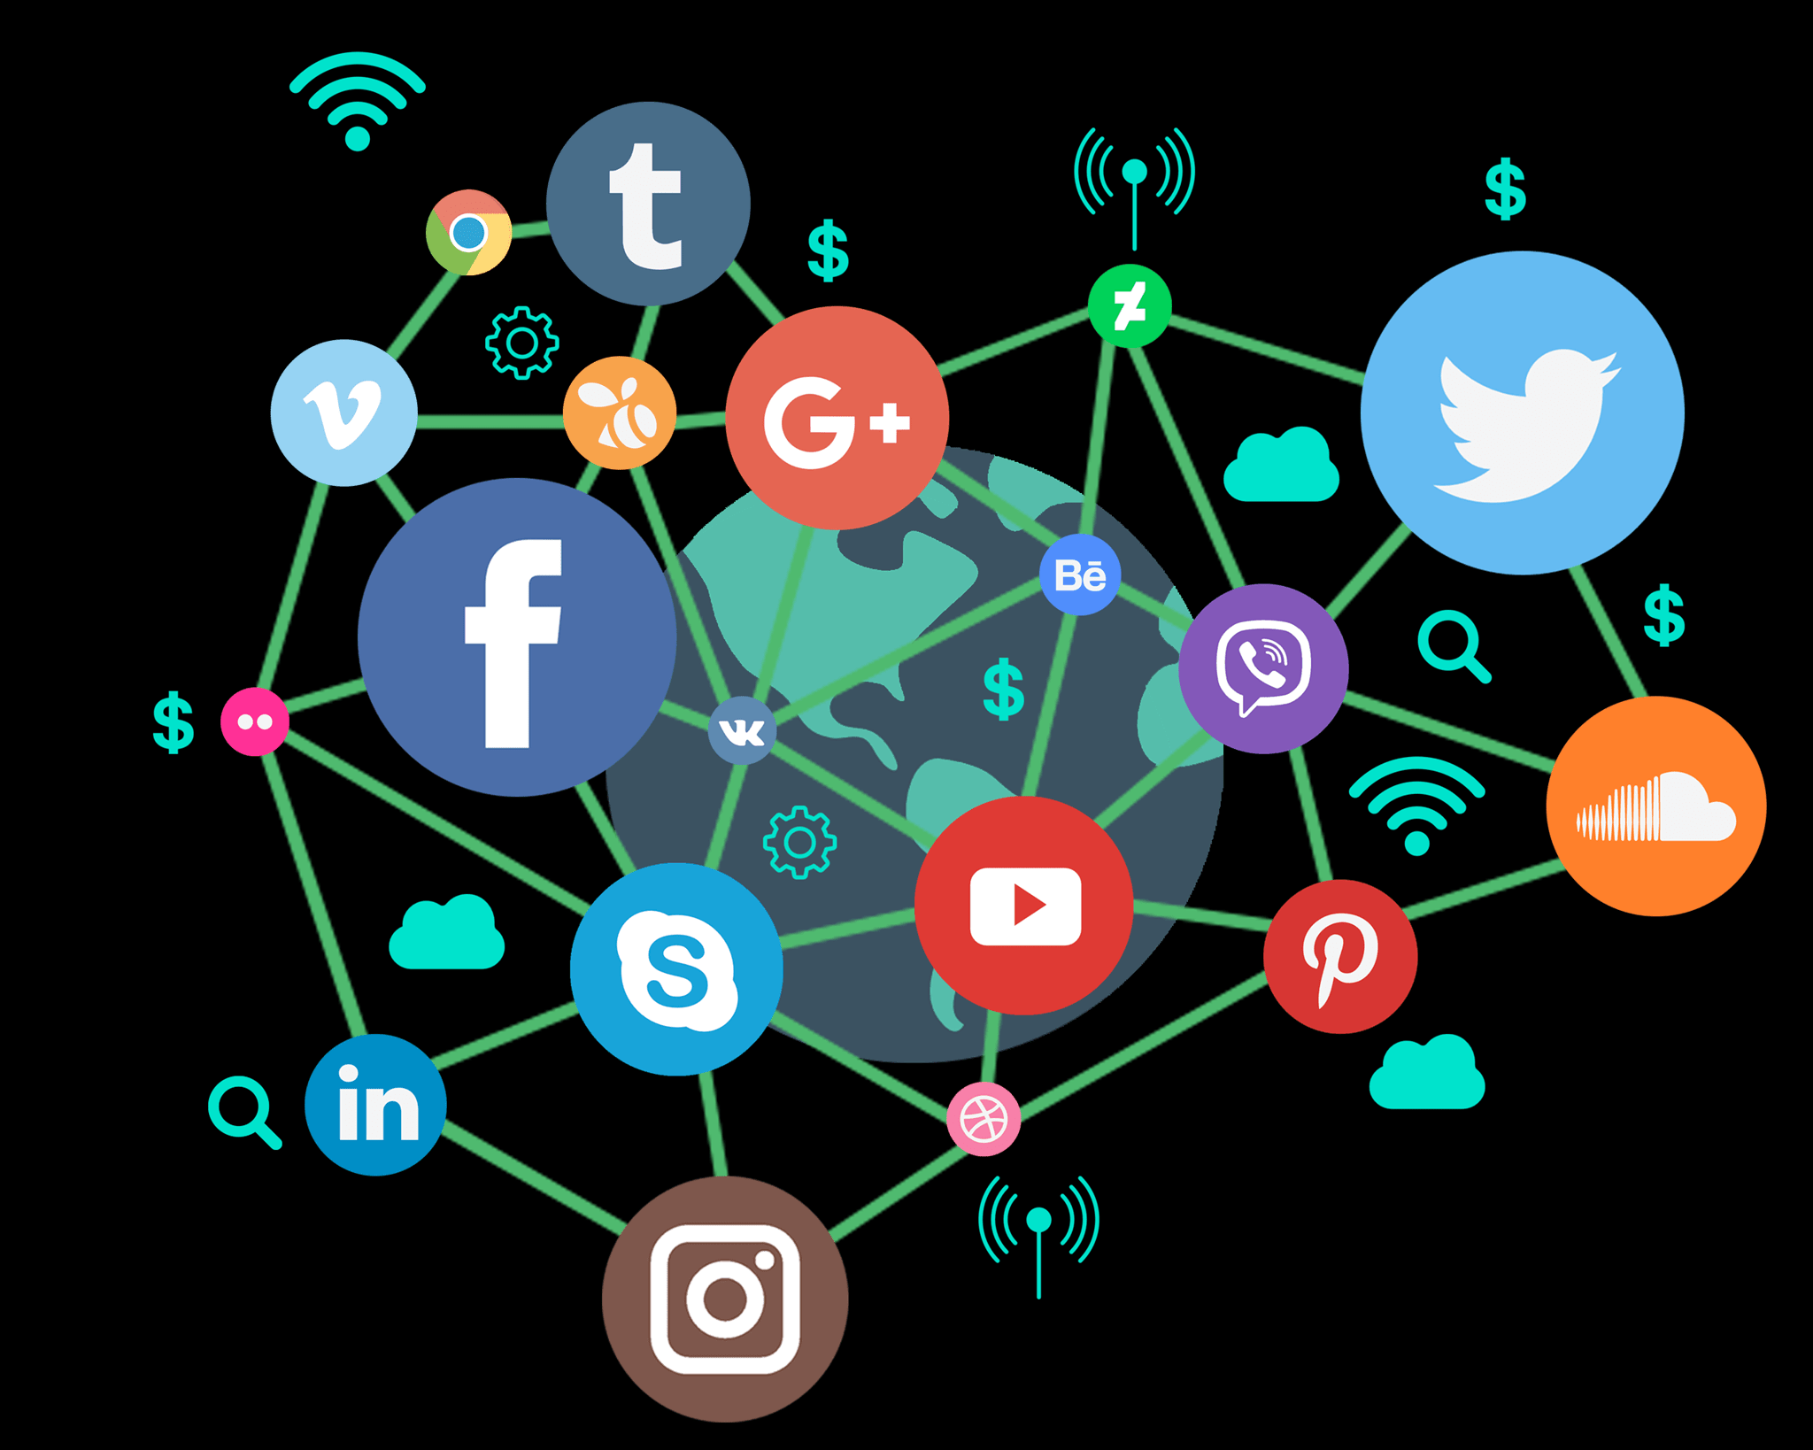
Internet
Developed in US (1960)
Initially for Military and Academic research
Expanded to Europe in 1973
World Wide Web (WWW)- early 1990’s

Slide 4
Internet in India
Internet in India (1987)
Commercial Net access in 1995
ERNET- Indias First internet service(1987)

Slide 5
BLOG
Contraction of the term Weblog
Type of website maintained by individual
Blogs combine- text, images, links to other blogs, web pages, other sites
Weblog- term coined by Jorn Barger in 1997
Blog- Coined by Peter Merholz in April 1999
Term Blog entered Oxford English Dictionary in 2003
Blogs can come up with – competing, contradictory alternative reports

Slide 6
Types of Blogs
1. Personal Blogs- ongoing commentary or diary by an individual
2. Corporate Blogs- enhance the communication in a corporate- internally
Marketing, branding or public relation purposes- externally
3. Media Blogs- focus on reporting and analysing events

Slide 7
Types of Blogs
4. Political Blogs- Blogs hard to control, Suppressed by authoritarians
5. Other Blogs- Travel blog, house blog, fashion blog, project blog, education blog etc.

Slide 8
News Portals
Portal is synonymous with gateway for WWW
Starting Site- provides Web searching, news, emails, links to other sites, online shopping etc.
General portals- Yahoo, Rediff, Netscape, MSN, AOL
Specialised Portals- manoramaonline.com, mathrubhumi.com, tehelka.com, moneycontrol.com etc.
Portals offer multiple services for the net surfers

Slide 9
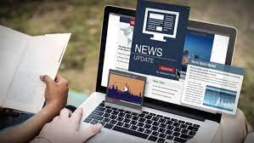
Web Journalism
News Portals- tehelka.com, cobrapost.com
Internet companies- MSN, Yahoo & Google
Portals have dedicate team of reporters and sub-editors
Agreement between Yahoo and Dainik Jagran- Milestone in history of web journalism

Slide 10
Online Newspapers
Entered in India in mid 1990
The Hindu- Forst Indian newspaper- launched internet edition in 1995
Dipika- first Malayalam newspaper that launched internet edition
Internet edition newspapers initially used same text and photos for contents
Now separate web department with professionals to update edition
Give a different dimension of interactivity

Slide 11
Positive Side
1. Interactivity
2. Increase Public access
3. Reduced gatekeeping powers
4. new a powerful story telling methods
5. convergence

Slide 12
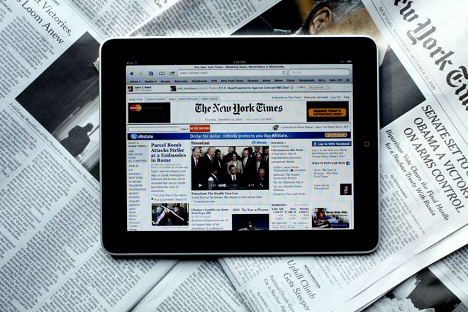
Negative Side
1. Rise in Journalism of assertion
2. Pressure to lower ethical standards
3. Media violate privacy
4. Confusion about who is the journalist
5. Ethical dilemma

Slide 13
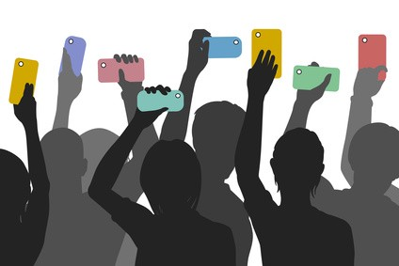
Citizen Journalism
Also know as public, participatory, democratic and street journalism
Member of public play active role in collecting , reporting, analysing and disseminating news and views
Ordinary people do it
Access content globally
Citizen journalism os of the people, by the people and for the people

Slide 14
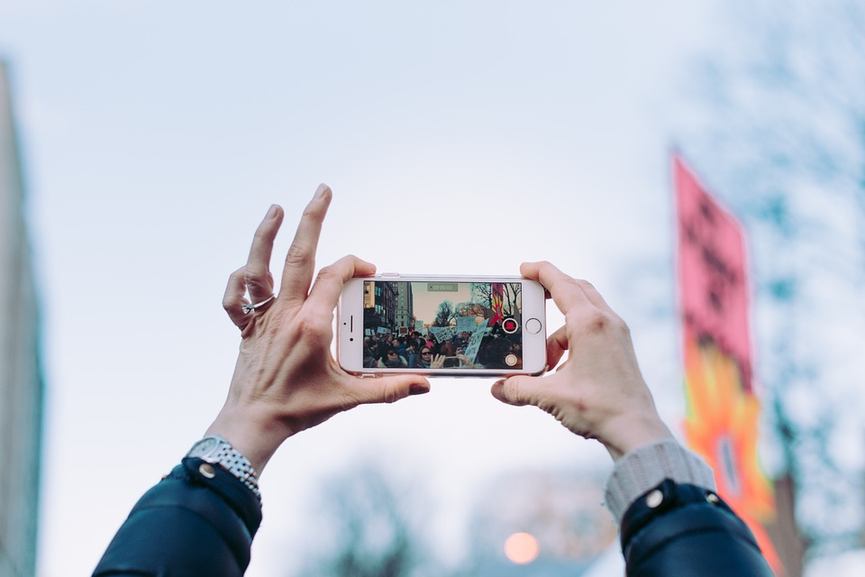
Citizen Journalist
They were formerly known as the audience who were on the receiving end of a media system
Robert Huesca- Associate professor of communication at Trinity University , Texas
9/11 terrorist attack- World Trade Centre- Reports came from Citizen Journalist
Tsunami (2004)- News reports from citizens widely broadcast
2009 Iranina election protest- Twitter played an important role

Slide 15
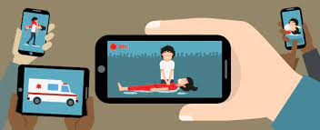
Citizen Journalism (Cont.)
Internet- Scope of media expanded
Rich enjoy monopoly- deprived people of their freedom
Hired people who report in biased manner
Hardly accept write up from commoner
Citizen journalist may be activists within communities
Citizen journalists is literally by the people- hence more democratic and transparent
Likely to become a potential mass medium of the future

Slide 16
Social Media Networks
Social Media- Electronic communication through which users create online communities to share information, ideas, personal messages and other content- Merriam Webster
Social Interaction among people
They create, share and exchange information and ideas in virtual communities and networks

Slide 17
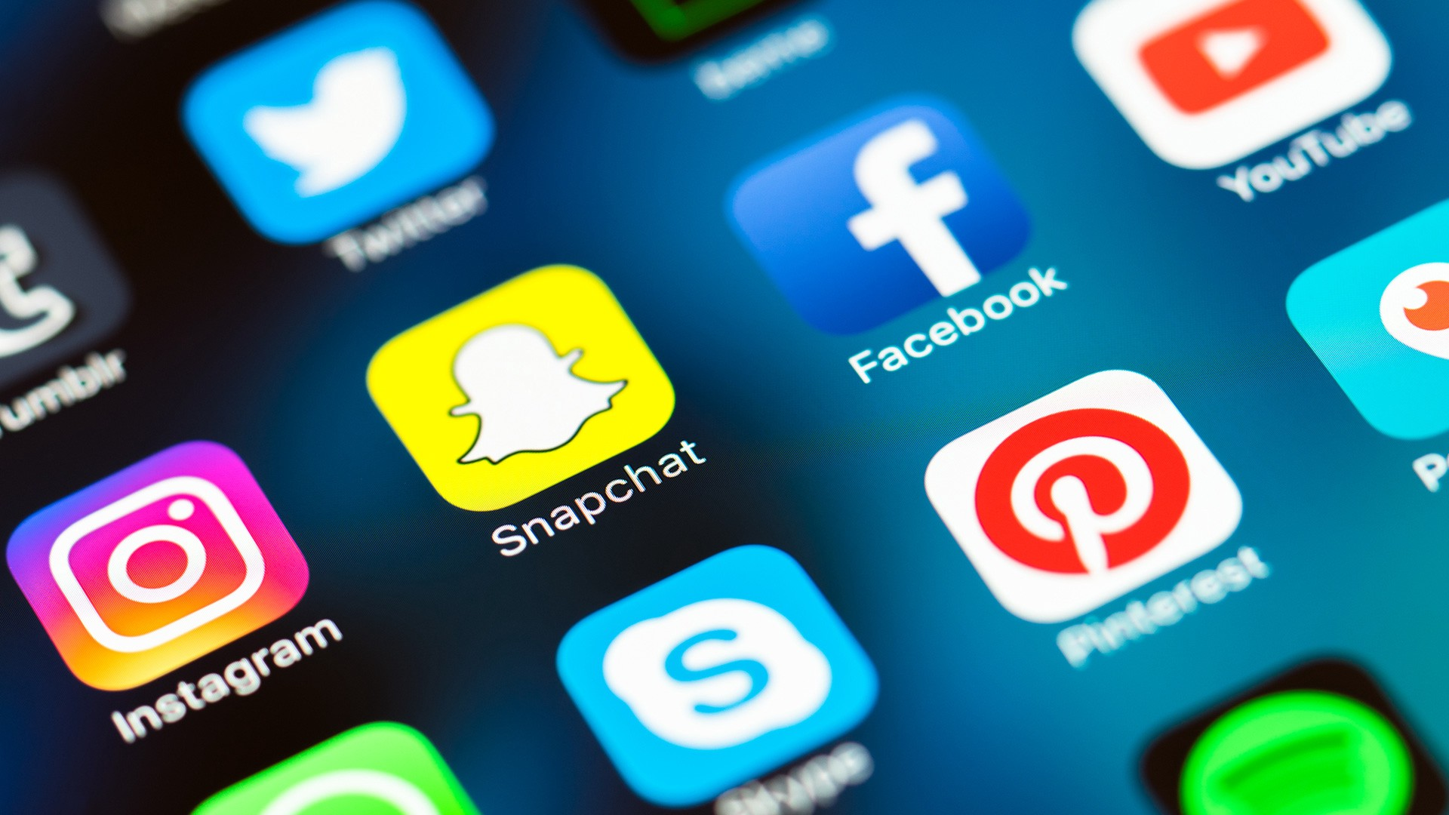
New Trends in Social Media networks
Digital media has impact in every walk of life in shortest time
Technology is evolving
Orkut closed in 2014- was a popular social media network
Now Facebook

Slide 18
Social Media ads
Advertising on major social networks like Facebook and Twitter- Social advertising
Social ads work better on mobile- take up less space and fit small screens better

Slide 19
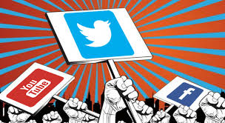
Social Media as a Political Tool
Jasmin Revolution- Social media driven movement across the Middle East
Social Media activism- take up global to local issues
Digital technologies empowered people
In India vast majority of population is beyond the digital revolution umbrella

