Slide 1
Preamble to the Constitution of India
Presentation by
Keerthy Sophiya Ponnachan
Assistant Professor
Department of English
Carmel College, Mala

Slide 2
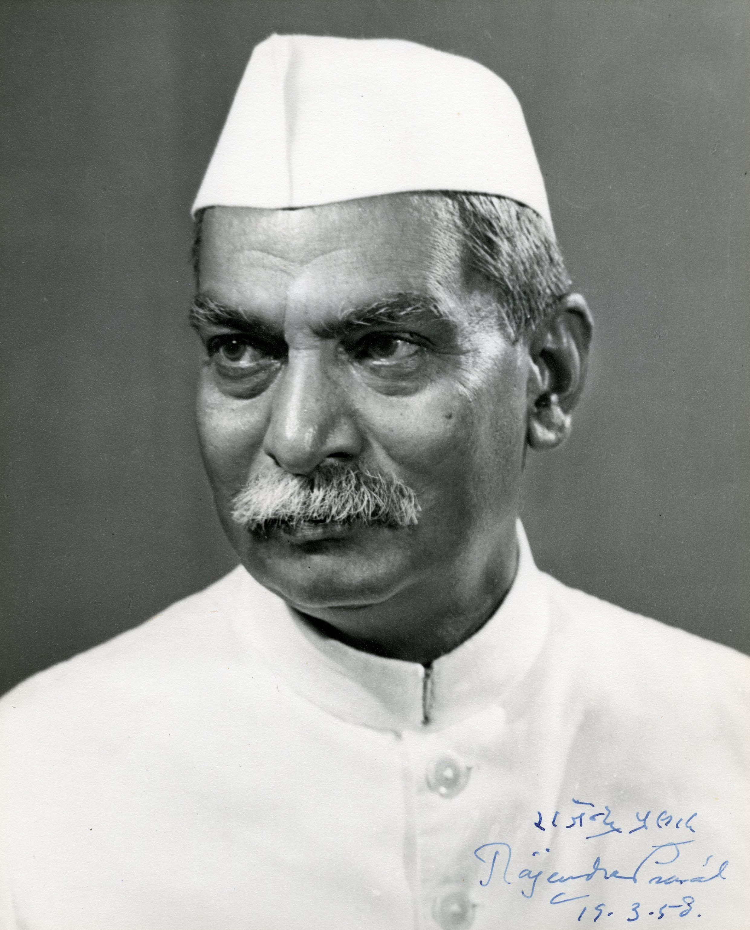
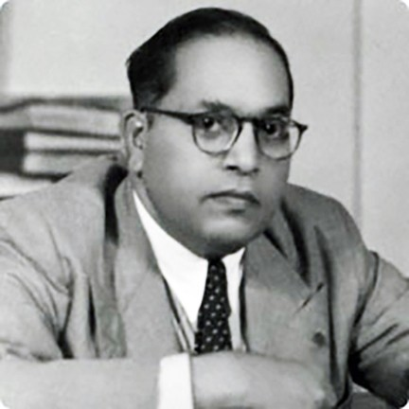
The making of Indian Constitution
New Constitution adopted by India on 26th January 1950
India became Sovereign, Socialist, Democratic republic
1946- Constituent Assembly formed for drafting the Indian Constitution
Dr. Rajendra Prasad- Chairman
Drafting committee- 7 Members- Dr. B. R. Ambedkar- Chaired
Final draft of constitution presented on 3rd November 1947
It consisted of- 395 Articles in 22 Parts and 8 Schedules
Implemented all over India Except Jammu & Kashmir- 26th January 1950

Slide 3
Indian Constitution
The makers borrowed a lot from different constitution to the Indian Constitution- bag of borrowing
It has a Preamble- Preface/Introduction
It consists of
25 Parts with 448 Articles
12 Schedules
5 Appendices
101 Amendments
Most Comprehensive and longest written constitution of the world

Slide 4
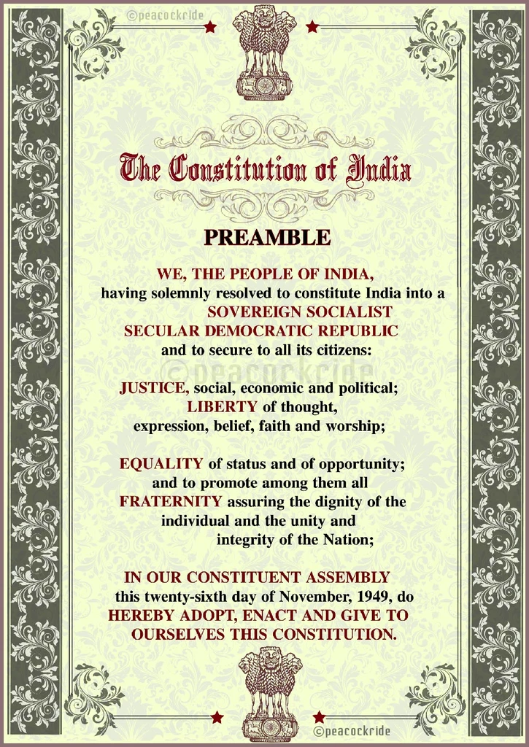
Preamble of the Indian Constitution
Preamble means- Preface/ Introduction
Tradition of Preamble from American Constitution
It refers to the essence of the constitution
It is described as “the Identity card of the constitution”
Has the fundamental values of political , moral and religious

Slide 5
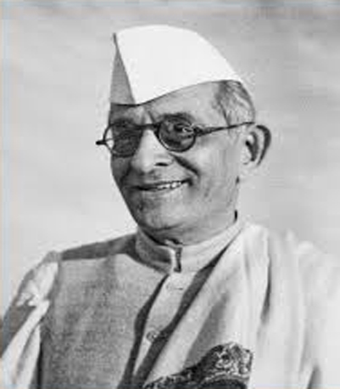
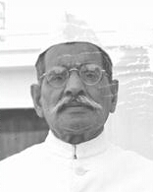
K. M Munshi
Preamble is the Horoscope of our sovereign democratic republic
Pandit Thakur Das
Preamble is the soul of the constitution

Slide 6
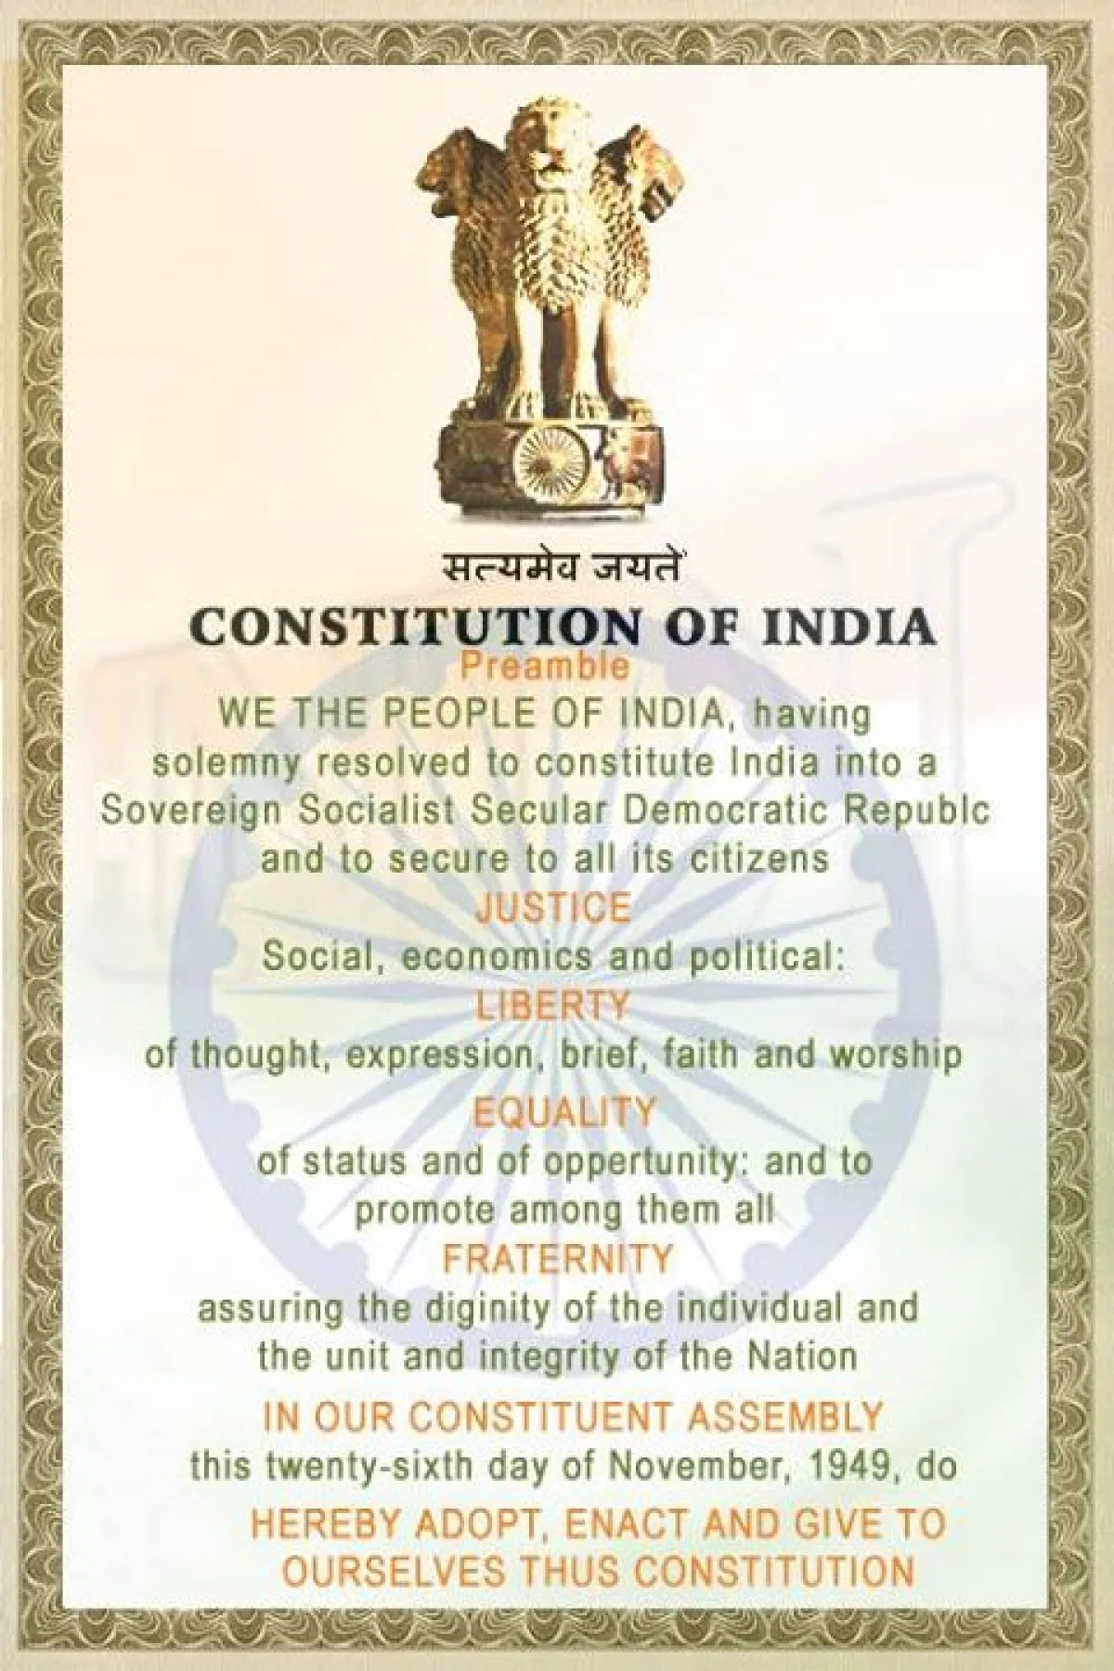
Amendment of the Preamble
42 Constitutional Ammendment Act- 1976
Added Three Words
Socialist
Secular
Integrity

Slide 7
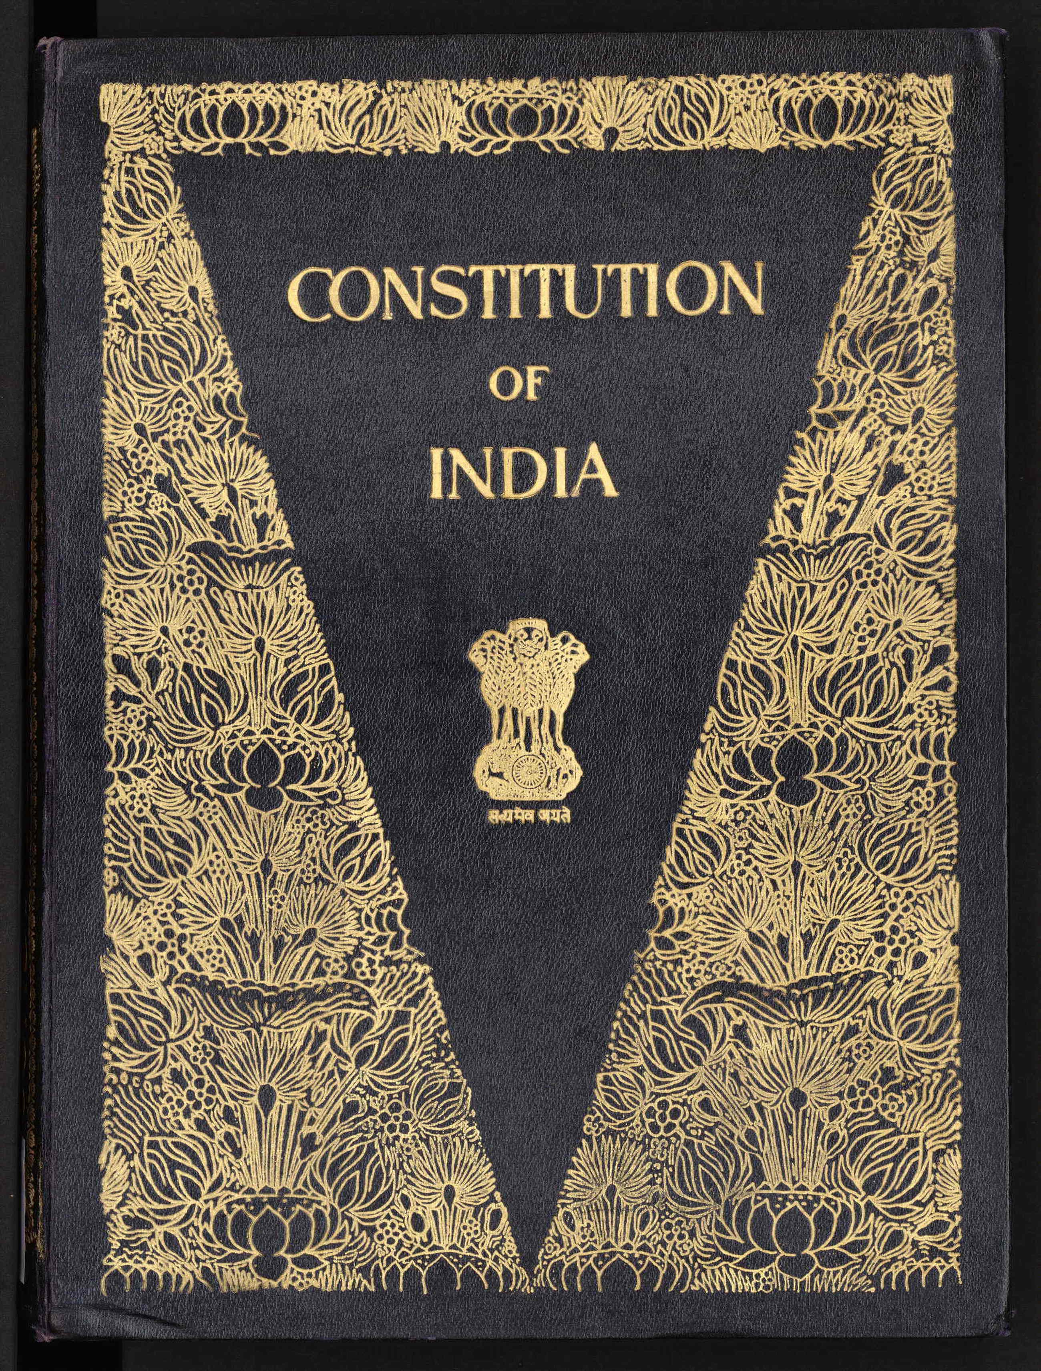

Slide 8
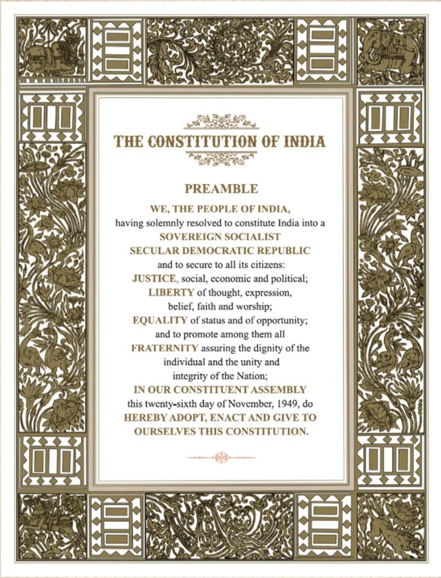

Slide 9
