Slide 1
PRINT MEDIA
Presentation by
Ms. Keerthy sophiya ponnachan
Assistant professor
Department of English
Carmel college, mala

Slide 2
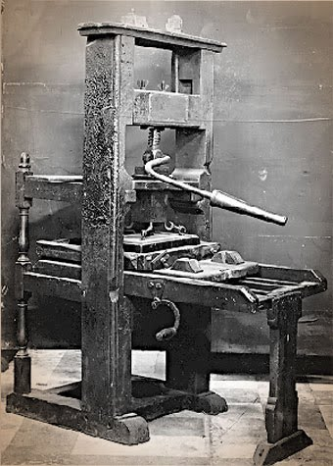
Print media
Movable Type invented by Johannes Guttenberg in 1450- Turning point
200 copies of 42 line Bible
Communication revolution in western world
More books in More languages
Emergence of New Media threatened Print Media
Print, broadcast and new media- Compliment each other

Slide 3
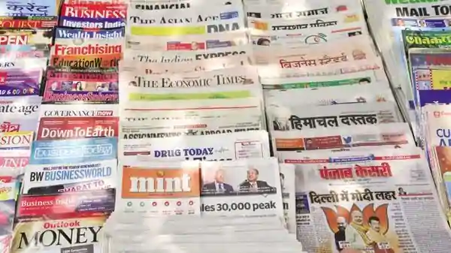
Types of Print Media
1. Newspaper
2. Magazine
3. Newsletter
4. Brochures
5. Posters

Slide 4
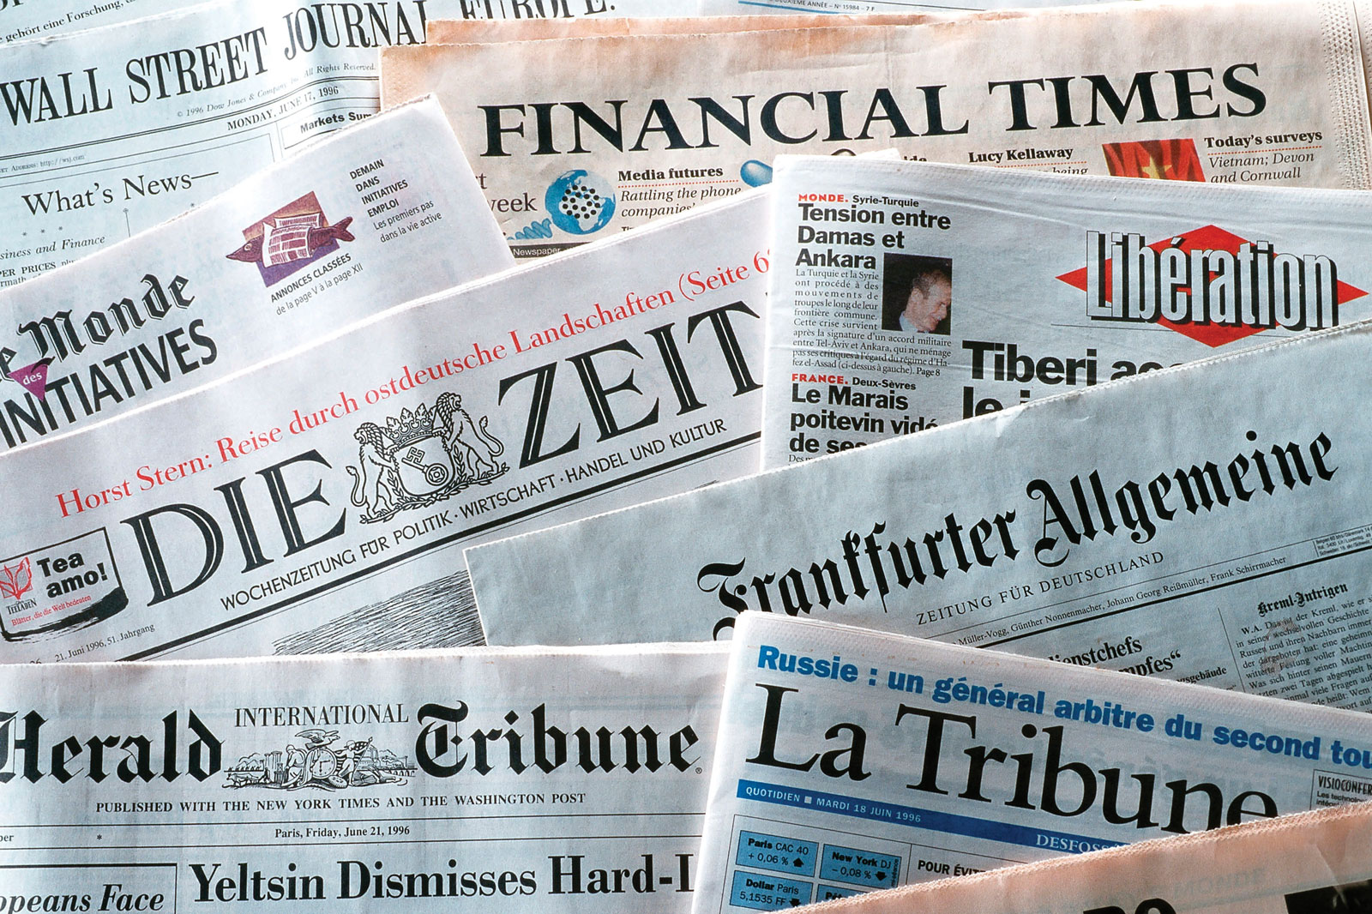
1. NewsPaper
Most popular form of Print Media
Daily newspaper to weekly tabloids
Cater to various audience
Different types of newspaper- Business newspaper, Sports newspaper, morning newspaper

Slide 5
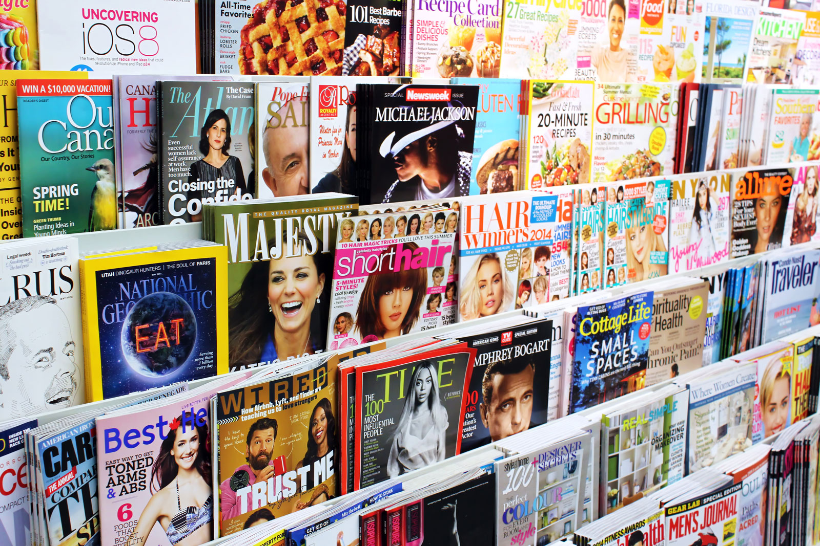
Magazine
Longer shelf life
Detailed reports, analysis, photographs and illustrations
Quality paper
Published- weekly, bi-weekly, fortnightly, monthly, quarterly, half yearly

Slide 6
Newsletters
Important part of print media
Specific group of audience
Give information on a product, service or institutions

Slide 7
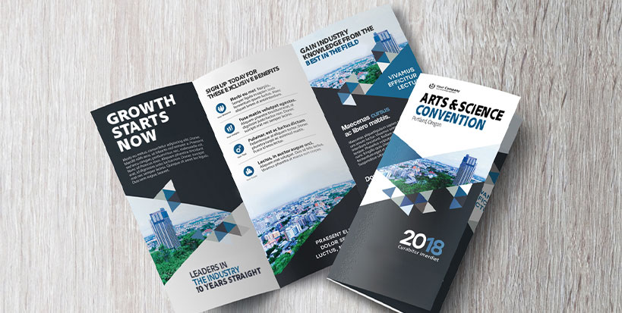
Brochure
Detailed information about the product
Distributed at events or main outlet
Consumers need to read details

Slide 8
Posters
Forms of outdoor advertisement
Message has to be brief and eye catching
It targets people on move

Slide 9
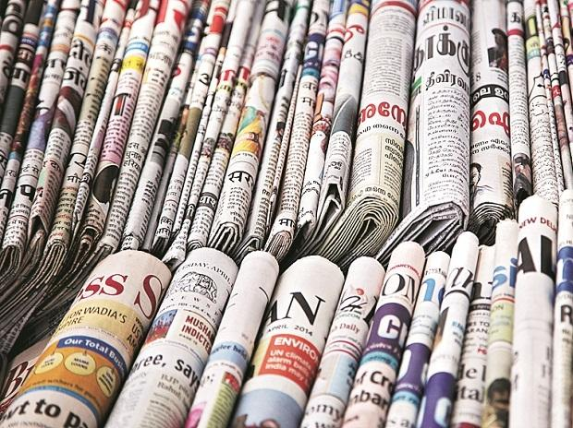
Advantage of newspaper
Report stories in detail
Readers could absorb news in their own speed
Can skip items that doesn’t interest a reader
Print certain material like death notice, stock marker, classified advertisement
Cheaply available
Reach a large number of people
Can be recycled
Important details given in first paragraph

Slide 10
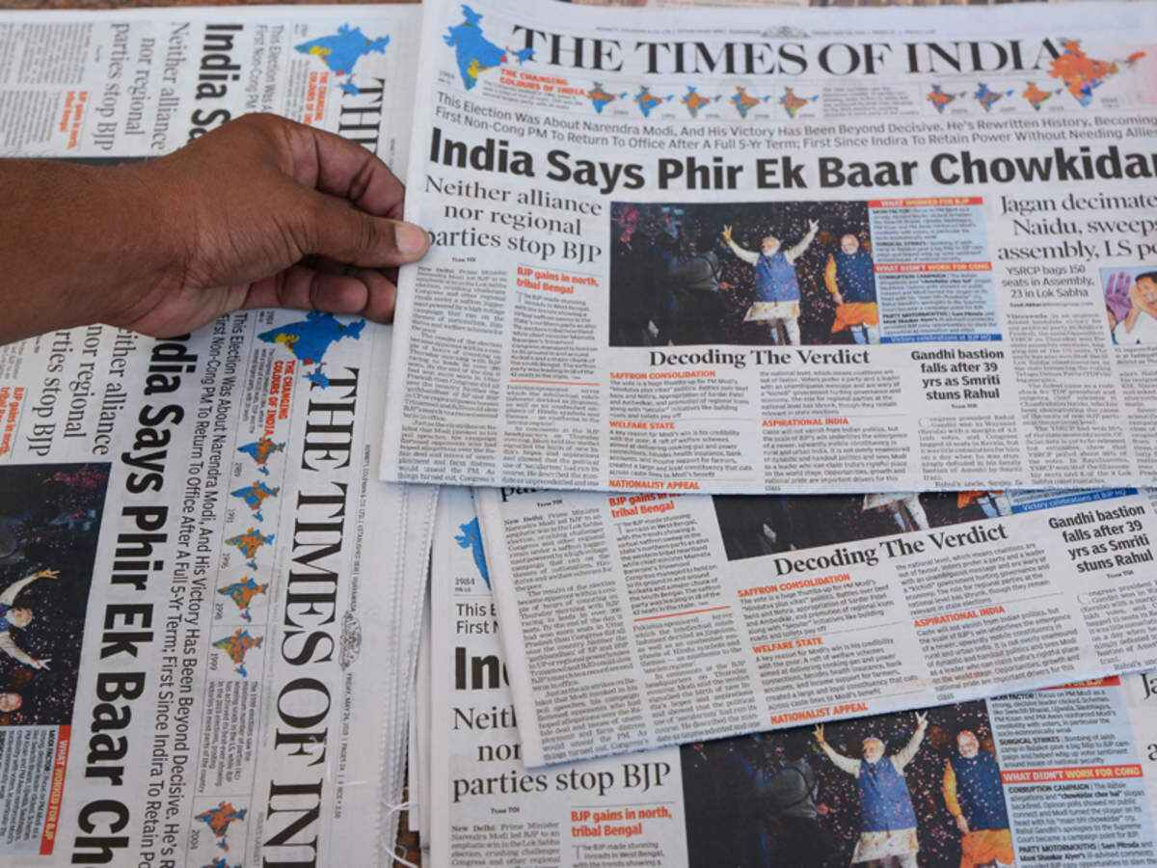
Disadvantage of newspaper
Short life duration
New media over took newspaper
Messy with commercials
Can cause pollution
Trees cut out- problem for environment

Slide 11
Principles of Journalism
One of the most important professions
Informs Citizens about various events
Helps people to form Opinions
Through New Media Journalists inform news to the public
Journalists throughout the world workhard
News Organisations have huge responsibility
Journal. Journalist & Journalism- French derivation from Latin term Diurnalis- Means Daily

Slide 12
Role and Responsibility of a journalist
Principles , aims and objectives of journalism vary from country to country
Depends on social, economic and cultural differences
A few principles are
People’s right to true information
Dedication to Objective reality
Social Responsibility
Professional Integrity

Slide 13
Role and Responsibility of a journalist (Cont.)
5. Public access and participation
6. Respect for privacy and human dignity
7. Respect for universal values and diversity of culture
8. Elimination of war and other great evils confronting humanity
9. Promotion of a new world information and communication order

Slide 14
Trends in print media
Readers switching to digital media
Evolving as a “Mixed Media”
A few trend in print media
Proliferation of news paper
Changes in news media audience
Convergence of Media

Slide 15
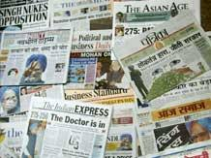
Trends in print media (Cont.)
4. Business Values
5. Overdependence on advertising revenue
6. Paid news system
7. Corporatisation of the media

