Slide 1
Product of Consumption
Cultural Studies: Module II
Ms. Linda P. Joseph
Assistant Professor
Carmel College, Mala

Slide 2
Product of Consumption
Object advertised, sold, purchased and used
Possess/markets particular features
Novelty
Utility
Brands
Cosmopolitanism

Slide 3
What do we purchase?
Not just the product
A meaning, a lifestyle
Pertinent to ‘read’ the packaging and rhetoric of a product

Slide 4
Novelty
Object is radically new-
It disrupts a previous set of individual experiences
Interrupts routine and uniform experience – moment of pleasure
(Bianchi 1998)
Pleasure through difference and change
Created in the move between an unconscious expectation of the ordinary/regular and the actual availability of something new/extra

Slide 5
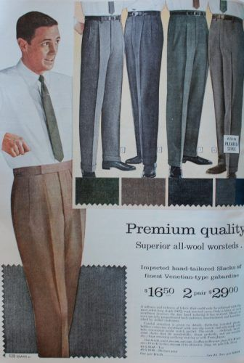
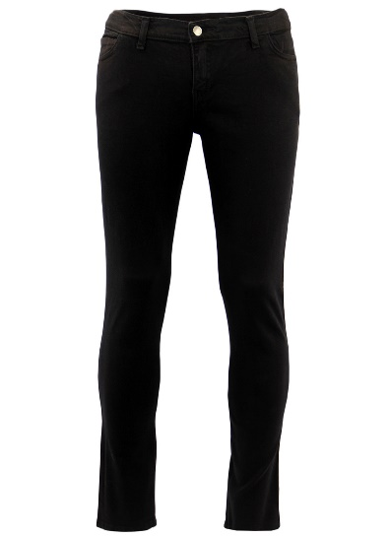
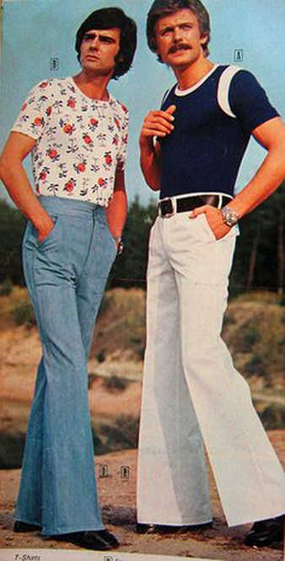
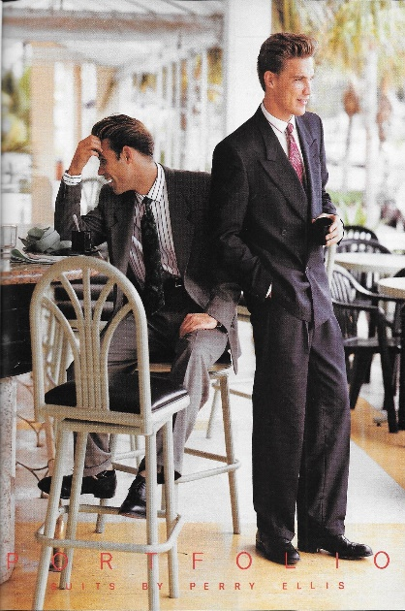
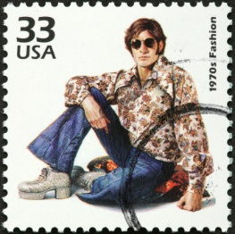
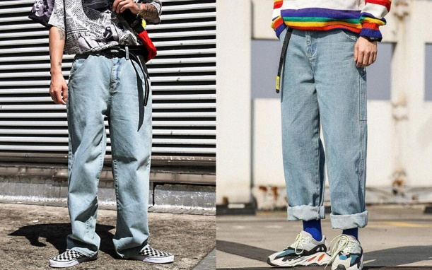
Novelty
Also when there is,
Some delay between the moment of consumption and the past experience
Eg: Fashion
Return to older styles – the memory of that style is well in the past
Men’s Trousers 1960s: Drain-pipe style (Narrow & tapering)
1970s: flaring bell bottoms
1990s: Revival of tapering form & flare; Loose/bell-bottom style jeans

Slide 6
Cult of Novelty & the Two-Pronged Rhetoric
Rhetoric of pluses
Rhetoric of the ‘new-now’
Novelty is bound up with acquisition – acquire an object with additional features
Eg: Cellphones/Smartphones/Vehicles
Promise of something beyond the expected/getting more than what you are actually paying for
Speak of extras, excess and boundlessness
‘Newness’ and immediacy
Ads emphasizing ‘today’ and ‘now’
The urge to ‘Hurry’
An offer, ready for consumption ‘today’
Temporal attainment of pleasure

Slide 7
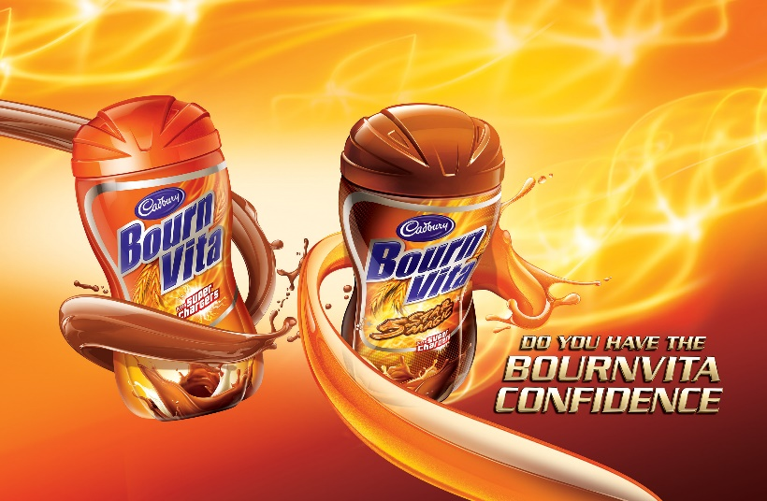
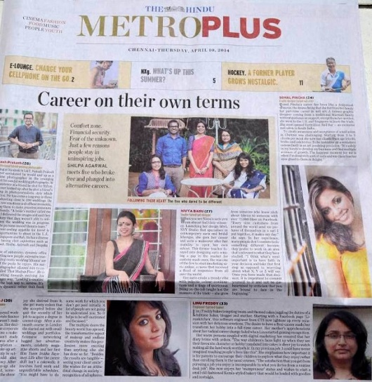
Rhetoric of Pluses: Examples
The Hindu MetroPlus is a lifestyle supplement dealing with subjects such as culture, heritage, travel, films and music, fitness, fashion and food.
Tata Tea’s ‘ New Rich Taste’
Horlicks ‘Supercharged’
Boost is ‘New Boost’
All Food World products are of ‘Super value’
Sundrop refined oil is ‘New improved’

Slide 8
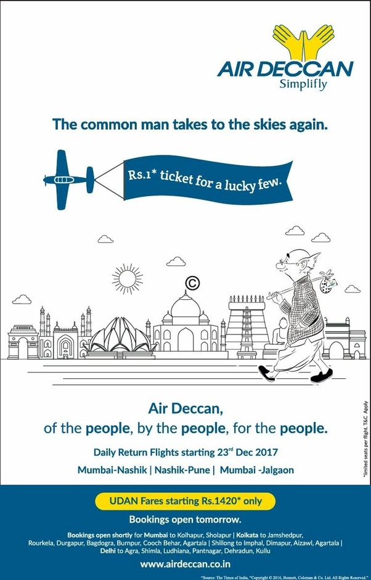
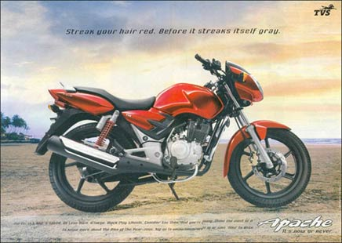
Rhetoric of ‘New-Now’
Motorcycle Apache (TVS) – ‘Now or Never’
Nokia’s N 72 – ‘Now in gold and black’
Air Deccan – ‘Book Now’
Lloyd’s ‘The future’s today and brought to you by Lloyd’

Slide 9
Packaging and Branding:
Consumer culture = ‘material culture’
Features of objects in material culture
As signs of status & ideology
As vehicles of meaning and equivalence
As bearers of aesthetic values
As knowledge and ideas
As indicators of lifestyle and identity
Values assigned to material objects/things,
The pattern of cultural consumption of particular objects

Slide 10
Examples:
Ad for New knorr series of Chinese masalas
Guess who’s opening a new Chinese restaurant?
You.
‘Surprise your family with authentic Chinese meals, right at home’.
Restaurant Jaisa Chinese Khana, Ghar Pe
Visuals:
Ethnic hanging lamp
A plate of noodles with chopsticks laid across
Few packets of Knorr with some fruits and vegetables nearby

Slide 11
Example: Knorr Chinese Masala
Ritual
Ethnicity
Hanging lamp, resembling those made of jute or bamboo
Location
Home/public place
Formal inauguration of a restaurant
Rhetoric employed:
Being asked to open/inaugurate a new restaurant, suggesting you are a celebrity
Being entrepreneurial enough to open a new restaurant
[Unclear rhetoric]

Slide 12
Example: Knorr Chinese Masala
Equivocation over the public/private locale – renders object in multiple codes
Class, locations, culture
(You can recreate the Chinese cuisine in your own home)
Home – place where a multicultural event takes place
(Such)Meal = opening a new restaurant
(Capitalist mode) Enterprise shifted into the Home

Slide 13
Example: Knorr Chinese Masala
The objects thus takes on the qualities of:
A capitalist venture
A leisurely trip outside
An exotic element
Within a domestic setting
Within the home
Within the familiar
A profit-making product
Within the natural-familial
Thus ‘authentic Chinese’ is localized, made intimate
Underlying ideology: Intimacy and family [masks the object’s profit-driven nature]

Slide 14
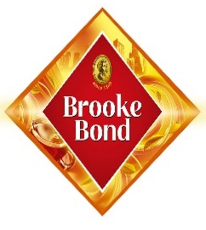
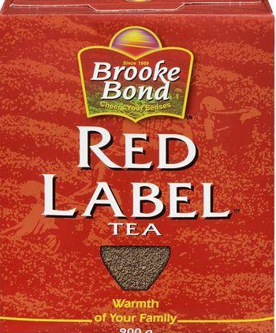
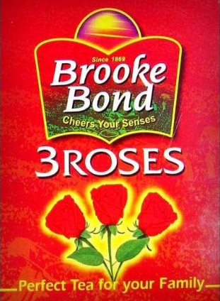
Entire family as consumer
Food products
Nestle India’s Maggi Noodles: “Extra health for your family in every pack”
Divya’s Chyawanprash: “Powerful ayurvedic health tonic for family”

Slide 15
Family as Consumer
Cooking oils, food products, refrigerators, hygiene products
Woman serves healthy food – concerned for well-being if family
Food & eating + family ritual
‘Success’ /’happiness’ derived from family eating healthy food together
Dettol hand wash:
“Ideal for everyday use by everyone in your family”

Slide 16
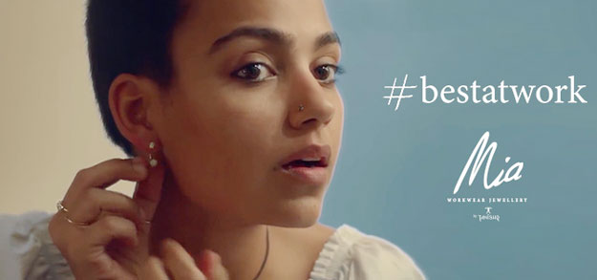
Individual as Consumer
Clothing, accessories and professional tools
Success/happiness derived from individual’s self-esteem,
acceptance by peer-group with similar taste in fashion/professional success.

Slide 17
AD RHETORIC
Emphasis on particular groups of consumers
Coca Cola India’s Thums Up brand (Ad in 2007)
Starring- Akshay Kumar (‘Action hero’) – athleticism, youth and machismo
“Thums Up is known for its strong, fizzy taste and its confident, mature and uniquely masculine attitude. This brand clearly seeks to separate the men from the boys”
https://youtu.be/_nITwKlOZpM
“Strong Cola Taste, Exciting Personality”

Slide 18
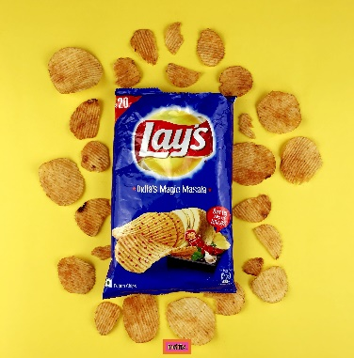
AD RHETORIC
Mysticism as central to product marketing and promotion
Examples:
Samsung Refrigerator’s ‘Silver Nano Health System’
Philips steam iron – ‘double active Calc system
The product & functioning are rendered mysterious by deliberately invoking the technology behind it.
Makes no sense to the non-technical-minded consumer
Directly invoked magicality
Examples:
Lay’s Potato Chips’ India’s Magic Masala
“These light and crispy potato chips are more magical than ever before with a rich medley of Indian spices” [You are invited to ‘taste the magic]

Slide 19
AD RHETORIC
Lay’s potato chips Classic salted variety
The ICC 2007 World Cup Ad –
‘The official global partner of ICC World Cup 2007’
Links global manufacturing and consumption to global entertainment
The Caribbean Hot and Sweet Chili variety
Stars Saif Ali Khan drumming away - highlights Caribbean culture and calypso
‘Main food for the good mood
These light and crispy potato chips with a playful mix of hot and sweet flavors are a real entertainment for the month’
A global company sells its food products in indigenized forms – appropriating local motifs, stereotypes and themes

Slide 20
AD RHETORIC
The Language used in product design and styling
Examples: Microsoft Windows –
Trash
Bin
Desktop
Common American terms
Then why Microsoft Office?
The office metaphor - The programme showcases the image of a formal, efficient, American office culture – Beth Kolko (2006)
The technology caters to office labour- (white-collar workers)
Product design encodes particular ideologies and community values

Slide 21
AD RHETORIC
Language of packaging – for possible consumers and markets
Examples:
Everest Masala powders – English, Hindi, Urdu
Philips – English
Kingfisher Airlines (Mallya groups)- English – Emphasizes personalized service

Slide 22
Brands
Class of goods identified as products of a single firm
Name, image, slogan
Resulted from the rise of mass production in the 19th century – manufacturing of millions of same car/jeans/domestic appliances
Brands indicate:
The identity of the product
The identity of the company
Companies seeking to distinguish their products from competing and identical products

Slide 23
Brands
Reliance Mobile
Usha Fans
Godrej Furniture
Gives products proper names
Can identify and distinguish between specific varieties (instead of generic products)
Brands & logos grants a mass-produced object a unique identity
Thus, we buy/consume not the object, but a brand
We Associate the object with something larger –
The company and its tradition itself
Levi’s Jeans
Coca-Cola Drink
Tommy Hilfiger T- shirts

Slide 24
Brands
Trademark (logo)
Functions as a guarantee- an assurance that the product is genuine and reliable
Evoke familiarity
Treasured by company
Misuse of the logo by rival companies can result in the latter getting sued.

Slide 25
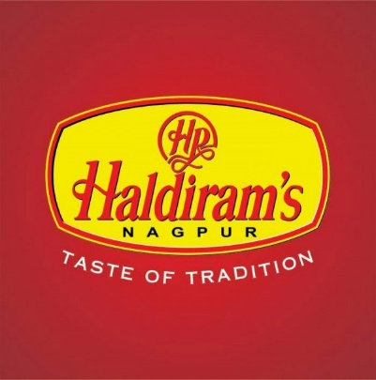
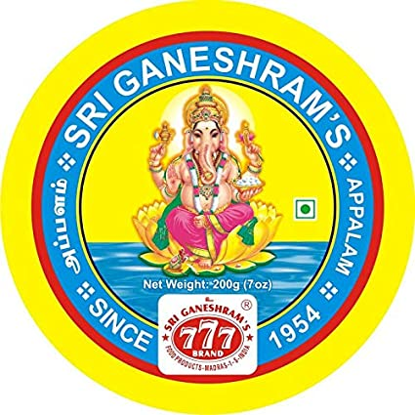
Brands
Date of establishment of the company
Eg: Levi’s Since….
Indicative of the heritage of the product – the older the company the more respectable and reliable its product
Timelessness – central to acceptability of product
Haldiram – ‘the taste of tradition’ – gestures at the need to retain older values of taste, consumption and food preparation
Madras-based Sri Ganeshram’s 777 brand masala powders – ‘traditionally yours since 1954’

Slide 26
Brand
Refer to the products and values of the particular company
Concerns with the recognizability/popularity of a particular company’s product
Methods employed by companies to popularize Brands:
Locate themselves in tradition in order to create a sense of familiarity and instill a sense of loyalty among their patrons
Eg: ITC’s ‘Kitchens of India’ – their write-up emphasizes tradition constantly (page: 148-149)
- By locating the postmodern developments within an Indian tradition of cooking, the company suggest not a break but a continuity (with tradition)
Appropriating the sentiments/traditional slogans associated with a particular culture/nation
Eg: Coca Cola ad starring Aamir Khan (based on ‘unity in diversity’ theme – to sell an MNC drink)
- Here, India’s consumer-globalization is disguised as a unifying ethos

Slide 27
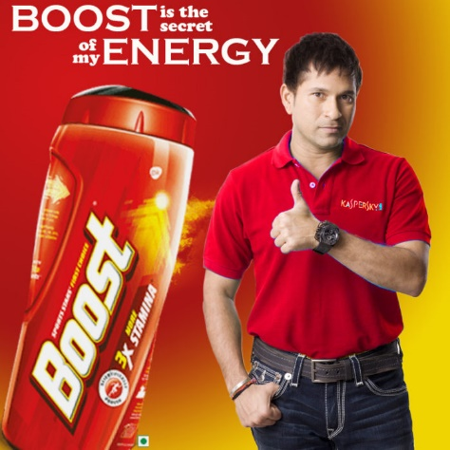
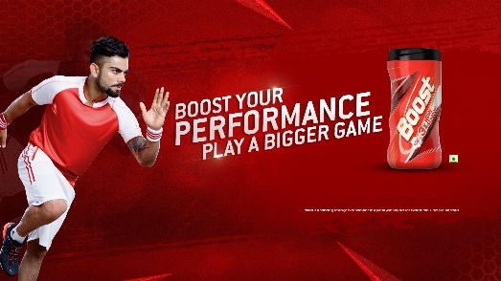
Brand
Methods employed by companies to popularize Brands:
Signatures and endorsements –results in convergence of the signature (of the individual) and of the brand (of the product/company)
Eg: Aamir Khan’s signature on Coke/ Tendulkar’s on Boost
Convergence signifies the qualities embodied in the endorser which the product claims for itself
Eg: Amitabh Bachchan’s reputation for being the best and ‘Bond with the best’ for Reid & Taylor
Brand Endorsement is thus the convergence of
The cultural/sporting industry (celebrity culture)
The manufacturing industry (industry culture)
The brand image thus includes the image of the product
& the person endorsing it

Slide 28
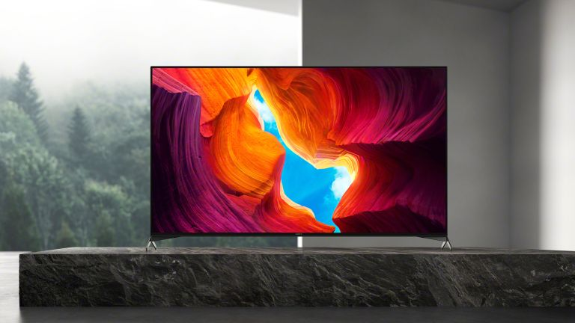
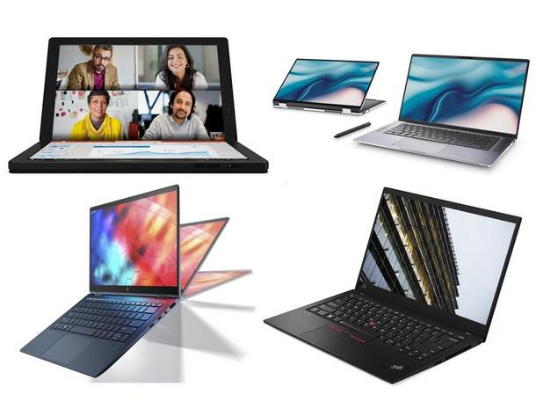
Brand
Product design – major area of research and innovation
Convergence of technology – products smaller in size and better in functionality
Eg: Laptops, TV

Slide 29
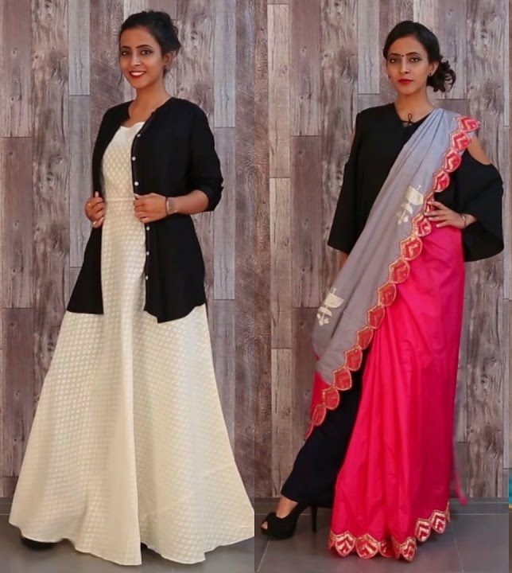
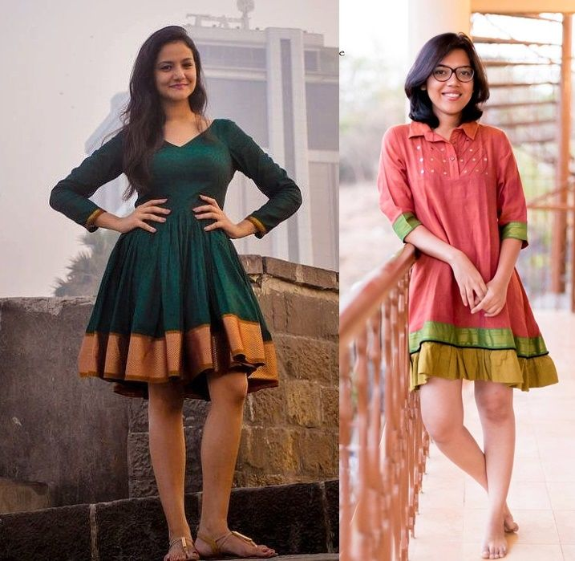
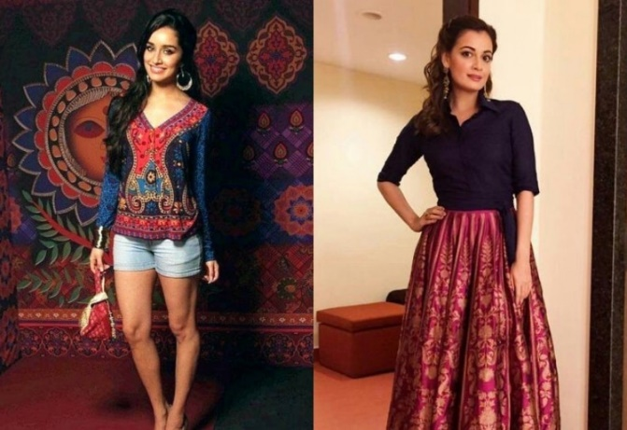
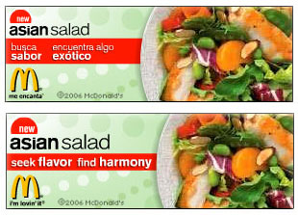
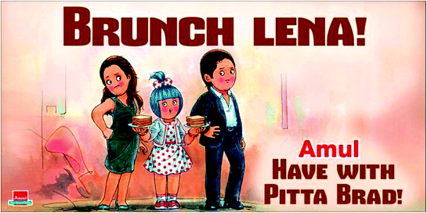
Cosmopolitanism
Brands & labels advertising other-nation origins & affiliations
Eclecticism: mixing codes and cultural vocabularies
Eg: Indian ethnic costumes and cultural codes mix with European styles
- Pizza Hut with Indian topping s such as Chettinad Chicken
- bilingual ads

Slide 30
Cosmopolitanism
The paradox (of global consumer culture):
Desire to be unique and exclusive vs. increasing standardization of consumption and lifestyle products
Global consumer culture is divided between:
Global labels and brands
The boutique labeled ‘exclusive’
Lifestyle is caught between two poles – most evident in food and clothing
Eg: Maggi indigenized noodles – ‘vegetable atta noodles’ (suggest multicultural cuisine)
‘Chinese fast food’ are ubiquitous in cities
Facilitates individual self-development by enabling him/her to move beyond the (familiar) local and the regional to other cultures, food habits and fashions (Caldwell et all)

Slide 31
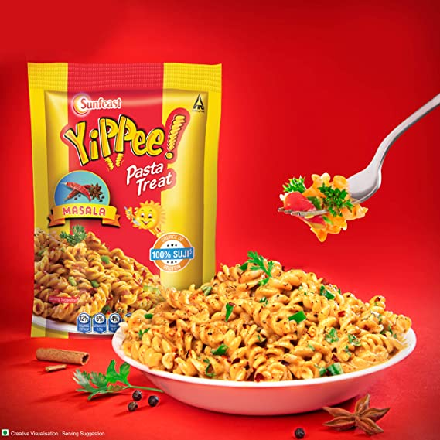
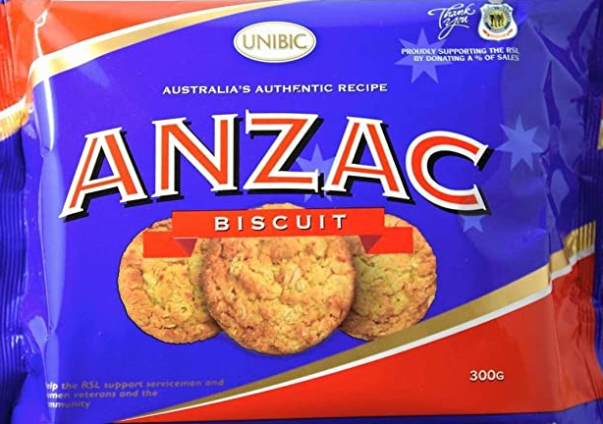
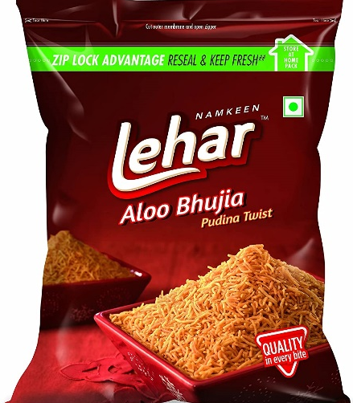
Cosmopolitanism
Transfer of symbolic meaning along with cuisine and manufacturing techniques
Eg: Anzac cookies: common ideology of caring for the nation’s soldiers
Manufacture of things clearly Indian by foreign firms and vice versa
Eg: Pepsi’s Lehar line of food products manufacturing the traditional Indian savoury, aloo bhujia
ITC’s Sunfeast range manufacturing (Italian) pasta

Slide 32
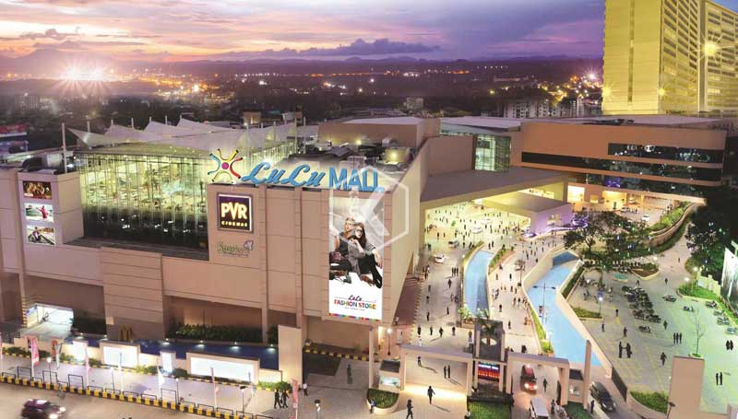
The Spaces of Consumption I : The Mall
A phase of mall culture
Exponential increase in the number of shopping malls in India (appr. 3810)
Unlike the stand-alone stores, the malls offer air-conditioning, organized parking and other public amenities

Slide 33
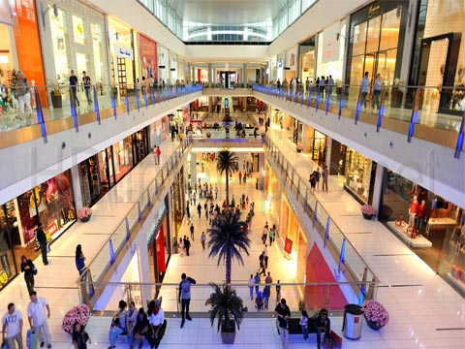
Spectacle
Retail store - one ask for things (needed) and is supplied the same
The mall - shopper gazes on a whole range of goods & products (not necessarily needed) before selection
Space of display
Good arranged for maximum visual appeal (in structure & arrangement) – to instil desire for particular products
Spectacle, attention-holding and desire : Central elements of shopping experience

Slide 34
The Mall
Becomes, primarily, a site of gazing and spectacle
Secondarily, a site of shopping
Spectacle of fantasy – presence of models & posters
Excessive number and dimension of Images of models in shop windows in a mall
Window shops and displays suggest possibilities (future-directed)
Surrounded by attractive men & women, cosy families and energetic youth
A fantasy world – experience the illusion of acquiring perfection

Slide 35
The Mall
Trying-on cloths and accessories extends the spectacle of fantasy
(‘Disneyfication’- Sharon Zukin)
Adorn, robe and redesign yourself – for a time
Strategically placed mirrors & images ask you to compare your ‘new look’ with what is possible
Participation in the fantasy- You can become whatever you want

Slide 36
Spectacle
Not just about the fantasy of a future possibility
A performance initiated and participated by the customer-consumer
Where one ‘performs’ & ‘enacts’ – A theatrical performance that is interactive
The staged nature evokes an other world

Slide 37
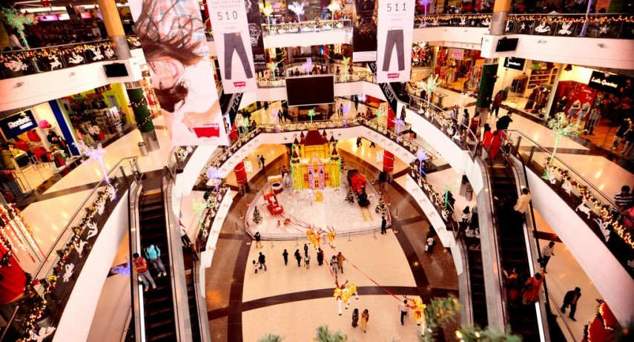
Spectacle
Display of consumption – people eating, wearing and using
Ads – represents the act of consumption & spectators consumes the ad
Spectacle of signs
Consumption coded as a sign

Slide 38
Spectacle
Vistas that open out at every level within the mall
Balconies & viewing points at every floor- enables survey
A prospect of shopping unveiled before us
The view is part of the pleasure of shopping experience
Suggests a sense of choice – where to go, what to buy

Slide 39
Eclecticism
The culture of the world
Experience of being cosmopolitan – world under one roof
Mixing of products, styles and traditions – central to mall culture

Slide 40
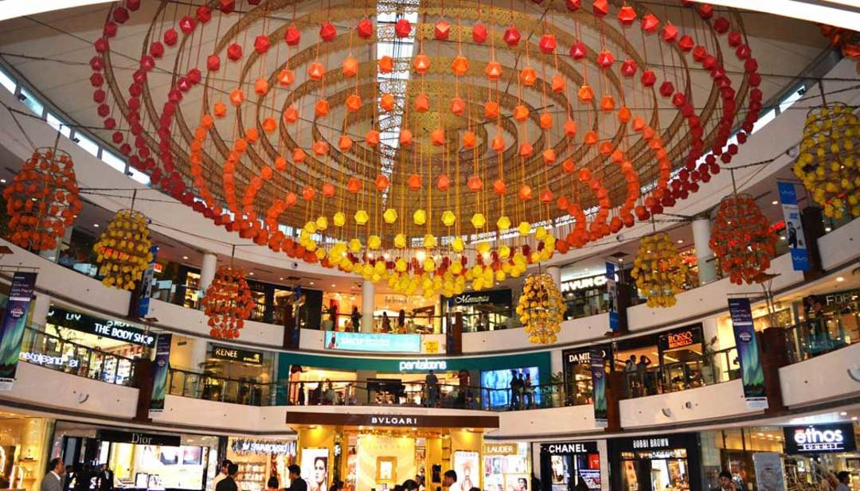
Organization
Modernization
Systematization
Consolidation
Mall offers an intensified experience of city life - but with particular meanings and codes
Extends city into a shopping area
An enclosed street, roofed and walled in
Strolling within the mall space - alleys & lanes to walk with a controlled space
Shopper becomes a flaneur, a stroller (Mona Abaza)

Slide 41
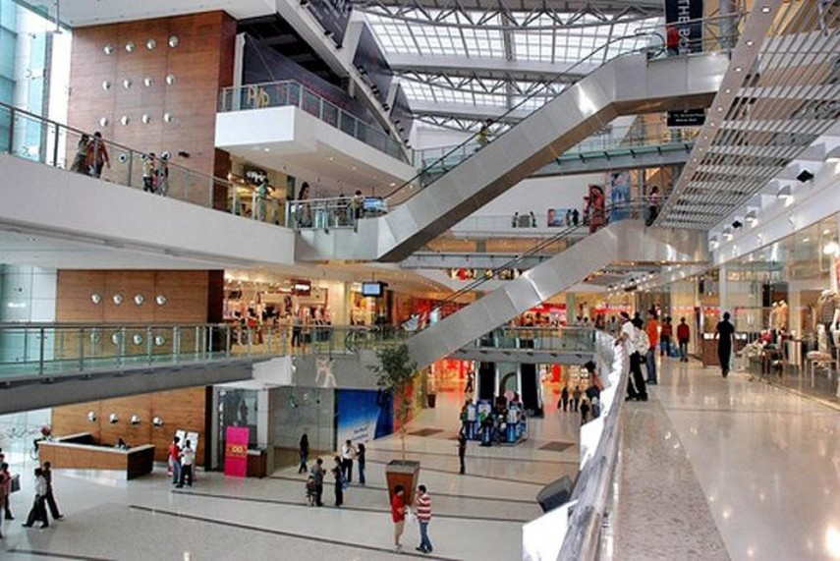
Organization
A sanitized city – free of dirt, pollution, bad weather, vehicular noise, chaotic traffic . Beggars, street people & vendors
Marked pathways to walk on, sit and sell
Designated places for rest, leisure and entertainment – in contrast to the chaos of the Indian street

Slide 42
Organization
Secured city space
Well guarded entrances – security directs traffic and parking
Tightly monitored
Security personnel, security cameras & floor mangers – monitor traffic inside
‘This complex is under electronic surveillance’ – customer’s sense of security

Slide 43
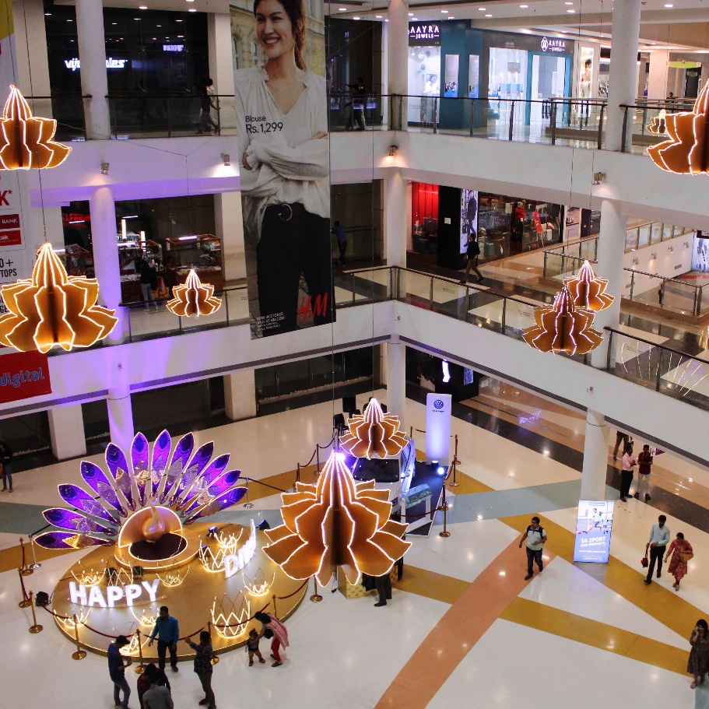
The Mall
An escape
Stand-alone place, set apart from the city’s chaos & traffic
Space to ‘hang out’
An end in itself
In city centre

Slide 44
The Mall
Hyperreal space
Illusion/simulation of what has never existed before
Paths that do not lead to destinations but to more images and paths – each path is a scene
Moving from display to display, object to object rather than from display to exit
Windows into many worlds, fluid designs
Numerous glass fronts & mirror surfaces – reflect other stores endlessly
Fantasy world of objects of desire in a mise en abyme of consumption
Never ending consumer choices and consumption

Slide 45
The Mall
Time, seasons, weather – do not matter
Lighting, arrangement of spectacle/cinematic effect of display and controlled environment make it appear real
The most common everyday elements are modified, upgraded and purified
The illusion merges with the real
The interpenetration of the artificial with the bodily
The space of mall is activated and transformed by the user
Directions painted on the floor and markers displayed at regular intervals – (equivalent to city’s traffic signals)
Thus the mall is a labyrinthine – paths leading to more stores and not exit

Slide 46
The Mall
Ahistorical - exclusively in the present
Postmodern secular space – free-floating nature
Cosmopolitan fashion and brands
Feminine space – attract women shoppers
Pedestrianization of space – organized (illusion of freedom)
Cleanliness
Erases the merging of the natural and the human
Globalization of culture – local festivals and events
Indianization of global products and globalization of an Indian festival/event

Slide 47
The Mall
Reshaping of public space
- New cosmopolitan lifestyles – reflecting global diversity, product range and cultures
Hybrid – space of/for shopping and social interaction
Spaces of youth culture – space of leisure and entertainment
Celebration of leisure – ‘eat, shop, celebrate’ – play areas, games zone, movie screens
Spatial equivalents – picnic spot, romantic spot, public park, shopping area, leisure space
Unique sense of place

Slide 48
The Mall
Uniformly hybrid space – mixes of registers and structures is the same everywhere
Glass surfaces, vinyl and wood, well-maintained floors and walls, seating arrangements, entry and exit points, music and announcements, m carefully located art works and vibrant colors
Space of multinational products and commodities

Slide 49
Leisure and Recreation
‘Pleasure shopping for nonessentials’
A stroll through the mall – pleasure of walk, spectacle and entertainment
Leisure shopping includes:
Trip to mall
Company of friends
Visual pleasure
Meal
Movie/games
Constant piped music, games zone, kids’ play areas and entertainment
Eg: Airport Malls – combining travel and leisure shopping

Slide 50
The Other Side of the Mall
Organization of consumption for profits- Key structural and ideological feature
Purposes of shoppers-strollers (other than intended by the mall)
Eg: Youth’s romantic trysts: Consumption of cinema and food
Older people: relax and watch others (safe & controlled environment)
Hybridity – paradox where contradictory elements negotiate
Eg: Modernity vs. Tradition (food and clothing)
Modernized version of tradition and traditional forms of cooking (ITC’s Kitchens of India)
Contesting globalization and westernization through revival of traditional forms
(Traditional forms themselves try and get globalized)

Slide 51
The Other Side of the Mall
Less glamorous side of the mall
People do not actually buy!
Not easy to corner customer loyalty
Most people visit for food and entertainment

Slide 52
Summary
Circuit of consumption includes representation, identity, production and consumption
Act of consumption cannot be separated from the packaging, branding and media representations of the product
Consumption also includes the spaces where products are displayed and sold
Malls are sites of spectacle and illusion, secure places organized around maximizing conditions for consumption
Culture of consumption- build on imagined happiness through consumption

Slide 53
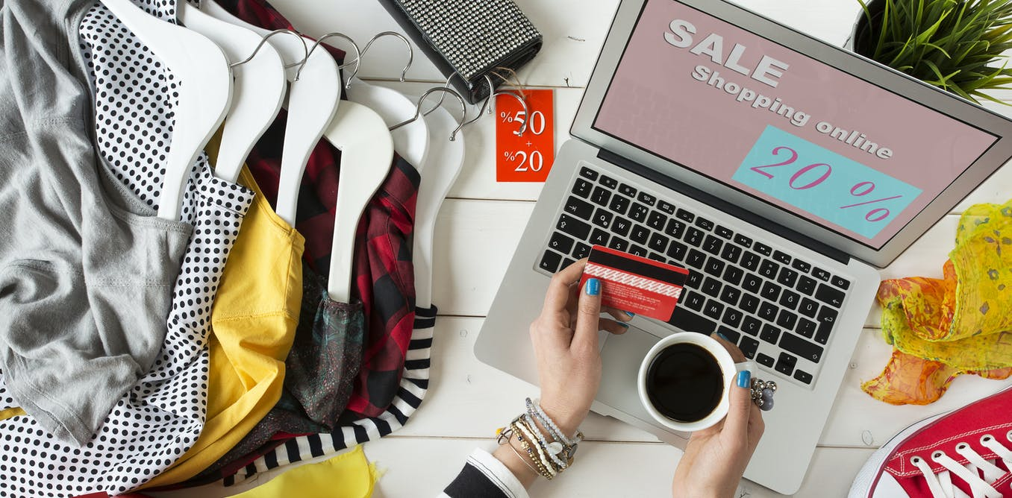
Spaces of Consumption II : Online Shopping
Easy buying processes
Easy –returns (on most products), with door-pick up
Loss of the tactile component to shopping and consequent dominance of the visual component
Amazon: ‘Convenient, fast and secure way’ to ‘search, browse, compare offers and shop online quickly and easily, at anytime from anywhere.’

Slide 54
Spaces of Consumption II : Online Shopping
I. The Organization of Choice:
Option to examine comparative pricing and offers
Choice of styles, brands, price range, delivery time and ease of shopping
Two specific features:
Decisional interference – the predictive nature of online shopping portal tells us what we could possibly be seeking by finishing our query for us and thus determining our choices
(The data unfolding in the box and dropdown menu- organization of choices – even before the decision on choice is made)
The appropriation of data from one’s searches and purchases in order to
Offer the same to other online buyers
Offer to the same person next time (system shortlists the preferences and tastes)

Slide 55
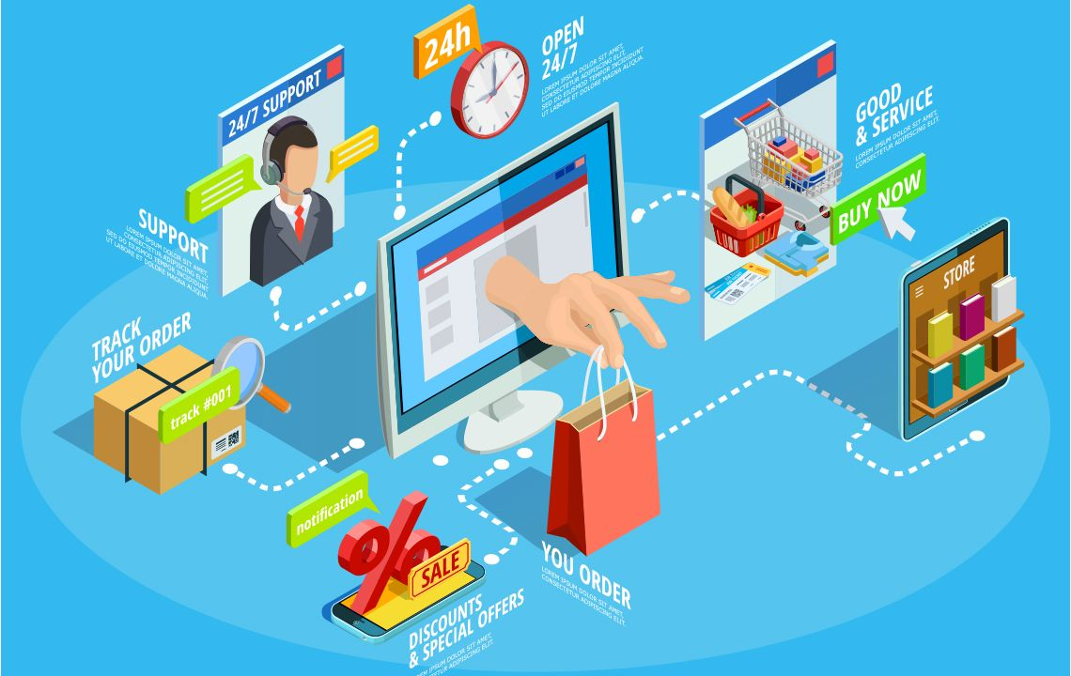
Spaces of Consumption II : Online Shopping
II. The organization of Easy-ness
Result of: Rise of App culture
Absence of physical movement
Absence of tactility
Home delivery mechanism
No discussion/bargain/advice-seeking with sales-person
No waiting in queues to pay
Customization and personalization of searches online
A matter of play than a chore – an easy, relaxing process
Privatization of a previously physical and social process of shopping

Slide 56
Spaces of Consumption II : Online Shopping
III. The organization of Risk – part of brand-building
Risk elements: lose of money, unsatisfactory product, harmful product
Measures taken:
Secure servers for financial transactions
A clear commitment to returns policy (Hassle-free 30 days returns and exchanges- Myntra)
The development of trust
Also involves organization of feedback mechanisms, advice, community of sellers & buyers and careful regulation of the rhetoric of sellers & buyers
Discussion boards on eBay offer user-feedback on products and sellers
Site policy ensures that offensive materials are not posted (involving sensitive matters like race, holocaust experience, crime)

Slide 57
Thank You!

