Slide 1
Television
Presentation by
Ms. Keerthy Sophiya Ponnachan
Assistant Professor
Department of English
Carmel College, Mala

Slide 2
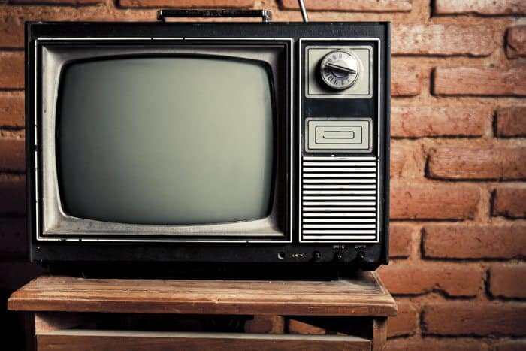
Origin and growth of television
Visual images with sounds- electromagnetic waves received converted into visual images
John Logie Baird- 23 January 1926- demonstration of a mechanical television apparatus
Bell Telephone Labs and AT&T- 7 April 1927- USA public mechanical television demonstration
1935-1938- Nazi government under Adolph Hitler- worlds first regular television service
After World War II in 1946- Commercial television came to US

Slide 3
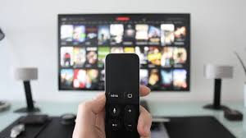
Television Broadcasting
Peter Goldmark- Introduced colour television
Cabel TV in Pennsylvania in 1948
Satellite Television in 1970
STB- Set- top box
DTH- Direct to Home
IPTV- Internet Protocol Television – Latest technology

Slide 4
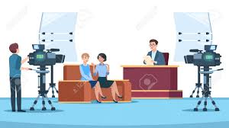
Characteristics of Television as a Mass Medium
Audio Visual Medium
Live Medium
Domestic Medium
Popular Medium
Transitory Medium
Expensive Medium
Air Wave Delivery
Good for Documentary Information

Slide 5
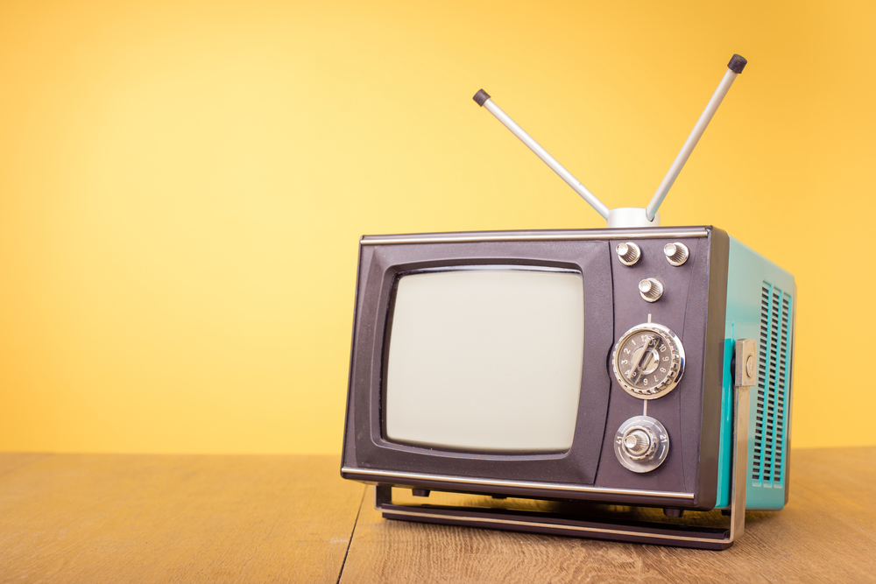
Types of Television Transmission Systems
TV Broadcasting- over the sir transmission of audio visual signals-at times antenna needed
Cable TV- - sending signals through a wire
Satellite Transmission- signals transmitted through satellites- also called DTH
Home Video- pre-recorded video sold or hired

Slide 6
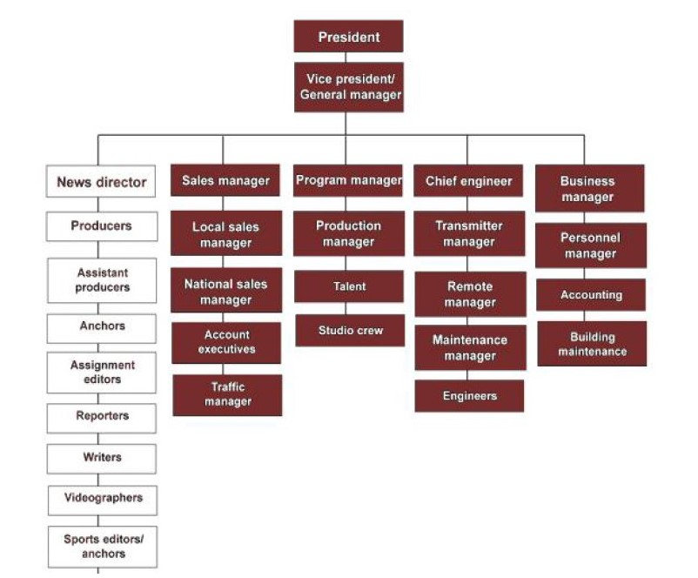

Slide 7
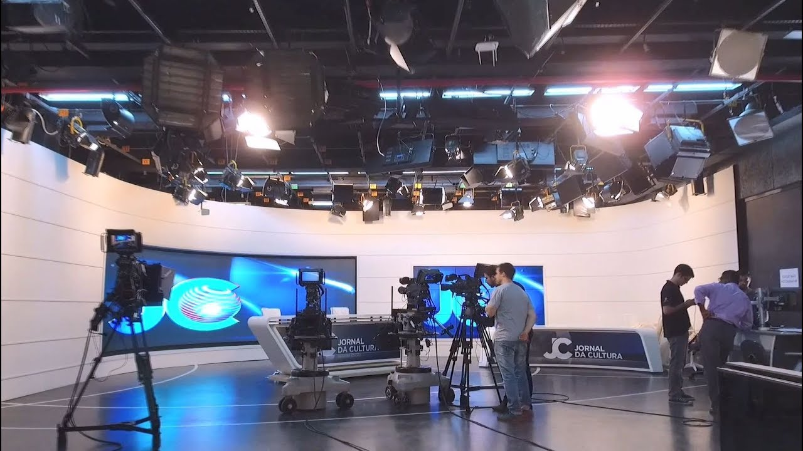
Structure of a Television Station
The General Manager
The News Department
The Sales Department
The Programme Production
The Engineering Department
The Business Department

