Slide 1
Toba tek singh
Saadat hasan manto
Presentation by
Ms. Keerthy sophiya ponnachan
Assistant professor
Department of English
Carmel college, mala

Slide 2
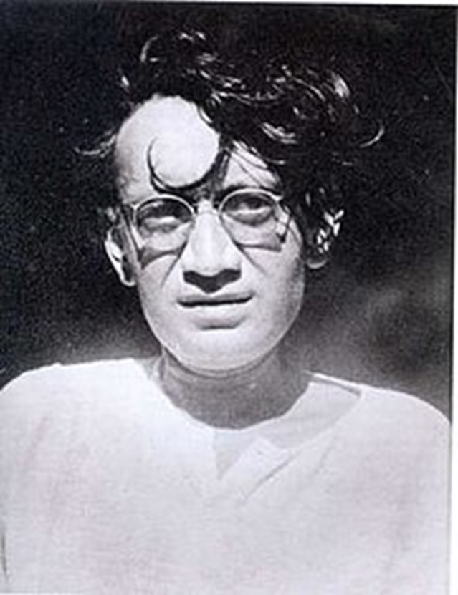
Saadat hasan manto
Indo Pakistani author, journalist and screen writer
Born in Ludhiana on 11 May 1912
Inspired by Abdul Bari Alig
His literary career began by translating Victor Hugo’s The last Day of a Condemned Man
Screen writing for films- Shikari and Mirza Ghalib

Slide 3
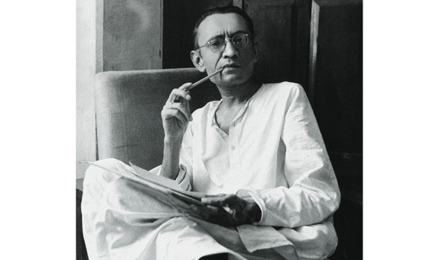
About the Author
Died in 18 January 1955
22 collection of short stories
Other works
Cold Meat
Bombay Stories
Open It
The Black Garment

Slide 4
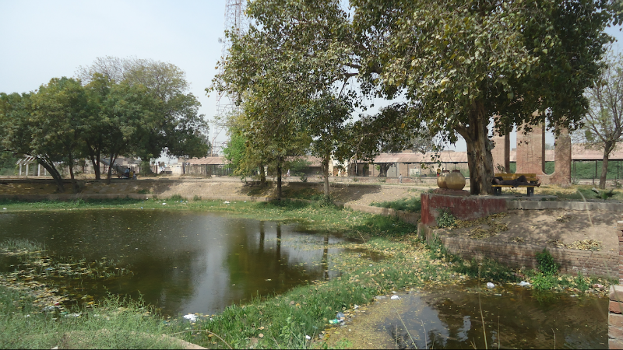
Toba Tek singh
Satirical short story
Toba Punjabi word means pond
Tek singh Sikh religious leader
The 3 motifs in the story-1.Rigmarole, 2. Bedlam, 3. Gibberish
First published in 1953 Uedu magazine- Savera
Translation from Urdu by Tahira Naqvi

Slide 5
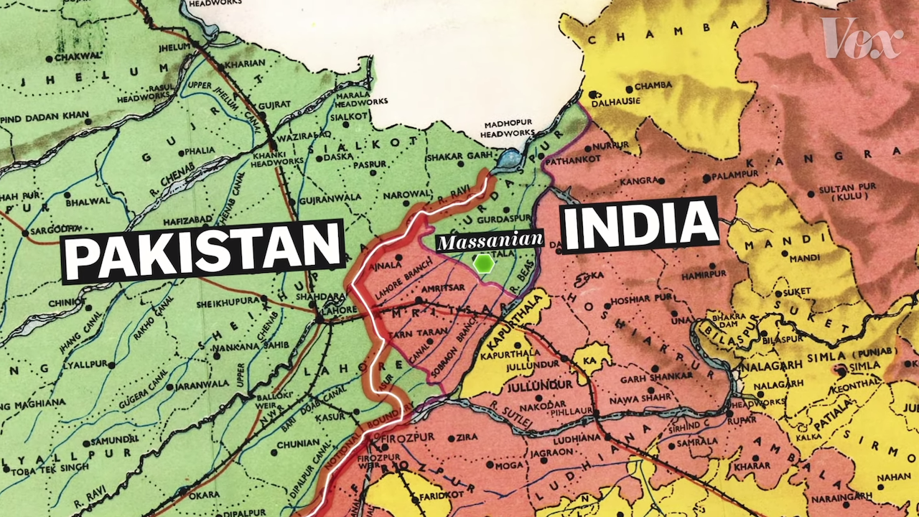

Slide 7
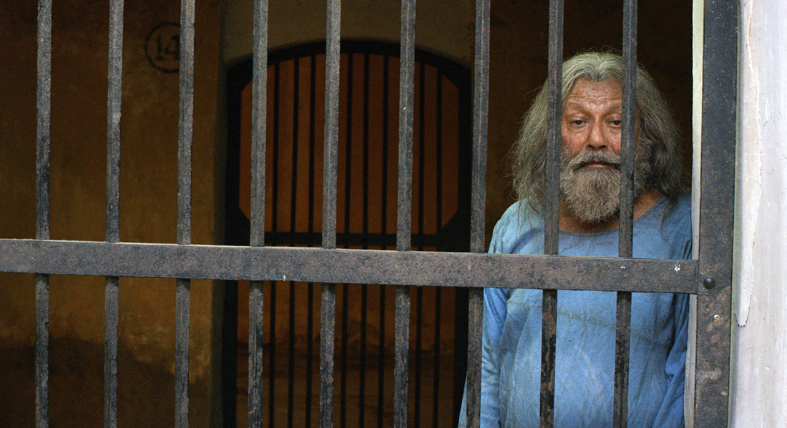

Slide 8
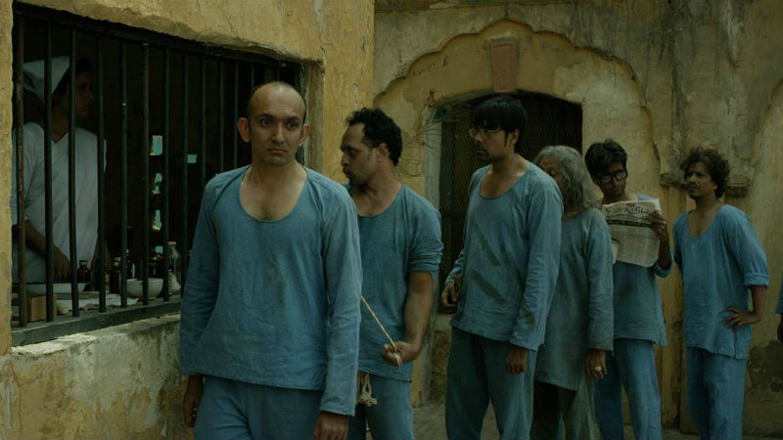

Slide 9
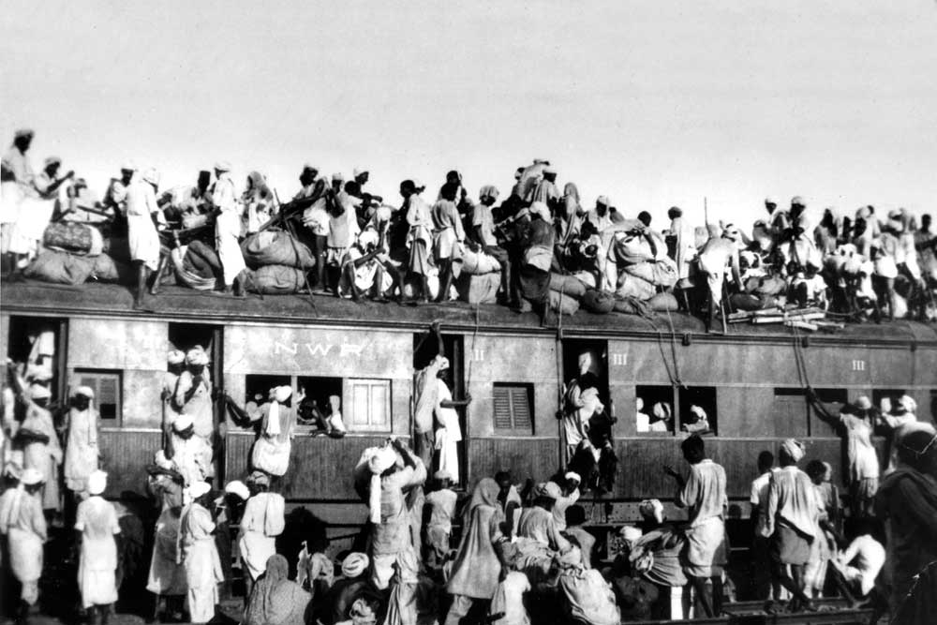

Slide 10
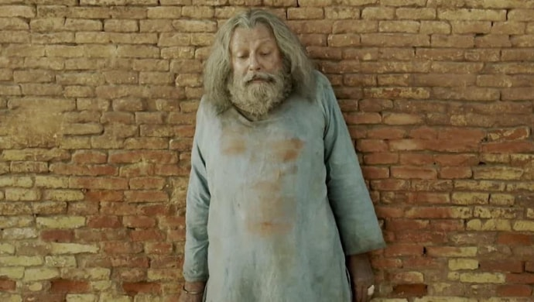

Slide 11
