Slide 1

PROGRESSIVE WAVES
DEPARTMENT OF PHYSICS

Slide 2
NORMAL MODES AND TRAVELLING WAVES
The waves produced by a continuous string of length L fixed at both ends can be described by the following eqn

Slide 3
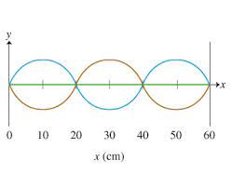
A vibrating string can be properly described as
Normal mode of vibration of a stretched string is a combination of two progressive sine waves identical to one another except the direction of travel

Slide 4
PROGRESSIVE WAVES IN ONE DIRECTION
Then at x= 0,

Slide 5
PROGRESSIVE WAVES IN ONE DIRECTION

Slide 6
ONE DIMENSIONAL WAVE EQUATION
We have the expression for instantaneous displacement of the particle executing wave motion
Differentiating with respect to x and t, we get

Slide 7
ONE DIMENSIONAL WAVE EQUATION
Differentiating again and equating the expression, we get the one dimensional wave equation as

