Slide 1
SOCIAL CYBERNETICS
Ms. Neethu C M
PG Department of Sociology

Slide 2
INTRODUCTION
This tools emerged the united states in the 1940’s from the cross fertilization of ideas that is common in the melting pot of the large universities.
MIT was to go from the birth of cybernetics to most critical issues, the debate on limits to growth.

Slide 3
SOCIAL CYBERNETICS
Cybernetics is the science of communications and control. It was been applied to everything from household thermostats to non-verbal communication. ethics is the study of beliefs right and wrong thought and behavior. The synthetic subfield of cybernetics deals with the application of ethics to the technology and practices of cybernetics. It is explore information networks and the rights, roles and responsibilities of people involved in information technology. This more adventure some approach will embrace broader themes in education and offer insights into the “box” outside of which we are relentlessly being told to think.

Slide 4
IMPORTENTS OF CYBERNETICS
Global challenges, energy and global warming, water and food, health and social justice designing for these challenges demands systems literacy as well as cybernetics the science of purposive systems, to help society steer toward a world that it wants.
Ranulph glanville, president of the society from 2009 through 2014, he emphasized the theme of ‘living in cybernetics’ that is embodying cybernetics ideas and ethics in everyday life.

Slide 5
FIRST ORDER CYBERNETICS
Also known as simple cybernetics, endeavours to place the individual outside of the system, to act as an observer. The individual is not seen as part of the system or in any way linked to the actions of the system.

Slide 6
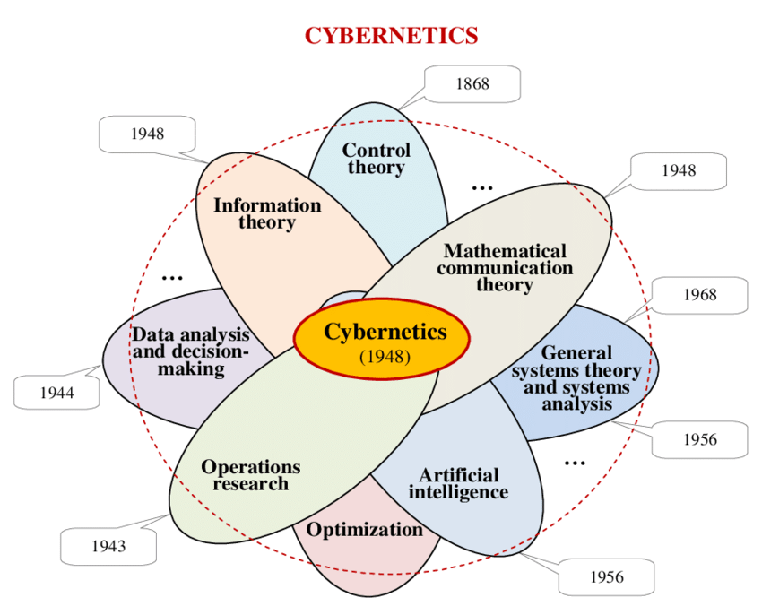

Slide 7
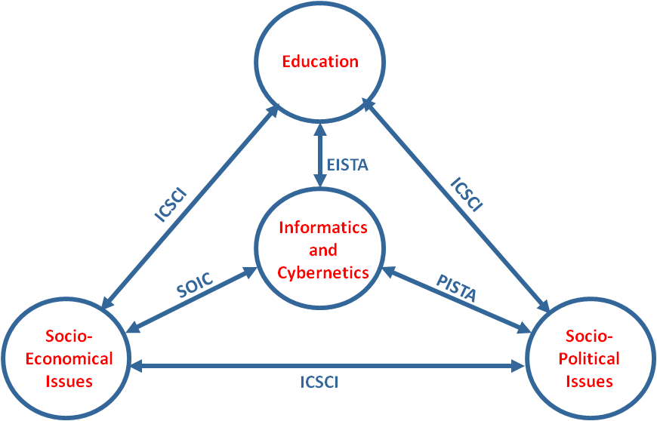

Slide 8
THANKS

