Slide 1
Digestion
III Semseter Zoology Complementary
Physiology
Dr. Sr. Rini Raphael

Slide 2
Digestion is the break down of complex, unabsorbable, unassimilable and unmetabolizable organic macromolecules or macronutrients into simole, absorbable, assimilable and metabolizable micromolecules and micronutrients
Digestion is characteristic of heterotrophs
Digestion – enzymatic hydrolysis

Slide 3
Digestive enzymes
Carbohydratases (amylases)
lipases
nucleases
proteases

Slide 4
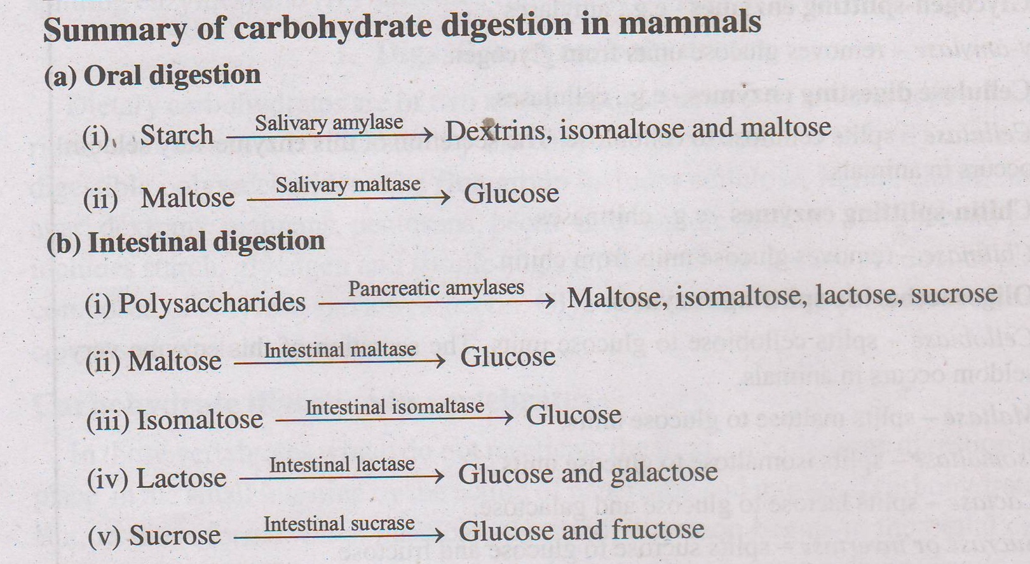

Slide 5
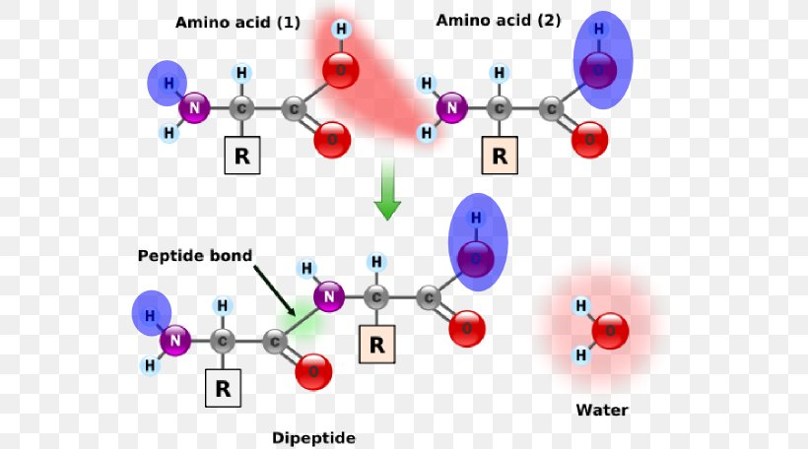
Proteins
Polymers of amino acid residues bound together by peptide bonds.

Slide 6
The digestive enzymes that attack these peptide bonds - proteases.
Digestion of protein occurs in stomach and small intestine

Slide 7
Digestion of Protein
Comples protein into oligopeptides by endopeptidases
Oligopeptides into dipeptides by expeptidases
Dipeptides into amino acids by another set of exopeptidases

Slide 8
endopeptidases
Pepsin
Rennin
Trypsin
Chymotrypsin
elastase

Slide 9
Exopeptidases
Carboxypeptidases
Aminopeptidases
Dipeptidases
tripeptidases
erepsins

Slide 10
Pepsin
Acts on positively charged proteins in an acidic medium
Secreted by gastric gland
Precursor form – pepsinogen
Activation by HCl in the gastric juice
Autocatalytic activity – activation by pepsin itself
It hydrolyses only those hydrogen bonds located in between phenyl group carrying aminoacids (tyrosine, phenylalanine) and a dicarboxylic acid (aspartic acid, glutamic acid)

Slide 11
Rennin
Milk coagualting enzyme
Found in gastric juice of calves
Coagulates milk by converting milk protein into paracasein which precipitates as calcium paracaseinate

Slide 12
Trypsin
An endopeptidase
Found in pancreatic juice of vertebrates
Active in slightly alkaline medium
Hydrolyses a peptide bond adjacent to a basic amino acid
Digestion produces oligopeptides
Precursor form – trypsinogen
Activated by intestinal enzyme enterokinase

Slide 13
Chymotrypsin
Pancreatic endopeptidase
Most active in slightly alkaline medium
Attacks peptide bonds adjacent to aromatic amino acids
Digestion produces short chain peptide fragments
Chymotrypsinogen from pancreas is activated by trypsin

Slide 14
Elastase
Pancreatic endopeptidases found in mammals
Pro elastse --- elastase
Unique property to digest fibrous protein elastin

Slide 15
Carboxypeptidases
Pancreatic exopeptidases
Terminal bonds – remove terminal amino acid with free carboxyl group
Contain one zinc ztom in every molecule
Inactive form – procarboxypeptidases activated by trypsin or enterokinase

Slide 16
Aminopeptidases
Pancreatic and intestinal exopeptidases,
Target – terminal peptide bond which remove amino acid with free amino group
Dipeptidases and tripeptidases
Intestinal exopeptidases

Slide 17
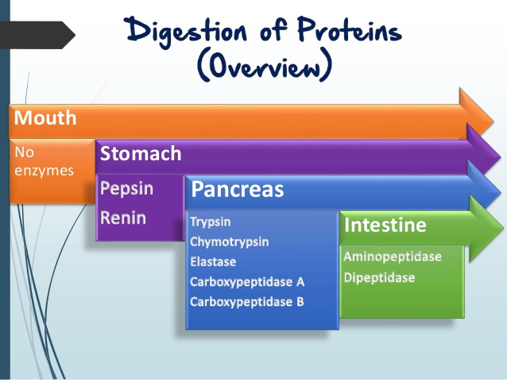

Slide 18
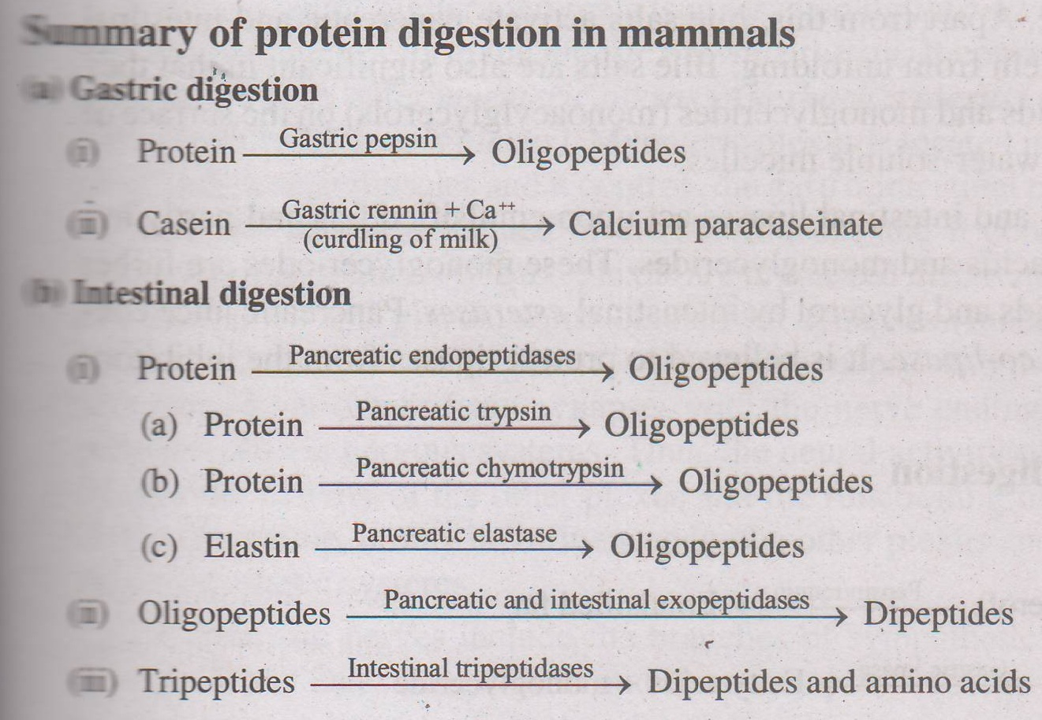

Slide 19
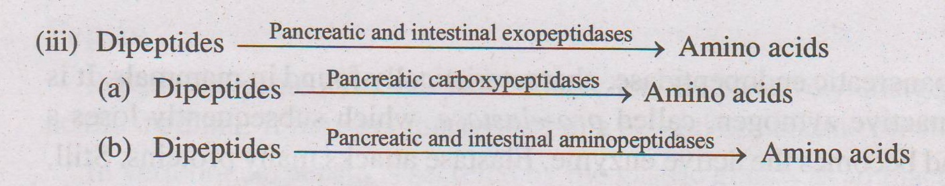

Slide 20
Digestion of lipid
Fats are esters of one molecule of glycerol and three molecules of fatty acids
Water insoluble and not hydrolysable by enzymes
Two enzymes involved
lipases hydrolyse the esters of long chain fatty acids releasing glycerides and fatty acids
Esterases hydrolyses the esters of short chain fatty acids releasing glycerol and fatty acids

Slide 21
Lipid digestion mostly in small intestine- very little in stomach
Mediated by gastric, pancreatic and intestinal lipases and intestinal esterases
Lipases can act only on emulsified fat
Emulsification - breakdown of large and complex fat globules to small and simple fat droplets which in turn form suspension called emulsion

Slide 22
Emulsidication at stomach and small intestine
Gastric emulsification – pepsin or rennin
Intestinal emulsification – bile
Bile salts activate pancreatic and intestinal lipases and protect them from unfolding
Bile salts combine with fatty acids and monoglycerides on the surface of fat droplets and form water soluble micelles

Slide 23
Lipases act upon emulsified fat and partly hydrolyse them to fatty acids and monoglycerides
Monoglyceries to fatty acids and glycerol by intestinal esterases

Slide 24
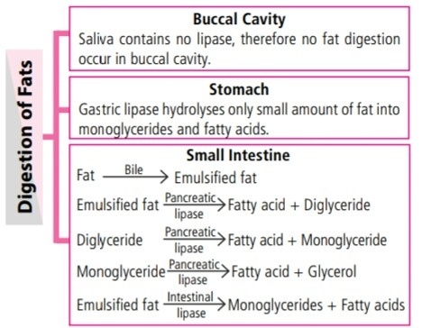

Slide 25
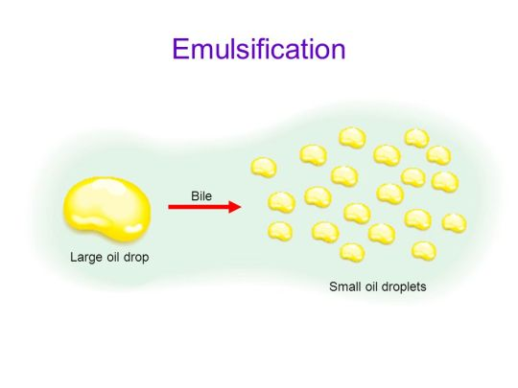

Slide 26
Digestion of nucleic acids
Nucleolytic enzymes in the intestinal juice
Three types
Nucleases – nucleic acids into nucleotides (RNAses and DNAses)
Phosphatases – nucleotides into nucleosides and phosphoric acids
Nucleosidases – nucleosides into free sugars and nitrogenous bases

Slide 27


