Slide 1
Nutrition
III Semester
Complementary Zoology
Dr. Sr. Rini Raphael

Slide 2
Nutrition involves a number of biochemical and physiological changes – convert the food components into body constituents
Nutrients – energy giving, body building components of food

Slide 3
Nutrients
Energy Suppliers (Macronutrients)
Body builders (Macronutrients)
Regulators (Micronutrients)

Slide 4
Energy Suppliers
carbohydrates
Lipids
Body Builders
Proteins
Water
Regulators
Vitamins
Other minerals
Some minerals – Ca, P

Slide 5
Proximate Principles
Proteins
Carbohydrates
Lipids

Slide 6
Proteins
Important body builders
Essential for growth and health
Provide amino acids to body
Amino acids are essential for
1. for repairing
2. synthesis of new tissue proteins
3. Production of enzymes, antibodies, hormones, melanin, purines, pyrimidines etc

Slide 7
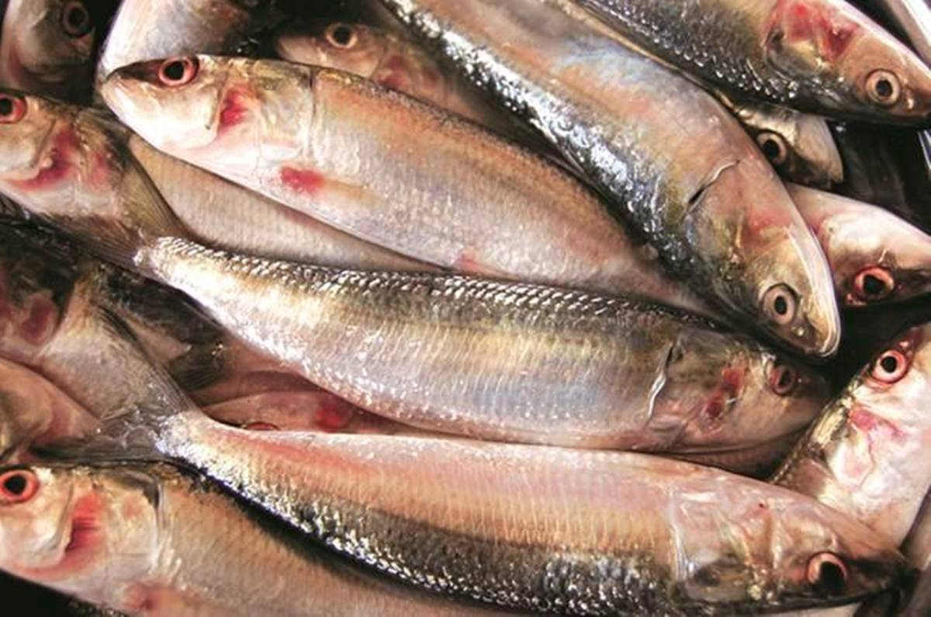
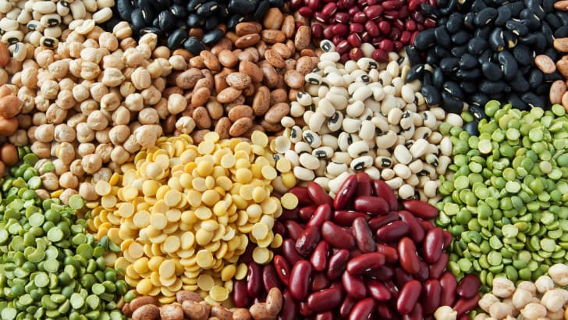
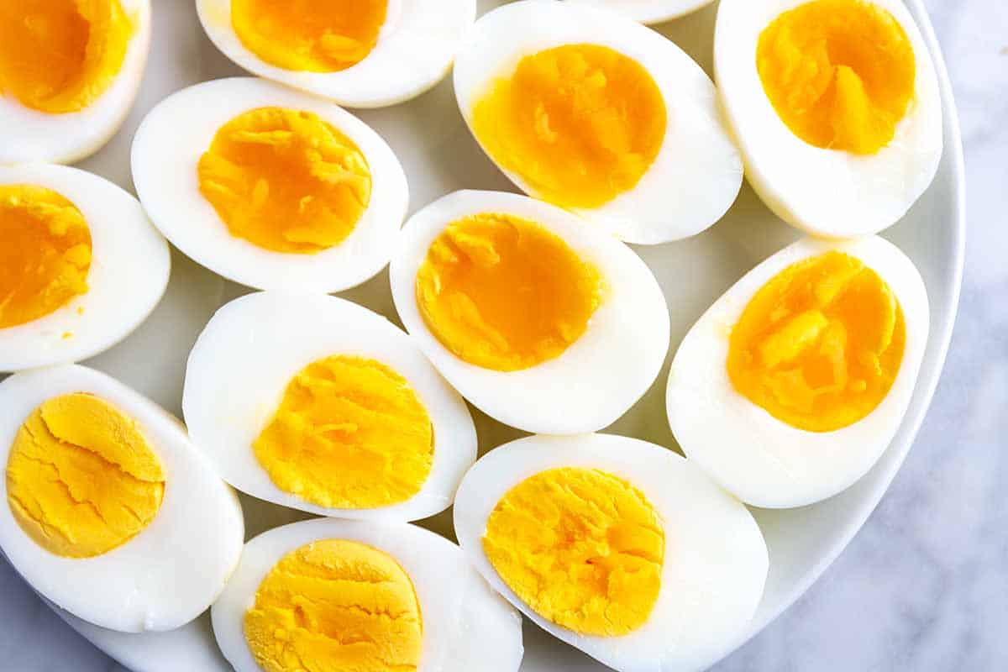
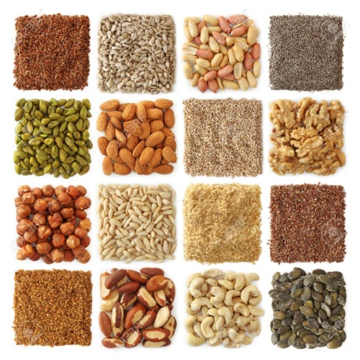
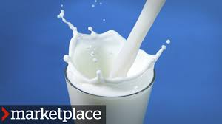

Slide 8
Classification of amino acids
Non essential amino acids (Dispensable)
Valine, lysine, leucine, methionine, threonine ….
Essential Amino acids (Indispensable)
Alanine, proline, aspartic acid, glutamic acid
Semi essential amino acids
Arginine, cysteine, glycine, serine, tyrosine

Slide 9
9 essential amino acids – Arginine not essential
8 amino acids – Arginine & Histidine not essential

Slide 10
Nutritional Classification of proteins
Nutritive value depends on amino acid composition
Proteins with all essential amino acids and similar composition of body proteins have highest nutritive value

Slide 11
Based on nutritive value
Complete Proteins/ High Quality proteins
Have all essential amino acids
Egg, Milk and meat
Partially complete proteins
Partially devoid of one or more essential amino acids – only moderate growth
Plant proteins
Incomplete Proteins
Completely devoid of one or more essential amino acids
gelatin

Slide 12
Based on Nutritive value
Complete Proteins/ High Quality proteins
Have all essential amino acids
Partially complete proteins
Partially devoid of one or more essential amino acids – only moderate growth
Incomplete Proteins
Completely devoid of one or more essential amino acids
Egg, Milk and meat
Plant proteins
gelatin

Slide 14
CARBOHYDRATES
Most important energy suppliers
Supply 40 – 80% of total calories in human beings
Dietary Source of carbohydrate
Cereals
Tubers
Roots
Fruits
milk

Slide 15
Starch - most abundantly natural carbohydrate
Present in cereals, roots and tubers
Lactose - milk
Sucrose - sweetest sugar
Glucose and fructose

Slide 16
Lipids
Rich source of the most concentrated form of chemical energy
Fish, milk and milk products, nuts, oils - dietary source
Different forms of lipids found in the diet
Fats (triglycerides)
Cholesterol (precursor of bile acids, steroid hormones and vitamin D₃)
Compound lipids (glycolipids and phospholipids)

Slide 17
Essential Fatty acids
PUFA
Linoleic acid, linolenic acid, arachidonic acid …
Non Essential fatty acids
Saturated fatty acids
Arachidic acid, palmitic acid, oleic acid, stearic acid

Slide 18
Vitamins
Regulatory food constituents
No energy value, but very importantin normal life processes
Vitamins obtain from the plant food, some by symbiotic bacteria, some by animals
Required in trace amount, deficiency results in disorders
Overabundance leads to vitamin poisoning - skin diseases, swelling at joints

Slide 19
Deficiency Diseases
Types of Vitamins | Deficiency Diseases
A (Retinol) | Night blindness
B1 (Thiamine) | Beri-beri
B2 (Riboflavin) | Retarded growth, bad skin
B12 (Cyanocobalamin) | Anaemia
C (Ascorbic acid) | Scurvy
D (Calciferol) | Rickets
K (Phylloquinone) | Excessive bleeding due to injury

Slide 20
20 vitamins are needed in human nutrition
2 types of vitamins
Fat soluble vitamins
Water soluble vitamins
Fat soluble vitamins – isoprenoid compounds insoluble in water
Can be stored in our body, in liver
Eg: - Vitamin A, D, E and K
Water soluble vitamins – numerous and diverse
B complex, C and P

Slide 21
Mineral Nutrients
Inorganic nutrients ingested as salt dissolved in water or food or as a part of organic compounds
4% of the body weight
Essential for metabolism
Deficiency leads to metabolic imbalances and disorders

Slide 22
Functions of Minerals
Maintain fluid balance (sodium, chloride, potassium)
Components of enzymes (Zinc, iodine, copper, manganese)
Normal functioning of muscles and nerves(sodium, potassium, calcium)
Clotting of blood (calcium)
Formation of some hormones, vitamins and organic compounds (iodine)
Strengthening of bones and teeth (calcium and fluoride)
Formation of respiratory pigments (Iron)

Slide 23
25 minerals in nutrition
Essential elements: most essential maintenance and functioning. Some elements are needed in large amounts (macronutrients: Na, K, Ca, Mg, P, S and Cl)
Some others needed in small amount (micronutrient: Fe, Zn)
Trace elements (Cu, Co, Mn,I)

Slide 24
Mineral Deficiency
Types of Minerals | Deficiency Diseases
Calcium | Brittle bones, excessive bleeding
Phosphorus | Bad teeth and bones
Iron | Anaemia
Iodine | Goitre, enlarged thyroid gland
Copper | Low appetite, retarded growth

