Slide 1
Phylum echinodermata
Class Ophiuroidea
Ms. Mariya Joy
Department of Zoology

Slide 2
Class ophiuroidea
Popularly known as basket stars, brittle stars,or serpent stars.
Basket stars -Branched arms
Brittle stars -Fragile and easily breakable arms
Serpent stars – Serpentine movement of the arms.
Ophiuroids resemble asteroids.
BCZ it’s body consists of central disc and arms .
Their arms are long, slender and more sharply set off from the disc

Slide 3
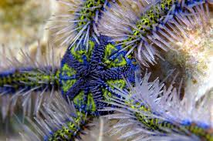
Brittle star

Slide 4
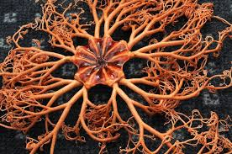
Basket star

Slide 5
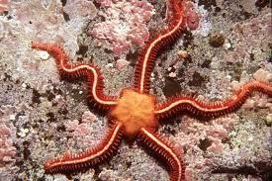
Serpent star

Slide 6
Salient features
* Flat body ,with a thin disc and five or more slender and flexible arms .
*Arms are formed of a series of segment – like section or articles each article being formed of four shields.
*Ambulacral grooves , pedicellariae and dermal branchiae are absent.
*Tube feet are without ampullae and suckers.
*Gut is blind sac without intestine and anus.
*Madreporite is on the oral surface .
*Sexes are seperate .
*Development is indirect with a larva called ophiopluteus.

