Slide 1
MODULE 1
INTRODUCTION TO MICROFINANCE

Slide 5
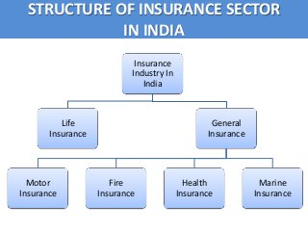

Slide 7
