Slide 1
BBA / B. Com. (CA)
SEMESTER 3
PROFESSIONAL BUSINESS SKILLS
MODULE 1 – PART 1
Notes:
DAY 1

Slide 2
PROFESSIONAL BUSINESS SKILLS
What do you mean by
    Profession
    Professional
    Professionalism

Slide 3
PROFESSIONAL BUSINESS SKILLS
Profession
  A paid occupation, especially one that involves prolonged training and a formal qualification
  Professional
  A person engaged or qualified in a profession.
  Professionalism
  The competence or skill expected of a professional.

Slide 4
PROFESSIONALISM
Professionalism is the way an individual conduct himself at work to represent both himself and his company in a positive way
It includes standards for behaviour that might be required by an organization

Slide 5
MEANING AND DEFINITION OF PROFESSIONALISM
According to Eric Mochnacz, ”Professionalism is someone’s inherent ability to do what is expected of them and deliver quality work because they are driven to do so”
Professionalism also includes the way an employee interacts with other people, including co-workers, customers and superiors

Slide 6
CHARACTERISTICS OF PROFESSIONALISM
1 Specialised Knowledge
2 Competency
3 Commitment and Confidence
4 Responsibility and Dependability
5 Ethics and Honesty
6 Initiative and accountability
7 Self regulation
8 Appearance and professional presence

Slide 7
MEANING AND DEFINITION OF PROFESSIONALISM
The original meaning of the word professional derived from the middle English ‘profes’, an adjective meaning having professed one’s promise, which itself derived from Latin ‘professus, past participle of ‘profiteri’ which meant to profess, confess.
The idea was that professionals were those who professed their skills to others and promised to perform their profession to the highest standard

Slide 8
MEANING AND DEFINITION OF PROFESSIONALISM
The Merriam – Webster dictionary (America's most trusted online dictionary for English) defines professionalism as
  “the conduct, aims or qualities that characterise or mark a profession or a professional person” and it defines a profession as a calling requiring specialised knowledge and often long and intensive academic preparation

Slide 9
TRAIT AND QUALITIES OF A GOOD PROFESSIONAL
  1 Excellence
2 Organisational Skills
3 Time Management
4 Good Communication
5 Soft Skills
Notes:
DAY 2

Slide 10
TRAIT AND QUALITIES OF A GOOD PROFESSIONAL
6 Positive Attitude
7 Focus and Hard work
8 Ethical behaviour
9 Continuous Learning
10 Seeks advice

Slide 11
TRAIT AND QUALITIES OF A GOOD PROFESSIONAL
11 Advancing in Profession
12 Teaches new generation
13 Appearance
14 Demeanour (behaviour)

Slide 12
PROFESSIONALISM IN BUSINESS
Professional Behaviour is necessary for the long term success of a business.
Professionalism helps companies success in the following ways:
  Establishes proper boundaries
  Encourages personal improvement
  Promote and maintain accountability
  Establishes respect

Slide 13
PROFESSIONALISM IN BUSINESS
  Minimises conflict
  Increases job satisfaction
  Sense of responsibility
  Personal Growth

Slide 14
PROFESSIONAL SKILLS
Communication Skills
Decision Making Skills
Problem Solving Skills
Leadership Skills
Interpersonal Skills

Slide 15
PROFESSIONAL SKILLS
Organisational Skills
Time Management Skills
Stress Management Skills
Teamwork
Work Ethic
Flexibility

Slide 16
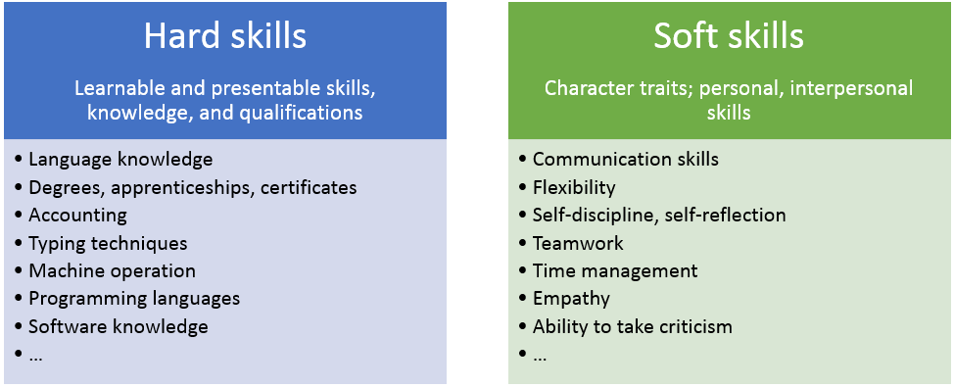
Importance of Soft Skills for Business Success
Difference between soft skill and hard skill

Slide 17
SOFT SKILLS
Soft Skills are the personal Attributes, personality traits, inherent social cues and communication abilities needed for success on the job. Soft skills characterises how a person interacts in his relationships with others.

Slide 18
Examples of soft skills
Communication
Coping under pressure
Empathy and emotional intelligence
Flexibility, the openness and ability to adapt to change
A growth mindset

Slide 19
PROFESSIONALISM IN COMMUNICATION
Professional communication refers to the various forms of speaking, listening, writing and responding carried out both in and beyond the work place, whether in person and electronically.

Slide 20
Types of work place communication
Written Communication
    Eg: Memos, letters, resumes etc
Oral Communication
Eg: Presentations, Meetings, daily conversations etc.

Slide 21
Types of work place communication
Visual Communication
Eg: videos
Technology based communication
  Eg: email, social media like, what's app, twitter, Instagram, Facebook etc.

Slide 22
Verbal Communication
Various characteristics that must qualify our communication
  Clear
  Concise
  Concrete
  Coherent
  Courteous

Slide 23
Professional Presentation
A good presentation should be organised in the following way:
  Introduction
  Body
  Summary
  Visual Aids

Slide 24
Presentation Techniques
Gather information
Write down main ideas
Develop introduction and conclusion
Practice the speech
Delivery style

Slide 25
Presentation Techniques
Use of the podium
Length of delivery
Eye contact
Voice
Speak calmly
Question and answer session

Slide 26
DIFFERENT PRESENTATION POSTURES
FACIAL EXPRESSION
EYE CONTACT
POSTURE
GESTURES
POSITION AND MOVEMENT

Slide 27
FACIAL EXPRESSIONS
Face is very important in making a good impression
If you are giving a presentation with a blank face, no matter how great your content is, your audience will not be engaged.
  Eg: raising your eyebrows a little
  Opening your eyes wider

Slide 28
EYE CONTACT
Make sure you look everyone
Don’t be afraid of eye contact
Don’t stare
Don’t look at the watch/screen constantly
Don’t look at the ceiling/ground
Engage as many people as possible

Slide 29
POSTURE
Posture conveys your attitude and a sense of certainty regarding the information you are presenting.
Your stance will work to attract, distract, shift or hold your audience’s attention.
  Don’t slouch
  Don’t be tense
  Do think about your audience
  Do be adaptable

Slide 30
GESTURES
Whenever you want to make an important point, emphasise your words with hand gestures.
Moving your hands during your presentation supports every word with more powerful meaning
Message will be more clear to the audience
Audience will remember the fact or information

Slide 31
POSITION AND MOVEMENT
While presenting make sure of your position and confirm if you have any flexibility to move around
If you are giving your presentation on a big stage, a bit of move around the space can help to create visual interest and keep different parts of the audience engaged
Jiggling your legs and constantly settling your standing position will show your discomfort.

Slide 32
POSTURE USING HANDS AND ARMS
Crossed arms
The box
Holding the ball
Pyramid Hands
Wide stance
Palms up
Palms down

