Slide 1
DAY – 2 Computer Organization and Architecture
LAKSHMI ANAND

Slide 2
Combinational Circuits
Combinational Circuits (CC) are circuits made up of different types of logic gates.
A logic gate is a basic building block of any electronic circuit.
The output of the combinational circuit depends on the values at the input at any given time.
The circuits do not make use of any memory or storage device.

Slide 3
The Adder
An adder is a digital circuit that is used to perform the addition of numeric values.
It is one of the most basic circuits and is found in arithmetic logic units of computing devices.
There are two types of adders.
Half adders compute single digit numbers, while full adders compute larger numbers.

Slide 4
Half Adder
The half adder adds two single digit binary numbers and forms the foundation for all addition operations in computing.
If we have two single binary digits, A and B, then the half adder adds them with the circuit carrying two outputs, the sum and the carry.
The carry represents any overflow from the addition of the two numbers.

Slide 5
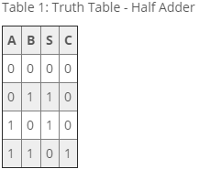
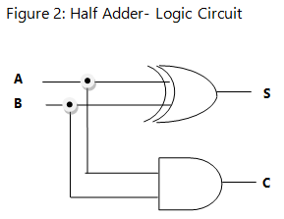
The sum S is represented by the Boolean Expression S = A'B + AB' and C = AB

Slide 6
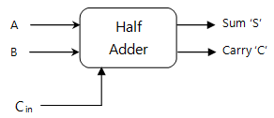
Full Adder
The full adder overcomes the disadvantages of the half adder in that it can add two single bit numbers in addition to the carry digit at its input

Slide 7
S = A'B'Cin + A'BCin' + AB'Cin' + ABCin
and
C = A'BCin + AB'Cin + ABCin' + ABCin

