Slide 1
DAY – 3 Computer Organization and Architecture
LAKSHMI ANAND

Slide 2
Subtractors
A subtractor is used to subtract one number from another.
Because we are dealing with binary digits, the 1s complement and 2s complement of the numbers are used to achieve this.
Three bits are involved in performing the basic subtraction: the minuend (X), the subtrahend (Y) and the borrow (Bi), which is input from the previous bit.
The outputs are the difference (D) and the borrow bit (Bout).

Slide 3
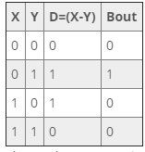
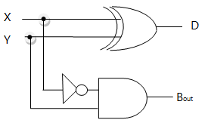
Half Subtractor
When a subtraction is done between just two bits a half subtractor is used, similar to the half adder.
Boolean expressions are as follows:
D = X'Y + XY'
Bout = X'Y

Slide 4
Full Subtractor
The combinational circuit of the full subtractor performs a subtraction operation on three bits, the minuend, the subtrahend, and the borrow-in bits.
The circuit generates two outputs comprising of the calculated difference, D and the borrow-out.

Slide 5
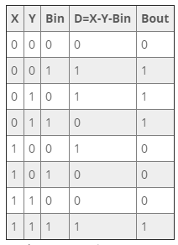

Slide 6
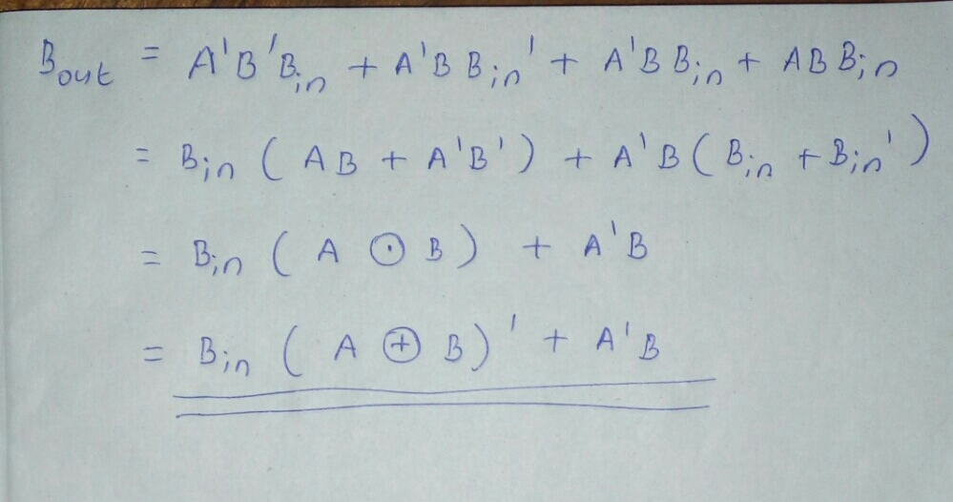

Slide 7
