Slide 1
LEVELS OF MANAGEMENT
Module 1

Slide 2
LEVELS OF MANAGEMENT
The term ‘levels of management’ refers to a line of demarcation between various managerial positions. The number of levels of management depends up on the size, technology, and degree of diversity and nature of products

Slide 3
There are three levels of management:
Top Level Management
Middle Level Management
Lower Level Management

Slide 4
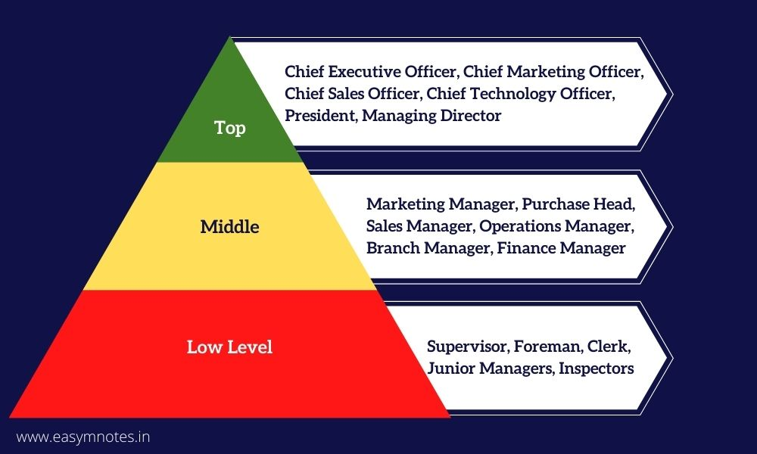

Slide 5
TOP LEVEL MANAGEMENT
Main functions are:
Determine the objectives
Define the goals
Establish the policies
Prepare strategic plans
Give guidance and directions
Control and create good relation with public

Slide 6
MIDDLE LEVEL MANAGEMENT
Min functions are:
Interpretation of the programmes and policies communicated by the top level management
Organizing and manning their department as per the main plan
Plan the departmental operations
Co-operate and co-ordinate with other department
Guide, direct and motivate their workers to attain the objectives
Evaluate the performance of his subordinates
Collect reports and statistics from the lower levels and send it to top level management.

Slide 7
LOWER LEVEL MANAGEMENT
The main functions are :
Plan for a day or week
Organize the activities of his group
Allot work to the workers under him
Issue instructions at the site
Motivate the employees
Arrange materials, machines, tools etc. for workers
Give guidance and supervise employees
To maintain discipline and good relations with in the group

Slide 8
THANK YOU

