Slide 1
MANAGEMENT BY OBJECTIVES
MODULE 1

Slide 2
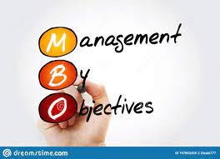

Slide 6
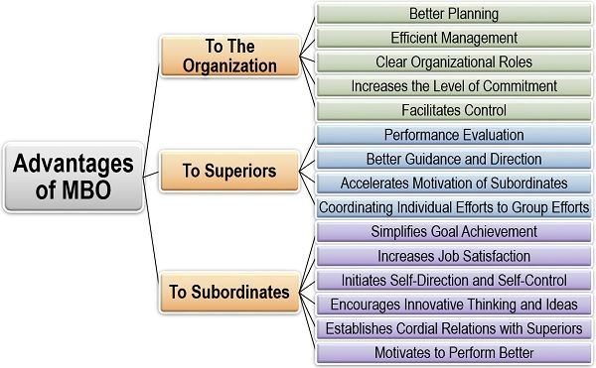

Slide 8
THANK YOU

