Slide 1
PHLOEM
Presented By
Jipcy Mol.P

Slide 2
Phloem or bast is the chief food conducting tissue of vascular plants.
It is concerned with the translocation of synthesised organic food from the centres of their production to the regions of their utilization.
Phloem can be classified into primary phloem and secondary phloem.

Slide 3
Primary phloem differentiates from procambium.
Secondary phloem differentiates from vascular cambium during secondary growth.
The first formed Phloem is called protophloem and the later formed metaphloem.

Slide 4
PHLOEM
Phloem is composed of four different kinds of cells.
1.Sieve elements.
2.Companion cells.
3.Phloem parenchyma.
4.Phloem fibres.

Slide 5
Companion cells are absent in Pteridophytes and gymnosperms.
Phloem fibres are absent in the primary phloem of many angiosperms.
In some plants, a fifth kind of cell, called transfer cells may also be present.

Slide 6
SIEVE ELEMENTS
These are the food transporting cells of vascular plants.
They include sieve tube elements or sieve members and sieve cells.
Sieve cells are relatively less specialised and they are found in gymnosperms and Pteridophytes.
Sieve tubes are more specialised and they are found in angiosperms.

Slide 7
SIEVE TUBE ELEMENTS
They are relatively advanced type of phloem cells found in angiosperms.
Mature sieve tube elements are long, tubular and non-nucleated cells with non lignified secondary wall and terminal sieve plate.
Their protoplast is devoid of nucleus,ER,mitochondria,plastids and other organelles.

Slide 8
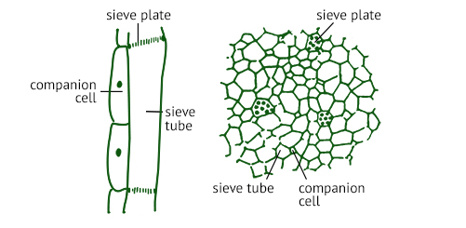
On one side of the sievetube cell there will be one or more companian cells.

Slide 9
Sieve tube members are arranged end to end forming several tubular columns called sieve tubes.
These correspond to the xylem vessels.
The end wall or crosswall between adjacent cells is an oblique and porous plate called sieve plate.

Slide 10
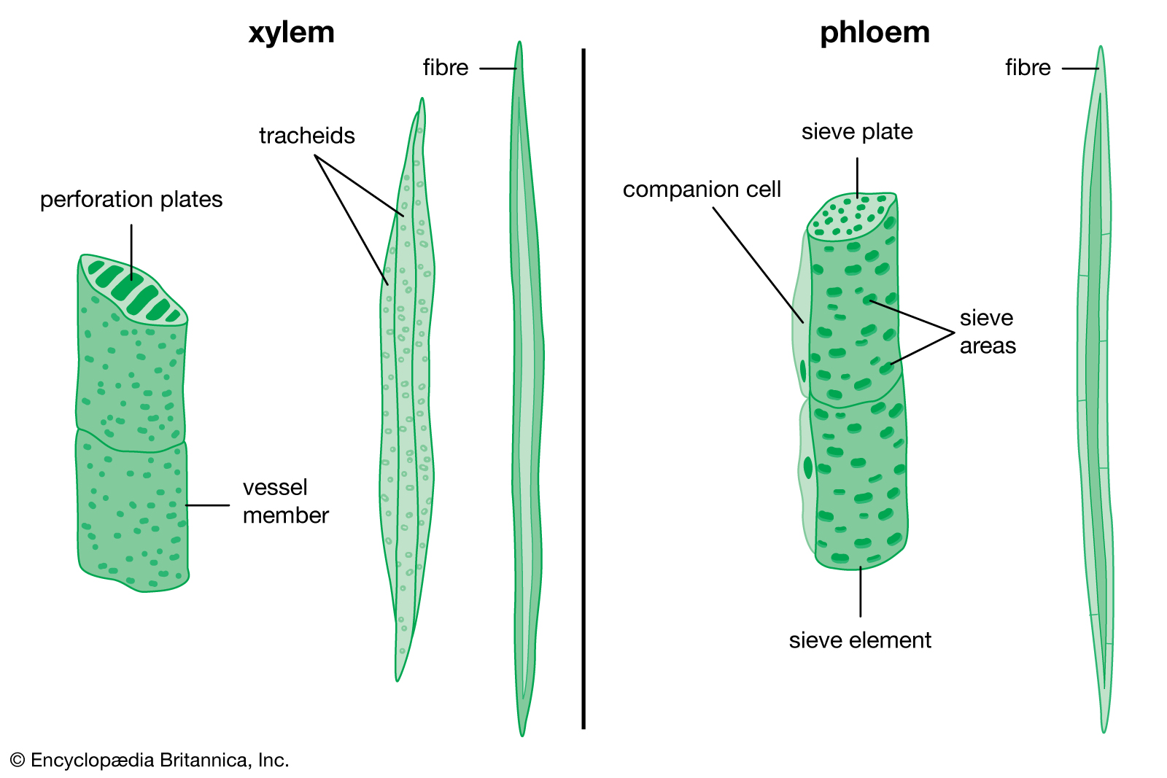

Slide 11
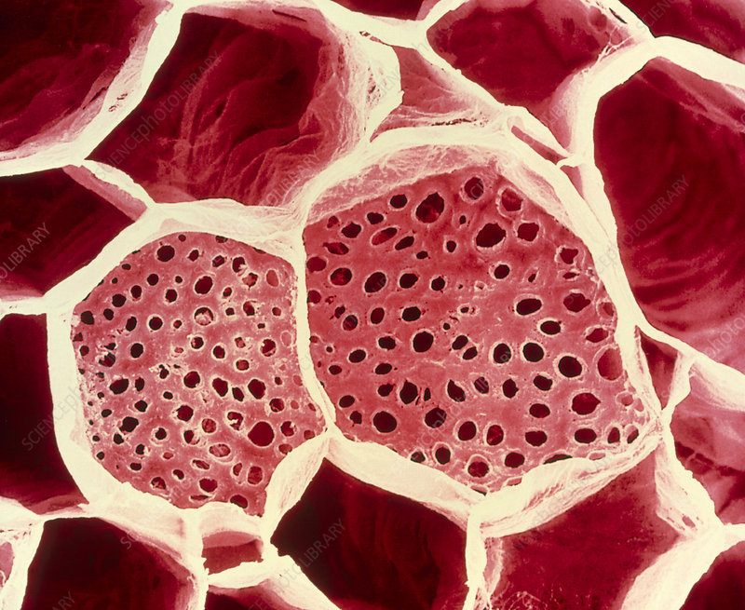
SIEVE PLATE

Slide 12
The slightly depressed part of the sieve plate perforated by a cluster of sieve pores is called the sieve area.
Sieve plates with only a single sieve area are called simple sieve plate and those with several sieve areas are called compound sieve plates.
Each sieve tube element contains fine cytoplasmic strands.

Slide 13
Through the sieve pores the cytoplasmic strands of one cell enter the next and become continuous with the strands.
In dicot plants, sieve tubes contain a viscous and proteinaceous substance called slime.
It accumulates in the sieve area called slime plug.
When the cell is injured, this plug closes up the broken tip and thus prevents the exudation of the cell content.

Slide 14
SIEVE CELLS
In gymnosperms and Pteridophytes ,true sievetube elements are absent.
They have primitive and less specialised vascular cells, called sieve cells.
They corresponds to the tracheids of xylem.
Sieve cells are long,narrow and spindle shaped cells which are longer and thinner than sieve tube elements.

Slide 15
They are not flanked by any companian cells and their sieve areas are relatively unspecialised and lateral.
Sieve cells are mainly concerned with the translocation of sugars.

Slide 16
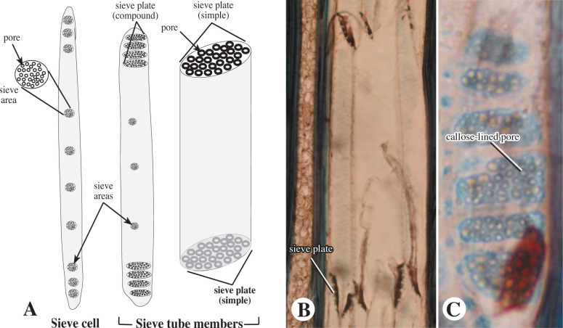

Slide 17
COMPANIAN CELLS
These are small and thin walled parenchymatous cells seen closely associated with the sieve tube members of angiosperm phloem.
In the primary phloem of herbaceous plants, there will be only a single long companian cell for each sieve tube element.

Slide 18
In the secondary phloem of woody plants, there will be numerous companian cells.
Companian cells are absent in gymnosperms and Pteridophytes.
Companian cells have dense cytoplasm, prominent nucleus, and all cell organelles.

Slide 19
The protoplast of a companian cell is continuous with the non nucleated protoplast of the adjacent sieve tube cell through plasmosdesmata.

Slide 20
FUNCTIONS
They supply the sieve tube elements metabolic products.
Regulate the rate of flow along the sieve tube.
The companian cells and its associated sieve tube element are sister cells formed by the unequal division of one and same procambial mother cells.

Slide 21
PHLOEM PARENCHYMA
This is the parenchyma seen associated with the phloem of gymnosperms,pteridophytes and dicots.
It is absent in the phloem of most monocots.
Its cells are long and have cellulose cell wall.
In active phloem parenchyma cells are functional.

Slide 22
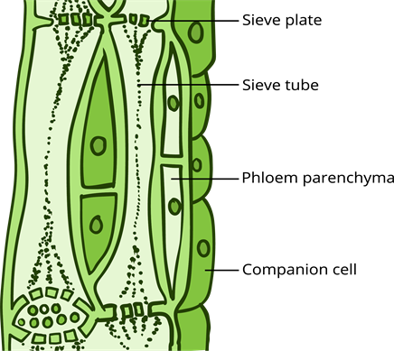

Slide 23
When the activity of sieve tube ceases,they become lignified.
There are two groups of parenchyma in secondary phloem vertical and horizontal.
The former is formed of phloem parenchyma, and the latter is formed of phloem rays.

Slide 24
FUNCTIONS
It is mainly concerned with the storage of organic food materials,resins,tannins and also with the translocation of stored food.

Slide 25
PHLOEM FIBRES
Phloem fibres or bast fibres are the dead ,narow and elongated sclerenchyma cells of the secondary phloem.
They are usually absent in primary phloem.
Their lumen is narrow and walls are thick and lignified with simple pits.
Phloem fibres give mechanical support and protection to soft tissues.
The fibres of Jute, hemp and flax are used for making threads,ropes,etc.

Slide 26
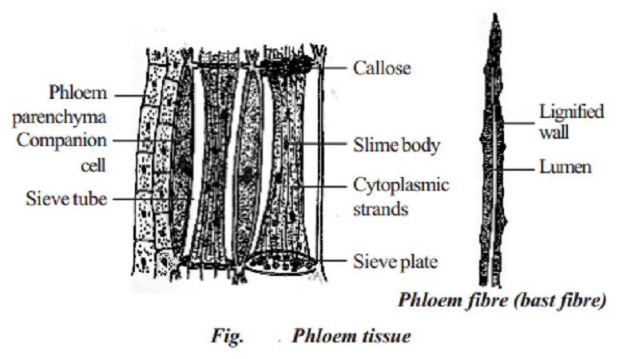

Slide 27
TRANSFER CELLS
These are the specialised cells,seen in association with leaf veins of leguminous plants .
They are also seen in nectaries and salt glands.
They are characterised by dense cytoplasm and ingrowths of the cell wall.
They are mainly concerned with the collection and short-distance transport of metabolites.

Slide 28
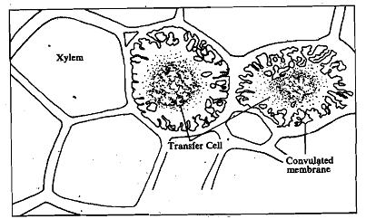
TRANSFER CELLS

Slide 29
FUNCTIONS OF PHLOEM
Translocation of organic nutrients such as simple sugars, complex carbohydrates, and amino acids.
Phloem fibres provide mechanical support and elasticity.
Storage of organic nutrients and other substances in phloem parenchyma.

Slide 30
GUMMOSIS
This is the pathological condition characterized by the excessive production of gum in trees or shrubs.
It can be an abnormal phenomenon or a defective process caused by bacteria.
In it the cells dry out and cell walls undergo enzymatic breakdown to form gum.

Slide 31
Gummosis is thought to result mainly from the breakdown of the organized cell wall materials into unorganized amorphous substances.
Starch may also be a source for gum formation.
In each cell the disintegration of the wall starts in the primary wall and proceeds towards the innermost lamella of the secondary cell wall. The cavity formed during this gets filled with gum.

Slide 32
LACTIFEROUS TISSUE
Lactiferous tissue or laticiferous tissue is the latex containing tissue.
It consists of a special kind of living cells concerned with the secretion and conduction of latex.
Latex is a viscous fluid which is an emulsion or suspension of proteins,sugars,enzymes,resins,tannins,terpenes,essential oils,waxes,alkaloids,malate and oxalate crystals,etc.

Slide 33
Latex is mostly milky white ,but in some plants it may be yellow ,reddish or colourless.
Latex has great economic value since it yields the commercial rubber.
Laticiferous tissue may be formed by the fusion of cells to form vessels or by the elongation and branching of ceonocytic cells.

Slide 34
There are two kinds of lactiferous tissue, namely
1.Non articulated lactifers.
2.Articulated lactifers.

Slide 35
NON ARTICULATED LACTIFERS
These are long tubular unbranched or branched living cells.
In the beginning they are uni nucleate,but later on they become siphon like and multinucleate or ceonocytic.
Each latex cell originates from a meristematic cell of the embryo.
Latex cells have cellulose cell wall and a thin lining of cytoplasm around a central vacuole.

Slide 36
Latex cells are found in plants of the families Apocyanaceae,Asclepiadaceae,Euphorbiaceae,etc.
Examples-Nerium odorum,Cannabis sativa.

Slide 37
ARTICULATED LATICIFERS
Articulated laticifers arebformed by the fusion of many cells.
These are usually branchedand resemble non articulated laticifers in structure.
But they differ from latex cells in that vessels are elongated and are joined end to end.
At these junctions, their end walls dissolve.

Slide 38
Articulated laticifers are multicellular and ceonocytic.
Examples-Argemone maxicana,Hevea,Manihot,etc.

Slide 39
FUNCTIONS
1.Stores water in xerophytic plants.
2.Stores food reserves.
3.Protects the plants against grazing.
4.Secretes commercially important rubber in rubber plants.

Slide 40
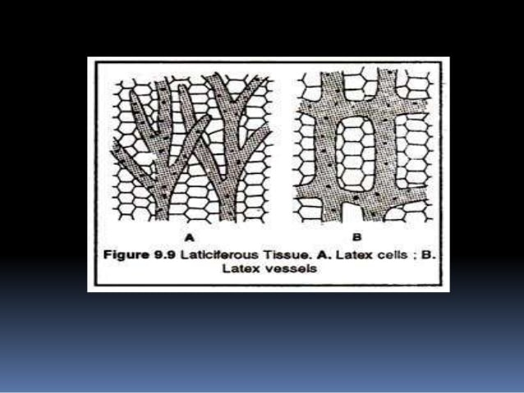
LACTIFEROUS TISSUE

