Slide 1
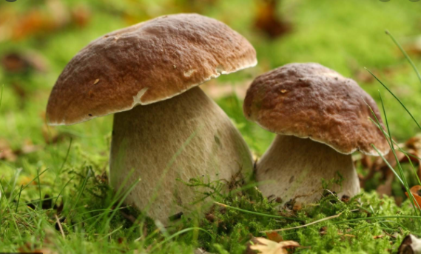
Classification of Fungi by Ainsworth G. C. (1973)

Slide 2
Fungal Classification
Initial classification – based on sexual reproduction
Modern classification-phylogenetic relationship using biochemical and molecular aspects
Whittaker (1969) – 5 kingdom classification- kingdom fungi.

Slide 3
Earlier classification of fungi
Based on habitat association.
3 types
Terrestrial fungi- growing in soil
Hypogean fungi-under the ground
Epiphytic fungi- growing on plants

Slide 4
Criteria used in fungal taxonomy
Dayal (1975) mentioned 7 characters that are used in fungal taxonomy
1. morphological characters
Host specialisation
Physiological characters
Cytological and general characters
Sorological characters
Biochemical characters
Numerical taxonomy

Slide 5
Fungal characters
Cell wall
Chemical composition of cell wall
Somatic phase
Reproduction
Nutrition
Structure that formed by fungi.:-
fruiting bodies
spores
Kuraishi et al (1985)- ubiquinone systems are useful in fungal taxonomy.

Slide 6
Important systems of fungal classification
1. classification by G.C Ainsworth
Classification by Alexopoulose.

Slide 7
Ainsworth G. C. (1973) proposed a more natural system of classification of fungi.
Based on morphology, espe­cially of reproductive structure.
He includes fungi along with slime molds under the kingdom Mycota.
Based on the presence or absence of Plas­modium and pseudoplasmodium-kingdom Mycota -2 division.
Myxomycota (slime molds) and Eumycota (true fungi).

Slide 9
Division. Myxomycota
Wall-less organisms possess either
a Plasmo­dium (a mass of naked multinucleate protoplasm having amoeboid movement) or
pseudoplasmo­dium (an aggregation of separate amoeboid cells).
Both are of slimy consistency, hence slime molds.
1. Class. Acrasiomycetes (cellular slime molds)
2. Class. Hydromyxomycetes (net slime molds)
3. Class. Myxomycetes (true slime molds)
4. Class. Plasmodiophoromycetes (endo- parasitic slime molds).

Slide 11
Division Eumycota
i. Free-living, parasitic or mutualistic symbionts, devoid of chlorophyll.
ii. Cell wall-chitin and glucan.
iii. Reserve food materials: mannitol and glycogen.
iv. majority are filamentous (some unicellular)

Slide 13
Division Eumycota

Slide 14
Division Eumycota (True fungi, all with walls):
Subdivision:- Mastigomycotina (motile cells – zoospores present, perfect state spore-oospore).
Zygomycotina (mycelium aseptate, perfect state spore-zygospore).
Ascomycotina (yeasts or septate mycelium, perfect state spore- ascospores formed in ascus, usually within ascocarp).
Basidiomycotina (yeast or septate mycelium, perfect state spore – basidiospore formed on a basidium).
Deuteromycotina or Fungi imperfecti. Yeast or septate mycelium. Perfect state unknown.

Slide 15
Subdivision Mastigomycotina
1. Class. Chitridiomycetes (unicellular, zoospore with single whiplash flagellum).
2. Class. Hyphochytridiomycetes (uni­cellular, zoospore with single tinsel flagellum).
3. Class. Oomycetes (aseptate myceli­um, zoospores with two flagella).

Slide 17
Subdivision. Zygomycotina
mycelium aseptate, perfect state spore-zygospore.
1. Class. Zygomycetes (mycelium immersed in the host tissue).
2. Class. Trichomycetes (mycelium not immersed in the host tissue).

Slide 19
Subdivision. Ascomycotina
Ascomycotina (yeasts or septate mycelium, perfect state spore- ascospores
1. Class. Hemiascomycetes (no asco­carp, asci naked).
2. Class. Loculoascomycetes (fruit body an ascostroma, asci bitunicate i.e., 2-walled).
3. Class. Plectomycetes (fruit body cleistothecium, asci unitunicate i.e., 1-walled).
4. Class. Laboulbeniomycetes (fruit body perithecium, asci unitunicate, exoparasite of arthopods).

Slide 20
5. Class. Pyrenomycetes (fruit body perithecium, asci unitunicate, not parasitic on arthopods.
6. Class. Discomycetes (fruit body apothecium, asci unitunicate).

Slide 21
Sub division- Ascomycotina

Slide 22
Subdivision. Basidiomycotina
Basidiomycotina (yeast or septate mycelium, perfect state spore – basidiospore formed on a basidium).
1. Class. Teliomycetes. Basidiocarp lacking, teliospores grouped in sori or scattered within the host tissue, parasitic on vascular plant.
2. Class. Hymenomycetes. Basidio- carp present. Hymenium is com­pletely or partly exposed at matu­rity. Basidiospore ballistospores.
3. Class. Casteromycetes. Basidiocarp present. Hymenium enclosed in basidiocarp. Basidiospore not ballistospores.

Slide 24
Subdivision. Deuteromycotina
Subdivision. Deuteromycotina or Fungi imperfecti. Yeast or septate mycelium. Perfect state unknown.
1. Class. Blastomycetes. Budding (Yeast or Yeast like) cells with or without pseudomycelium. True mycelium lacking or not well-developed.
2. Class. Hyphomycetes. Mycelia ste­rile or bearing asexual spore directly or on conidiophore, in various aggregation.
3. Class. Coelomycetes. Mycelial; asexual spore formed in pycnidium or acervulus.

Slide 26
Ten years after the classification of Ainsworth (1973), Hawksworth et al. (1983) revised Ainsworth’s classification in the 7th edi­tion of the “Dictionary of the Fungi”.
The changes made by them are:
1. The Division Myxomycota divided into eight classes instead of four classes.
2. The Sub-division Ascomycotina is directly divided into thirty seven (37) orders and arranged alphabetically; there is no classes in-between.
3. The subdivision Basidiomycotina is divided into four classes instead of three, where class Teliomycetes is replaced by Uredinio- mycetes and Ustilaginomycetes.
4. In the sub-division Deuteromycotina, the class Blastomycetes was not considered.

Slide 27
Later, Hawksworth et al. (1995) thoroughly revised the classification in the 8th edition of the “Dictionary of the Fungi”. The classification was based on the sequence of 18s rRNA among the different members.
Though members of fungi show similarity in their morphology, mode of nutrition and ecology, but the higher dissimilarity is observed in the base sequences of their 18s rRNA (or more precisely in the DNA coding for it), which is now considered as the most important parameter to determine the genetic relationship. Thus, it shows that the fungi are polyphyletic aggregation of unrelated members.
Based on the above fact and phylogenetic consideration, the entire fungal community are now segregated out and placed them under three different Kingdoms Fungi, Straminopila (Chromista) and Protozoa.

Slide 28
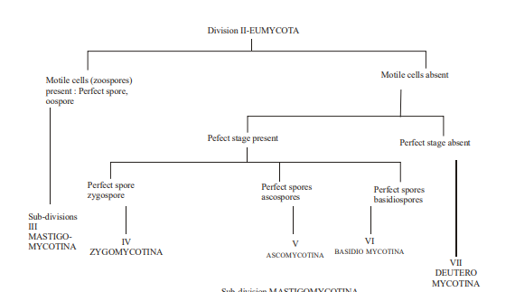

Slide 32
