Slide 1
Conventional methods of plant breeding
Plant domestication& introduction

Slide 2
Plant breeding is an art and science of improving the qualities of the crop plants.
Major plant breeding methods includes
1 domestication of plants
2. Introduction of plants
3. Selection of plants
4. Plant hybridization
5. Mutation breeding
6. Polyploidy breeding
7. Biotechnological approaches

Slide 3
Conventional methods of plant breeding
1. Plant domestication
2. Introduction-
3. Selection
4. Hybridisation

Slide 4
Modern methods
1. Mutation breeding
2. Polyploidy breeding
3. Distant hybridisation
4. Biotechnological approaches

Slide 5
Domestication of plants
Process of bringing wild plants into human management.
Introduction of plants
Process of taking genotypes or group of genotypes to a new environments where they were not being grown before.

Slide 6
Selection of plants
Both domesticated and introduced plants shows considerable degrees of variation.
Some characters and some inferior
The process of selecting superior plants is an important technique.

Slide 7
Plant hybridisation
Technique of bringing superior characters into a single variety by cross pollinating them artificially.
Desirable characters that are scattered in different varieties can be brought together by hybridisation

Slide 8
Mutation breeding
Process- used to introduce new variation.
The seeds or propagules are treated with some chemicals /physical agents- mutagens.

Slide 9
Polyploidy breeding- breeding in polyploids.
More than two sets of chromosomes are seen in their somatic cells- polyploid.
Polyploid shows superiority in characters

Slide 10
Biotechnological breeding
Biotechnology- make use of enzymes and tools to accelerate the biochemical pathways in crop plants
Invitro culture technique
Marker assisted selection
Somatic hybridisation
Trasgenesis
Bioreactor technology

Slide 11
Plant domestication
Process of bringing wild plants under human management.
Wild plants undergo certain modifications.

Slide 12
Natural selection
Artificial selection
Nature
Retain considerability
Permits all the genotype to produce progeny
Man made selection
Progressively reduces the variability
Permits only the selected plants to reproduce.

Slide 13
Changes in plants under domestication
1. Elimination/reduction in shattering of pods
2. elimination of seed dormancy to fit cropping schedules.
3. Decrease in toxins or other undesirable content in crop plants.eg: Bitternss content in cucubitaceous plants
4. Plant type- extensively modified (tillering branching, leaf characters).

Slide 14
5. Several crops plant height is decreased (cereals, millet).
6. Plant height is increased (sugarcane, forage grasses).
7. Life cycle has become shorter in some plants (cotton, cajanus cajan).
8. Increase in grain size and fruits.
9. Increase in economic yield.

Slide 15
10. Asexual reproduction is promoted (sugarcane, potato, sweet potato).
11. Favours polyploidy
12. dioecious fruit- bisexual forms
13. self incompatibility eliminated
14. variability – decreased.

Slide 16
Plant introduction
Taking genotype / group of genotypes into new environment.
Involves: new variety of a crop
wild relatives of crop
new crop species for the area.

Slide 17


Slide 18
Primary
secondary
Well suited to new environment
Released directly for commercial cultivation without any alteration in the original genotype
Less common
Eg: introduction of semidwarf wheat(Triticum aestivum)-Sonora 64 Lerma Rojo
Semidwarf rice
Subjected to selection to isolate a superior variety
Hybridised with local varieties
More common
Kalyan sona & Sonalika- whaet varieties introduced from CIMMYT.

Slide 19


Slide 20
History of plant introduction
Centers of origin
Central Asian Centre (Apple, walnut)- india
Africa(finger millet, jowar)-India
Afganisthan(Cherries,grape)- India
Portugese(maize, ground nut, chillies, potato)-India.
19th centuary – botanical garden
Calcutta Botanical Garden 1781.
Kew Botanic garden – arrangned the introduction of quinine and rubber trees from south America to India.

Slide 21
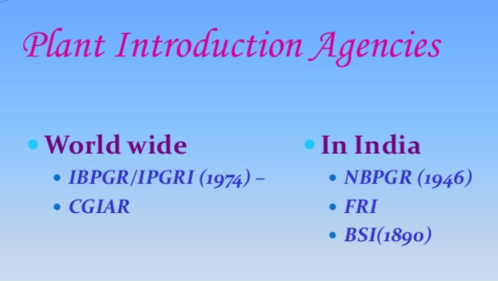
Plant Introduction Agencies

Slide 22
Centralised plant introduction agency – 1946- at Indian Agriculture Research Institute (IARI).
Funded by ICAR
1976- Division reorganised as National Bureau of Plant Genetic Resources (NBPGR).
NBPGR- responsible for introduction and maintenance of agricultural and horticultural crops.

Slide 23
National Bureau of Plant Genetic Resources.
Head Quarters at IARI.
4 substations –for testing introduced plant material.
1. Simla- temperate zone
2. Joghpur,Rajasthan-Arid zone
3. Kanya Kumari- Tropical zone
4. Akola, Maharashtra-mixed climatic zone
Additional one – Shillong-North East Asia.

Slide 24
Activities
Introduces required germplam.
Arranage exploration- collet germplam
Inspection and quarantine
Testing, multiplicationand maintainence of germplasm.
To supply germplasm
Maintain record on plant material.
To publish and record collection lists
To setup natural gene sanctuaries of plants.
Improvement of plants

Slide 25
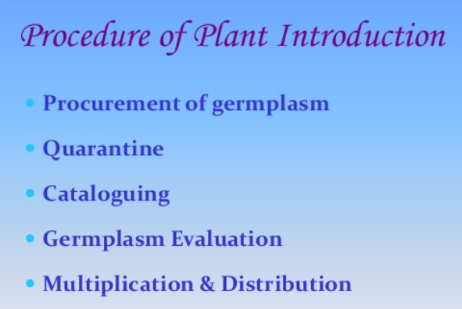

Slide 26
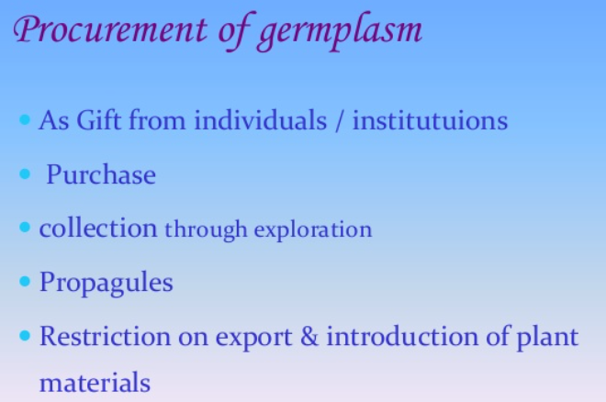

Slide 27
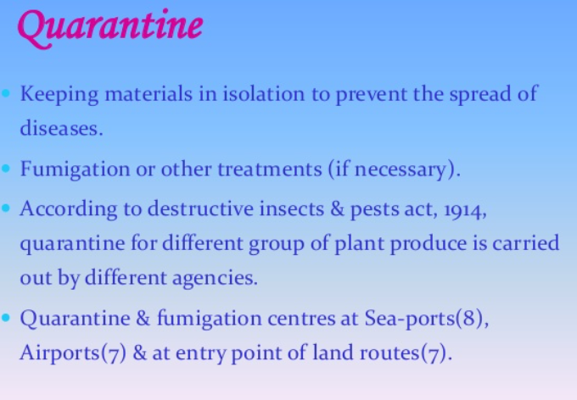

Slide 28
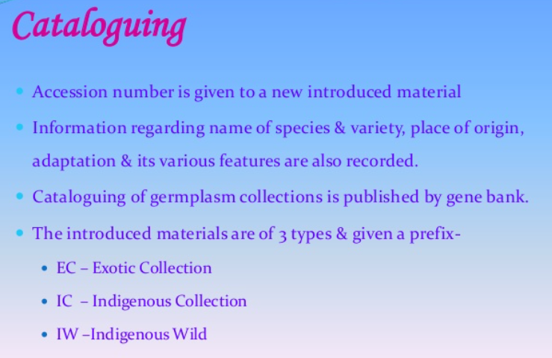

Slide 29
Evaluation
Performance of plants were evaluated.
Evaluation is done by NBPGR/ other research institutes under NBPGR.
Acclimatisation- process that leads to the adaptation of variety to new environment.
Acclimatisation – mode of pollination
range of genetic variability present in the original population.
duration of life cycle

Slide 30
Multiplication and distribution
Promising introductions- increased –released as variety.

Slide 31
Purpose of plant introduction
1. to obtain entirely new crop.
2. to serve as new varieties.
3. to be used in crop improvement.
4. To save the crop from disease and pests.
5. For scientific studies.
6. For aesthetic value
7. varieties selected from introductions.
8. Varieties developed through hybridisations

Slide 32
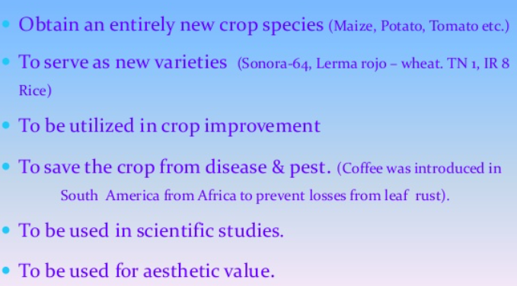

Slide 33
Merits of plant introduction
Provides entirely new plants.
Provides superior variteies either directly or as selection and hybridisation.
To protect genetic variability
To protect crops from genetic erosion.
Very quick and economical method.

Slide 34
