Slide 1
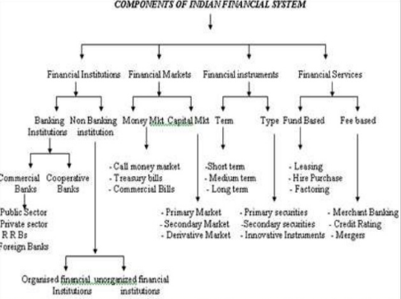

Slide 2
Financial system-Meaning and definition
According to Howells and Bain, financial system is defined as "A set of markets for financial instruments, and the individuals and institutions that trade in those markets, together with the regulators and supervisors of the system". A financial system is a system that allows the exchange of funds between lenders, investors and borrowers. They consist of complex, closely related services, markets, and institutions used to provide an efficient and regular linkage between investors and depositors.

Slide 3
FINANCIAL MARKETS
Meaning
Financial markets are the Centre that facilitates buying and selling of financial instruments, claims or services.it caters the credit needs of the individuals, firms, and institutions. It deals with the financial assets of different types such as currency deposits, cheques, bills, bonds etc. Financial markets may be defined as “a transmission mechanism between investors or lenders and the borrowers or users through which transfer of funds is facilitated”.

Slide 4
It consists of individual investors, financial institutions and other intermediaries who are linked by a formal trading rules and communication network for trading the various financial assets and credit instruments. The main participants in the financial markets are financial institutions, agents, brokers, dealers, borrowers, savers, lenders and others who are interconnected by law, contract and communication networks.

Slide 5
NATURE OF FINANCIAL MARKET
The important role performed by a financial market is described below
(i) They generate and apportion credit.
(ii) They serve as intermediaries in the process of mobilization of savings.
(iii) They provide convenience and benefits to the lender and borrowers.
(iv) They promote the economic development through a balanced regional and sectoral allocation of investible funds.

Slide 6
FUNCTIONS OF FINANCIAL MARKET
Borrowing and lending: financial markets permit the transfer of funds (purchasing power) from one agent to another for either investment or consumption purposes.
2. Price determination: financial markets provide means by which prices are set both for newly issued financial assets and for the existing stock of financial assets.
3. Information aggregation and coordination: financial markets act as collectors and aggregators of information about financial asset values and the flow of funds from lenders to borrowers.

Slide 7
4. Risk sharing: financial markets allow a transfer of risk from those who undertake investments to those who provide funds for those investments.
5. Liquidity: financial markets provide the holders of financial assets with a chance to resell or liquidate these assets.
6. Efficiency: financial markets reduce transaction costs and information costs.

