Slide 1
Corporate Accounting is a special branch of accounting which deals with accounting for companies, preparation of their final accounts and cash flow statements, analysis and interpretation of companies’s financial results and accounting for specific events like amalgamation, absorption, preparation of consolidated balance sheets.

Slide 2
Accounting Standard: Accounting standards are the policy documents issued by the recognized expert accountancy body relating to various aspects of measurements, treatment and disclosure of accounting transactions and events.
AS-I : Disclosure of Accounting Policies : The standard issued by Accounting standard Board (ASB) deals with the disclosure of significant accounting policies followed in preparing and presenting financial statements. Such disclosure would facilitate a meaningful comparison between financial statements of different enterprise.

Slide 3
Debentures: A debenture is written acknowledgement of debt by a company under its common seal, generally secured by floating change on company‟s assets. Interest is paid to debenture holders at a fixed rate at regular intervals.

Slide 4
Types of Debentures:
(a) Registered Debentures: Debentures which are transferable only by transfer deed.
(b) Bearer Debentures: Debentures which are transferred by mere delivery and the company does not keep the record of debenture holders.
(c) Redeemable Debentures: Debentures which are redeemed after specified period of time.
(d) Irredeemable Debentures: Such debentures are payable after a long period of time (not pre decided) or on winding up of the company.

Slide 5
(e) Convertible Debentures: Debentures which are convertible into shares or new debentures.
(f) Non-Convertible Debentures: Debentures which can not be converted into shares or new debentures.
(g) Secured or Mortgage Debentures: Debentures which are secured on particular assets or on general assets of the company.

Slide 6
Forfeiture of shares is a process where the company forfeits the shares of a member or shareholder who fails to pay the call on shares or instalments of the issue price of his shares within a certain period of time after they fall due. In other words, when the shareholder fails to pay the full amount of share which he agreed to pay in instalments the company can cancel his shares.

Slide 7
Redemption of debentures refers to payment of the amount of debentures by the enterprise. When debentures are reclaimed, liability on account of debentures is being discharged. To put it in other words, the amount of capital needed for redemption of debentures is large and, hence, economic enterprises make adequate provision out of gains and accrue capital to reclaim debentures.
Meaning of Redemption of Debentures
It means repayment of the number of debentures to the debenture holders.
Debentures can be redeemed either at par or at a premium.
The terms and conditions of redemption are usually given in the prospectus inviting applications for the issue of debentures.

Slide 8
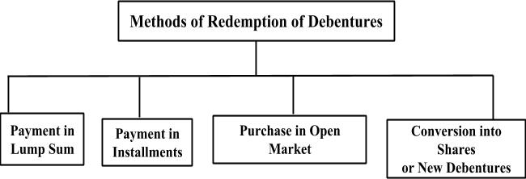

Slide 9
Payment in lump sum : The enterprise reclaims the debentures by paying the fund in lump sum (round sum) to the debenture holders during the maturity hereof as per the terms and conditions of issue.
Payment in instalments: Under this method, usually redemption of debentures is paid in instalments on the particular date during the time in the position of the debentures. The total amount of debenture liability is being divided by the total number of years. This must be noted that the authentic debentures reclaimable are recognised by the sources of drawing the required number of lots out of the debentures outstanding for the payment.

Slide 10
Purchase in open market: When an enterprise buys its own debentures for the aim of cancellation, such an act of buying and cancelling the debentures comprises redemption of debentures by purchase in the open marketplace.
Conversion into shares or new debentures: An enterprise can reclaim its debentures by transforming them into a new class of debentures or shares. If debenture holders find that the proffer is useful to them, they can exercise their right of transforming their debentures into new class of debentures or shares. These new shares or debentures can be either circulated at a premium, at a discount or at par.

