Slide 1
COLOR THEORY AND DIMENSIONS OF COLOR

Slide 2
COLOUR THEORY
INTRODUCTION
Day.1
Discussion on colour
Color is perception. Our eyes see something (the sky, for example), and data sent from our eyes to our brains tells us it's a certain color (blue). Objects reflect light in different combinations of wavelengths. Our brains pick up on those wavelength combinations and translate them into the phenomenon we call color.
Color means many different things to different people and cultures. We all have our own favorite colors. People like different colors like they like different foods. Color also represents feelings, people, countries, cultures, and color symbolism The most popular color in the world is blue. The second favorite colors are red and green, followed by orange, brown and purple. Yellow is the least favorite color, preferred by only five percent of people The most popular color in the world is blue. The second favorite colors are red and green, followed by orange, brown and purple. Yellow is the least favorite color, preferred by only five percent of people

Slide 3
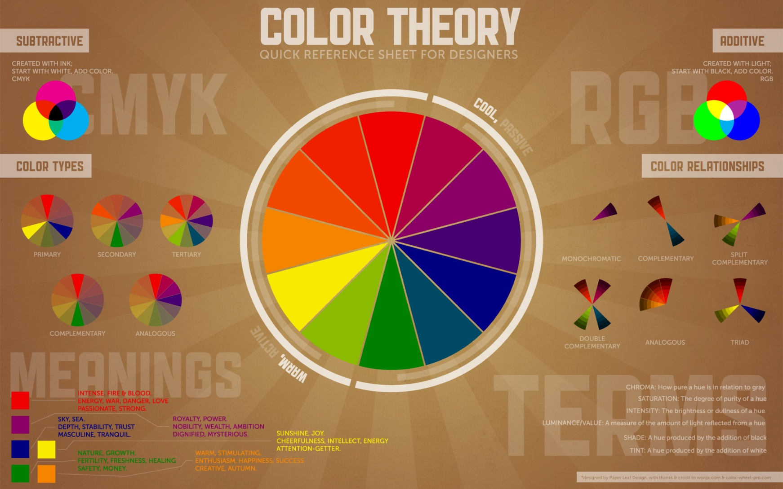
COLOR THEORY

Slide 4
PRANG COLOR SYSTEM
Day.2
The Prang color system is the basis of the artist's color wheel, and it uses red, blue and yellow as its primaries. This system theorizes that the three primary colors can't be produced by mixing other hues, but can produce all other hues through mixing two of the primaries together. Developed by Louis Prang, the Prang color system is most often used by artists in determining what paint pigments to mix in order to produce desired colors out of the basic primary colors.

Slide 5
MUNSELL COLOR SYSTEM
Day.3
The Munsell color system is a color system that specifies colors based on three color dimensions, hue, value, and chroma (difference from gray at a given hue and lightness). ... The system consists of an irregular cylinder with the value axis (light/dark) running up and down through it, as does the axis of the earth.

Slide 6
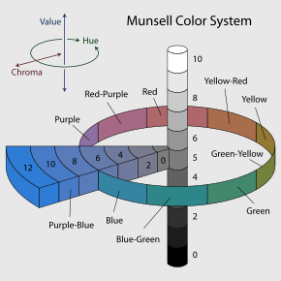
MUNSELL COLOR THEORY

Slide 7
DIMENSIONS OF COLOUR
Day.4
Qualities or dimensions of colors can be explained by means of fig 4.3 and the terminologies as follows.
Hue
Value
Chroma or Intensity

Slide 8
COLOUR SCHEME
Day.5
In color theory, a color scheme is the choice of colors used in design for a range of media. For example, the "Achromatic" use of a white background with black text is an example of a basic and commonly default color scheme in web design. Color schemes are used to create style and appeal.

Slide 9
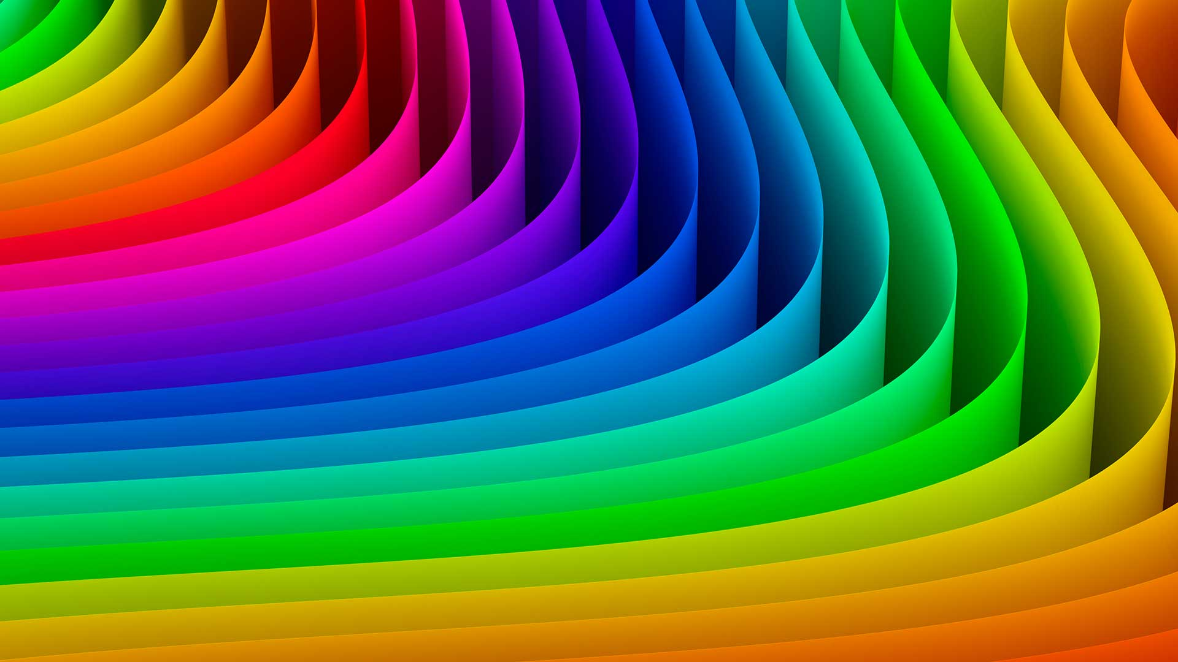
COLOR SCHEME

Slide 10
TEXTURE OF COLOR
Day.6
TEXTURE
The texture of a fabric will affect the appearance of colour because of the way in which different textures absorb and reflect light off their surface: Satin and silks will reflect light, velvet absorb light and a rough-textured fabric will cast shadows upon itself – affecting the appearance of the colours' temperature

Slide 11
TYPES OF TEXTURE
Day.7
1Actual texture
2Simulated texture
3Abstract texture
4Invented texture
5Needle texture

Slide 12
TYPES OF COLOUR SCHEME
Day.8
The 6 types of color schemes
Monochromatic color scheme. ...
Analogous color scheme. ...
Complementary color scheme. ...
Triadic color scheme. ...
Split-complementary color scheme. ...
Tetradic color scheme.

Slide 13
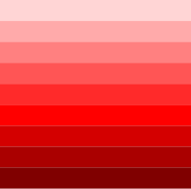
MONOCHROMATIC

Slide 14
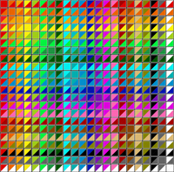
ANALOGUES

Slide 15
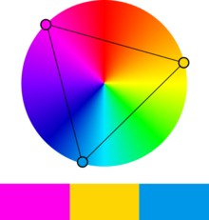
TRIADIC

Slide 16
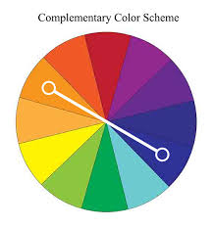
COMPLIMENTARY COLOR SCHEME

Slide 17
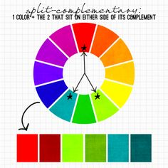
SPLIT COMPLEMENTARY

Slide 18
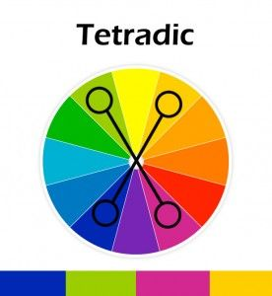
TETRADIC

