Slide 1
ELEMENTS OF DESIGN PRINCIPLES OF DESIGN

Slide 2
ELEMENTS OF DESIGN
Day.1
Elements of Design: In creating a design one of the components which interact is the Art Elements The elements and principles of design are flexible and should be interpreted within the context of current fashion. A design can be defined as an arrangement of lines, shape, colors and texture that create a visual image. The principles of design are the rates that govern how elements are combined. The elements are therefore the raw materials that must be combined successfully. The following are the different elements of Design:
Line
Form
Shape
Texture and
Color

Slide 3
ELEMENTS OF DESIGN

Slide 4
ELEMENTS OF DESIGN 1.LINE
Day.2
Line: It provides the visual dimensions of length and width. When lines combine, space is enclosed and forms and shapes are defined. Lines offered a path of vision for the eyes when is wearing an object/outfit. The arrangement of lines in clothing design can cause to appear heavier or thinner than what actually is
Horizontal line
Vertical line
Oblique line
Diagonal line.
Curved line etc.

Slide 5
LINE

Slide 6
ELEMENTS OF DESIGN 2.FORM
Day.3
Form: It is an object having three dimensions like length, width and depth. The human body is a form and by viewing it analytically, its various perspectives are revealed. The human form changes visually with clothing, especially as fashion changes.

Slide 7
FORM

Slide 8
ELEMENTS OF DESIGN 4.SHAPES
Day.4
SHAPES: It describes the outer dimensions or contour of an object. Shape also encloses space and imparts a certain character to the object viewed. Through clothing design, the shape of the human body is often revealed in a natural way, but sometimes even distorted. The shape of clothing in a human body, communicates silently, the messages about the wearer.

Slide 9
SHAPES

Slide 10
ELEMENTS OF DESIGN 5.COLOUR
Day.5
Color: When we talk of principles of designing, or when we start off with a given design theme the first thing to occur to our minds is the co lour and texture of the fabric

Slide 11
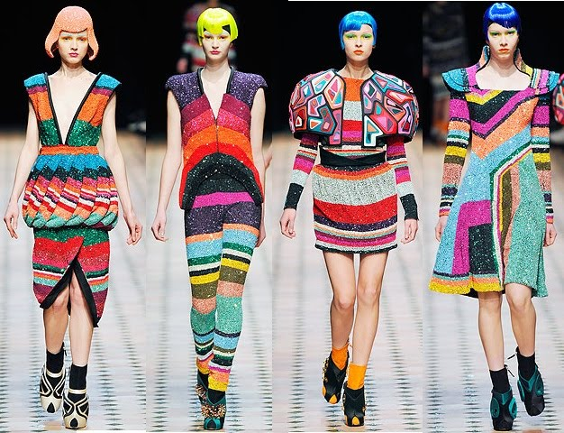
COLOUR

Slide 12
ELEMENTS OF DESIGN 6.TEXTURE
Day.6
Texture: As texture is the feel, drape and degree of stiffens and softness of the fabric, it also creates a visual effect upon the wearer, given a small swatch of fabric, the designer can visualize the texture and the fall of fabric which helps him to design further.

Slide 13
TEXTURE

Slide 14
PRINCIPLES OF DESIGN
Day.7
The Principles of Fashion Design:
The Principles are concepts used to organize or arrange the structural elements of design. Principles are guidelines and fundamental ideas that every designer in the working field should follow. In fashion design, there are five important principles and then apply to both the garments basic structure and that application. They provide guidelines to combine properly the five elements of design to create Balance
Proportion
Emphasis
Rhythm
Harmony

Slide 15
PRINCIPLES OF DESIGN 1.BALANCE
Day.7
Balance is the concept of visual equilibrium and relates to our physical sense of balance. It is a reconciliation of opposing forces in a composition that results in visual stability. Balance relates to the overall stability in the dress with the satisfactory arrangement of parts and details. Well, balanced dress produces visual harmony. The balanced design of the fashion is also divided into two ways. Such as-
Symmetric Balance
Asymmetric Balance

Slide 16
BALANCE

Slide 17
PRINCIPLES OF DESIGNS 2.RHYTHM
Day.8
Rhythm is created when one or more elements of design are used repeatedly to create a feeling of organized movement. Rhythm creates a mood like music or dancing. To keep rhythm exciting and active, variety is essential.

Slide 18
RHYTHM

Slide 19
PRINCIPLES OF DESIGN 3.EMPHASIS
Day.9
3. Emphasis or Centre of Attraction:
Emphasis is the concentrations of interest in the selected area of design. Usually, designers will make one area stand out by contrasting it with other areas. The area could be different in size, color, texture, shape.

Slide 20
PRINCIPLES OF DESIGN 4.HARMONY
Day.10
5. Harmony or Unity:
It is also called as UNITY of design. A good balance between unity and variety must be established to avoid a chaotic or a lifeless design. Unity is the feeling of harmony between all parts of the work of art, which creates a sense of completeness. Unity is a difficult principle to define. Unity ensures the goal for the overall look.

Slide 21
PRINCIPLES OF DESIGN 5.PROPORTION
Day.11
2. Proportion:
Proportion is the feeling of unity created when all parts (sizes, amounts, or number) relate well with each other. When drawing the human figure, the proportion can refer to the size of the head compared to the rest of the body.

Slide 22
PROPORTION

