Slide 1
ELEMENTS OF FASHION ILLUSTRATION

Slide 2
FASHION ILLUSTRATION
INTRODUCTION
Day.1
Fashion Illustration is the art of communicating fashion ideas in a visual form that originates with illustration, drawing and painting and also known as Fashion sketching

Slide 3
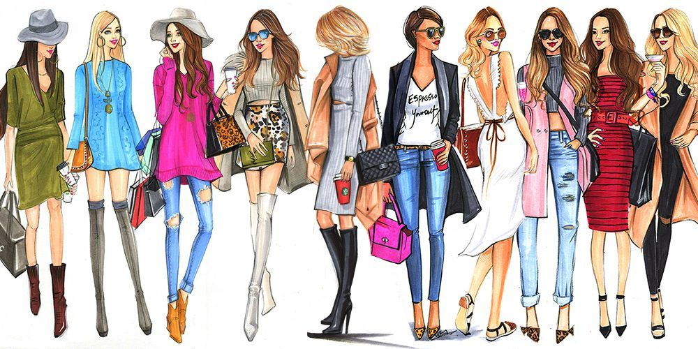
FASHION ILLUSTRATION

Slide 4
FASHION ILLUSTRATION
DEFINITION
Day.2
Fashion Illustration is the art of communicating fashion ideas in a visual form that originates with illustration, drawing and painting and also known as Fashion sketching. It is mainly used by fashion designers to brainstorm their ideas on paper or digitally.

Slide 5
FASHION ILLUSTRATION
HISTORY
Day.3
Fashion illustration has been around for nearly 500 years. Ever since clothes have been in existence, and there has been a need to translate an idea or image into a fashion illustration. Not only do fashion illustrations show a representation or design of a garment but they also serve as a form of art. Fashion illustration shows the presence of hand and is said to be a visual luxury.^{[1]}

Slide 6
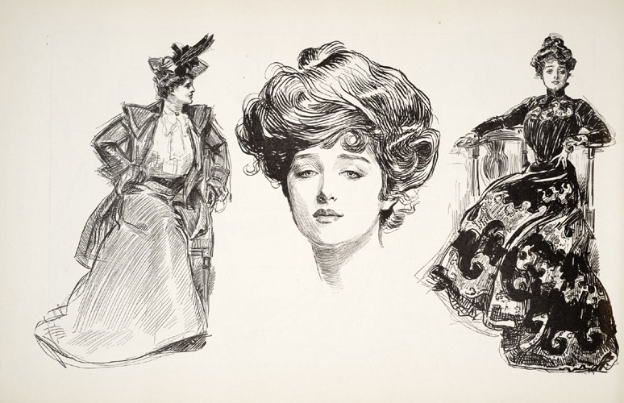
FASHION ILLUSTRATION
HISTORY

Slide 7
FASHION ILLUSTRATION
ELEMENTS
Day.4
Fashion illustration shows the presence of the fabric texture through the art and gives a visual luxury.
It is the communication of fashion.
Fashion illustration has been around for nearly 500 years.

Slide 8
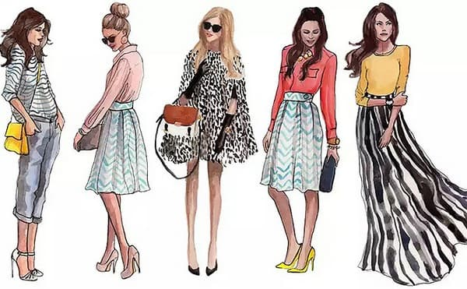
ELEMENTS

Slide 9
IMPORTANCE OF FASHION ILLUSTRATIONS
Day.5
Fashion illustration forms the initial face of every design. It can be defined as the basic transmission of an idea into a creative design through diagrams and drawings. Fashion illustration is a visual way of explaining different design ideas. They have played a critical role in fashion designing since the evolution of clothes.

Slide 10
INTERNATIONAL FASHION
ILLUSTRATORS
Day.6
The Top Fashion Illustrators Around The World
Kerrie Hess. Age: 39. Country: Australia. Most famous for: Her work with Louis Vuitton and Vogue. ...
Jason Brooks. Age: 50. Country: England. Most famous for: His iconic art for Ministry of Sound's record label Hedkandi. ...
Sean Ryan. Age: 33. Country: England.

Slide 11
HISTORICAL FASHION ILLUSTRATORS
Day.7
Paul Iribe (1883-1935)
Carl Erickson (1891-1958)
Rene Grau (1909-2004)
Andy Warhol (1928-1987)
Antonio Lopez (1943-1987)

