Slide 1
WEAVING
MODULE THREE

Slide 2
Day 26

Slide 3
WEAVING
It is a method of textile production in which two distinct set of yarns or threads are interlaced at right angles to form a fabric or cloth.
The longitudinal threads are called warp (end) and the horizontal or cross threads are the weft (pick) or filling

Slide 4
Cloth is usually woven on a loom, a device that holds the warp threads in place wile filling threads are woven through them.
The way the warp and filling threads interlace with each other is called weave.
The majority of woven products are created with one of three basic weaves : Plain weave, Satin weave or twill weave

Slide 6
The weft is threaded through warp using a shuttle.
Shuttle in the weaving of cloth a spindle shaped device used to carry the cross wise threads (weft) through the lengthwise threads (warp)

Slide 7
Weaving process
Three basic motions
Primary motions of weaving : in order to interlace warp and weft threads to produce a fabric on any type of loom, three operations are necessary.
shedding
Picking/filling /weft insertion
Beating up

Slide 8
Secondary motions of weaving
Warp let-off
Take up
Tertiary motions of weaving
Warp protector motion
Weft change motion
Warp stop motion

Slide 9
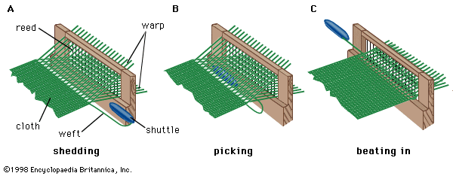
Primary motions of weaving
These are fundamental or essential mechanisms of loom.
Without these mechanisms, it is practically impossible to produce a fabric.
It is for this reason that these mechanisms are called primary mechaninms.

Slide 10
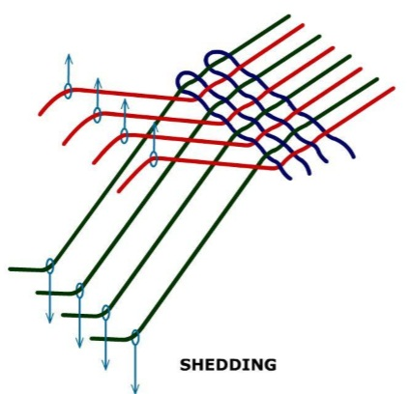
Shedding
Separating the warp threads into two layers to form a tunnel known as shedding.
Space between sheets called shed.

Slide 11
Day 27

Slide 12
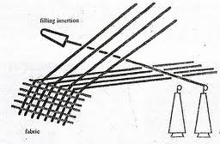
Picking
The process of inserting the filling yarn through the shed by the means of shuttle while the shed is opening.
The filling yarn emerges through a hole in the shuttle as it moves across the loom. A single crossing of the shuttle from one side of the loom to other is known as a pick.

Slide 13
Shuttle with quill or pirn
The filling yarn is inserted through the shed by a small carrier device called shuttle.
The shuttle is normally pointed at each end to allow passage through shed.
In the traditional shuttle loom, the filling yarn is wound on to a quill or pirn.

Slide 14
Beating up
Pushing the newly inserted length of weft, known as pick, into the already woven fabric at a point known as fell.

Slide 15
Warp control ( or let off)
This motion delivers warp to the weaving area at the required rate and at a suitable constant tension by unwinding it from weaver’s beam.
Cloth control ( or take up)
This motion withdraws fabric from the weaving area at the constant rate that will give the required pick spacing and then winds it onto a roller

Slide 17
Day 28

Slide 18
TYPES OF WEAVES
Weave is the interlacing pattern warp and weft yarns, in order to produce a woven fabric.
Weave structures is the design by which fabric is produced.
Fabric are manufactured in wide varieties and design.
The basic weaves are plain, twill, and satin. All the others are derivatives of these basic weaves or their combination.

Slide 19
Basic structure of weave

Slide 20
Plain weave
Most basic of three fundamental types of weaves.
It is strong and hard wearing
Used for fashion and furnishing fabrics.
In plain weave warp and weft threads interlace in alternate manner, giving maximum number of inter­lacements.
This maximum interlacement imparts firmness and stability to the structure.
The special names like broadcloth, taffeta, shantung, poplin, calico,
tabby, alpaca are applied to plain weave.

Slide 21
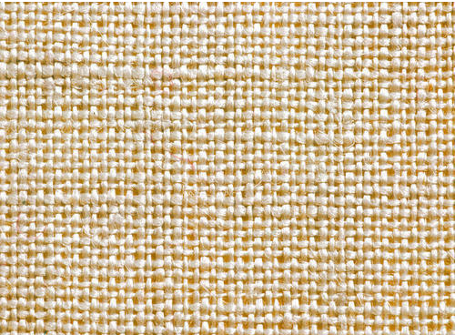

Slide 22
No right or wrong side
No lengthwise of crosswise stretch, only stretch is on the bias
Creases easily
Less absorbent than other weaves
Flexible
Strong
Hard-wearing
Durable
Characteristics of plain weave

Slide 23
Day 29

Slide 24
Variations of plain weave
Basket weave
Plain weave
Warp rib
Weft rib

Slide 25
RIB WEAVE
Rib weaves are obtained by extending the plain weave in either warp or weft direction.
Two kinds of rib weave are
warp rib
Weft rib

Slide 26
WARP RIB WEAVE
A warp rib are produced by extending plain weave in warp direction.

Slide 27
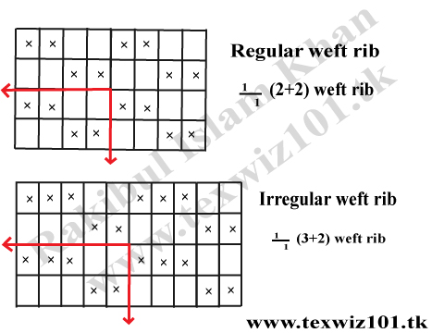
WEFT RIB WEAVE
A weft rib are produced by extending plain weave in weft direction and can be constructed on regular and irregular basis.

Slide 28
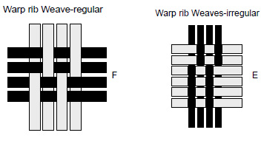

Slide 29
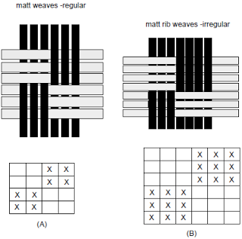
MATT/BASKET WEAVE
A matt or basket weave results from extending plain weave in both direction.

Slide 31
Day 30

Slide 32
Fabrics made out of plain weave
Calico
Georgette
Chiffon
Seersucker
Cambric
Voile
Muslin
Tabby
Tafetta

Slide 33
Voile : a soft yet firm, sheer fabric of plain weave. It is generally 100% cotton and blends include polyester and linen.
Muslin is a cheap, medium-weight plain weave fabric that is often used by tailors and designers to make a test garment before working with more expensive material.
Cambric, lightweight, closely woven, plain cotton cloth first made in Cambrai, France, and originally a fine linen fabric. Because cambric launders easily and well, it is ideal for handkerchiefs, children’s dresses, slips, underwear, and nightgowns.
Seersucker : this is a lightweight cotton fabric with alternating crinkled and smooth vertical stripes that never needs ironing.
Taffeta : taffeta is typically used for formal wear like gowns and fuller skirts. Taffeta counts as one of the richest and so much awesome fabrics.
Calico : Usually a plain, closely woven inexpensive cloth made in solid colors on a white or contrasting background. Often one, two, or three colors are seen on the face of the goods which are usually discharge or resist printed, frequently in a small floral pattern. Used mainly for aprons, dresses, crazy quilts, sportswear.

Slide 34
TWILL WEAVE
Twill weave produce diagonal lines in the cloth.
Twill lines are formed on both sides of cloth and direction of lines may be right or left.
Twill weaves enables greater weight,closer setting, better draping quality than plain weave in the cloth.

Slide 37
CHARACTERISTICS
They form diagonal lines from one selvedge to another.
More ends per unit are and picks per unit area.
More cloth thickness
The value of twill weave include its strength an durability

Slide 38
The diagonally arranged interlacing of warp and weft provide greater pliability and resilience than the plain weave.
Twill weave fabrics are more tightly weave and will not get dirty as quickly as the plain weave.
The yarns are usually closely beaten,making especially durable fabric.
Twill weave are commonly used in men’s suit and coats.

Slide 39
Day 31

Slide 40
Derivatives of twill weave
Herring bone twill
Diamond twill
Broken twill
Zigzag/waved twill weave
Curved twill

Slide 41
What Is Twill Used For?
Twill is a durable and versatile fabric that is used for clothing, accessories, and home goods.
Denim. Jeans are probably the most omnipresent and popular use of the twill weave. Denim is usually woven from cotton or a cotton blend.
Chinos. Cotton twill fabric makes chinos and khaki pants. The difference between chinos and jeans is in the weight of the fabric. Jeans are woven from heavier fibers, while chinos are lighter weight.

Slide 42
Work clothing. The twill weave creates a very durable fabric, which is ideal for outdoor and industrial work clothes such as overalls and jumpsuits, that get a lot of hard wear.
Upholstery. Many upholstery fabrics and home decor items are made using the twill weave, such as sofas, chairs, cushions, and curtains that usually need to withstand several years of repetitive use.
Bed and bath linens. The twill weave allows for high thread counts, which makes it very popular for sheets, bedding, and towels. Higher thread count cotton fabrics are generally softer and wear well, which make them great for everyday use.

Slide 43
Fabrics made out from twill
Drill
Denim
Gabardine

Slide 44
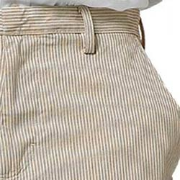
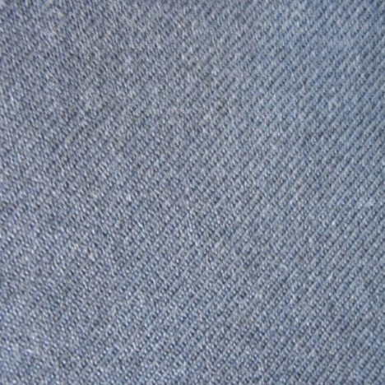
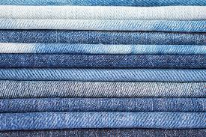
Drill : durable fabric of medium weight. Breathable. Good draability . Used for skirt, trousers etc..
Denim : firm, 2/1,3/1 ,twill weave of white filling and coloured warp.
Gabardine : A durable, compactly woven twill fabric that sometimes has a high sheen.
Denim drill gabardine

Slide 45
Day 32

Slide 46
Satin weave
Similar to twill weave but the diagonal line of satin weave is not possible.
It is purposely interrupted in order to contribute to the flat, smooth an lustrous surface desired.
There is no visible design on the face of fabric.
In a true stain weave, each warp and weft yarn only interlace once in each repeat of weave.
Thus, satin weave fabric have relatively long floats.

Slide 47
Satin weave creates a super smooth fabric that has a soft hand and drapes well.
This weave is achieved by ‘floating’ the warp or weft yarn over four or more of the opposite yarn
.The floating yarn is then passed under one of the opposite yarn before repeating the process again.

Slide 48
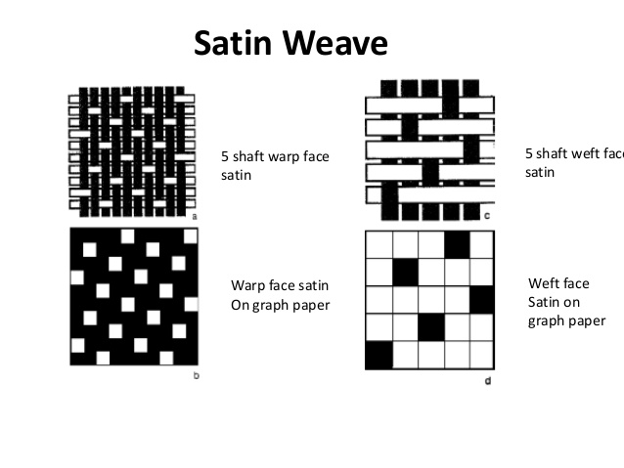

Slide 49
Satin & sateen

Slide 50
Sateen fabric
It is a durable cotton fabric usually with weft face satin weave.
it is not lustrous as satin fabric
Since it is also heavier,with thicker yarns , it is not as drapable as satin fabric.

Slide 51
Characteristics/properties of satin fabric
Good Drape
Good elasticity
Lustrous Surface
Versatile
Luxury fabric
Challenging to Sew
Frays easily
Snags easily because of the long floats
Difficult to care for
Fluid
Made from filament yarns, this is how it differs from sateen which is made from staple fibres

Slide 52
What Is the Difference Between Satin and Sateen?
Sateen is fabric made using short staple fibers in the satin weave pattern. Staple fibers are short fibers rather than long continuous fibers like silk, which are called filament fibers. For example, cotton makes short fibers that, when woven in the same way as satin, form a cotton sateen.

Slide 53
End Uses of Satin Fabric
Eveningwear
Lingerie
Linings
Facings
Sportswear
Hats
Shirts
Ties
Wedding Gowns

Slide 55
Day 33

Slide 56
Fancy weaves
Fancy weaves are ornamented weaves meant for decorating fabrics.
Ave an appearance distinctly different from basic, woven fabrics.
They are created by adding extra warp and weft yarns to the fabric structure and or by using special looms.
Types of fancy weaves are
Jacquard weave
Pile weave
Dobby weave
Leno weave

Slide 57
Jacquard weave
Jacquard fabrics have complex patterns.
These fabrics are made on jacquard loom.
Jacquard fabrics have more floats and lustre.
They are more stable and stretchy than the fabrics made through basic weaves.
The jacquard loom was invented by Joseph Jacquard in 1801 .
This was an mechanical loom and was controlled by punch cards having punched holes.

Slide 59
Types of jacquard fabrics
Brocade : Brocade is the most elaborately woven fabric. It has a raised pattern and is woven with multi-colored threads. Brocade produces rich designs and is the traditional jacquard fabric. It is generally heavy than other fabrics. Brocade is popularly used in fashion clothing and upholstery.
Damask fabric : A more fine and sheer version of Brocade, the Damask is also a patterned fabric which is woven mostly with single color. It is generally used in fiber blends or synthetic fiber production.

Slide 60
Pile weave
Extra sets of warps or fillings are woven ground yarns of plain or twill weave to form loops.
It is defined as fabrics with cut or uncut loops which stand up densely on the surface.
This textile is made up of multiple layers that give it a soft feel.
Piled fabrics classified as uncut pile and cut pile fabric.

Slide 61
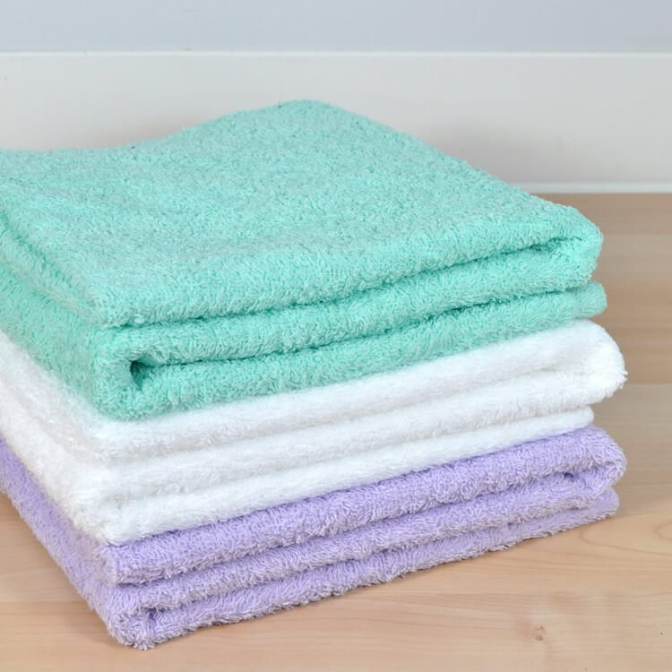
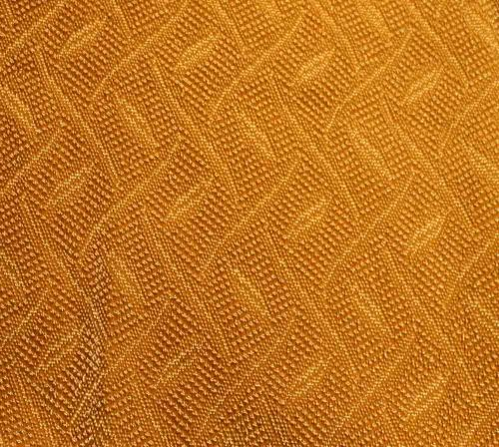
Uncut pile fabrics
Uncut pile, also known as loop pile or rounded loops, is a finish of the fabric without cutting the yarns. The Fabrics with uncut pile is very strong because the loops of the yarn run continuously from face of the carpet through its back. Added backing helps to strengthen it further.
Soft, absorbent relatively inexpensive
Can snags if loops are caught
Common fabrics : Terry Cloth, frieze

Slide 62
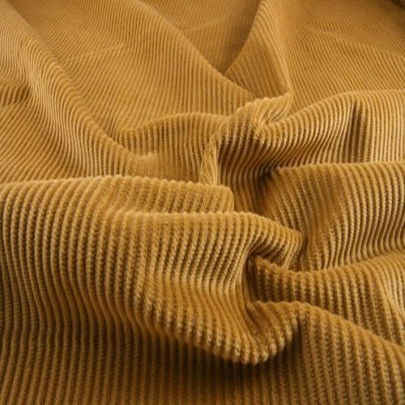
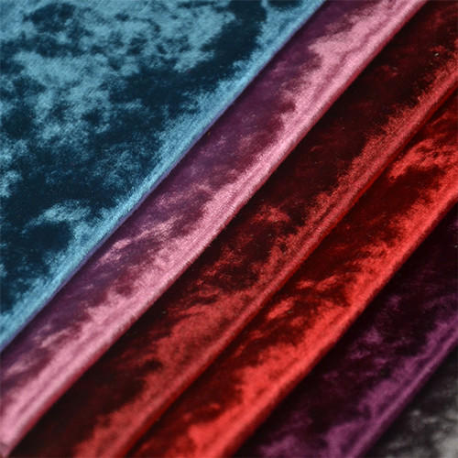
Cut pile weave
In this type of weave the face of the carpet is composed of cut ends of pile yarn.
The tops of the loops are cut in an uniform length.
Cut Pile is one of the most popular constructions for carpets.
Cut Pile is durable but the durability depends upon the type of fiber, density of the tufts and the amount of twist in the yarn.
Common fabrics : Corduroy, velvet

Slide 63
Day 34

Slide 64
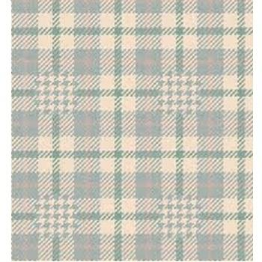
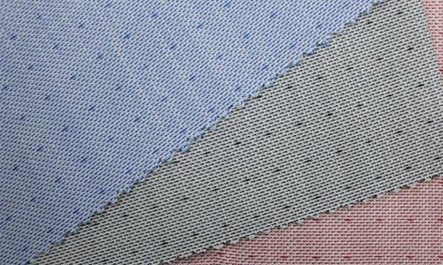
Dobby weave
Small figured designs (floral or geometrical) woven repeatedly throughout the fabric, produced by a combination of two or more basic weaves, using a dobby attachment on the loom. Weaving pattern controlled by a plastic tape with punched holes that control the raising & lowering of warp yarns.

Slide 65
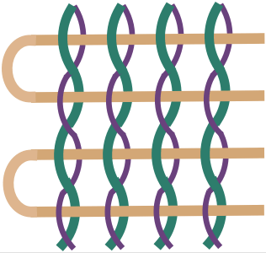
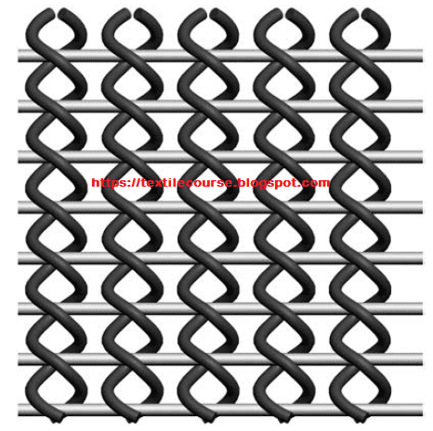
Leno weave
Also called gauze weave or cross weave
It is a weave in which two warp yarns are twisted around the weft yarns to provide a strong yet sheer fabric.

Slide 66
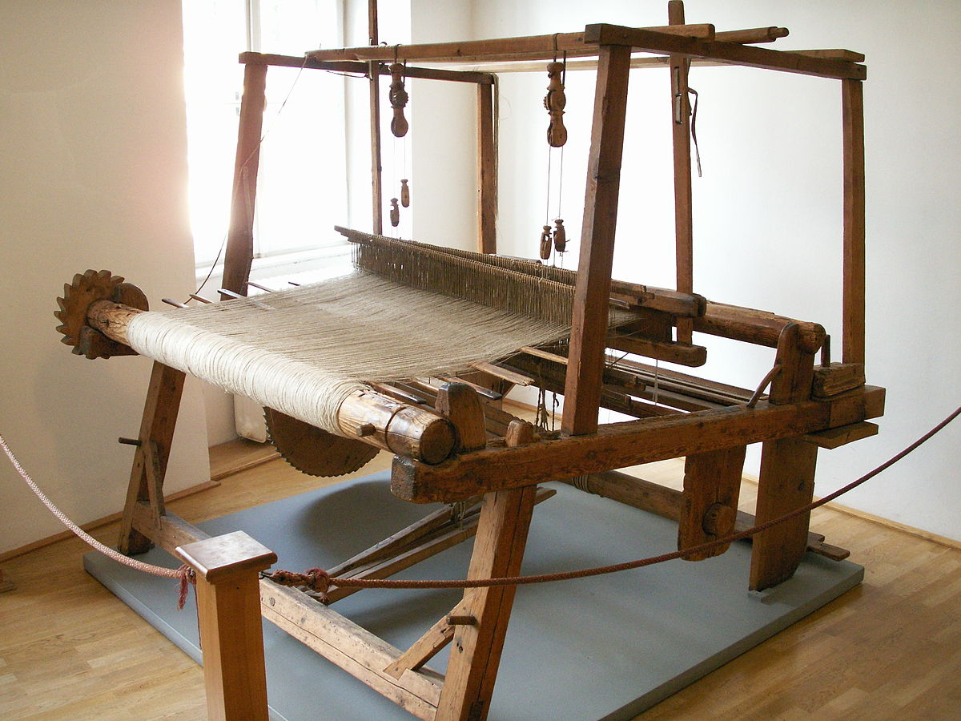
Loom
A loom is a device a used to weave a cloth.
The basic purpose of a loom is to hold the warp thread under tension to facilitate the interweaving of the weft threads.

Slide 67
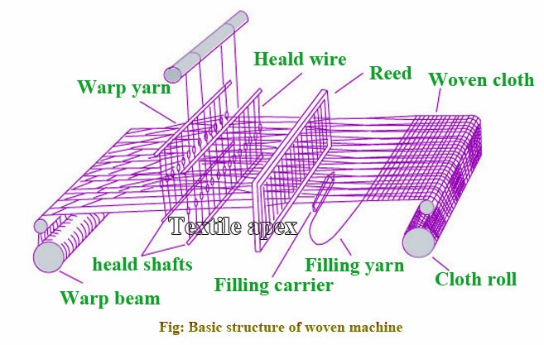
The Parts of A Loom

Slide 68
Day 35

Slide 69
Types of loom
Shuttle loom
Shuttleless loom - Projectile loom
Rapier loom
Waterjet loom
Airjet loom

Slide 70
Shuttle loom
The shuttle loom is the oldest type of weaving loom which uses a shuttle which contains a bobbin of filling yarn that appears through a hole situated in the side.
The shuttle is batted across the loom and during this process, it leaves a trail of the filling at the rate of about 110 to 225 picks per minute (ppm).
Although very effective and versatile, the shuttle looms are slow and noisy. Also the shuttle sometimes leads to abrasion on the warp yarns and at other times causes thread breaks.
As a result the machine has to be stopped for tying the broken yarns.

Slide 71
ADVANTAGES OF SHUTTLE LOOM
More economical than shuttleless loom.
It is suitable for low scale production industry.
Easy to operate.
Spare parts are avilable in the market.
DISADVANTAGES
Shuttle loom causes more noise in the working field.
The production rate is slower than shuttless loom.
High labour cost.
The value of fabric lost because of shuttle movement.
Efficiency of shuttle loom is less than shuttleless loom.
Increase physical and mental pressure on labour.

Slide 72
Shuttleless loom
Projectile Loom:
It is sometimes called missile loom as the picking action is done by a series of small bullet like projectiles which hold the weft yarn and carry it through the shed and then return empty.
All the filling yarns are inserted from the same side of the loom.
A special tucking device holds the ends of the wefts in place at the edge of the cloth to form the selvage.
This loom needs smooth, uniform yarn which is properly sized in order to reduce friction.
Projectile loom can produce up to 300 ppm and is less noisier then the shuttle loom.

Slide 73
Rapier loom
Rapier loom is a shuttle less weaving loom in which the filling yarn is carried through the shed of warp yarn to the other side of loom by finger like carriers called rapiers.
Features
Fancy fabric produced
Production costly
Power consumption moderate
Simple mechanism

Slide 75
Day 36

Slide 76
Airjet loom
Air jet weaving loom is that , at which jet of air is used to propel the weft yarn through the shed at a speed of up to 600 ppm.
Features
Weft yarn insertion is done by air force
Finer count of yarn is used as weft thread to produce fancy type of fabric .
Advantages
Higher production capacity
High quality and complex designs fabric can produce
Automatic pick repairing
Heavier yarns are suitable for airjet looms

Slide 77
Disadvantages
Loose pick
Need to nozzle pressure
Power consumption due to compressed air
Lighter fabrics are very difficult to control through shed
Too heavy yarns also can’t be carried across the loom by air jet.

Slide 78
Water jet loom
A water jet is the machine for weaving cloth (loom) which use a jet of water to insert the weft into the warp. The force of air water carriers the yarn from one side to the other.
Features
This type of loom is suitable for non absorbent fiber like synthetic fabric
Less power consumption
Highest weft insertion
Treated water are used by pump nozzle

Slide 79
Advantages
Less power consumption
Production rate is high
Noise level is lower than missile and rapier loom
Disadvantages
Not suitable for absorbent fiber like cotton
By hard water may form rust on the yarn

Slide 80
Day 37

Slide 81
General characteristics of woven fabric
Count of cloth or thread count
Count is the technical term used to indicate the number of warp and the weft (the filling yarn or picks) in one square inch of fabric as it comes from the loom.
If warps are 90 and the wefts are 80, the count written as 90 x 80 and a fabric in which the warp yarns and weft yarns are more in number it is called as high count fabric.

Slide 82
A very low count fabric is one in which the warp and the weft yarns number 28 and 24 respectively example in surgical gauze.
The exact number of warp and the weft yarns in a square inch of fabric can be counted with the help of an ordinary magnifying glass held over a tightly stretched piece of cloth.
2. Balance of cloth
The ratio of warp yarns to filling yarns is known as the balance of a cloth.
If the number of warps and number of fillings to the inch are nearly the same (not more than 10 yarns difference) a cloth is said to have a good balance for instance if the count is 60 X 50, it would be a well.
Shirts, pillow slips and towels which have various washing must have a good balance.

Slide 83
3. Selvage
A selvage is the self-edge of a fabric formed by filling yarn when it turns to go back across the fabric.
4. Yarns
Warp and filling have different characteristics and the fabric performs differently in the warp and filling direction.
Stronger yarns are used in the warpwise direction as they undergo more tension and friction than weft yarns.
Most fabrics stretched less in the warp direction.
5. Grain
The grain indicate the direction of the warp or weft yarns.
Length wise grain is a position along the warp yarns and parallel to selvedges crosswise grain is along the filling yarn.

Slide 84
Thank you

