Slide 1
MODULE 4 INDIAN NATIONAL MOVEMENT –GANDHIAN ERA
A new phase of Indian National Movement
1915- arrival of Gandhi
Truth and Non-violence
Satyagraha :
Non violent and Non-cooperation towards the government
His program includes Five virtues
Spinning
Removal of untouchability
Non-consumption of alchahol and opium
Hindu-Muslim Unity
Equality for women

Slide 2
A. NON VIOLENCE AND SATYAGRAHA
Elements of Gandhian philosophy
Qualities of a Satyagrahi:
Truth and peaceful
Accept sufferings willingly
Resist the Evil but love the Evildoer
Fearless
No hatred
Satyagraha – a combination of two words ‘Satya’ and ‘Agraha’
It is different from passive resistance
Satyagraha is truth oriented
Self sacrifice and readiness to bear endless sufferings

Slide 3
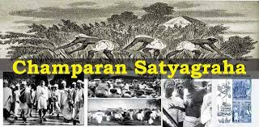
B. EARLY STRUGGLES(Gandian Satyagrahas)
1. Champaran Satyagraha(1917)
Bihar
Indigo cultivators
Protested against landlords
2. Kheda Satyagraha(1918)
Gujarat
Peasant struggle
To reduce the tax
3. Ahmedabad Mill Strike(1918)
Gujarat
Cotton cultivators
To increase wages

Slide 4
C. ROWLATT ACT(1919)
Sidney Rowlatt
Government appointed a committee
Prepared two bills- Anarchical and Revolutionary Crimes Act1919
Bills came to be known as ‘Black Bills’
According to the Bill:
A special Court should do a speedy trial of crimes
The provincial government was allowed the right to search any place and arrest people without a warrant
April 6th 1919- A hartal was organised against the Black Act
Gandhi started the Satyagraha Saba
Instructed people to use Khadi

Slide 5
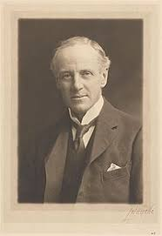
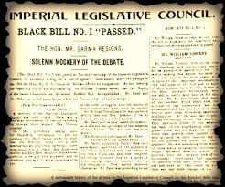
Act of 1919: 1.Govt.could rison people for 2 years without trial
2.No evidence was indeed
Sidney Rowlatt
The Black Bill

Slide 6
D. JALLIANWALLA BAGH MASSACRE
13th April 1919
At Amritsar
General Dyer
Prohibited all meetings and demonstrations
On a Baisakhi day villagers assembled in a Bagh
To protest against the arrest of two leaders
General Dyer entered the garden along with his troops
Blocked the main entrance
Ordered to fire on the crowds about 10 minutes
Hundreds were killed and thousands were wounded

Slide 7
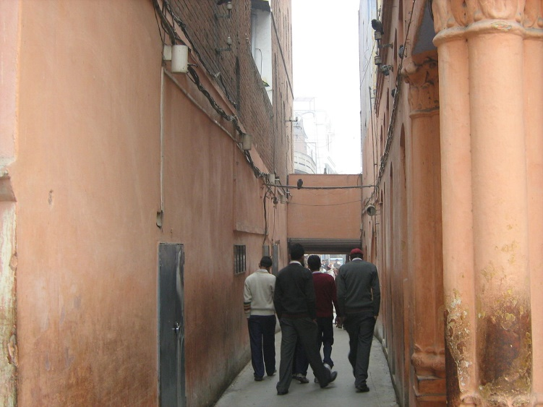
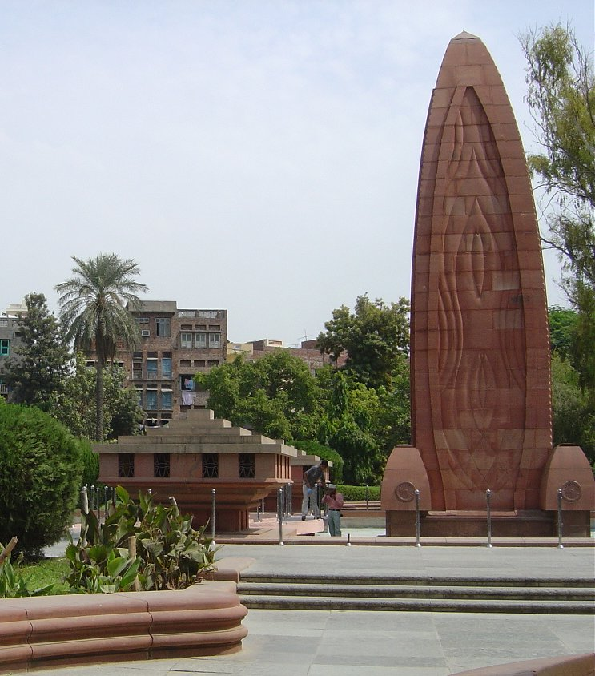
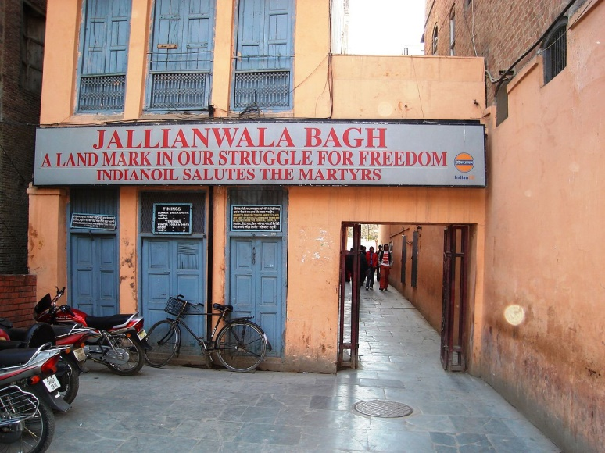
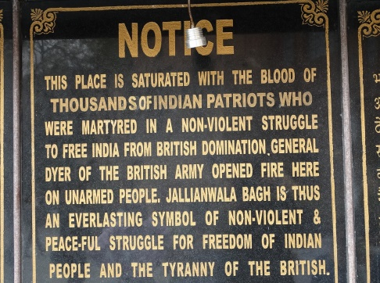

Slide 8
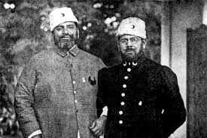
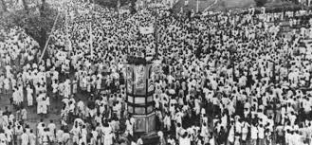
F. KHILAFAT MOVEMENT(1918-1919)
First World War
Defeat of Turkey
Abolition of Caliphate by the British
Khilafat Movement in Islamic countries
Ali Brothers(Maulana Muhammed Ali and Maulana Shaukat Ali)
Gandhi supported the movement to reunite the Hindus and Muslims

Slide 9
E. NON-CO-OPERATION MOVEMENT
Nagpur Session of INC-1920
The first major struggle of Gandhi against the British
concept of Satyagraha
Aimed to resist British rule in India
Refused to buy British goods
Factors led to the movement:
Oppressive policies of the British
Rowlatt Act
Jallianwalla Bagh Massacre
Khilafat Movement
Economic Hardships
Boycott movement
Surrender of Honourable titles
Non-payment of tax

Slide 10
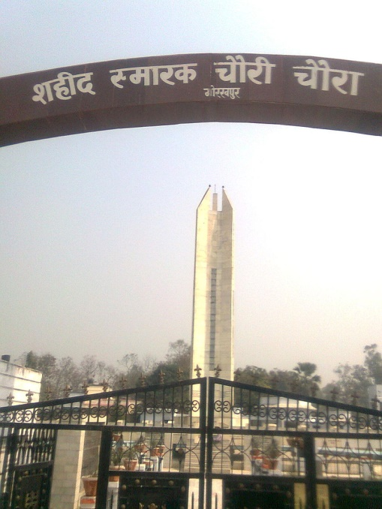
Swadeshi Movement
Formation of Kisan Sabha
Chauri Chaura Incident-1922
Withdrawal of Non Cooperation by Gandhi
Arrest of Gandhi for six years
Emergence of pro-changers and no-changers
Formation of Swaraj Party in 1923 by C.R.Das and Motilal Nehru

Slide 11
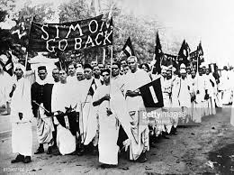
Hindustan Republican Association -1924
Kakori Conspiracy Case-1925
Arrival of Simon Commission to India ,1928
Anti- Simon Commission agitation
Raised the slogan ‘Simon Go Back’
Murder of Lala lajpat Rai
Assassination of British officer by Bhagat Singh and Chandrasekhar Azad
Execution of Bhagat Singh ,Sukhdev and Rajguru on 23rd March 1931

Slide 12
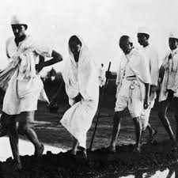

Slide 13
Simon Commission
Simon Commission, group appointed in November 1927 by the British Conservative government under Stanley Baldwin to report on the working of the Indian constitution established by the Government of India Act of 1919.
The commission consisted of seven members
Its composition met with a storm of criticism in India because Indians were excluded.
The commission was boycotted by the Indian National Congress and most other Indian political parties.
It met a hostile reception in India, and was boycotted there because it had no Indian members.
It recommended giving greater autonomy to Indian provincial governments, but maintaining a veto for the Viceroy.

Slide 14
The Simon Commission left England in January 1928.
Almost immediately with its arrival in Bombay on 4 February 1928, its members were confronted by thongs of protesters]
A strike began and many people turned out to greet the Commission with black flags and a slogan “Simon Go Back”
Similar protests occurred in every major Indian city that the seven British MPs visited
One protest against the Simon Commission became infamous.
On 30 October 1928, the Commission arrived in Lahore where it was met by protesters waving black flags.
The protest was led by the Indian nationalist Lala Lajpat Rai, who had moved a resolution against the Commission in the Legislative Assembly of Punjab in February 1928.
In order to make way for the Commission, the local police force began beating protestors.
Lala Lajpat Rai was critically injured and died a fortnight later.

Slide 15
The Commission published its 2-volume report in May 1930.
It proposed the abolition of dyarchy and the establishment of representative government in the provinces.
It also recommended that separate communal electorates be retained, but only until tensions between Hindus and Muslims had died down.
In September 1928 Motilal Nehru presented his Nehru Report to counter its charges that Indians could not find a constitutional consensus among themselves.
This report advocated that India be given dominion status of complete internal self-government.
In October, 1929 Lord Irwin made an unclear offer of a 'dominion status' for India.
On 10th Dec the Lahore session of INC passed a resolution declaring “Poorna Swaraj”
On 31st March ,they hoisted the newly adopted try colour flag of freedom
On 26th Jan 1930 was fixed as the First Independence Day
The session announced the launching of Civil Disobedience Movement

Slide 16
CIVIL DIS OBEDIENCE MOVEMENT
Civil disobedience was initiated under the stewardship of Mahatma Gandhi.
It was launched after the observance of Independence Day in 1930.
The civil disobedience movement commenced with the infamous dandi march when Gandhi left the Sabarmati Ashram at Ahmedabad on foot with 78 other members of the Ashram for Dandi on 12 March 1930.
After reaching Dandi, Gandhi broke the salt law.
It was considered illegal to make salt as it was solely a government monopoly.
The salt satyagraha led to a widespread acceptance of the civil Disobedience movement across the country.
This event became symbolic of people’s defiance of the government policies.

Slide 17
Following Gandhi’s footsteps, C. Rajgopalchari in Tamil Nadu led a similar march from Trichinopoly to Vedaranyam.
At the same time Sarojini Naidu a prominent leader in the congress led the movement in Darasana in Gujarat.
The police opened a lathi charge which led to over 300 satyagrahis being severely injured.
Consequently, there were demonstrations, hartals, a boycott of foreign goods, and later refusal to pay taxes.
A lakh of participants including women participated in this movement.
In order to consider the reforms by the Simon Commission, the British government convened the first round table conference in November 1930.
It was however boycotted by the Indian National Congress.
The conference was attended by Indian princes, the Muslim League, Hindu Mahasabha, and some others.
However, nothing came of it.
The British realized that without the participation of congress no real constitutional changes would come about.

Slide 18
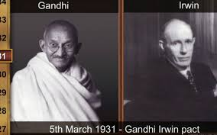

Slide 19
G. CONSTRUCTIVE PROGRAMMES OF GANDHI
Introduction of Khadi
Symbol of Nationalism, equality and self reliance
1924- Vaikkom Satyagraha
To remove the ban of entry of the depressed near temples roads
1926- Travancore Government - Opening of temple roads to depressed
1932 – formation of All India Anti- Untouchability League
Participation in Guruvayur Satyagraha

Slide 20
H. CRITIQUE OF GANDHIAN PROGRAMMES BY AMBEDKAR
- Ambedkar criticized caste and untouchability
- Gandhi wished to destroy the notion of hierarchy in Hinduism
2. - Gandhi: Villages are unique and basic social unit
- Ambedkar: Villages represents a kind of colonialism of Hindus
- Ambedkar: Separate Electorates for the depressed classes
- Gandhi : Reluctant to accept the depressed as a separate community
COMMUNAL AWARD/POONA PACT
16th August 1932
British Prime Minister Ramsay Mc Donald
Granting separate electorates for SC, Forward class, Muslims , Depressed etc.,
Special Constituencies for SC
Gandhi go for a fast unto death in Yervada Jail, Poona
A compromise agreement between Gandhi and Ambedkar
Known as Poona Pact

Slide 21
Signing of Poona Pact

Slide 22
Working Class Movement-Socialist Movements
Based on immediate economic grievances
To improve the conditions of working class
Labour strikes
Formation of Trade Unions
1920- All India Trade Union Congress

Slide 23
FIRSTWORLD WAR AND REVOLUTIONARY MOVEMENTS
Revolutionary movements in India haunted the imagination of post-war British officialdom.
They were used in the aftermath of the First World War to justify everything from colonial massacres to the indefinite censorship of the press.
The Revolutionary movement for Indian Independence was the part of the Indian independence movement comprising the actions of violent underground revolutionary factions.
Rash Behari Bose was called the 'father of Indian revolutionary movement'.
Groups believing in armed revolution against the ruling British fall into this category, as opposed to the generally peaceful civil disobedience movement spearheaded by Mohandas Karamchand Gandhi.
The revolutionary groups were mainly concentrated in Bengal, Maharashtra, Bihar, the United Provinces and Punjab.
More groups were scattered across India.
During the First World War the engine of revolutionary activity shifted from cosmopolitan elites in India to semi-permanent communities of migrant labourers abroad.
The largest proportion of these came from Punjab in north-west India and were largely Sikh.

Slide 24
Apart from a few stray incidents, the armed rebellion against the British rulers was not organised before the beginning of the 20th century.
The revolutionary philosophies and movement made its presence felt during 1905 partition of Bengal.
The initial steps to organise the revolutionaries were taken by Aurobindo Ghosh, his brother Barin Ghosh, Bhupendranath Datta, Lal Bal Pal
They formed the Jugantar party in April 1906.
Jugantar was created as an inner circle of the Anushilan Samiti, which was already present in Bengal, mainly as a fitness club.
Barin Ghosh was the main leader.
Along with 21 revolutionaries including Bagha Jatin, he started to collect arms and explosives and manufactured bombs.
Jugantar, along with other revolutionary groups, and aided by Indians abroad, planned an armed revolt against the British rulers during the First World War.

Slide 25
Left-wing politics supports social equality and egalitarianism, often in opposition of social hierarchy.
Left-wing politics typically involve a concern for those in society whom its adherents perceive as disadvantaged relative to others as well as a belief that there are unjustified inequalities that need to be reduced or abolished

Slide 26
I. SUBASH CHANDRA BOSE AND INA
Leftist leader of INC
Formed a party named ‘Forward Block’
Aim :
To lineup the right and left groups under one umbrella
British kept him under house arrest
He escaped to Japan
In 1943 he went to Singapore
1943- Japan conquered South East Asian British colonies
Indian soldiers were caught as prisoners
Japan offered help to liberate India
Indian Independence League was formed in Tokyo
In Bangkok they decided to form Indian National Army
Azad Hind Fauj was formed on September 1st 1942
Invited S.C. Bose to take the leadership of INA

Slide 27
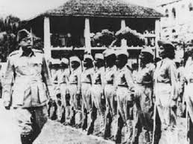
Slogans – “Jai Hind “and “Dili Chalo”
Soldiers called him “Netaji”
His declaration – “You give me blood and I will give you freedom”
In 1943 October he formed an Independent India Interim Government
Headquarters – Singapore
Interim Government declared war against the British
INA marched to India
Planted the Tri colour flag in Indian soil
British defeated INA
Subash Chandra Bose disappeared from Formosa

Slide 28
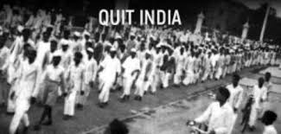
J. QUIT INDIA MOVEMENT(1942)
The last strong people’s struggle against British Government
Major reason:
The failure of Cripp’s Mission
The famine and price rise during the war
Attack threat from Japan
The British should leave India
All India Congress Committee met in Bombay on 8th August 1942
Passed the Resolution of ‘Quit India’
Gandhi’s slogan was ‘Do or Die’
Gandhi was arrested on 9th August 1942
People went on strike
Protest roared all over the country
A shift from the moderate philosophies
Established parallel governments
A turning point in Indian history

Slide 29
K. RIN MUTINY
Royal Indian Navy
18th February 1946
Bombay
Involvement of twenty thousand soldiers in 78 ships
A protest against their miserable living conditions and food
A Naval Central State Committee
Offered left hand salute to British
They disobeyed the British orders
Revolting ships hoisted three flags tied together
The Congress , The League and The Communist Party of India
A meeting was called between officials
The mutiny ended with the suspension of RIN officers

Slide 30
L. THELENGANA MOVEMENT(1946)
Peasant rebellion against the feudal lords
Feudal lords were known as Reddys
They ruled over the communities
Collected tax
Nizam had little control over the region
The communists took over three thousand villages from feudal chiefs
Many peasants lost their life
It became a struggle against the Nizam
Demand was to writing off of all debts

Slide 31
M. TEBHAGA MOVEMENT
A peasant agitation in Bengal
To reduce the land lord’s share in harvest
Movement resulted in clashes between Jotedars and Bargadars
The Muslim League Ministry launched
The share of harvest to the landlords were reduced to one third of the produce

Slide 32
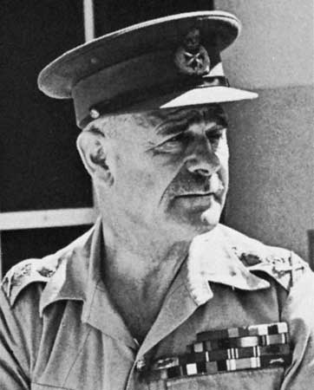
N. WAVELL’S PLAN
Viceroy Lord Wavell freed all prisoners
His Recommendations:
Formation of an Executive Council at the Centre
Every member except Viceroy and Commander in Chief would be an Indian
Hindus and Muslims would be given equal representation in Viceroy’s Executive Council
Constitution of India would be prepare by Indians
Viceroy would have veto power

Slide 33
O. SEPARATIST MOVEMENT
Two stages of separatism
Moderate Phase from the beginning ton 1935
Extremist Phase started from 1935 till partition
Emergence of the theory of Two Nation
Sir Sayyed Ahmad Khan declared that the Hindu Muslim interests are different
Mohammad Iqbal first put forward the idea of a separate state of Pakistan
Rahmat Ali , a Muslim student recommended the name Pakistan
Pakistan in Urdu means ‘Holy Land’
Muhammad Ali Jinnah propagated two Nation Theory
Hindu Maha Sabha unde V.D.Savarkar propagated aggressive communalism

Slide 34
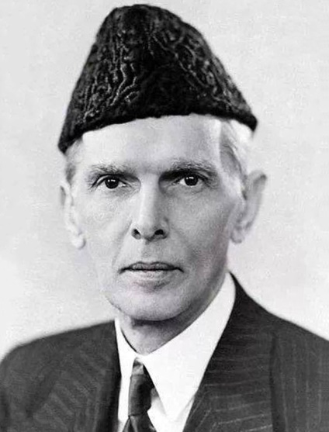
Two Nation Theory (Muhammad Ali Jinnah)
The Hindus and Muslims are two separate nations
They are economically, socially ,politically and culturally different
Their religious ideologies ,social customs are different
Due to all these reasons they can neither live together nor form a common viewpoint
Lahore Conference accepted the two nation theory
A resolution demanded the formation of a separate Muslim state
This was termed as the ‘ Pakistan Resolution’

Slide 35
P. CABINET MISSION PLAN
New government took office in Britain
Clement Atlee became the Prime Minister
Decided to withdraw from India
In 1946, Britain sent a three member Commission
Stafford Cripps , A.V. Alexander, Pethwick Lawrence
Recommendations:
A federal government consisting of British provinces and native states
Provinces have extensive power
A constitution committee would be summoned
An Interim government should be formed in the centre
Muslim League withdrew their support to Cabinet Mission Plan
They declared August 16 ,1946 as ‘Direct Action Day’
Communal riots broke out in Bengal
The Great Calcutta killing

Slide 36
Q. INTERIM GOVERNMENT
Lord Wavel invited Congress to form an Interim Government
Under Jawaharlal Nehru
League joined the Interim Government
Clement Atlee declared that they would leave India by June 1948
Ready to transfer power to Indians
League’s demand for a separate nation became stronger

Slide 37
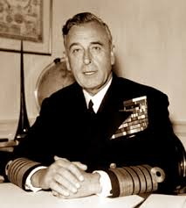
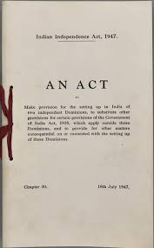
R. MOUNTBATTEN PLAN AND PARTITION
Viceroy Lord Mount Batten
Partition became inevitable
Proposed a compromise plan
Mount Batten plan:
Divided into two domains – India and Pakistan
Muslim majority areas would be included in pakistan
A border Commission was appointed to decide the borders of Bengal and Punjab
Native states have the right to join either India or Pakistan or being independent
1947 July – Indian Independence Act was passed
Created two independent states
15th August 1947 India became Independent
14th August 1947 Pakistan was created

Slide 38
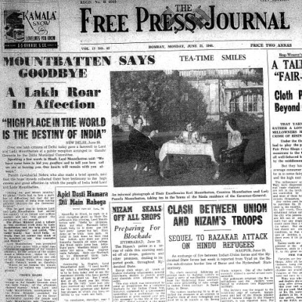
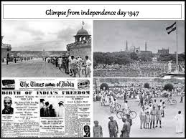
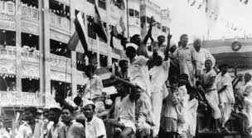
Memories of Independence:

Slide 39
Communal riots took place all over the country
Jammu and Kashmir had to face the question of choice
Refugee Crisis
Provinces of Punjab and Bengal were separate

Slide 40
THE END

Slide 41
THANK YOU

