Slide 1
V SEM
METHODOLOGY OF HISTORICAL WRITING

Slide 2
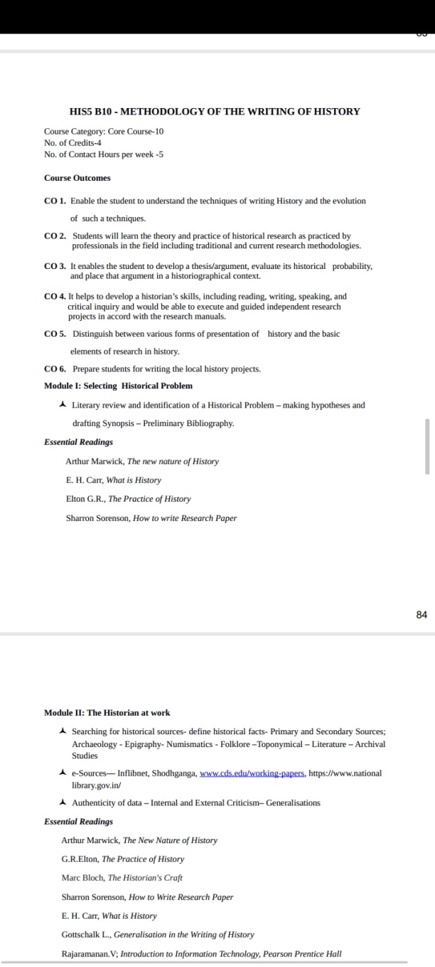

Slide 3
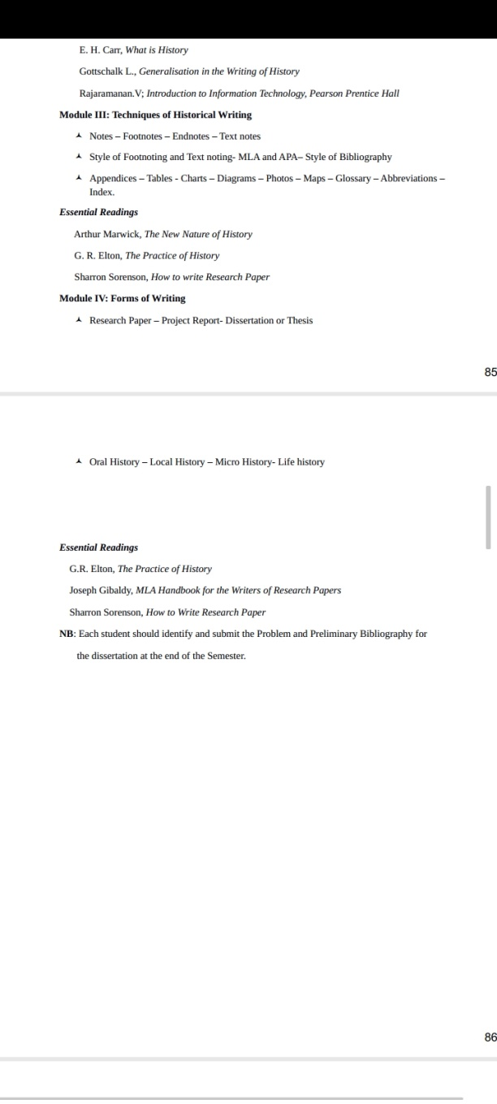

Slide 4
MODULE 1
SELECTING A RESEARCH PROBLEM
WRITING OF HISTORY
History is interpretation of the past in the words of a historian.
It is a scholarly study of what happened in the past without being judgmental or subjective.
The main job of a historian is to record the information and facts based upon narratives of the past and recollect the entire sequence of events without getting biased.
History starts from the time when writing was invented and people started to keep records of events occurring at that time.
Events belonging to a period before history are termed as prehistory and include events and people that are beyond the scope of history as it cannot be verified.
History includes authentic information about the past as and when it happened

Slide 5
What is Historical Research?
Historical research is the process of systematically examining past events to give an account of what has happened in the past.
•
It is not a mere accumulation of facts and dates or even a description of past events.
•
It is a flowing, dynamic account of past events which involves an interpretation of the events in an attempt to recapture the nuances, personalities, and ideas that influenced these events.
•
One of the goals of historical research is to communicate an understanding of past events

Slide 6
Significance of Historical Research
The following gives five important reasons for conducting historical research.
1. To uncover the unknown (i.e., some historical events are not recorded).
2. To answer questions (i.e., there are many questions about our past that we not only want to know but can profit from knowing).
3. To identify the relationship that the past has to the present (i.e., knowing about
the past can frequently give a better perspective of current events).
4. To record and evaluate the accomplishments of individuals, agencies, or institutions.
5. To assist in understanding the culture in which we live (e.g., education is a part of our history and our culture)

Slide 7
Steps in Historical Research:
The essential steps involved in conducting a historical research are as follows:
1. Identify a topic/subject and define the problems/questions to be investigated.
2. Search for sources of data.
3. Evaluate the historical sources.
4. Analyze, synthesize and summarize interpreting the data / information.
5. Write the research report.
Since most historical studies are largely qualitative in nature, the search for sources of data, evaluating, analyzing, synthesizing and summarizing information and interpreting the findings may not always be discreet, separate, sequential steps i.e. the sequence of steps in historical research is flexible.

Slide 8
Identification of a Historical Problem.
This is the most challenging part of research
It is the foundation stone of the research
According to Borg “In historical research, it is especially important that the student carefully defines his problem and appraises its appropriateness before committing himself too fully’. Many problems are not adaptable to historical research methods and cannot be adequately treated using this approach. Other problems have little or no chance of producing significant results either because of the lack of pertinent data or because the problem is a trivial one.”

Slide 9
Beach has classified the problems that prompt historical inquiry into five types:
1. Current social issues are the most popular source of historical problems in education. e.g. Rural education, adult and continuing education, positive discrimination in education etc.
2. Histories of specific individuals, histories of specific educational institutions and histories of educational movement.
These studies are often conducted with “the simple desire to acquire knowledge about previously unexamined phenomena”.
3. A historical study of interpreting ideas or events that previously had seemed unrelated. For example, history of educational financing and history of aims of education in India may be unrelated. But a person reviewing these two researches separately may detect some relationship between the two histories and design a study to understand this relationship.
4.A historical study aimed at synthesizing old data or merges them with new historical facts discovered by the researcher.
5. A historical inquiry involving reinterpretation of past events that have been studied by other historical researchers. This is known as revisionist history.

Slide 10
On the other hand, in order to identify a significant research problem;
Gottschalk recommends that four
questions should be asked:
(i) Where do the events take place?
(ii) Who are the persons involved?
(iii) When do the events occur?
(iv)What kinds of human activity are involved?

Slide 11
STEPS IN RESEARCH
Identification of Research Problem
Review of related literature
Formulation of Hypothesis
Definition of Key terms and Concepts
Definition of population , sample and sampling
Development of Research Design
Development of Instrumentation Plan
Data Collection
Data Analysis
Writing The Report

Slide 12
1, Identification of a Research Problem
A problem can be regarded as the difference between the actual situation and the desired situation.
A problem identification provides the platform for investigating a broad range of intervention and generating options
Identification of a problem is rather difficult for an inexperienced researcher
If the problem is not properly selected the scholar may not be in a position to do full justice to his research
A research problem should be difficult ,unclear situation,which the researcher experiences and wants an explanation or solution to it
He should be equipped with moral , mental,intellectual and practical training for identification of the problem
Researcher should make sure that the study should provide something worthwhile

Slide 13
SELECTION CRITERIA
1. Genuine Interest of the scholar
2. Availability of resources
3. The language of the materials
Genuine Interest of the scholar
The appropriation and acceptance of the problem are necessary to sustain the interest
The more problems investigated the more problems emerge
The periodization of history and the branches has to be decided by the scholar before his venture
Geographical extent is also to be decided

Slide 14
Availability of resources
The scholar should not be over ambitious
He should be aware of the availability of economic resources , time available and the period in which he has to finalise his work
He should be aware of the infrastructure facilities
He would have a thorough understanding about the availability of the source materials for his work
Place, availability, scattered sources, equippments
The language of the materials
If the material available is not in the language in which the scholar has mastery
In such cases there is no meaning in the availability of materials
Usefulness of the topic
The research topic must be useful for the future references

Slide 15
2, Review of related literature
Research studies related to the topic
Journal Articles
Importance:-
  To make a deep understanding about the research problem
  Extension of research knowledge
  To prevent unintentional duplication of well established facts
  To trace intellectual progression in the field of research
  To reveal the research gaps that exists in the literature
  To locate your own research within the context of existing literature
  To identify new ways to interpret prior research with new
  To resolve conflicts among seemingly contradictory previous studies
  To locate better methodology to accelerate the research
  To point the way in fulfilling a need for additional research

Slide 16
Definition:-A literature review is a comprehensive summary of previous research on a topic. The literature review surveys scholarly articles, books, and other sources relevant to a particular area of research.
The review should enumerate, describe, summarize, objectively evaluate and clarify this previous research.
It should give a theoretical base for the research and help you (the author) determine the nature of your research.
The literature review acknowledges the work of previous researchers, and in so doing, assures the reader that your work has been well conceived.
It is assumed that by mentioning a previous work in the field of study, that the author has read, evaluated, and assimilated that work into the work at hand.
Literature reviews are designed to provide an overview of sources you have explored while researching a particular topic and to demonstrate to your readers how your research fits within a larger field of study.

Slide 17
There are several steps in developing a literature review. These include:
selecting the topic
setting the topic in context
looking at information sources
using information sources
getting the information
organizing information (information management)
positioning the literature review
writing the literature review

Slide 18
3, Formulation of hypothesis
Hypothesis is a tentative solution
A shrewd assumption
A proposed explanation
Starting point of research
An educated prediction that can be tested
A proposed explanation for a phenomenon
A possible outcome of a research

Slide 19
What is a 'hypothesis'?
A hypothesis is a single sentence answer to the Key Inquiry Question that clearly states what your entire essay is going to argue.
A hypothesis (plural hypotheses) is a proposed explanation for a phenomenon.
It contains both the argument and the main reasons in support of your argument.
Each hypothesis should clearly state the ‘answer’ to the question, followed by a ‘why’.
When writing a dissertation or a thesis about history, students and researchers are asked to state a problem and a hypothesis for that problem

Slide 20
Hypothesis is a guide to investigation
A working hypothesis is a provisionally accepted proposal for further research
A researcher should try to prove or disprove it
A working hypothesis is empirical ,that can be tested using observation or experiment
It cannot be predicted before doing the research
Working hypothesis acts like a useful guide to address problems that are still in a formative phase
It is not necessary that the hypothesis should be correct
The hypothesis predicts what the researcher is expected to see
The goal of the research is to determine whether this guess is right or wrong

Slide 21
Researchers might draw a hypothesis from a specific theory or build on previous researches
It must imply a greater variety of observation statements
A hypothesis should be self consistent
Its conclusion should not be contradictory
It must be definite and clear,unless it would be difficult to verify the truth
The function of a hypothesis is to research facts

Slide 22
4, Definition of key terms and concepts
Define the words in the title
Give general definitions
Why need definitions?
To give precise and communicable meaning in a specific context
To avoid variations and confusions in interpretations
To establish the credibility of methodology
To ensure the reproducibility of the result

Slide 23
5, Definition of population , sample, and sampling
a)Population of Interest
The population of interest is the study’s target population that it intends to study or treat.
In clinical research studies, it is often not appropriate or feasible to recruit the entire population of interest.
Instead, investigators will recruit a sample from the population of interest to include in their study.
In such cases, the objective of the research study is to generalize the study findings from the sample to the population of interest

Slide 24
b)Sampling
Sampling is the process of selecting a statistically representative sample of individuals from the population of interest .
Sampling is an important tool for research studies because the population of interest usually consists of too many individuals for any research project to include as participants.
A good sample is a statistical representation of the population of interest and is large enough to answer the research question

Slide 25
6, Development of Research Design
It is the overall strategy utilised to carry out the research that defines a logical plan to answer established research questions through collection , analysis, interpretation and discussion of data
How to develop a research design?
A) Qualitative Research Design
B) Quantitative Research Design (survey , experimental)
C) Mixed Method Design (Strongest design)

Slide 26
7, Data Collection
Data means qualitative or quantitative value of a variable
Lower unit of in formation from which other measurements and analysis can be done
Three P’s of data collection
  a, Plan
  b, Procedure
  c, Protocol

Slide 27
8, Data Analysis and Interpretation
Analysis is the process of ordering , structuring and giving meaning to the collected rough data
The breaking down of the complex research materials into its fundamental and simplify states
Data interpretation is assigning a meaning to the information analysed and determine its significance and implication

Slide 28
9, Writing the report
Things to remember:-
A) novelty – Newness (Attractive)
Make the reader to move deep into the content
B) Simple Language- Everyone should understand
C) Conceptual Changing – connectivity among sentences
D) Research Format – Follow the format
E) Spelling Errors – Should not have a mistake
F) Typographical mistakes – Typing mistakes (spacing)
G) Referencing Format – Format in Bibliography

Slide 29
Drafting Synopsis
Synopsis is primarily a short note of an essay
It must have the relevant points of the proposed essay
The problems that stimulated the researcher to select the topic should be noted in the introduction of synopsis
The researches done already in the area and related areas also to be mentioned
Reference should be made to the related study
Give a title to the essay
The title should convey the central theme of the project
The introductory part of synopsis should contain the aims and objectives of the research project
The problem has to be expressed in the form of a hypothesis
A working bibliography has to be prepared
Critical summary of published work should be made to overcome limitations

Slide 30
Mark the methodology adopted in the proposed project
The methods of data collection, case studies etc. are also to be provided in the relevant part of the synopsis
Preliminary Bibliography
Bibliography is the alphabetical list of all sources used for the preparation of an academic essay
It is the list of published works
Two kinds of bibliography –(a) Preliminary Bibliography (b)Final Bibliography
Preliminary bibliography give a clear idea about the available sources for the preparation of the essay
Only after the preparation of preliminary bibliography that the scholar shall be in a position to decide whether there is scope for ensuing further on the topic or not

Slide 31
Not all the books be useful to prepare the preliminary bibliography
The scholars has to be selective
One has to make sure that the material is really related to the topic chosen through checking of the table of content and index
It is a working bibliography and should be reviewed and updated periodically
Preliminary bibliography have essential information like Author’s name & initials ,the name of book or articles, place of publication, publisher and date of publication etc.
Preliminary bibliography is a temporary format for details of the sources to be used

