Slide 1
MODULE – III NATIONALIST MOVEMENT- PRE GANDHIAN ERA
A). Economic critiques of colonialism
Dadabai Naoroji
Grand old man of India
First national critique of colonial economy
First economic thinker of India
Founder of East India association
First Indian to be elected to British Parliament
He formulated Drain Theory
His famous book – Poverty and Un British Rule in India
A major part of India’s wealth and resources were annually drained out to England without any adequate returns
Drain is the fundamental evil of the British
British policies were leading to the draining of the eye-blood of India and its wealth
He called British rule as plundering, unrighteous, despotic, destructive and un-British

Slide 2
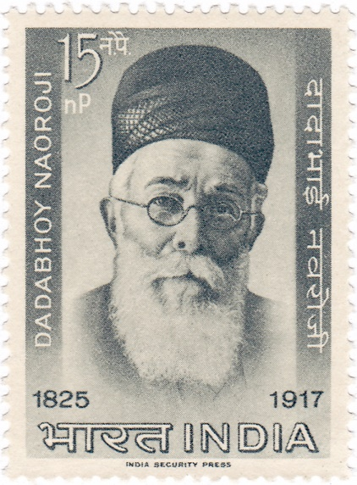
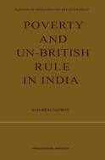
A Stamp
Dadabai Naoroji
Book written by Naoroji

Slide 3
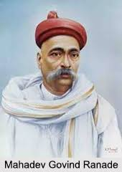
Drain Theory
Britain was draining and ‘bleeding’ India
Large part of India’s capital and wealth was being transferred to Britain
India did not get any economic and commercial benefit
Process of drain started after battle of Plassey
Drain was the most important cause of poverty in India
Drain was not only the loss of wealth but also the loss of capital
M.G. Ranade
Pointed out exploitative character of colonial economy
Delivered a lecture at Poona in 1872
More than one third of India’s national income was taken away by the British

Slide 4
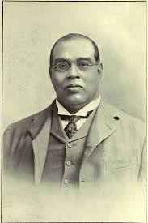
R.C. DUTT
“The Economic History of India”
One half of the net revenue flows annually out of India
Stagnation and poverty of Indian people under British
Colonialism was the main obstacle to India’s economic development
Early nationalist believed that development of modern industries were essential for economic growth
Nationalist leaders criticised the policy of encouraging foreign capital and suppressing Indian capital
The process of Drain began after Battle of Plassey

Slide 5
B). Programmes and Policies of Moderates
Moderates (1885- 1905)
INC dominated by liberal leaders
Dadabai Naoroji, Pheroz Sha Mehta, M.G. Ranade, Gokhale, S.N. Banerji, W.C. Banerji
They believed in British sense of Justice
Considered British rule as a blessing
Did not demand freedom of the country
Aimed at the self government for India within British Empire
Methods
Constitutional agitation
Prayer, Petition and Protest

Slide 6
Demands
Elected representatives in the provincial and central Legislative Council
Holding of ICS examination in India
Reduction of Military expenditure
Spread of education
Agricultural and industrial development

Slide 7
Extremists (1906 – 1918)
Aggressive attitude of the Leaders
The agitation methods of protests
Bal Gangadhar Tilak, Lala Lajpat Rai, Bipin Chandra Pal (Lal Bal Pal)
Causes for the rise of Extremist
Young middle class men lost faith in moderates
Wanted to get their demands full filled by force and pressure
Economic discontent
Great famine of 1896-1897
Bubonic plague of 1899 – 1900
Extravagance of British government
20th century revolutions all over the worlds
Their goal was Poorna – swaraj
They criticized “political mendicancy” of moderates

Slide 8
Methods
Boycott, Swadeshi, National education
Boycott British Goods and use Indian
Boycott schools and colleges run by British government
National Schools and colleges were setup
Wanted to achieve Swaraj through mass struggle

Slide 9
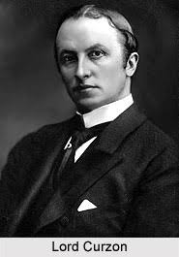
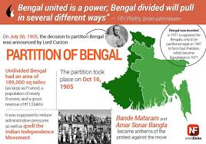
C). Partition of Bengal (1905)
Lord Curzon
Divided Bengal into Two
West Bengal with Hindu majority
East Bengal with Muslim Majority
‘Divide and Rule’
Repealing the partition in 1911 by Lord Hardinge
Reaction against partition
INC opposed partition
Partition as a challenge to Nationalism
Anti partition movement lead by Nationalist leaders of Bengal
S.N. Banerji and Krishnakumar Mitra
Anti partition movement on 7th August 1905
Massive demonstration organized in Calcutta
Partition took effect on 16th October 1905
The day was observed as ‘Day of National Mourning’
Hartals in Calcutta
Tagore Composed National Song ‘Amar Sonar Bangla’

Slide 11
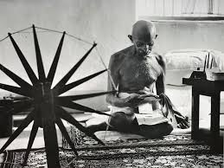
D). Swadeshi Movement
Means of Protest
Laid emphasis on self resistance
Aim was to encourage Indian industries
Encouraged regional education
Encouraged cotton industries and large scale business ventures
Started national schools
Formed National Education Committee in 1906
‘Swaraj or self governance’ become the slogan of the movement
Results
Contributed new modes of resistance
Paved way for revolutionary terrorist activities
Reaching the national resistance to the masses

Slide 12
FORMATION OF MUSLIM LEAGUE (30th December 1906)
All India Muslim League was established in 1906
Party was formed in Dhaka ,in the present day Bangladesh
It was formed under the leadership of Aga Khan
The partition created a communal divide
The Bengal partition happened due to the split in Congress and the difference between Hindu and Muslim
Muslim community feel that they are neglected and poorly represented in comparison with the majority
This was the ideology that led to the formation of Muslim League
League became a sole body of Indian Muslims because:
The support of the British government to the political Islamists in their non-secular intention
The contemptuous attitude towards the majority rule

Slide 13
E). Surat Split (1907)
The conflict between the moderates and extremists in the congress
Split in INC
Direct confrontation with the extremists
INC session on 26 December 1907 at Surat
The first days meeting had to be stopped following an agitation by extremists
Direct physical confrontation between the moderates and the extremists
INC summit was temporarily suspended
Extremists exited the congress
Congress split became official

Slide 14
F). Administrative Reforms of 1909
Indian Council Law 1909
Minto – Morley reforms
Lord Minto was the Viceroy and Morley was the Secretary of State for India
Aim:-
To take in to confidence of Moderates and Muslims
To create a split among nationalists
Reforms:-
One seat was left vacant in the Governor General’s Legislative Council for an Indian
Membership age in Central Legislative Council was raised from 16 to 60
The membership in the State Legislative Council was increased
Minto – Morley reforms arranged separate electorates for Muslims

Slide 15
G). Home Rule Movement
A movement in British India on the lines of Irish Home Rule Movement
Leadership of Annie Besant
1909 Government of India Act failed to satisfy Indian demands
In 1916 Home Rule League were instituted in India
Tilak founded Indian Home Rule Movement in Belgaum (Karnataka)
Aim
To gain Home Rule or Self Governance for India within British Empire
Government Measures
Government imposed the ban on Tilak entering Delhi and Punjab
Annie Besant was kept under house arrest
Due to people agitation government was forced to release Annie Besant
In 1917 British parliament declared that responsible government would be brought about to India

Slide 16
H). Lucknow Pact (1916)-Congress –League Pact
It was an agreement between moderates and extremists
Reunion of INC and Muslim league
Educated Muslim youth had joined the nationalist movement
They tried to bring the Congress and League together
Joint session of all in 1916 at Lucknow
Signed by Tilak and Muhammad Ali Jinnah
Pact for Hindu – Muslim Unity
Came to be known as Congress – League programme
Demands
Self Government for India from British
Expansion of Provincial Legislative Councils
Separate Legislative Councils for the Muslims
Minority in the provinces should be protected
Separating the Executive from Judiciary

Slide 17
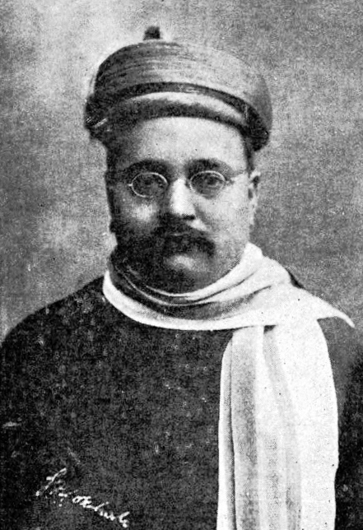
I). Gokhale
Born on 9th May 1866 in Maharashtra
Received English Education
Appointed as a clerk in British Raj
Became a member of INC in 1889
Accepted Ranade as his Guru
The president of Congress in Banaras session 1909
A moderate leader
Established an organization ‘ Servants of India Society’ in 1905

Slide 18
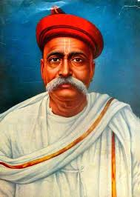
J). Bal Gangadhar Tilak
Born on 23rd July 1856 in a Marathi Brahmin family
A post graduate from Bombay University
First leader of Indian independence movement
British called him “Father of Indian Unrest”
Conferred with the title “Lokmanya “
Founded new English School in Pune in 1880
Later this school came into exist as Fergusson College
Joined INC in 1890
An extremist leader
Founded news papers ‘Kesari’ and ‘Maratha’(English)
He spread patriotism through his news papers
His words – “Swaraj is my birth right and I shall have it”

Slide 19
Tilak used the Ganapati festival and the Sivaji festival of Maharashtra to unite people and to spread nationalism
He started Lathi Clubs to inspire Hindhu youth
In 1896-97 he started Anti-Tax movement in Maharashtra
He asked farmers to not to pay tax
He called the people to Boycott the British goods
He opposed the moderate views of Gokhale
After Surat Conference he was arrested
Tilak defended the revolutionaries and called for immediate self rule
Government charged with him sedition (misconduct)
He was imprisoned for 6 years in Mandalay(Burma)
There he wrote two works ‘Truth in Gita’ and ‘Arctic Home in the Vedas’

Slide 20
K). Revolutionary Movements
Secret groups arose in Bengal and Maharashtra
‘Swadeshi Dacoities’
1). Abhinav Bharat – 1904
2). Bharat Mata Association
3). Bharat Mata Society
4). Anusheelan Samiti
5). Yuganthar Party

