Slide 1
Module 3 TECHNIQUES OF HISTORICAL WRITINGS
A historian should be aware of the techniques and methods of historical writing
In the introductory part of the work he should express the methods and techniques through which he is going to present the subject
Objectivity is an essential aspect of historical writing

Slide 2
NOTES
It is essential for any research scholar to take notes from books, articles and any other sources
It is on the basis of these notes he composes his research work
It is not possible for an individual to memorise all that he had read for the preparation of a research work
Notes should be taken carefully and systematically
The scholar should be very clear about what is to be noted down

Slide 3
It is not necessary to copy down the whole document
The scholar should make a rough chapterisation on the basis of his synopsis and give suitable headings for each chapters
He should have a fair idea about the matter to be included in each chapter
Taking notes does not mean copying the documents
The notes can be broadly placed under two categories:- ‘corpus’ & ‘regesta’
Corpus :- in which extensive notes are taken down
Regesta :- in which only the relevant points are noted down

Slide 4
The nature of the notes depends on the significance of the document
Taking notes is not an easy affair
It needs power of understanding and capacity to decide what is to be noted or not to be noted
It also needs deciding about the nature and importance of the document from which notes are to be taken

Slide 5
FOOTNOTES AND END NOTES
Footnotes are notes placed at the bottom of a page.
They cite references or comment on a designated part of the text above it.
For example, say you want to add an interesting comment to a sentence you have written, but the comment is not directly related to the argument of your paragraph.
In this case, you could add the symbol for a footnote.
Then, at the bottom of the page you could reprint the symbol and insert your comments

Slide 6
A research work is prepared on the basis of materials collected from different sources
So it becomes essential that source material should be acknowledged and be available for verification if needed
It is an integral part of the scholarly honesty that the source or authority of a citation in the body is acknowledged with the help of a proper footnote, or endnote
Footnotes are usually given at the foot of the page
Text notes are source references appearing parenthetically within the main text

Slide 7
While footnotes and endnotes are keyed by number to a word,phrase or sentence in the text ,textnotes do not require this
The key difference between the footnotes ,end notes and text notes is their placement in the text
Footnotes are more accessible than end notes because they are found nearer to the actual text being referred or referenced to
End notes are useful for providing graphs and tables

Slide 8
Style of Foot noting and Text noting
A footnote should contain the source of information usually the name of the author, title page and date of publication
In the cases of end notes a centered heading ‘foot notes’ is required at the end of the paper ,chapter or work
The details in footnotes and end notes are similar
In the footnotes , names of the authors and editors should be given in normal order with first name given first
This should be followed by the date of source , title of the source and page numbers
If the work is in volumes then the number of volume should be given in Roman numerals

Slide 9
Page numbers will be in Arabic numerals
Introductory pages should be in lower case Roman Numerals
The title of the reference source is normally underlined in the footnotes
Titles and subtitles are separated by a colon.
Titles of books, publications, periodicals and newspapers are italicized.
The title of a work that has not been translated into the language of the document in which the reference appears is normally given in the language of publication.

Slide 10
Once the first reference is spelled out in the footnotes ,the repetition can be avoided
If reference is made to a different page of the same source ,supplied immediately above, the term ‘Ibid’ is used
Eg:E.H.Carr,1961,What is History,p.88.
Ibid.,pp.92-93.
If the reference is made to the same work as proceeding,but not immediately proceeding the reference ,’op.cit’ is used,following the author’s name
Carr ., op.cit. p.140.

Slide 11
The abbreviation ‘p’ for page and ‘pp’ for pages are used
Footnotes in tables or figures are to be placed one single space below the table or diagram
Textnotes : As text notes appear parenthetically it does not require numbers to a word,phrase or a sentence
If the manuscript has a very few sources and no bibliography at the end ,complete source can be inserted within the text as parenthetical text notes
If author’s name is mentioned in the text itself ,there is no need to repeat it in the text notes

Slide 12
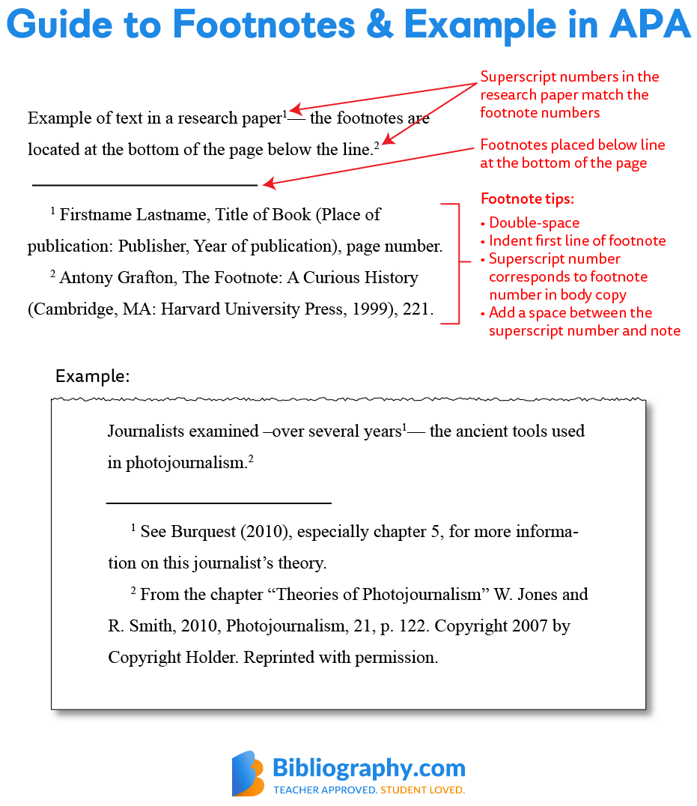
There are two types of footnotes used in APA format: content footnotes and copyright footnotes.

Slide 13
How to Create an MLA Parenthetical Footnote Citation
Denoting a footnote in MLA style requires a number in superscript.
Try to place this at the end of a sentence. It should come after punctuation or quotes.
However, in some cases, it’ll make the most sense to have the superscript number in the middle of a sentence.
MLA Footnote Example: In-Text
Alaskans must avoid their father during the time of puberty.¹ In that area, obstacles come in to “keep the men and women separated.”² The men and women in stories are kept separate,³ and this might be due to some financial obstacle.

Slide 14
How to Write a Footnote Citation in MLA
Place footnotes at the bottom of the page in their own special section.
Follow the same numerical order on the page.
Firstly, start each note with the superscript number that corresponds with the in-text citation.
Then, remember that bibliographical notes provide citations similar to the works cited and vary based on the source.
By contrast, content notes will point the reader to where more information can be found.

Slide 15
MLA Bibliographic Citation Footnote Format & Example
Format: ¹Author’s Name, Title of Work in Quotes (City: Publisher, Year) Page Number.
Example: ¹Sigmund Freud, Totem and Taboo (New York: Random, 1918) 26.
MLA Content Note Citation Footnote Format & Example
Format: ²See Author’s Last Name, especially (insert important pages), what it will show or prove.
Example: ²See Green, especially 1-8, to show the different courtship principles

Slide 16
STYLE OF BIBLIOGRAPHY
Bibliography comprises a list of sources both primary and secondary
It is usually placed immediately after the last chapter of the work and some writers like to place it after appendix
Every book,articles,thesis,document which have been read examined and cited should be included
The bibliography should follow a logical arrangement in alphabetical order

Slide 17
Sources should be done into primary and secondary
Unlike the referencing in footnote ,surname precedes initials or first name in bibliography
The purpose of a reference in a footnote is to help the reader to verify the information given readily
The purpose of bibliographical entry is to identify the whole work rather than a specific part of it
The necessary information in the bibliographical entry should be the name of the author , title of the book and details concerning the imprint with year , place of publication and name of the publisher

Slide 18
Example
Chandra, Bipan,(1997),The Rise and Growth of Economic Nationalism in India, New Delhi, Peoples Publishing House.
2. Carr,E.H., What is History?, London, Penguine Books,1964.

Slide 19
Appendices
Appendix (plural: appendices or appendixes) is a useful part of the book.
It is a useful device to make available to the reader, the material related to the text.
An appendix is a group of items.
Mention of those relevant events which are not given place in the book are included in the end of the work in the form of appendix.
It contains a lot of information about the relevant topic which are not given place in footnotes for want of space.
Hence after the end of the book they are given place in the form of short chapters.

Slide 20
Appendix may contain the following items:
Tables and illustrations.
Technical notes on method.
Schedules and forms used in collecting data.
Copies of rare documents generally not available to the reader.
The appendix provides a lot of information to the future writers on the subject.
In the absence of appendix some of the important information will not be supplied to the readers, hence their role in the end of book is quite remarkable.
All appendices go at the end of the thesis, never at the end of the chapters to which they pertain.
Appendices are classified as Appendix A, Appendix B, and so on

Slide 21
The title of the appendices are to be listed in the table of contents
They are to be designated as Appendix A, Appendix B and so on
The pages in which Appendices appear are numbered consecutively with those of the main portion of the work
Appendices should be centered on the page in capital letters without punctuation

Slide 22
Charts and Tables
Chart is a visual representation of data in which the data are represented by symbols.
It depicts such as lines in a ‘line chart’ bars in a ‘bar chart’ and slices in a ‘pie chart’.
Data chart is a typical diagram of graphs that organises and represents a set of numerical data.
Charts are often used to ease the understanding of large quantities of data.
There are various kinds of charts used in the preparation of a research work.

Slide 23
The most commonly used models are bar chart, histogram, pie chart and line chart.
Bar chart uses bars to show frequencies or values of different categories.
Histogram chart shows the quantity of points that fall within various numeric ranges.
Line chart shows two dimensional plot of ordered observations, where observations are connected following their order.

Slide 24
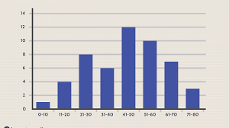
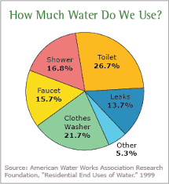
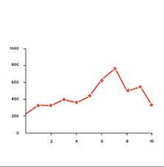
Bar Chart
Histogram
Line Chart
Pie Chart

Slide 25
Table
Table is an orderly arrangement of data.
In tables data are arranged in columns and rows in an essentially rectangular form.
It is prepared to provide more specific details.
In tables, information is presented a tabular form.
The table should help the reader quickly to follow than the textual presentation.
Every chart and table should be given a title, which will be a concise summary of what is presented in a chart and table.

Slide 26
DIAGRAMS
A diagram is a two/three dimensional symbolic representation of information according to a visualisation technique
Diagrams are simplified figures ,caricatures in a way and intended to convey essential meanings
These simplified figures are often based on a set of rules
The basic shapes can be charecterised in terms of elegance, clarity, simplicity and validity

Slide 27
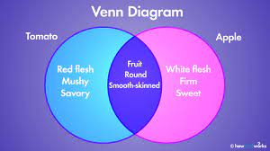
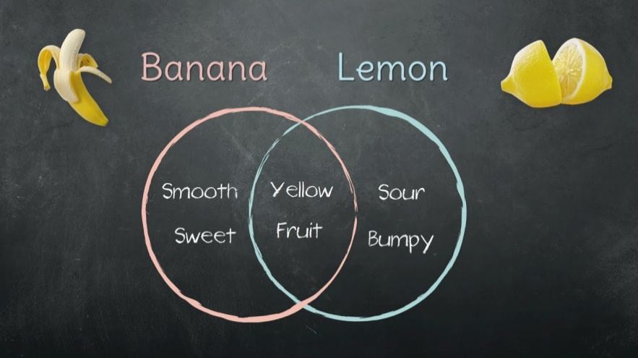
There are several types of diagrams
The most popular one is Venn Diagram, envisioned by John Venn
It is generally used to illustrate elementary set theory in simple set relations
Example

Slide 28
MAPS
A diagrammatic representation of an area of land or sea showing physical features, cities, roads, etc.
Cartography is the study and practice of making and using maps
There are many different types of maps, which are usually classified according to what they are attempting to show.
The most common types are Physical map and Political map
Physical map is prepared to show the physical features of geography

Slide 29
PHYSICAL MAP

Slide 30
POLITICAL MAP

Slide 32
ABBREVIATIONS
It is a shortened form of a word or phrase
The word abbreviation itself is represented by it’s short form abbr: or abbrev:
The method of abbreviation is a contraction or reduction of size
The contraction of a word is made by omitting certain letters or syllabus and bringing together the first and last letters
The only rule universally accepted is that one should be consistent in using abbreviation in a research paper or work

Slide 33
Examples
eg: - exempligratia/for example
fig. – figure
ie: - ideology establish/that is
rev. - revised

Slide 34
GLOSSARY
It is an alphabetical list of terms used in a particular work with definitions
The terms given in glossary are either uncommon or newly introduced
A bilingual glossary is a list of terms in one language defined in a second language
A core glossary is a simple glossary or defining a dictionary
It contains a small working vocabulary and definitions for important concepts

Slide 35
Example
Desom – The smallest revenue unit , a village
Jatha – A touring squad of people on feet
Jenmi – A land lord

Slide 36
INDEX
It identifies the source of the books or articles cited by listing the titles alphabetically under subject and author headings
There may be General Index and Specialised Index
If an index is included in the thesis ,it follows a Glossary, Bibliography and Appendix
It become the last part of the thesis
It is not essential for a written assignment or for an unpublished work
Index is sometimes divided into Author Index and Subject Index

