Slide 1
CYCLIC CODES
HIMA MOHAN
ASSISTANT PROFESSOR ON CONTRACT
CARMEL COLLEGE MALA

Slide 2
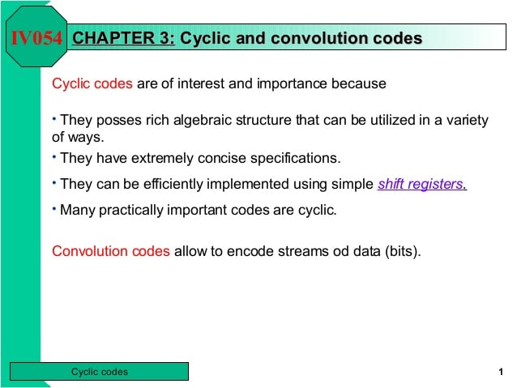

Slide 3
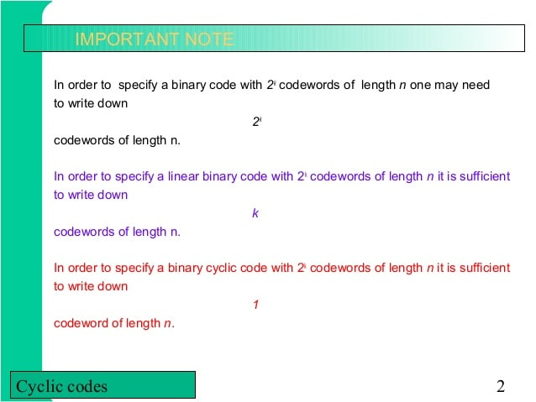

Slide 4
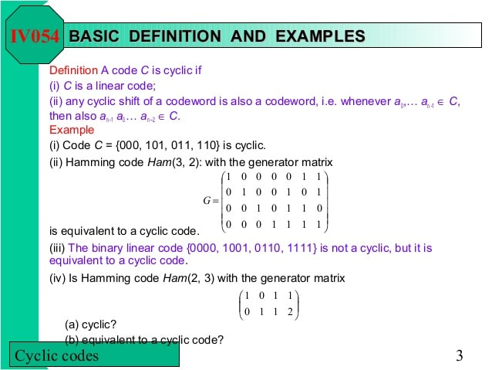

Slide 5
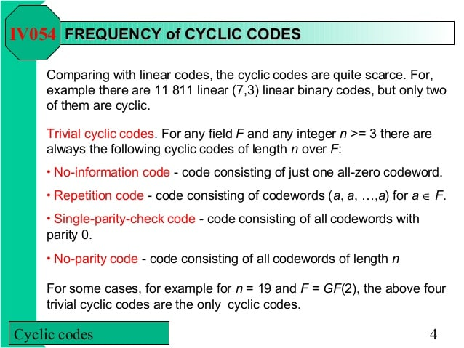

Slide 6
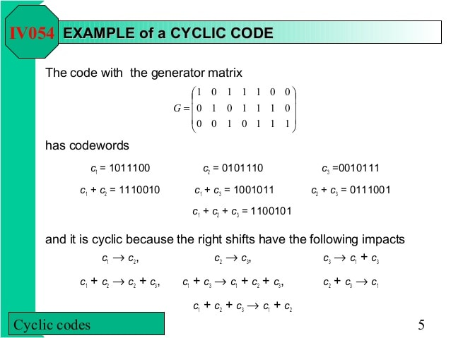

Slide 7
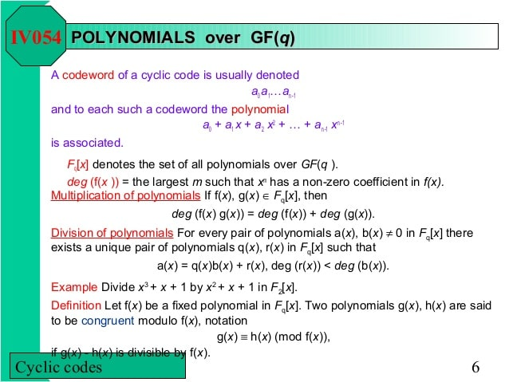

Slide 8
REFERENCE:
CODING THEORY: The Essentials, Mareel Dekker Inc, 1991
D.J Hoffman

