Slide 1
GEORGE SIMMEL

Slide 3
Works
The problems of the philosophy of history
Fundamental questions of sociology
Sociology – investigation on the form sociation
The philosophy of money

Slide 5
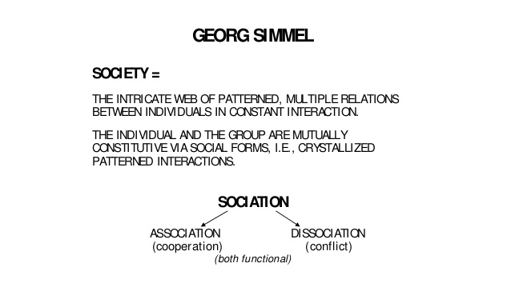

Slide 6
Formal sociology
Simmel considered as founder of “FORMAL SOCIOLOGY”
It concerned with the forms of social relationships and interaction
He uses the term “SOCIATION” to refer social interaction
According to him the subject matter of sociology is forms of sociation and patterns of social interaction
It distinguishes the social interactions in according with its forms and patterns

Slide 7
Forms - sociation
Monad
Dyad
Triad
Superordination & subordination

Slide 8
dyad.
Simmel believed that in a dyad, a group of two people, interactions were intense and very personal. A marriage is an example of a dyad.

Slide 9
Triad
Triad refers to a group of three people in sociology. It is one of the simplest human groups that can be studied and is mostly looked at by microsociology. The study of triads and dyads was pioneered by German sociologist Georg Simmel at the end of the nineteenth century.
A triad can be viewed as a group of three people that can create different group interactions.

Slide 10
Superordination & subordination
Authority & Prestige
Subordination under an individual
Unification of group in opposition to the ruler
The higher tribunal

