Slide 1
Module :1 Structure & function in sociological theory

Slide 2
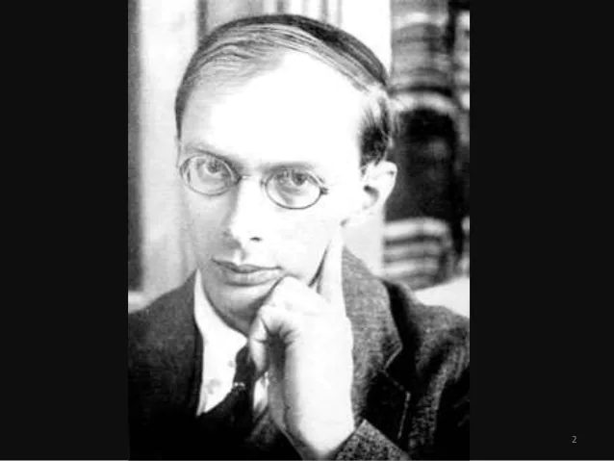

Slide 3
Malinowski
Born | Bronisław Kasper Malinowski 7 April 1884 Kraków, Galicia and Lodomeria, Austria-Hungary
Died | 16 May 1942 (aged 58) New Haven, Connecticut, U.S.
Alma mater | Jagiellonian University (PhD) University of Leipzig (PhD) London School of Economics
Known for | Father of social anthropology
Scientific career
Institutions | London School of Economics, Yale University

Slide 5
Works
The economic aspect of the Intichiuma ceremonies 1912
The Family Among the Australian Aborigines 1913
Primitive Religion and forms Social Structure 1915
Fishing in the Traditional Islands 1918
The Role of Myth in life 1926

Slide 6
Anthropology
Anthropology is the scientific study of humanity, concerned with human behavior, human biology, cultures and societies, in both the present and past, including past human species.
Social anthropology studies patterns of behaviour , while cultural anthropology studies cultural meaning, including norms and values.

Slide 7
Functionalism
Malinowski in the study of culture acted as an originator of a functionalist approach.
The function is the key idea throughout his work from his initial insightful research on an Australian native family to his financial theoretical statement in a scientific theory of culture.

