Slide 1
MODULE-1

Slide 2
TRANSMISSION MEDIA
Physical layer transmits raw bit stream from one machine to another.
Media roughly grouped as guided media(copper wire,fiber optics) & unguided media(radio,lasers through air).
Transmission media is a communication channel that carries the information from the sender to the receiver.
In a copper-based network, the bits in the form of electrical signals.
In a fibre based network, the bits in the form of light pulses.
Transmission media is of two types are wired media and wireless media.
In wired media, medium characteristics are more important whereas, in wireless media, signal characteristics are more important.
The transmission media is available in the lowest layer of the OSI reference model, i.e., Physical layer.
Different transmission media have different properties such as bandwidth, delay, cost and ease of installation and maintenance.

Slide 3
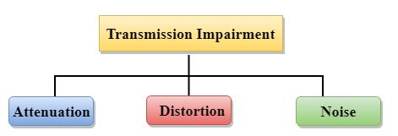
Causes Of Transmission Impairment:-
Attenuation: Attenuation means the loss of energy, i.e., the strength of the signal decreases with increasing the distance which causes the loss of energy.
Distortion: Distortion occurs when there is a change in the shape of the signal. This type of distortion is examined from different signals having different frequencies. Each frequency component has its own propagation speed, so they reach at a different time which leads to the delay distortion.
Noise: When data is travelled over a transmission medium, some unwanted signal is added to it which creates the noise.

Slide 4
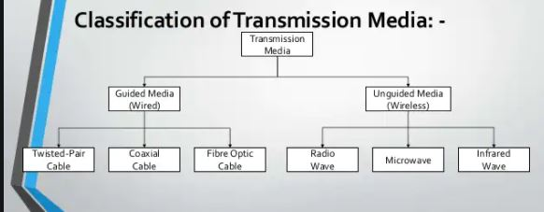

Slide 5
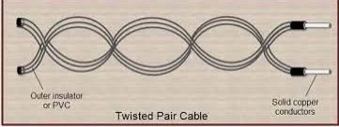
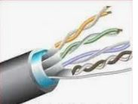
Guided Media
It is defined as the physical medium through which the signals are transmitted. It is also known as Bounded media.
Twisted-pair and co-axial cable use metallic (copper )conductors that accept and transport signals in the form of electric current.
Optical fiber is a cable that accepts and transport signals in the form of light.
1.Twisted-pair Cable

Slide 6
Consists of two conductors(copper),each with its own plastic insulation,twisted together.
One wire- used to carry signals to the receiver.
Other –used as a ground reference.
If two wires are parallel,the effect of unwanted signals is not same in both wires(one closer or farther relative to noise or crosstalk sources).
By twisting the pairs,balance is maintained.
Twisting makes both wires equally affected by external influences,both canceled out.
The degree of reduction in noise interference is determined by the number of turns per foot.
Increasing the number of turns per foot decreases noise interference.

Slide 7
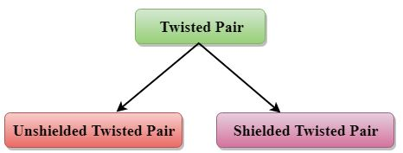
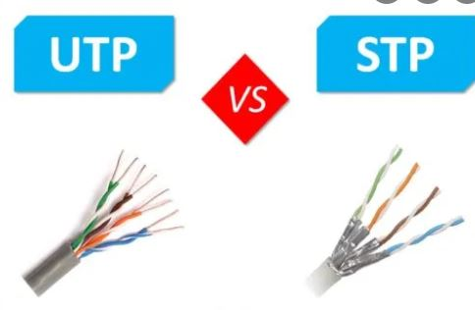
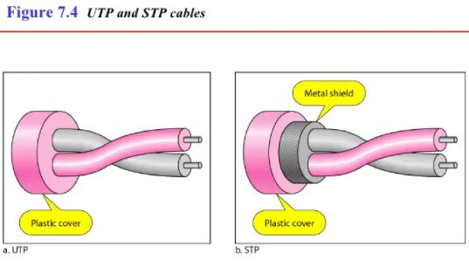
Types of Twisted pair

Slide 8
Unshielded Twisted Pair(UTP)
An unshielded twisted pair is widely used in telecommunication.
Advantages Of Unshielded Twisted Pair
It is cheap.
Installation of the unshielded twisted pair is easy.
It can be used for high-speed LAN.
Disadvantages
This cable can only be used for shorter distances because of attenuation.

Slide 9
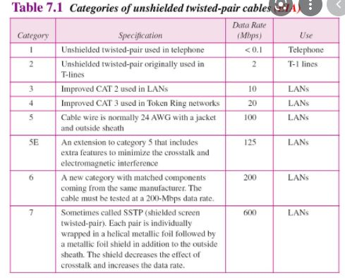

Slide 10
Shielded Twisted Pair
A shielded twisted pair is a cable that contains the mesh surrounding the wire that allows the higher transmission rate.
Characteristics Of Shielded Twisted Pair
The cost of the shielded twisted pair cable is not very high and not very low.
An installation of STP is easy.
It has higher capacity as compared to unshielded twisted pair cable.
It has a higher attenuation.
It is shielded that provides the higher data transmission rate.
Disadvantages
It is more expensive as compared to UTP and coaxial cable.
It has a higher attenuation rate.

Slide 11
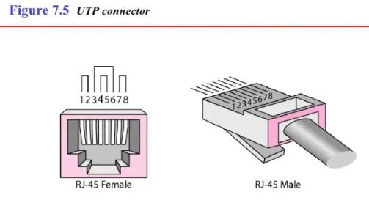
Connectors
UTP Connector - RJ45(Registrered Jack)
Keyed Connector- can be connected only one way.

Slide 12
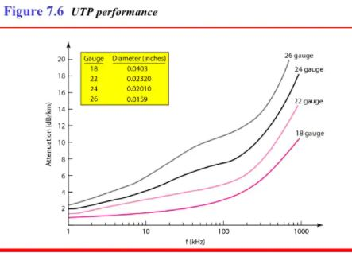
Performance
One way to measure the performance is to compare attenuation versus frequency and distance.
With increasing frequency,the attenuation ,measured in decibels per kilometer(dB/km),sharply increases with frequency above 100khz
Guage is a measure of the thickness of the wire.
Application
Used in telephone lines to provide voice and data channels.

Slide 13
2.Coaxial Cable
Coaxial cable is very commonly used transmission media, for example, TV wire is usually a coaxial cable.
The name of the cable is coaxial as it contains two conductors parallel to each other.
It has a higher frequency as compared to Twisted pair cable.
The inner conductor of the coaxial cable is made up of copper, and the outer conductor is made up of copper mesh. The middle core is made up of non-conductive cover that separates the inner conductor from the outer conductor.
The middle core is responsible for the data transferring whereas the copper mesh prevents from the EMI(Electromagnetic interference).
Inner conductor + insulating sheath + second conductor + insulating sheath enclosed in an plastic cover.

Slide 15
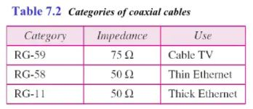
Coaxial Cable Standards
Categorized by their Radio Government(RG) ratings.
Each RG number denotes a unique set of physical specifications,
including the wire guage of the inner conductor ,the thickness and type of the inner insulator,the construction of the shield and size and type of the outer casing.

Slide 16
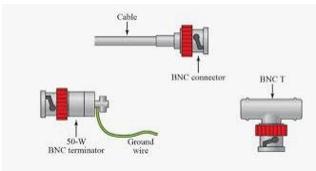
Coaxial Cable Connectors
Commonly used ones - Bayonet Neill Concelman(BNC) connector.

Slide 17
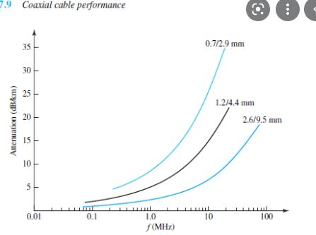
Performance
Attenuation is higher in coaxial cable than in twisted-pair cable.
Although co-axial cable has higher bandwidth,the signal weakens rapidly and requires the frequent use of repeaters.

Slide 18
Applications
1.Telephone networks
2.Cable TV networks
3.Traditional ethernet LAN
Coaxial cable is of two types:-
Baseband transmission: It is defined as the process of transmitting a single signal at high speed.
Broadband transmission: It is defined as the process of transmitting multiple signals simultaneously.
Advantages Of Coaxial cable:
The data can be transmitted at high speed.
It has better shielding as compared to twisted pair cable.
It provides higher bandwidth.

Slide 19
Disadvantages Of Coaxial cable
It is more expensive as compared to twisted pair cable.
If any fault occurs in the cable causes the failure in the entire network.

Slide 20
3.Fibre Optic Cable
Fibre optic is made of glass or plastic and transmits signals in the form of light.
Fibre optic is a cable that holds the optical fibres coated in plastic that are used to send the data by pulses of light.
The plastic coating protects the optical fibres from heat, cold, electromagnetic interference from other types of wiring.
Fibre optics provide faster data transmission than copper wires.

Slide 22
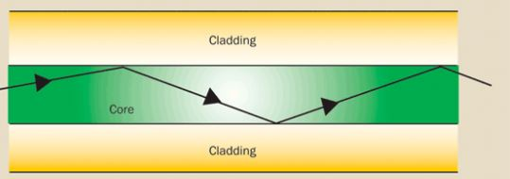
Optical Fiber
Uses reflection to guide light through a channel.
A glass or plastic core is surrounded by a cladding of less dense glass or plastic.
The difference in density of the two materials must be such that a beam of light moving through the core is reflected off the cladding instead of being refracted into it.

Slide 23
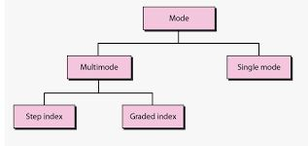
Propagation Modes
Multimode
Multiple beams from a light source move through the core in different paths.
Multimode Step Index Fiber
The density of the core remains constant from the center to edges.

Slide 24
Impact of variable density on the propagation of light beams-Modes

Slide 25
A beam of light moves through this constant density in a straight line until it reaches the interface of the core and the cladding.
At interface there is an abrupt change due to a lower density;this alters the angle of the beam’s motion..
Step-index refers to the suddenness of this change ,which contributes to the distortion of the signal as it passes through the fiber.
Multimode Graded-Index FIber
Decreases the distortion of the signal through the cable.
Index means index of refraction which is related to density that is with varying density.
Density is highest at the center of the core and decreases gradually to its lowest at edge.

Slide 26
Single mode
Uses step-index fiber.
Manufactured with a much smaller diameter than that of multimode fiber & with substantially lower density.
The decrease in density results in a critical angle that is close enough to 90 degree to make propagation of beams almost horizontal.
So propagation of different beams is almost identical and delays are negligible.
All the beams arrive at the destination together and can be recombined with little distortion to the signal.
Fiber Sizes
Optical fiber are defined by the ratio of the diameter of their core to the diameter of their cladding,both expressed in micrometers.

Slide 27
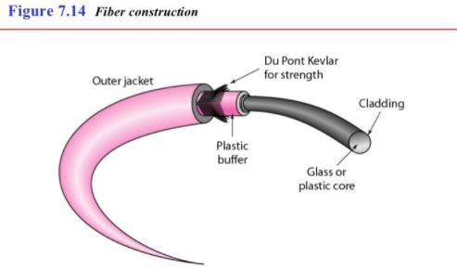
Cable Composition

Slide 28
The outer jacket is made of either PVC or Teflon.
Inside the jacket are Kevlar strands to strengthen the cable.
Kevlar is a strong material used in the fabrication of bulletproof vests.
Below the kevlar is another plastic coating to cushion the fiber.
The fiber is at the center of the cable and it consists of cladding and core.
Fiber –Optic Cable Connectors
3 types of connectors:-
1.Subscriber Channel Connector (SC)–used for cable TV.
It uses a push/pull locking system.
2.Straight-tip(ST) –used for connecting cable to networking devices.
It uses a bayonet locking system & more reliable than SC.
3.MT-RJ is a connector that is same size as RJ45.

Slide 30
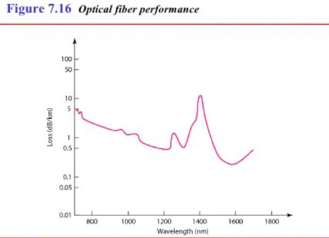
Performance[plot of attenuation versus wavelength]
Attenuation is flatter than in case of twisted-pair cable and coaxial cable.
The performance is such that we need fewer repeaters when we use fiber-optic cable.

Slide 31
Applications
1.Often used in backbone networks because its bandwidth is cost-effective.
2.Some cable TV companies use a combination of optical fiber and co-axial cable,creating a hybrid network.
Advantages
1.Higher Bandwidth.
2.Less signal attenuation.
Can travel 50 km without regeneration,only 5 km for others
3.Immunity to electro magnetic interference.
4.Resistant to corrosive materials
Glass is corrosive resistant than copper.
5.Light weight
6.Greater immunity to tapping

Slide 32
Disadvantages
1.Installation & Maintenance
Expertise required,since it is a new tecnology.
2.Unidirectional light propagation
Need 2 fibres for bi-directional propagation.
3.Cost
If the demand is not high,use optical fiber.

Slide 33
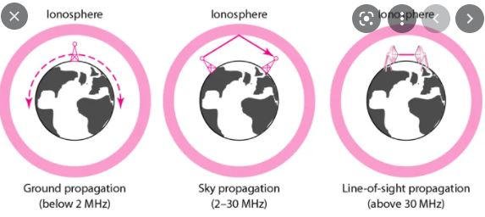
UNGUIDED MEDIA:WIRELESS
Transport electromagnetic waves without using a physical conductor.
Signals are normally broadcast through free space and thus available to anyone who has a device capable of receiving them.
In electromagnetic spectrum,3 Khz to 900THz,used for wireless communication.
Radiowave and microwave -3Khz – 300 GHz
Infrared – 300 GHz-400THz
Lightwave – 400THz-900THz
Propagation can be ground,sky and line-of –sight.

Slide 34
In ground propagation ,low-frequency signals emanate in all directions from the transmitting antenna and follow the curvature of the planet.
Distance depends on the amount of power in the signal.
In sky propagation,higher-frequency radio waves radiate upward into the ionosphere where they are reflected back to earth.
This transmission allows for greater distances with lower output power.
In line-of-sight,very high-frequency signals are transmitted in straight lines directly from antenna to antenna.
Antennas must be directional,facing each other and either tall enough or close enough together not to be affected by the curvature of the earth.
Electromagnetic spectrum defined as radio waves and microwaves is divided into 8 ranges called bands,each regulated by government authorities.

Slide 35
1.Radio waves,Microwaves – penetrate through walls
2.Infrared –don’t penetrate through walls.

Slide 36
Radio waves
Microwaves
1.line-of sight used.So towers with mounted antennas need to be in direct sight to each other
2.Very high –frequency microwaves cannot penetrate walls
3.Use of certain portions of band requires permission from the authorities
4.High data rate possible,since band is relatively wide as 299GHz.
Unidirectional Antenna
Send out signals in one direction.
Two types:-
1.Parabolic/dish antenna
2.Horn antenna

Slide 37
Radio waves are used for multicast communications,such as radio and teelvision and paging systems.
Microwaves are used for unicast communications such as cellular telephones,satellite networks and wireless LAN’s.
Infrared signals can be used for short-range communication in a closed area using line-of –sight propagation.

