Slide 1
MODULE1
PHYSICAL LAYER

Slide 2
PHYSICAL LAYER
https://slideplayer.com/slide/9415506/

Slide 3
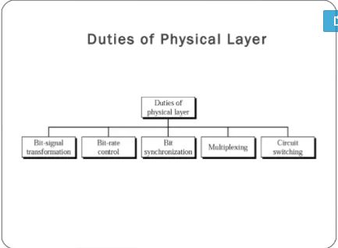

Slide 4
ANALOG AND DIGITAL DATA, PERIODIC AND A PERIODIC SIGNALS, COMPOSITE SIGNALS
https://www.slideshare.net/MukeshChinta/physical-layer-osi-model
Slides[8-11]
https://www.slideshare.net/SehrishRafiq1/lecture-07-32370532
[full]

Slide 5
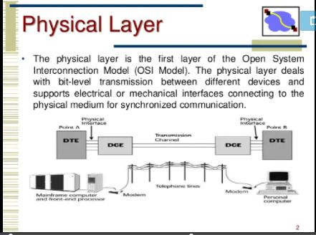

Slide 6
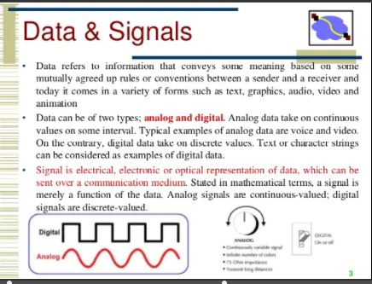

Slide 7
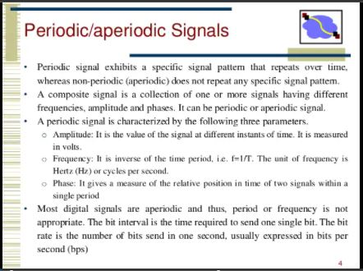

Slide 8
Both analog and digital data can be periodic and non-periodic.
In data communications ,we commonly use periodic analog signals and non-periodic digital signals.
Periodic analog signals
Classified as simple or composite.
A simple periodic analog signal ,a sine wave,cannot be decomposed into simpler signals.
A composite periodic analog signal is composed of multiple sine waves.

Slide 9
Study this also
Data rate limits
Noiseless Channel – Nyquist Bit Rate
Noisy Channel – Shanon Capacity
Performance
Bandwidth
Throughput
Latency(delay)
Jitter

