Slide 1
MODULE-1

Slide 2
MULTIPLEXING
Multiplexing is a technique used to combine and send the multiple data streams over a single medium.
The process of combining the data streams is known as multiplexing and hardware used for multiplexing is known as a multiplexer.
Multiplexing is achieved by using a device called Multiplexer (MUX) that combines n input lines to generate a single output line. Multiplexing follows many-to-one, i.e., n input lines and one output line.
Demultiplexing is achieved by using a device called Demultiplexer (DEMUX) available at the receiving end. DEMUX separates a signal into its component signals (one input and n outputs). Therefore, we can say that demultiplexing follows the one-to-many approach.

Slide 3
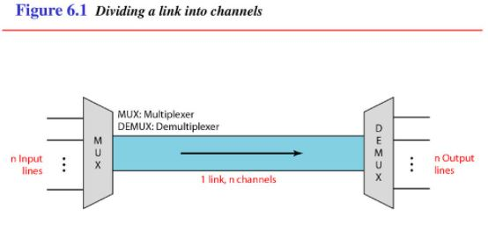
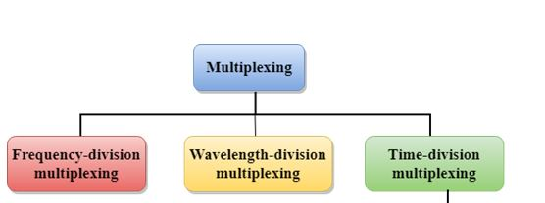

Slide 4
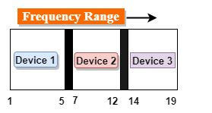
Advantages of Multiplexing:
More than one signal can be sent over a single medium.
The bandwidth of a medium can be utilized effectively.
1.Frequency-division Multiplexing (FDM)
It is an analog technique.
Frequency Division Multiplexing is a technique in which the available bandwidth of a single transmission medium is subdivided into several channels.

Slide 5
In the above diagram, a single transmission medium is subdivided into several frequency channels, and each frequency channel is given to different devices. Device 1 has a frequency channel of range from 1 to 5.
The input signals are translated into frequency bands by using modulation techniques, and they are combined by a multiplexer to form a composite signal.
The main aim of the FDM is to subdivide the available bandwidth into different frequency channels and allocate them to different devices.
Using the modulation technique, the input signals are transmitted into frequency bands and then combined to form a composite signal.
The carriers which are used for modulating the signals are known as sub-carriers. They are represented as f1,f2..fn.
FDM is mainly used in radio broadcasts and TV networks.

Slide 6
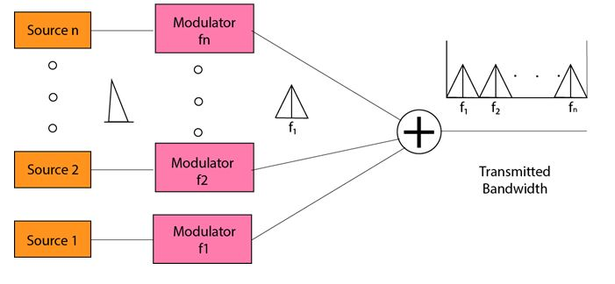

Slide 7
Advantages Of FDM:
FDM is used for analog signals.
FDM process is very simple and easy modulation.
A Large number of signals can be sent through an FDM simultaneously.
It does not require any synchronization between sender and receiver.
Disadvantages Of FDM:
FDM technique is used only when low-speed channels are required.
It suffers the problem of crosstalk.
A Large number of modulators are required.
It requires a high bandwidth channel.
Applications Of FDM:
FDM is commonly used in TV networks.
It is used in FM and AM broadcasting. Each FM radio station has different frequencies, and they are multiplexed to form a composite signal. The multiplexed signal is transmitted in the air.

Slide 8
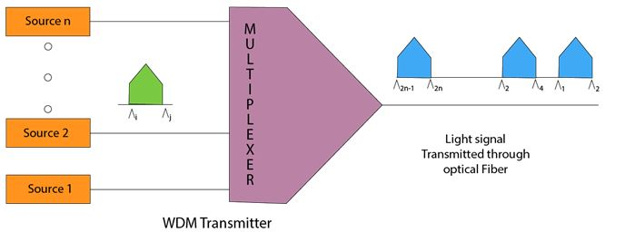
Wavelength Division Multiplexing (WDM)

Slide 9
Wavelength Division Multiplexing is same as FDM except that the optical signals are transmitted through the fibre optic cable.
WDM is used on fibre optics to increase the capacity of a single fibre.
It is used to utilize the high data rate capability of fibre optic cable.
It is an analog multiplexing technique.
Optical signals from different source are combined to form a wider band of light with the help of multiplexer.
At the receiving end, demultiplexer separates the signals to transmit them to their respective destinations.
Multiplexing and Demultiplexing can be achieved by using a prism.
Prism can perform a role of multiplexer by combining the various optical signals to form a composite signal, and the composite signal is transmitted through a fibre optical cable.
Prism also performs a reverse operation, i.e., demultiplexing the signal.

Slide 10
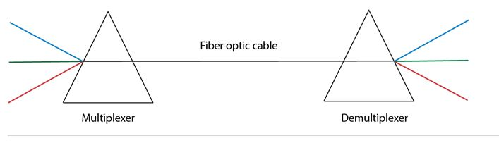
3.Time Division Multiplexing
It is a digital technique.
In Frequency Division Multiplexing Technique, all signals operate at the same time with different frequency, but in case of Time Division Multiplexing technique, all signals operate at the same frequency with different time.
In Time Division Multiplexing technique, the total time available in the channel is distributed among different users.
Therefore, each user is allocated with different time interval known as a Time slot at which data is to be transmitted by the sender.

Slide 11
A user takes control of the channel for a fixed amount of time.
In Time Division Multiplexing technique, data is not transmitted simultaneously rather the data is transmitted one-by-one.
In TDM, the signal is transmitted in the form of frames. Frames contain a cycle of time slots in which each frame contains one or more slots dedicated to each user.
It can be used to multiplex both digital and analog signals but mainly used to multiplex digital signals.
There are two types of TDM:
Synchronous TDM
Asynchronous TDM

Slide 12
Synchronous TDM
A Synchronous TDM is a technique in which time slot is preassigned to every device.
In Synchronous TDM, each device is given some time slot irrespective of the fact that the device contains the data or not.
If the device does not have any data, then the slot will remain empty.
In Synchronous TDM, signals are sent in the form of frames. Time slots are organized in the form of frames. If a device does not have data for a particular time slot, then the empty slot will be transmitted.
The most popular Synchronous TDM are T-1 multiplexing, ISDN multiplexing, and SONET multiplexing.
If there are n devices, then there are n slots.

Slide 13
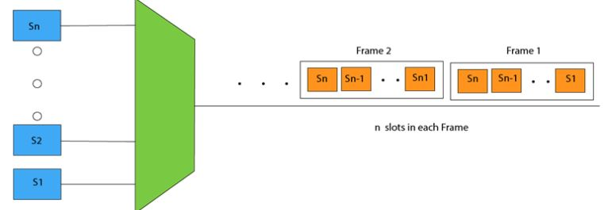

Slide 14
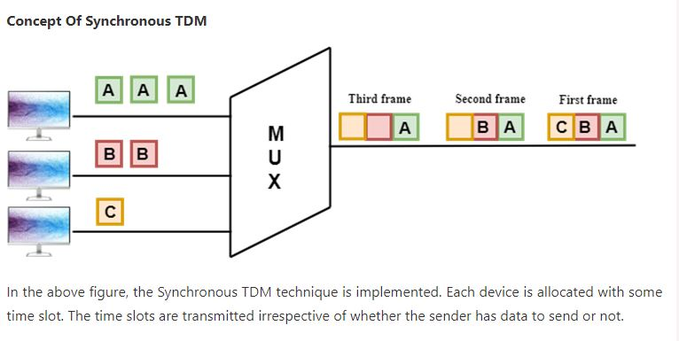

Slide 15
Disadvantages Of Synchronous TDM:
The capacity of the channel is not fully utilized as the empty slots are also transmitted which is having no data. In the above figure, the first frame is completely filled, but in the last two frames, some slots are empty. Therefore, we can say that the capacity of the channel is not utilized efficiently.
The speed of the transmission medium should be greater than the total speed of the input lines. An alternative approach to the Synchronous TDM is Asynchronous Time Division Multiplexing.

Slide 16
Asynchronous TDM
An asynchronous TDM is also known as Statistical TDM.
An asynchronous TDM is a technique in which time slots are not fixed as in the case of Synchronous TDM. Time slots are allocated to only those devices which have the data to send. Therefore, we can say that Asynchronous Time Division multiplexor transmits only the data from active workstations.
An asynchronous TDM technique dynamically allocates the time slots to the devices.
In Asynchronous TDM, total speed of the input lines can be greater than the capacity of the channel.
Asynchronous Time Division multiplexor accepts the incoming data streams and creates a frame that contains only data with no empty slots.
In Asynchronous TDM, each slot contains an address part that identifies the source of the data.

Slide 17

The difference between Asynchronous TDM and Synchronous TDM is that many slots in Synchronous TDM are unutilized, but in Asynchronous TDM, slots are fully utilized.
This leads to the smaller transmission time and efficient utilization of the capacity of the channel.
In Synchronous TDM, if there are n sending devices, then there are n time slots.
In Asynchronous TDM, if there are n sending devices, then there are m time slots where m is less than n (m<n).
The number of slots in a frame depends on the statistical analysis of the number of input lines.

Slide 18
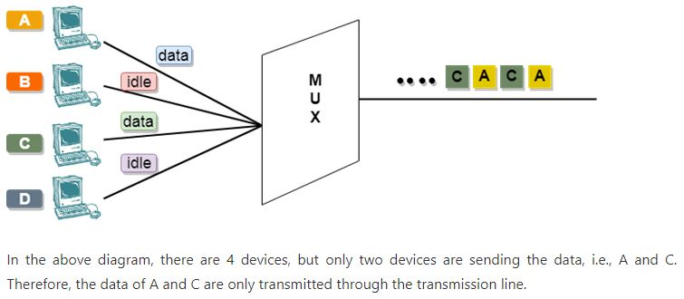
Concept Of Asynchronous TDM

Slide 19
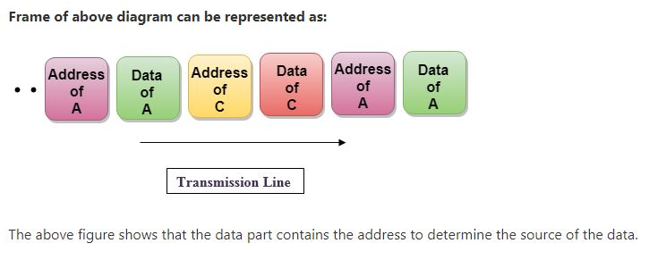

Slide 20
SWITCHING
https://www.slideshare.net/I_s_h_i_e/switching-techniques-in-data-communication-and-networking
https://www.javatpoint.com/computer-network-switching-techniques
Switching techniques
In large networks, there can be multiple paths from sender to receiver. The switching technique will decide the best route for data transmission.
Switching technique is used to connect the systems for making one-to-one communication.

Slide 21
CIRCUIT-SWITCHED NETWORKS+
A circuit-switched network is made of a set of switches connected by physical links,in which each link is divided into n channels using either FDM or TDM.
Circuit switching is a switching technique that establishes a dedicated path between sender and receiver.
In the Circuit Switching Technique, once the connection is established then the dedicated path will remain to exist until the connection is terminated.
Circuit switching in a network operates in a similar way as the telephone works.
A complete end-to-end path must exist before the communication takes place.
In case of circuit switching technique, when any user wants to send the data, voice, video, a request signal is sent to the receiver then the receiver sends back the acknowledgment to ensure the availability of the dedicated path. After receiving the acknowledgment, dedicated path transfers the data.
Circuit switching is used in public telephone network. It is used for voice transmission.
Fixed data can be transferred at a time in circuit switching technology.

Slide 22
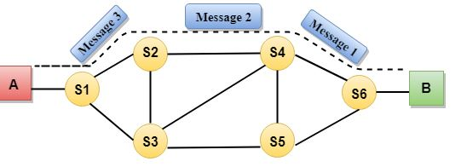
*
*
*****************************
Communication through circuit switching has 3 phases:-
1.Setup Phase(Circuit establishment)
2.Data transfer phase(Data transfer)
3.Teardown phase(Circuit Disconnect)

Slide 23
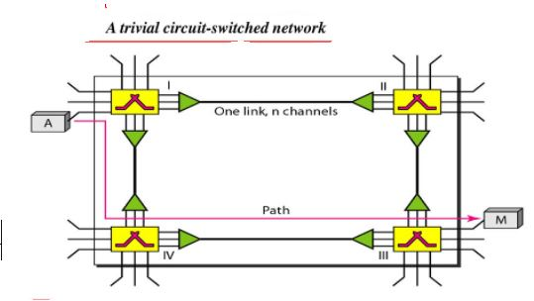
****

Slide 24
Advantages Of Circuit Switching:-
In the case of Circuit Switching technique, the communication channel is dedicated.
It has fixed bandwidth.
Disadvantages Of Circuit Switching:-
Once the dedicated path is established, the only delay occurs in the speed of data transmission.
It takes a long time to establish a connection approx 10 seconds during which no data can be transmitted.
It is more expensive than other switching techniques as a dedicated path is required for each connection.
It is inefficient to use because once the path is established and no data is transferred, then the capacity of the path is wasted.
In this case, the connection is dedicated therefore no other data can be transferred even if the channel is free.

Slide 25
Efficiency- low as copmared to other networks
Delay – minimal
PACKET SWITCHING
In this switching network,there is no resource reservation;resources are allocated on demand.
The packet switching is a switching technique in which the message is sent in one go, but it is divided into smaller pieces, and they are sent individually.
The message splits into smaller pieces known as packets and packets are given a unique number to identify their order at the receiving end.
Every packet contains some information in its headers such as source address, destination address and sequence number.
Packets will travel across the network, taking the shortest path as possible.
All the packets are reassembled at the receiving end in correct order.
If any packet is missing or corrupted, then the message will be sent to resend the message.
If the correct order of the packets is reached, then the acknowledgment message will be sent.

Slide 26
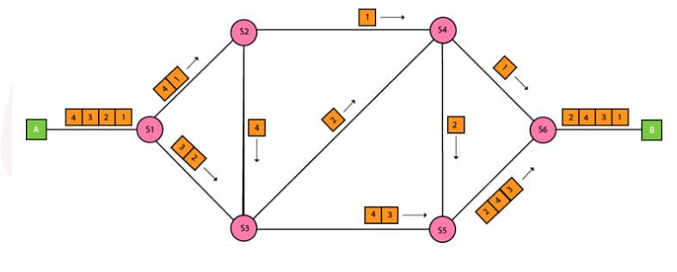
2 types of packet-switched networks:-
1.Datagram networks
2.Virtul circuit networks.

Slide 27
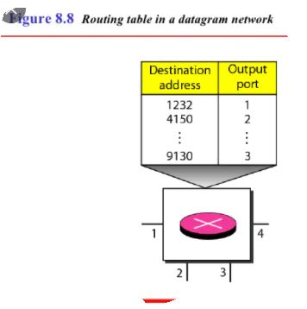
1. Datagram Packet switching:
It is a packet switching technology in which packet is known as a datagram, is considered as an independent entity. Each packet contains the information about the destination and switch uses this information to forward the packet to the correct destination.
The packets are reassembled at the receiving end in correct order.
In Datagram Packet Switching technique, the path is not fixed.
Intermediate nodes take the routing decisions to forward the packets.
Datagram Packet Switching is also known as connectionless switching.

Slide 28
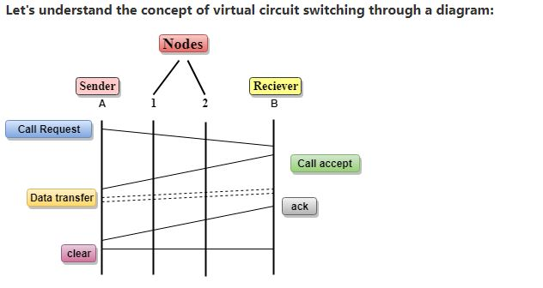
Should have destination address.
A switch in a datagram network uses a routing table that is based on the destination address.
The destination address in the header of a packet in a datagram network remains the same during the entire journey of the packet.
Efficiency – better than circuit-switched network;since resources are allocated only when there are packets to be trnsferred.
Delay –greater than virtual-circuit network.
2.Virtual Circuit

Slide 29
Addressing
Global
Local
Virtual-Circuit Identifier(VCI)
A small number used by a frame between two switches.
Has three phases.
Efficiency –high
Delay –low
Switching at data-link layer is implemented using virtual-circuit techniques.

Slide 30
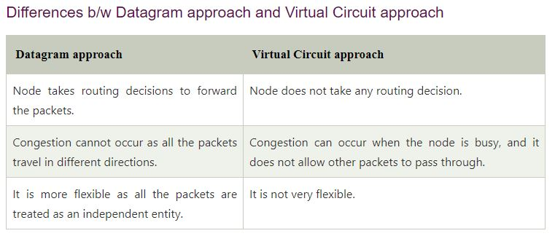
******
*
2. Virtual Circuit Switching
Virtual Circuit Switching is also known as connection-oriented switching.
In the case of Virtual circuit switching, a preplanned route is established before the messages are sent.
Call request and call accept packets are used to establish the connection between sender and receiver.
In this case, the path is fixed for the duration of a logical connection.

Slide 31
Advantages Of Packet Switching:
Cost-effective: In packet switching technique, switching devices do not require massive secondary storage to store the packets, so cost is minimized to some extent. Therefore, we can say that the packet switching technique is a cost-effective technique.
Reliable: If any node is busy, then the packets can be rerouted. This ensures that the Packet Switching technique provides reliable communication.
Efficient: Packet Switching is an efficient technique. It does not require any established path prior to the transmission, and many users can use the same communication channel simultaneously, hence makes use of available bandwidth very efficiently.

Slide 32
Disadvantages Of Packet Switching
Packet Switching technique cannot be implemented in those applications that require low delay and high-quality services.
The protocols used in a packet switching technique are very complex and requires high implementation cost.
If the network is overloaded or corrupted, then it requires retransmission of lost packets. It can also lead to the loss of critical information if errors are nor recovered.

Slide 33
MESSAGE SWITCHING
Message Switching is a switching technique in which a message is transferred as a complete unit and routed through intermediate nodes at which it is stored and forwarded.
In Message Switching technique, there is no establishment of a dedicated path between the sender and receiver.
The destination address is appended to the message. Message Switching provides a dynamic routing as the message is routed through the intermediate nodes based on the information available in the message.
Message switches are programmed in such a way so that they can provide the most efficient routes.
Each and every node stores the entire message and then forward it to the next node. This type of network is known as store and forward network.
Message switching treats each message as an independent entity.

Slide 34
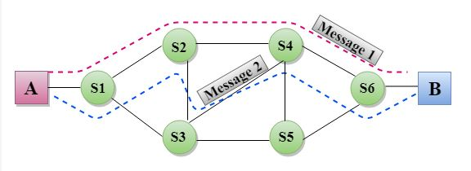

Slide 35
Advantages Of Message Switching
Data channels are shared among the communicating devices that improve the efficiency of using available bandwidth.
Traffic congestion can be reduced because the message is temporarily stored in the nodes.
Message priority can be used to manage the network.
The size of the message which is sent over the network can be varied. Therefore, it supports the data of unlimited size.
Disadvantages Of Message Switching
The message switches must be equipped with sufficient storage to enable them to store the messages until the message is forwarded.
The Long delay can occur due to the storing and forwarding facility provided by the message switching technique.

