Slide 1
PHYLUM ARTHROPODA
Joint footed animals
Bilaterally symmetrical body with tagmosis and cephalization
Body- 3 tagmata or divisions- head, thorax and abdomen
Cephalization- fusion of anterior segments
Cephalothorax covered by carapace
Cuticular skeleton- secreted by epidermis of the body wall- restricts the unlimited growth of the body, provides protection, prevents water loss
Moulting or ecdysis
Jointed and segmentally paired appendages- segments of these appendaged are called podomeres- flexors and extensors
Appendages – uniramous or biramous

Slide 2
Striped muscles
Perivisceral haemocoel and reduced coelom
Open circulatory system with dorsal heart – blood flows through open channels and spaces and not through closed blood vessels
Respiratory organs include branchiae, tracheae, book gills and book lungs
Excretory organs - Malpighian tubules and green glands
Annelidan type of nervous system
Absence of locomotor cilia

Slide 3
PENAEUS INDICUS(class malacostraca)
Cephalothorax (fusion of 13 segments-5 cephalic and 8 thoracic) and abdomen(6 segments) with a telson
Cuticular skeleton, secreted by underlying epidermis(formed of chitin and protein)- has infolding called apodemes
Segments called sclerites
Abdominal region – terga (dorsal sclerite) and sterna (ventral sclerite)
Pleuron extension from tergum
Epimeron – the part between pleuron and abdominal appendage
13 tergal plates fuse to form carapace
Sternal plates form ventral shield
Thelycum on female
Rostrum – compound eyes
Branchiostegite - gill cover

Slide 4
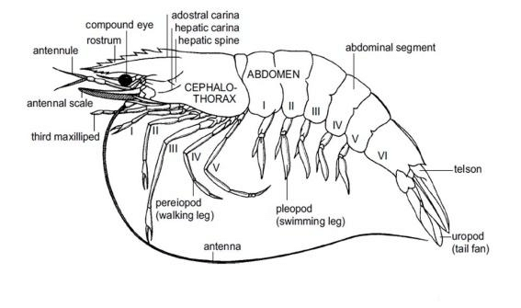

Slide 5
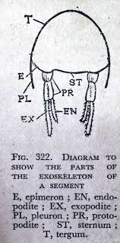

Slide 6
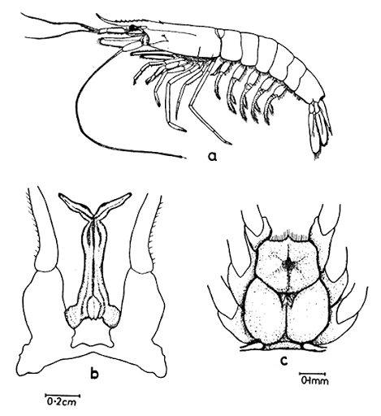

Slide 7
Appendages
19 pair- 5 cephalic , 8 thoracic and 6 abdominal
Attach to sternum of exoskeleton
Segmented (podomeres ) and biramous
Base called protopodite- 2 segmented- coxa and basis
Rami- exopodite(unsegmented) and endopodite (segmented in some)
Cephalic appendages
Antinnule and antennae- tactile structures
Mandible – masticatory structures
1st maxillae and 2nd maxillae- feeding jaws

Slide 8
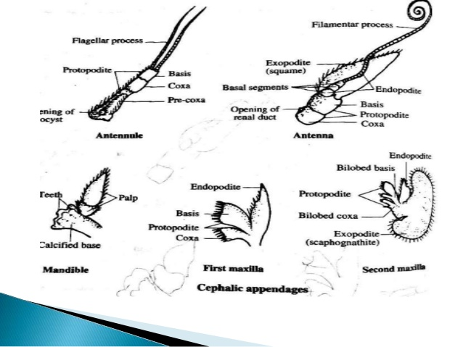

Slide 9
Thoracic appendages
8 pairs
Maxillipeds or foot jaws- first 3
Pareopods or walking legs- rest 5
All are biramous with 2 segmented protopodite
5 segmented endopodite- ischium, merus, carpus, propodus and dactylus
Maxillipeds- exopodite well developed and unsegmented
To the coxa of maxillipeds and chelipeds is a respiratory process called epipodite
Pareopods- 1st 3 are chelate legs or chelipeds(formed by propodus and dactylus)
Last 2 non chelate pareopods- no epipodite

Slide 10
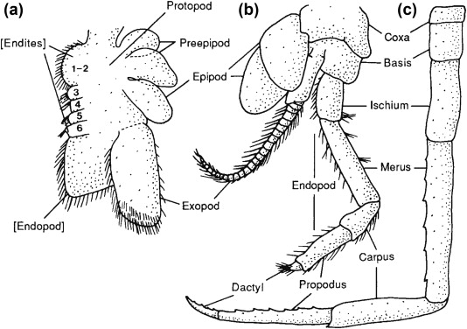

Slide 11
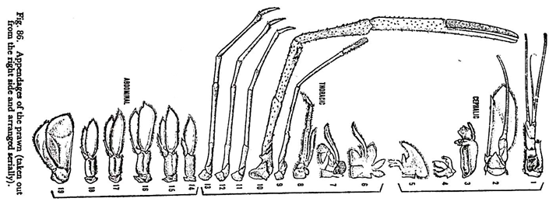

Slide 12
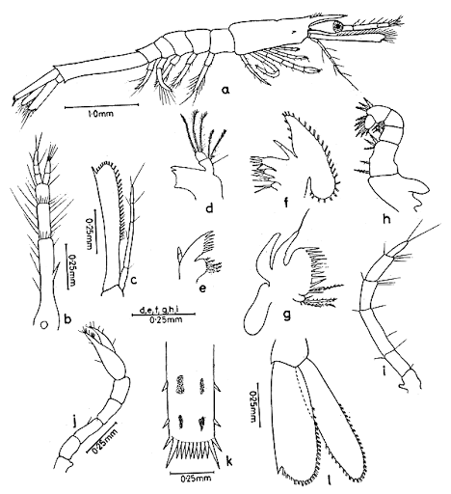

Slide 13
Abdominal appendages
For swimming- called pleopods or swimmerets
Biramous- 2 segmented protopodite, unsegmented exopodite and endopodite
Last pair – uropods- serve as tail fins
In uropod coxa and basis fuse to form single segment – sympod
In male prawns- 1st pair of pleopods- endopodite has small hooks- with this right and left appendages interlock and form petasma (used for transferring sperms to the thelycum of female)

Slide 14
Digestive system
Alimentary canal and digestive gland, called hepatopancreas or liver
Alimentary canal 3 divisions- stomodaeum, mesodaeum and proctodaeum
Stomodaeum (fore gut) consists of mouth, buccal cavity, oesophagus and stomach
Mesodaeum (mid gut)- intestine
Proctadaeum (hind gut) – rectum and anus
Intima – internal cuticular lining of stomodaeum and proctodaeum
Mouth
Situated in between 3rd and 4th cephalic segments
Guarded infront by chitinous plate, called labrum or upper lip, on sides- mandibles and behind by labium or lower lip
Labrum is bilobed- 2 lobes called paragnathae

Slide 15
Buccal cavity (compressed chamber) and oesophagus
Stomach
Spacious chamber
Divisions- cardiac (for storage and grinding of food) and pyloric stomach(for sorting and straining of food)
On the floor of cardiac stomach- there are cuticular folds with setae and spicules
Also has many tooth like denticles- serve as internal masticatory apparatus- called gastric mill
Pyloric stomach also has cuticular folds- called lappets or valvulae
It also has a filtering apparatus, formed of chitinous plates and comb like bristles
Then comes intestine, leads to rectum, opens out by anus(guarded by muscular sphincter)

Slide 16
Digestive gland
Only digestive gland is the bilobed hepatopancreas
Surrounds the stomach
Develop from mid gut as hepatic caeca
Formed of branching tubules held together by connective tissue called tunica propria
From each lobe is hetatopancreatic duct
Serves the function of liver, pancreas and intestinal glands of vertebrates
Secretes proteolytic, amylolytic and lipolytic enzymes
Stores glycogen, fats and calcium and absorbs digested food

Slide 17
Feeding and digestion
Omnivores – planktonic organisms
Chelipeds(food collection) – 2nd maxialle(push food into mouth) – mandibles(food cut into pieces - mastication) – maxillae and maxillipeds(masticated food is pushed to oesophagus) – reach stomach through peristaltic movements of oesophagus
In stomach- food mixed with digestive enzymes and get pulverized, strained and sorted
In cardiac stomach- internal mastication and churning – further contraction and expansion of stomach leads to crushing and grinding of food by gastric mill – churning(mixing with hepatopancreatic secretions)
Digestion mostly in cardiac stomach – sometimes in hepatopancreas wherein they are ingested and digested by some phagocytic cells
Absorption mostly in hepatopancreas- some in intestine

Slide 18
After gastric digestion, the pyloric filter separates the digested food and diverts it into hepatopancreas via hepatopancreatic ducts
The absorptive cells of hepato pancreas absorb it
Excess nutrients are stored in the hepatopancreas as glycogen and fats
Undigested residue or faeces is 1st forced from stomach to intestine and finally passed to outside by peristaltic movements of gut wall

Slide 19
Respiratory system
Include gills or branchiae –principal
Epipodites or mastigobranchiae and the vascular lining of branchiostegites- accessory respiratory structures
Gills - vascular and feathery or plumose outgrowths from the thoracic appendages
18 gills on each side, lodged in the branchial chamber in between the branchiostegite and the thoracic wall
Each gills is a crescentic structure, with a central axis or stem, called gill axis
On this there are numerous thin, flat and bilaterally arranged plates, called gill lamellae, which in turn divided into gill filaments- this gill of tree like fashion- called dendrobranchs or dendrobranchiae
Gill axis and gill lamellae – is vascularised and covered by chitin layer

Slide 20
Each gill is attached to the body by a root through which blood vessels and nerves pass. Based on this 3 types of gills
Podobranchs- foot gills- attach to the coxa of the thoracic appendages
Arthrobranchs- joint gills- remain attached to the arthrodial membrane, seen at the junction between the thoracic wall and appendage
Pleurobranchs- side gills or wall gills- remain attached to the inner wall of the branchial chamber
In penaeus
1 pair of podobranchs- attached to 2nd maxillipeds
11 pairs of arthrobranchs, attached to the 2nd and 3rd pair of maxillipeds and 1st 4 pairs of walking legs
6 pairs of pleurobranchs, attached to the segments to which the 3rd pair of maxillipeds and 1st 5 pairs of walking legs are connected

Slide 21
Mechanism of respiration
Ventilation of gills- scaphognathites (exopodite of 2nd maxillae) or balers vibrate- constant current of water over the gills , epipodites and branchiostegal plates- gaseous exchange takes place
Setose hairs at the entrance of gill chambers prevent entry of foreign particles into the gill chambers

Slide 22
Blood vascular system
Open or lacunar type
Blood flows through open channels and spaces, sinuses and lacunae
Consists blood, heart, arteries and sinuses and lacunae
Capillaries and veins are absent
Blood or haemolymph, is a light blue fluid - consists of plasma(with cu containing pigment haemocynanin) and colourless and amoeboid leucocytes. Hb and erythrocytes absent
Heart triangular organ- in cephalo thoracic region- in the pericardial cavity below dorsal shield. Has 5 pairs of valvular lateral openings, called ostia
From heart arise many arteries, its branches open to blood channels and blood spaces, which collectively constitute the haemocoel

Slide 23
Heart arteries blood sinuses lacunae ventral sinuses afferent branchial channels gills efferent branchial channels pericardial sinus again to heart…so on

Slide 24
Excretory system
Include a pair of antennary glands(coxal glands, green glands, or renal glands)
4 parts- end sac, labyrinth, glandular tube and bladder
End sac- closed mesodermal sac with a coelomic cavity. Lined by excretory cells
Connects with labyrinth through a small opening
Labyrinth or glandular plexus- made of coiled renal tubules
Glandular tube – coiled excretory tube that leads from labyrinth and opens to bladder
Bladder – chamber- lined by excretory cells- renal duct – opens to outside by an renal pore

Slide 25
Green gland function
Excretion and osmoregulation
Excretion and elimination of nitrogenous wastes and the excess of water and mineral ions and also in the regulation of the ionic composition and volume of blood
Ammonia + urea + uric acid – in prawn
Elimination occurs by diffusion across gills+
From blood by ultrafiltration- reach end sac = called primary urine or ultrafiltrate – undergoes reabsorption in labrynth – the fluid left out in labrynth is called final urine, which contains water, ammonium compounds, uric acid, urea etc
Urine collected in bladder and pass out through renal opening

Slide 26
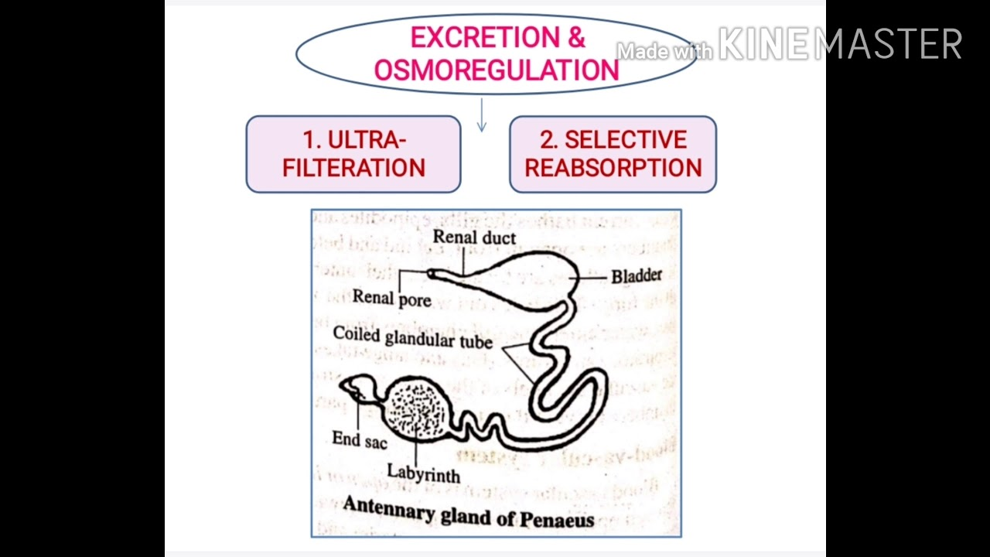

Slide 27
Nervous system
Composed of Circum oesophageal nerve ring , fused and ganglionated double ventral nerve cord and a large number of nerves
Circum oesphageal nerve ring consists of
Supra oesophageal ganglionic mass
Above oesophagus
Unspecialized brain – formed by fusion of several ganglia
From it arise, a pair of antennular nerves to antennules, statocysts etc, a pair of antennary nerves to antennae and a pair of optic nerves to compound eyes

Slide 28
Sub oesophageal ganglionic mass
Below oesophagus
Formed by fusion of a few ganglia
From it arise, 5 pairs of nerves – to mandibles, 1st maxillae, 2nd maxillae, 1st maxillipeds and 2nd maxillipeds
Circum oesophageal connectives
Around oesophagus
Transverse nerve – called oesophageal commissure, commisural nerve or visceral loop
Just below oesophagus

Slide 29
Double ventral nerve cord
Fused
Has 6 thoracic ganglia and 6 abdominal ganglia
From each ganglion – 3 pairs of nerves – 2 pairs to muscles and 1 pair to appendages
Between 11th and 12th body segments, 2 nerve cords remain separate, leaving a passage for sternal artery

Slide 30
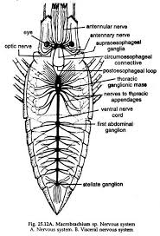

Slide 31
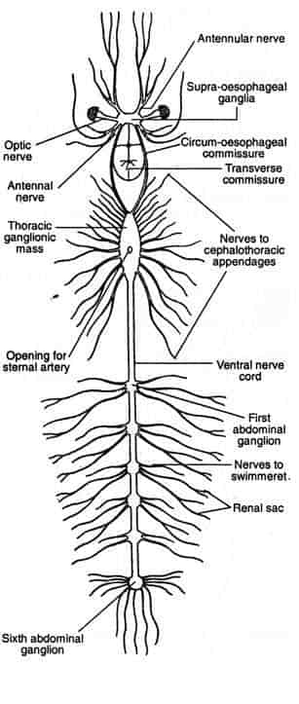

Slide 32
Sense organs
Statocysts
For orientation and equilibrium
A pair of them in the pre coxal segment of antennules
Consists of a chitinous sac, attached to pre coxa through a short stalk.
Chitinous sac encloses a central mass of sand grains (act as statoliths), surrounded by ring of sensory setae
A sensory setae has 2 parts – a swollen base (attached to statocyst wall through an arthrodial membrane) and a filamentar shaft (has many sensory bristles).
Any change in the swimming position of the animal, or any movement in the surrounding water, will cause the displacement of sand grains. They press against and stimulate sensory setae. From setae impulses are transmitted to brain. Brain responds and enables the animal to properly orient itself

Slide 33
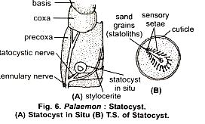

Slide 34
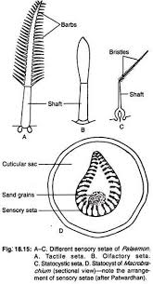

Slide 35
2. Compound eyes
A pair of stalked and movable compound eyes
Seen at the base of rostrum
Cannot see distant objects as it has no perfect focusing mechanism or power of accomodation
Formed of a large number of (2000 – 2500)light perceiving visual units or simple eyes called ommatidia
Ommatidium
Are long, rod shaped and closely packed structures
Has its own focusing system, light transmitting system, photoreceptor cells and a field of vision (overlap in case of adjacent ommatidia)
Adjacent ones are separated by a layer of black pigment
Specialized for refracting light rays and also for eliciting sensory impulses
It has a transparent cuticular covering, which serves as a cornea or as biconvex lens

Slide 36
The cuticular cornea is rigid in shape- so it has a fixed focal length and is incapable of accomodation in relation to the changing distance of the objects
Just below cornea- a pair of epidermal cells, known as reticular cells or corneagen cells, which secretes the cuticular cornea
Inner to this is a group of 4 elongated and inwardly tapering crystalline cells, called cone cells or vitrellae
These cells secrete and surround a central transparent and refractive body called cyrstalline cone
The vitrellae, inturn maybe surrounded by a pigmented sheath (that separates adjacent ommatidia), known as iris sheath or distal pigment sheath – formed of pigment cells- called chromatophores.

Slide 37
Beneath vitrellae – is a group of 7 or 8 elongated cells, called retinular cells or retinulae – they contain light sensitive visual pigment rhodopsin –
Rhodopsin when sensitized by light undergoes chemical change which elicits an action potential transmitted to brain as a nerve impulse
Retinular cells surround a central refractile rod – rhabdome, formed by interdigitation of microvilli of retinular cells
Retinular cells are surrounded by a pigmented sheath, called retinular sheath or proximal pigment sheath
From each retinular cell is an axon at its terminal portion
7-8 axons from each ommatidium join optic ganglion
Axons from all ommatidia together form an optic nerve – which joins the brain

Slide 38
Dioptric apparatus or focusing apparatus – the portions of ommatidium that comprises the cuticular lens, lenticular layer and vitrellae
Remaining part –i.e, rhabdome, retinular cells and the reticular sheath forms receptor apparatus or receptor region
Each ommatidum rests on a basal membrane or basal lamina

Slide 39
Working of compound eye
2 mechanisms
Mosaic vision
In bright light
Pigment cells fully expand and spread all over the ommatidium – isolating adjacent ommatidia from each other- thus each becomes an individual visual unit
They will be stimulated only by the parallel or perpendicular rays falling on the cornea- thus each can form an image of only a portion of the object
All the images obtained are integrated in the brain
Complete image is formed by the apposition of fusion of of several partial images – called apposition image or mosaic image
Such a vision called mosaic vision or apposition vision

Slide 40
Superimposed vision
In dim light or night
Pigment cells contract very much – so adjacent ommatidia overlap each other – forming a visual complex
Images formed by adjacent ommatidia overlap and vision becomes blurred – called superimposition image or super imposed image
Object cannot be seen clearly – but can detect moving objects

Slide 41
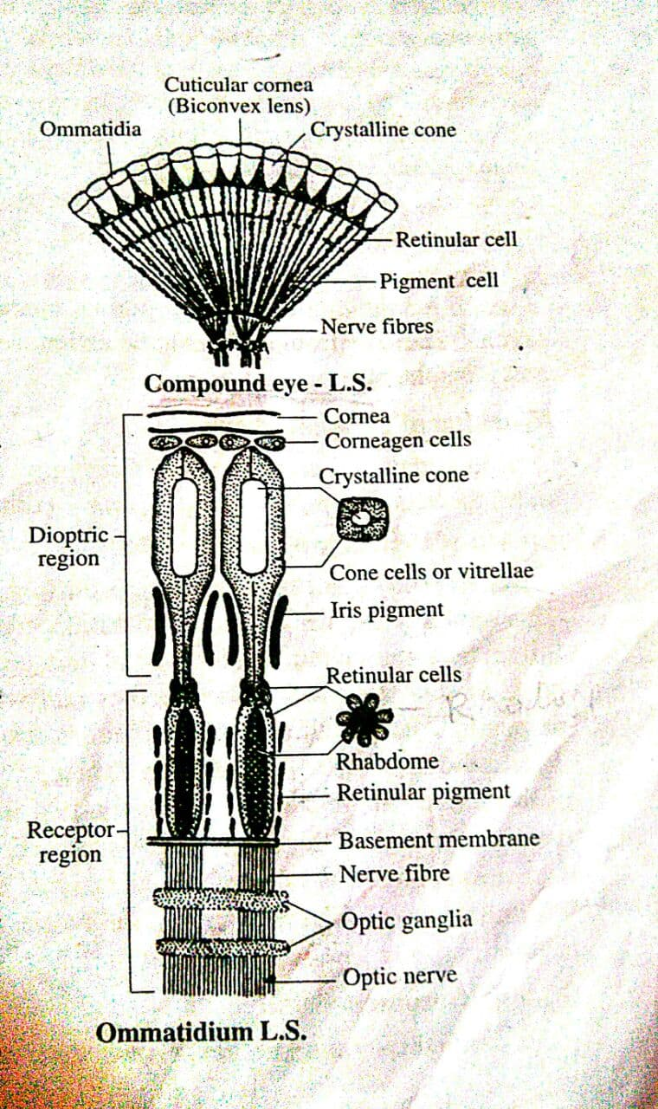

Slide 42
Reproduction
Sexes are separate
Also some degree of sexual dimorphism
Male has petasma and female has thelycum
Male genital openings are seen on the coxal segment of the last pair of walking legs, but female openings are seen on coxa of the 3rd pair of walking legs
Male organs
Include a pair of testes – one on each side of thorax
Testes - formed of numerous long and coiled seminiferous tubules
2 Testes are connected anteriorly, while separate posteriorly
Has testicular diverticula
A vas deferens or sperm duct- which leads to a seminal vesicle or ejaculatory bulb- then comes ejaculatory duct that opens out to coxa of last walking leg

Slide 43
Secretions of seminal vesicle glue sperms together and form sperm clusters- spermatophores- stored in seminal vesicle
Female organs
A pair of ovaries, one on each side of thoracic and abdominal regions
United posteriorly while separate anteriorly
Ovarian diverticula
Oviduct- opens to coxa of 3rd walking leg

Slide 44
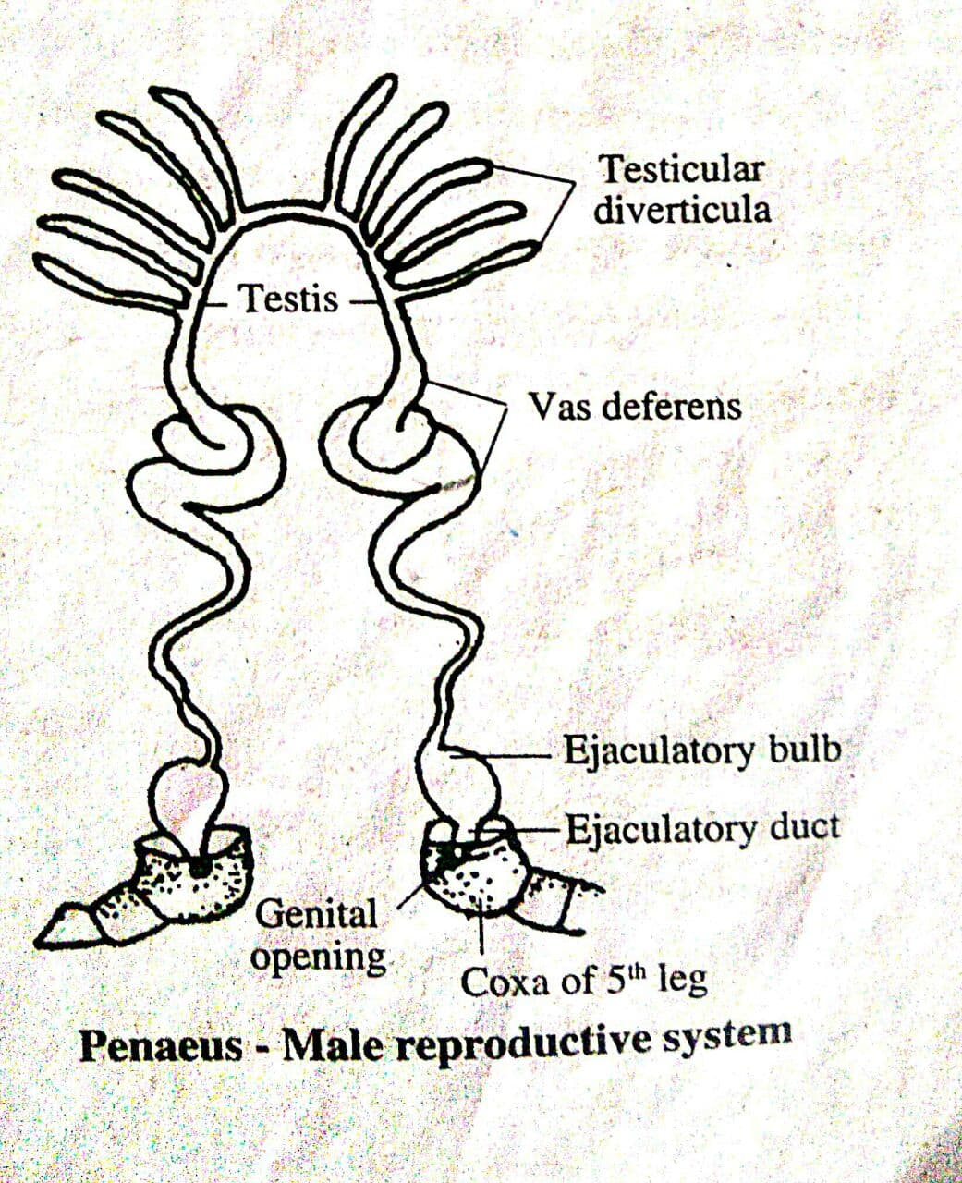

Slide 45
