Slide 1
NUCLEAR AND RADIATIOIN CHEMISTRY

Slide 2
Nuclear chemistry
Nuclear chemistry deals with,
Structure of nucleus
Stability of nucleus
Process of nucleus changes
Nuclear particles (Nucleons)
Mainly protons and neutrons
Charge mass and spin are the most important properties of nuclear particles

Slide 3
Nuclear stability
Radioactive decay can takes place only when the energy of the parent nucleus is greater than that of products.
Stability is determined by the ratio of the number of protons to the number of neutrons.
For lighter elements no of protons is equal to no of neutrons

Slide 4
Also stability is affected by whether the no of protons and neutrons are even or odd.
Nuclei with even numbers of both protons and neutrons are found to be most stable.
For even-even nuclei the stability is maximum if the no of protons= no of neutrons.
The no of nuclei with either N or Z odd is about 1/3 ^{rd} those with both are even.
In the odd-odd case stability is very less.

Slide 5
Nuclear models
Liquid drop model
Developed by Niels Bohr and Wheeler
Nucleus is treated as a homogenous entity consisting of certain no of protons and neutrons.
Each nucleon interacts strongly with adjacent nucleons just as do the molecule in a liquid drop model.
Both liquid drop and nucleus are incompressible and homogenous density charge etc. are the same throughout the nucleus except only at surface boundaries.

Slide 6
Nuclear shell model
Nucleons are distributed in a serious of discrete energy levels satisfying certain quantum mechanical conditions.
Protons and neutrons have their own separate shells.
Neutrons as well as protons are believed to pair among themselves.
These paired nucleons are packed into separate shells within the nucleus.
No of nucleons in each shell is determined by quantum rules.

Slide 7
A completely filled shell represents a particularly stable configuration of low energy.
Orbit of a nucleon is analogues to the quantum state of an electron in the outer sphere.
Orbit of a nucleon is determined by the nuclear potential which is the average total effect of interaction of all the nucleons with one another.
Two type of potential fields are if interest.
In the first the potential is assumed to be of square well form. Other one is of harmonic oscillator type.

Slide 8
The fermi gas model
Nucleus is treated as a whole, disregarding independent motion of nucleons.
The concept of nuclear potential well is retained.
Each level starting from the bottom is completely filled.
The nucleus is said to be in its lowest energy level resembling a gas at 0 K.
When excited some nucleons may get promoted to levels above fermi level.

Slide 9
As the energy of excitation increases excitation to higher levels also increases.
It is similar to the kinetic motion of a gas, here level density is considered at high energy of excitation.
Level density=no of permitted levels between energy ℇ and ℇ+dℇ
ρ(ℇ)=C e^{2-(αℇ)1/2}
C , α are constants depending on A

Slide 10
The collective model
Developed by A Bohr and B R Mottelson.
Considering the motion of a nucleus as a whole.
Conserves the essential features of liquid drop model and retain the arrangements of nucleons as in shell model.
Nucleon with proton and neutron numbers close to magic numbers are spherical in shape. The addition of more nucleons outside the magic shell causes a deformation of the nucleus so it becomes a prolate spheroidal in shape.

Slide 11
Here consider a mutual interaction between the nucleons and suffer permanent deformation.
Will produce motions which are similar to oscillation and rotation of the nucleus as a whole.
The collective motion are independent on the numbers of nucleons outside the filled shells.
Quadruple moment of a highly deformed nucleus lying farther from magic numbers is many times greater than the value attributed to a single odd particle.
This is due to the collective motion of many nucleons lying outside together.

Slide 12
There will be angular momentum and energy associated with collective motion of nucleons giving rise to energy levels different in nature from those explained by shell model.
Rotational energies for even-even nuclei are,
E rot= ℏ²/2J I(I+1)
I=Total angular momentum of the nucleus (0,2,4,6)
J=Moment of inertia of the deformed nucleus.

Slide 13
The optical model
A nuclear reaction takes place in two steps.
When a nucleus is bombarded with a high energy particle the target nucleus takes in the projectile particle forming the compound nucleus.
Energy of the projectile is suddenly shared between all other nucleons in the target nucleus
Compound nucleus decays into the final products

Slide 14
Nuclear reactions
Nuclear reaction means transformation of a target nucleus by bombarding with lighter nuclei.
^{A1}X _{z1}+ ^{A2}a _{Z2} → ^{A3}b_{Z3} + ^{A4}Y_{Z4}
Where,
x= target nucleus
a= the projecti_{le}
b=particle ejected
Y=product nucleus

Slide 15
Types of nuclear reactions
1 Elastic scattering
Here a=b and X=Y
Incoming particles strikes the target nucleus, losses some of its K.E and projectile gets its direction deflected by an angle.
There is no changing P.E and K.E is conserved
2 In elastic scattering
Projectile should have energy higher than the first exited state of the target nucleus
K.E of the projectile is used up in raising the P.E of the nucleus

Slide 16
3 Photo nuclear reactions
Reactions induced by x ray or γ photons.
Interaction of x ray or γ ray with matter some or all of the energy of absorbed radiation transferred to the target nucleus
Then it is converted to highly excited state resembling a compound nucleus
4 Radiative capture
Here the projectile particle gets captured by the target nucleus

Slide 17
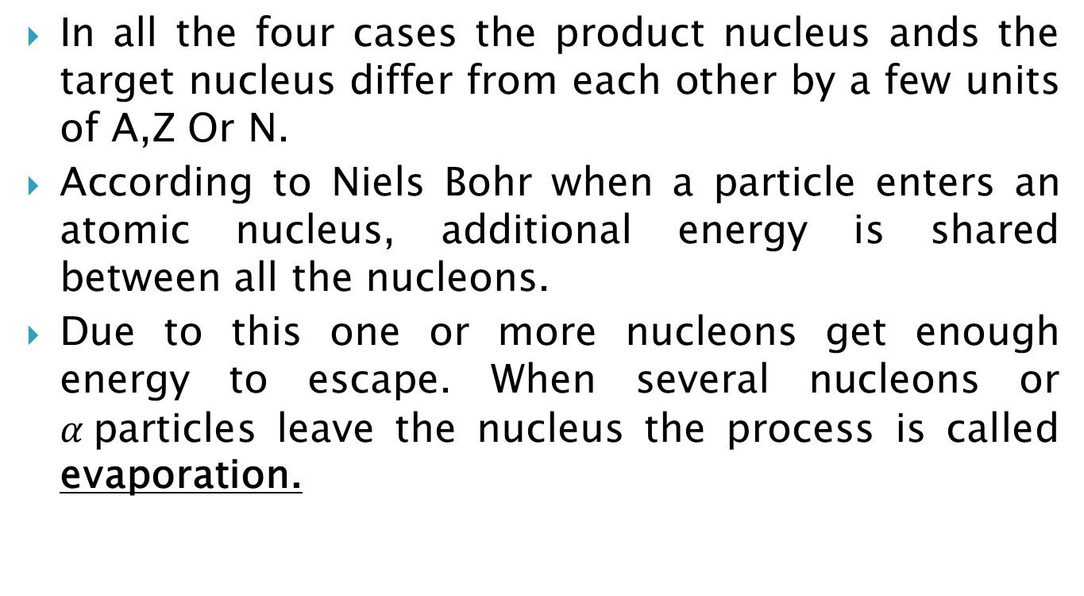
In all the four cases the product nucleus ands the target nucleus differ from each other by a few units of A,Z Or N.
According to Niels Bohr when a particle enters an atomic nucleus, additional energy is shared between all the nucleons.
Due to this one or more nucleons get enough energy to escape. When several nucleons or $α$particles leave the nucleus the process is called evaporation.

Slide 18
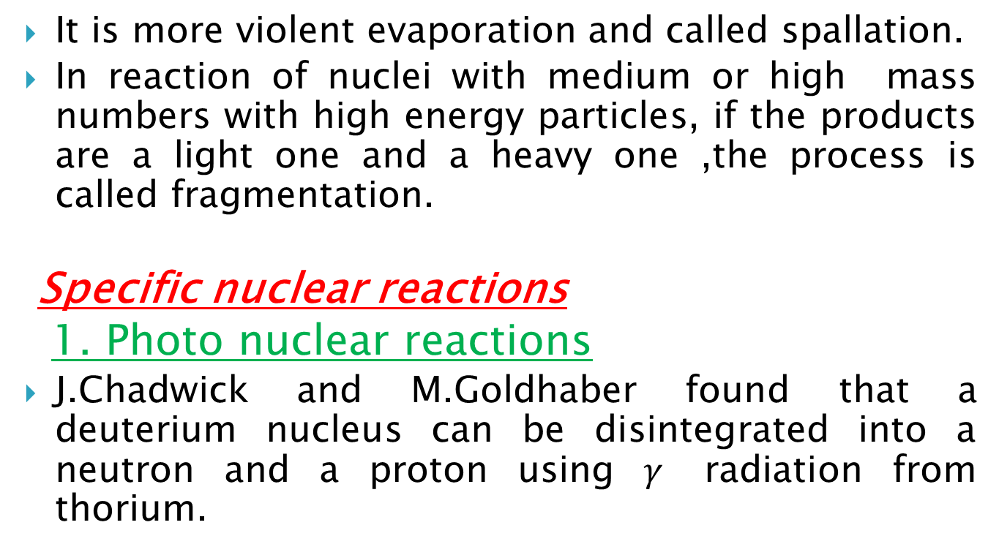
It is more violent evaporation and called spallation.
In reaction of nuclei with medium or high mass numbers with high energy particles, if the products are a light one and a heavy one ,the process is called fragmentation.
Specific nuclear reactions
1. Photo nuclear reactions
J.Chadwick and M.Goldhaber found that a deuterium nucleus can be disintegrated into a neutron and a proton using $γ$ radiation from thorium.

Slide 19
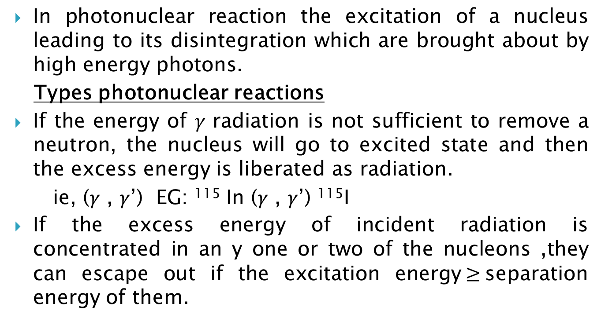
In photonuclear reaction the excitation of a nucleus leading to its disintegration which are brought about by high energy photons.
Types photonuclear reactions
If the energy of 𝛾 radiation is not sufficient to remove a neutron, the nucleus will go to excited state and then the excess energy is liberated as radiation.
ie, (𝛾 , 𝛾’) EG: ¹¹⁵ In (𝛾 , 𝛾’) ¹¹⁵I
If the excess energy of incident radiation is concentrated in an y one or two of the nucleons ,they can escape out if the excitation energy$≥$separation energy of them.

Slide 20
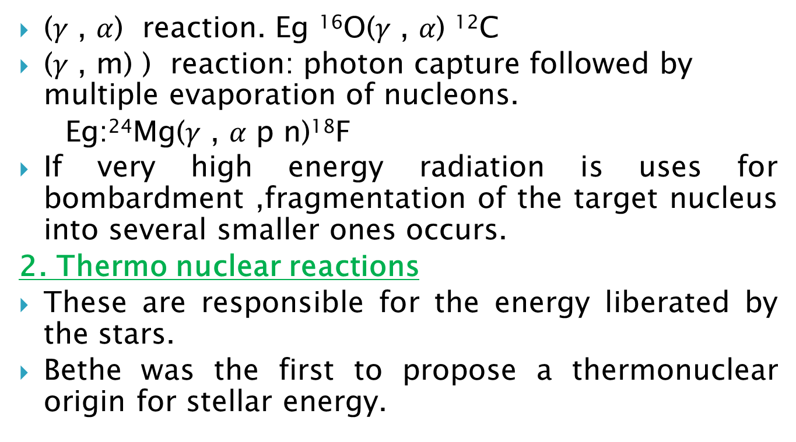
(𝛾 , $α$) reaction. Eg ¹⁶O(𝛾 , 𝛼) ¹²C
(𝛾 , m) ) reaction: photon capture followed by multiple evaporation of nucleons.
Eg:²⁴Mg(𝛾 , 𝛼 p n)¹⁸F
If very high energy radiation is uses for bombardment ,fragmentation of the target nucleus into several smaller ones occurs.
2. Thermo nuclear reactions
These are responsible for the energy liberated by the stars.
Bethe was the first to propose a thermonuclear origin for stellar energy.

Slide 21
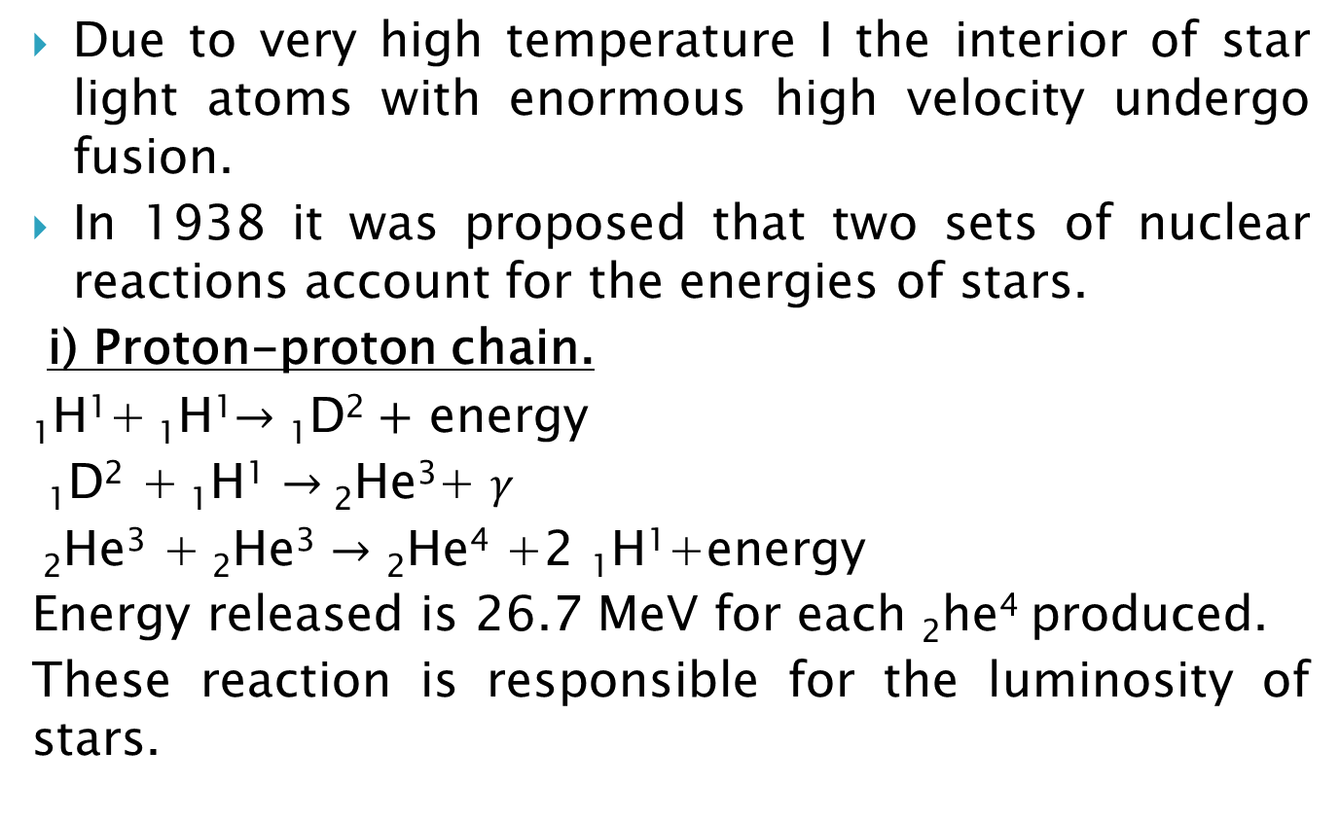
Due to very high temperature I the interior of star light atoms with enormous high velocity undergo fusion.
In 1938 it was proposed that two sets of nuclear reactions account for the energies of stars.
i) Proton-proton chain.
₁H¹+ ₁H¹$→\text{1}\text{D}\text{2}+$ energy
$\text{1}\text{D}\text{2}$ + ₁H¹ $→$₂He³+ 𝛾
₂He³ + ₂He³ $→$ ₂He⁴ +2 ₁H¹+energy
Energy released is 26.7 MeV for each ₂he⁴ produced.
These reaction is responsible for the luminosity of stars.

Slide 22
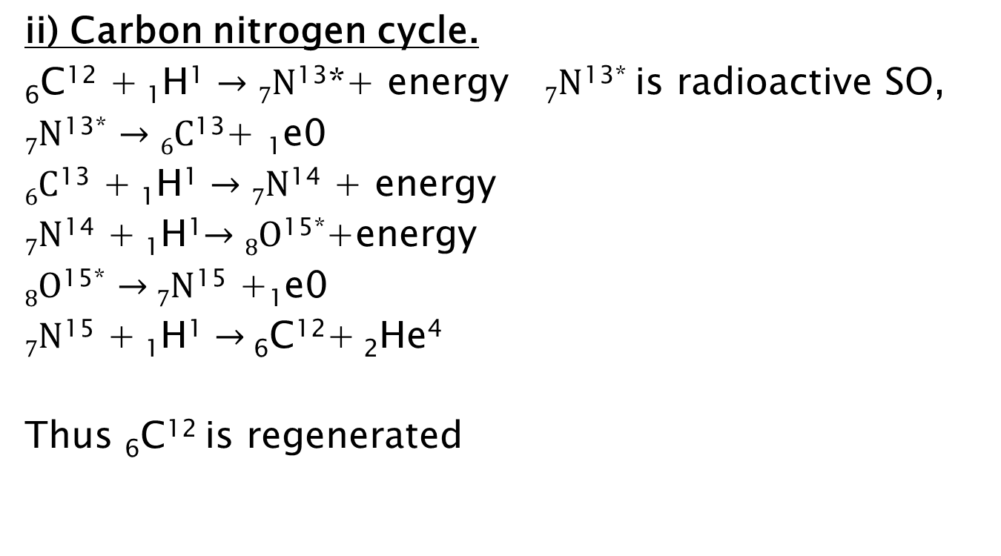
ii) Carbon nitrogen cycle.
₆C¹² + ₁H¹ $→7N$¹³*+ energy $7N$^{13*} is radioactive SO,
$7N$^{13*} $→6C$¹³+ ₁e0
$6C$¹³ + ₁H¹ $→7N$¹⁴ + energy
$7N$¹⁴ + ₁H¹$→8O$^{15*}+energy
$8O$^{15*} $→$ $7N$¹⁵ +₁e0
$7N$¹⁵ + ₁H¹ $→$ ₆C¹²+ ₂He⁴
Thus ₆C¹² is regenerated

Slide 23
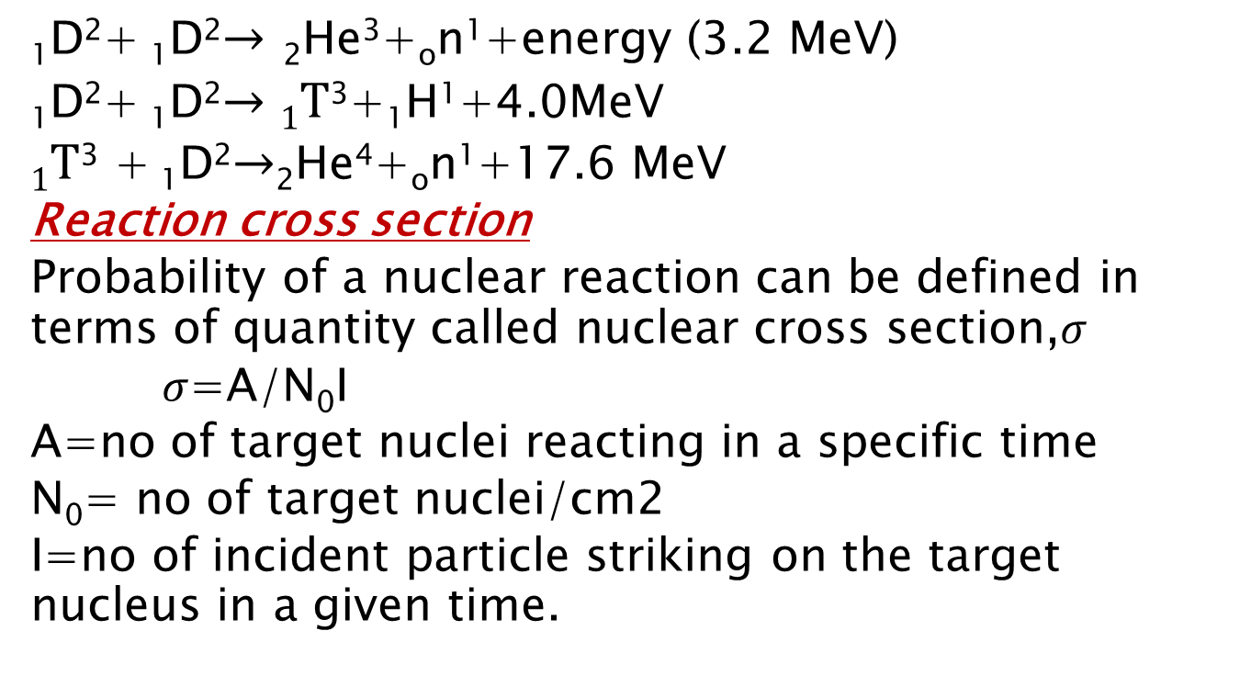
Thermo nuclear reactions on earth
₁D²+ ₁D²$→$ ₂He³+_{o}n¹+energy (3.2 MeV)
₁D²+ ₁D²$→1T$³+₁H¹+4.0MeV
$1T$³ + ₁D²$→$₂He⁴+_{o}n¹+17.6 MeV
Reaction cross section
Probability of a nuclear reaction can be defined in terms of quantity called nuclear cross section,$σ$
$σ$=A/N₀I
A=no of target nuclei reacting in a specific time
N₀= no of target nuclei/cm2
I=no of incident particle striking on the target nucleus in a given time.

Slide 24
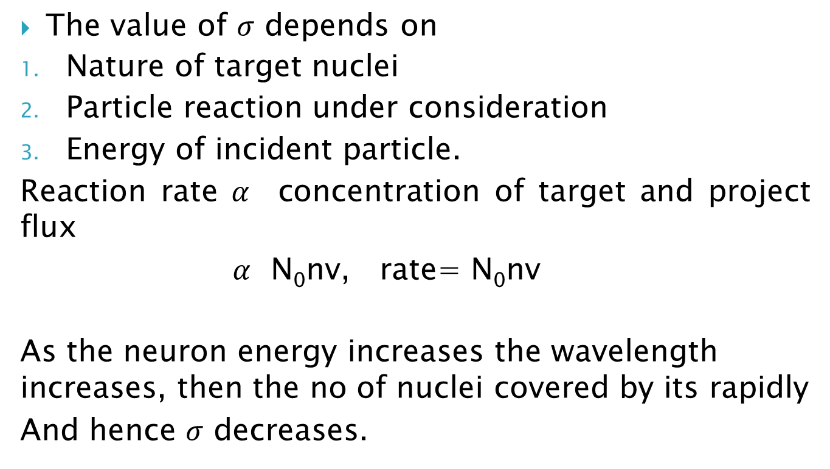
The value of $σ$ depends on
Nature of target nuclei
Particle reaction under consideration
Energy of incident particle.
Reaction rate$α$ concentration of target and project flux
$α$ N₀nv, rate= N₀nv
As the neuron energy increases the wavelength increases, then the no of nuclei covered by its rapidly
And hence $σ$ decreases.

Slide 25
Conservations in nuclear reactions
Conservations of protons and neutrons
In low energy reactions, the no of protons(Z), no of neutrons(N) and Σhence A remains separately constant. Σ Z _{reactants=} Σ Z _{products}
Σ N _{reactants=} Σ N _{products}
In reactions induced by very high energy particles, the conservation of N&Z separately will not hold but together will be Constant ie A whole is conserved.

Slide 26
Conservations of momentum
The initial momentum of the projectile particle=that of compound nucleus
Mv=(M+m)V m=mass of projectile
v=velocity of projectile ,M=mass of target nucleus,
V=velocity of compound nucleus.
For the conservation of linear momentum V=(m/m+M)v
Due to the conservation of V the entire K.E of the projectile is not available for the excitation of the target nucleus, but only a fraction of it.

Slide 27
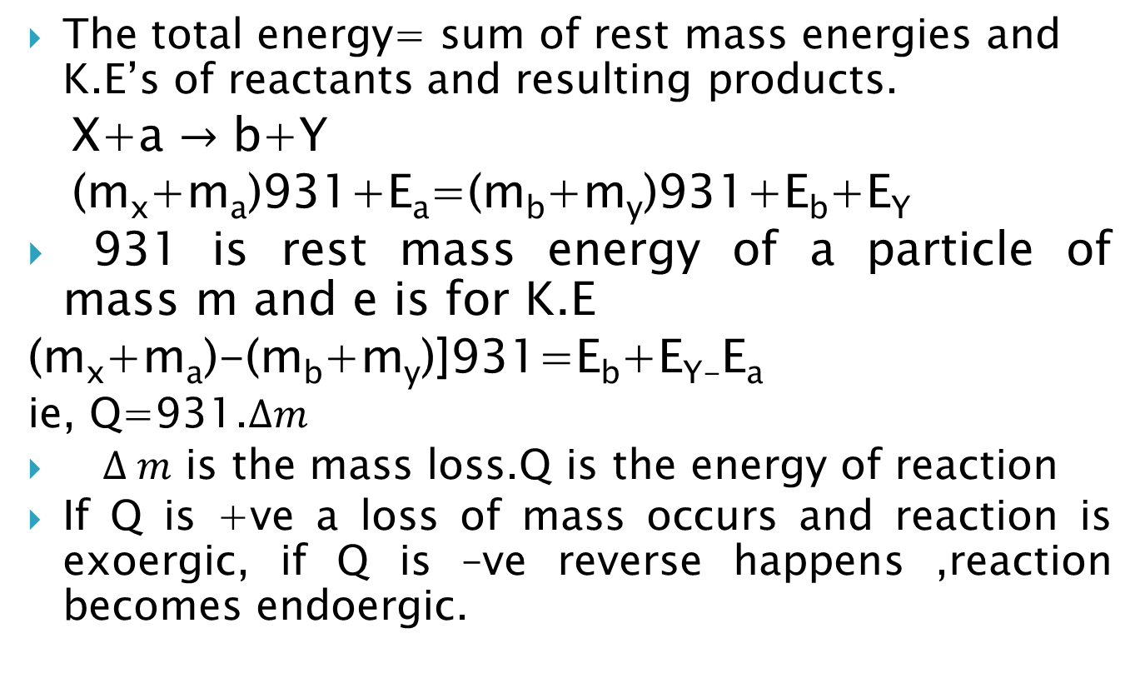
The total energy= sum of rest mass energies and K.E’s of reactants and resulting products.
X+a $→$ b+Y
(m_{x}+m_{a})931+E_{a}=(m_{b}+m_{y})931+E_{b}+E_{Y}
931 is rest mass energy of a particle of mass m and e is for K.E
(m_{x}+m_{a})-(m_{b}+m_{y})]931=E_{b}+E_{Y-}E_{a}
ie, Q=931.$∆m$
$∆ m$ is the mass loss.Q is the energy of reaction
If Q is +ve a loss of mass occurs and reaction is exoergic, if Q is –ve reverse happens ,reaction becomes endoergic.

Slide 28
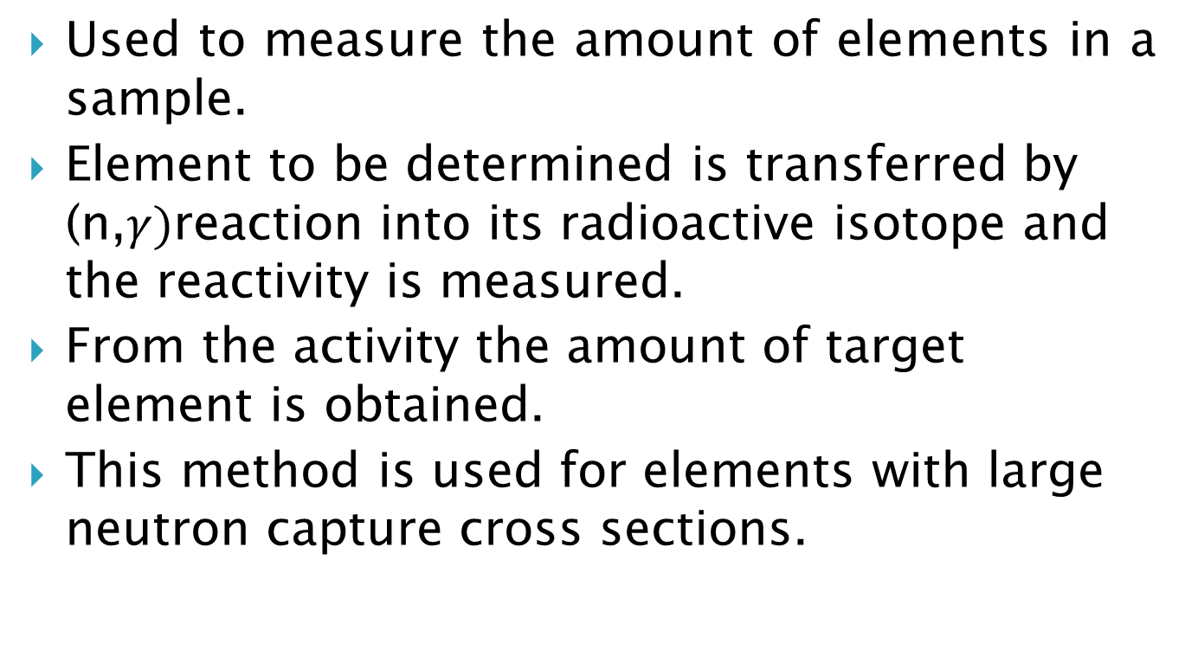
Neutron activation analysis.
Used to measure the amount of elements in a sample.
Element to be determined is transferred by (n,$γ)$reaction into its radioactive isotope and the reactivity is measured.
From the activity the amount of target element is obtained.
This method is used for elements with large neutron capture cross sections.

Slide 29
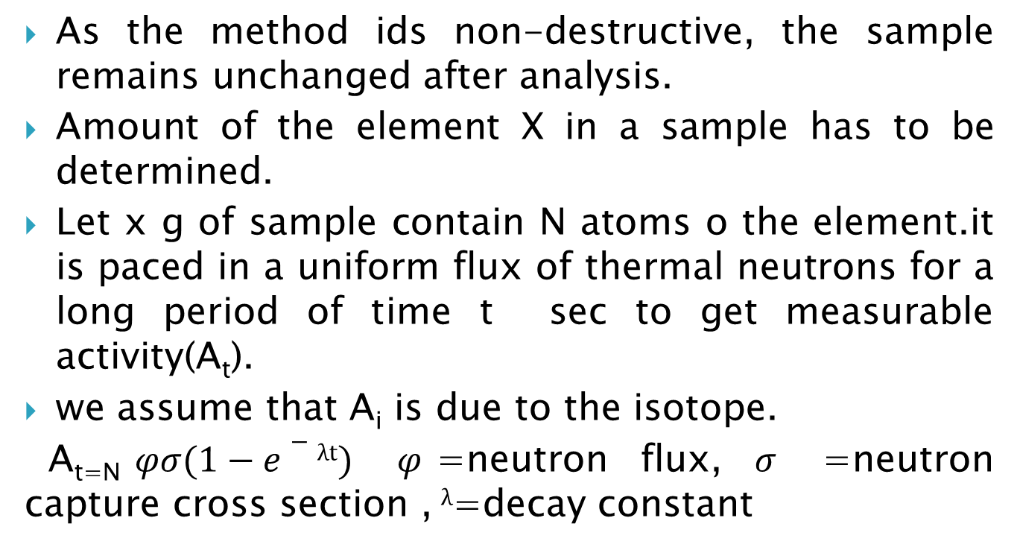
As the method ids non-destructive, the sample remains unchanged after analysis.
Amount of the element X in a sample has to be determined.
Let x g of sample contain N atoms o the element.it is paced in a uniform flux of thermal neutrons for a long period of time t sec to get measurable activity(A_{t}).
we assume that A_{i} is due to the isotope.
A_{t=N}$φσ(1−e−λt)$ $φ$=neutron flux, $σ$ =neutron capture cross section , $λ$=decay constant

Slide 30
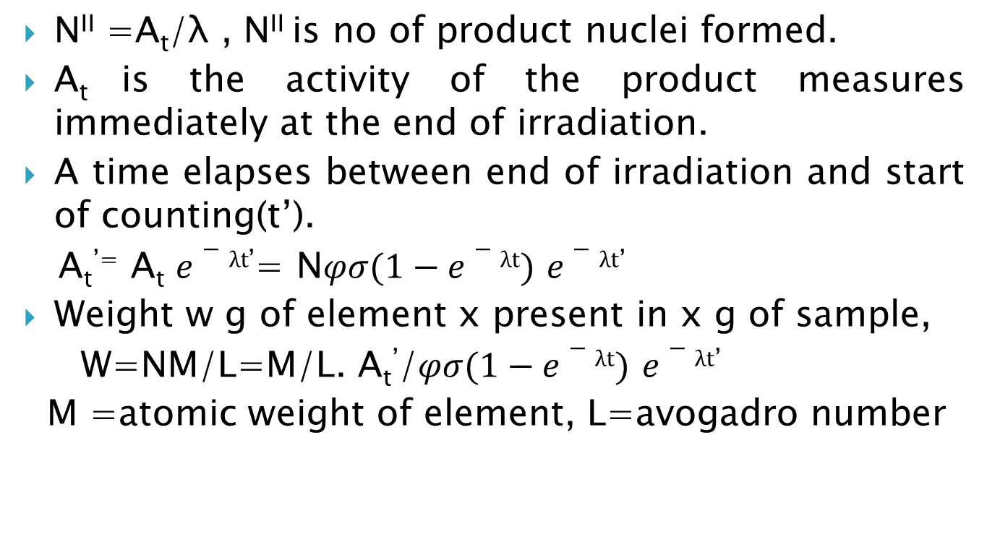
N^{II} =A_{t}/λ , N^{II} is no of product nuclei formed.
A_{t} is the activity of the product measures immediately at the end of irradiation.
A time elapses between end of irradiation and start of counting(t’).
A_{t}^{’=} A_{t} $e−λt$’= N$φσ(1−e−λt)$ $e−λt$’
Weight w g of element x present in x g of sample,
W=NM/L=M/L. A_{t}’/$φσ(1−e−λt)$ $e−λt$’
M =atomic weight of element, L=avogadro number

Slide 31
In practice 2 samples are irradiated simultaneously under identical conditions ,one standard containing known amount of element w₀,and other unknown w. w/w₀₌A_{t/}A_{t0}
APPLICATIONS
Chromium content of ruby
Mn content of tea leaves.
Archaeological samples.
Arsenic ion in human body-slow poisoning.
Pre and post -1850 paintings.

Slide 32
Radiation chemistry
It is defined as the study of chemical effects produced in a system by the absorption of ionizing radiation from a radioactive nuclei.
It is entirely different from radiation chemistry.
Origin.
G value- the yield of a reaction can be represented by G-value.
It is the no of molecules undergoing change for each 100eV of energy.
G=(M/N)(100/W) ,(M/N) is the ion-pair yield ,w is the mean energy in eV required to form ion pairs

Slide 33
INTERACTION OF HIGH ENERGY ELECTRON WITH MATTER
If the energy of electron is low elastic scattering occurs.
For more higher energies inelastic collision occurs.
For very-high energy electron energy of then are lost by electromagnetic emission.
Energy loss through inelastic scattering: energy loss by coulomb interaction with electrons of stopping material produces ionization of stopping material whereby electron get decelerated

Slide 34
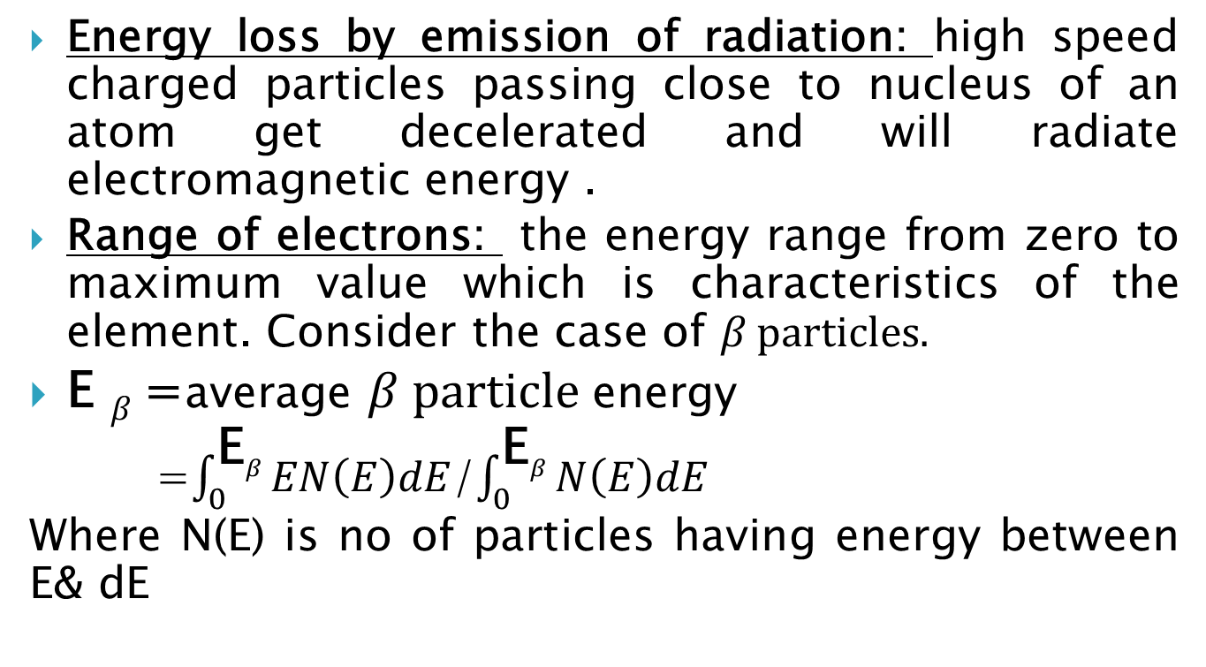
Energy loss by emission of radiation: high speed charged particles passing close to nucleus of an atom get decelerated and will radiate electromagnetic energy .
Range of electrons: the energy range from zero to maximum value which is characteristics of the element. Consider the case of $β particles.$
E $β$ =average $β particle$energy
=$\int_{0}^{\text{E}β}{EN\left(E\right)dE}$/$\int_{0}^{\text{E}β}{N\left(E\right)dE}$
Where N(E) is no of particles having energy between E& dE

Slide 35
Heavy charged particles
Energy loss is by inelastic scattering. Emission of m electromagnetic energy occur only at the order of 1000eV
linear energy loss increases the particles slows down.
NEUTRONS
As they are not charged they don’t produce ionization directly, they interact with nuclei and products formed can produce ionization.

Slide 36
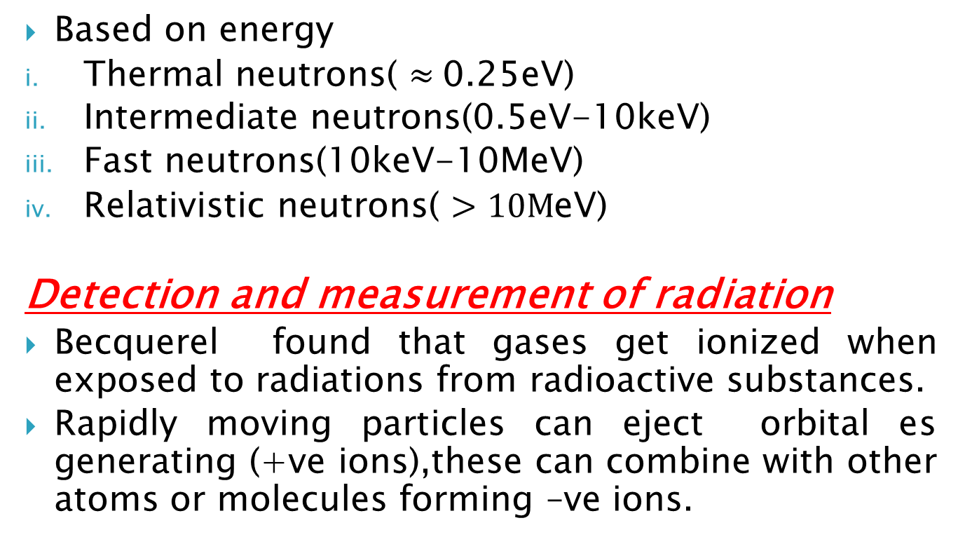
Based on energy
Thermal neutrons( $≈$0.25eV)
Intermediate neutrons(0.5eV-10keV)
Fast neutrons(10keV-10MeV)
Relativistic neutrons( $>10M$eV)
Detection and measurement of radiation
Becquerel found that gases get ionized when exposed to radiations from radioactive substances.
Rapidly moving particles can eject orbital es generating (+ve ions),these can combine with other atoms or molecules forming –ve ions.

Slide 37
Thus ion pairs are generated.
The no of ion pairs formed per cm of the path of a moving charged particle in its path through a gas is called ionization.
IONISATION CHAMBER
It consists of two electrodes separated by a gas filled space in which the incident radiation is applied to the electrodes. Instruments fall into two categories.
Non integrating or pulse type (ii) integrating type.
If the response time of the system relative to the frequency of arrival of ionizing particle is small, each pulse produced by an ionizing particle can be detected separately and counted.

Slide 38
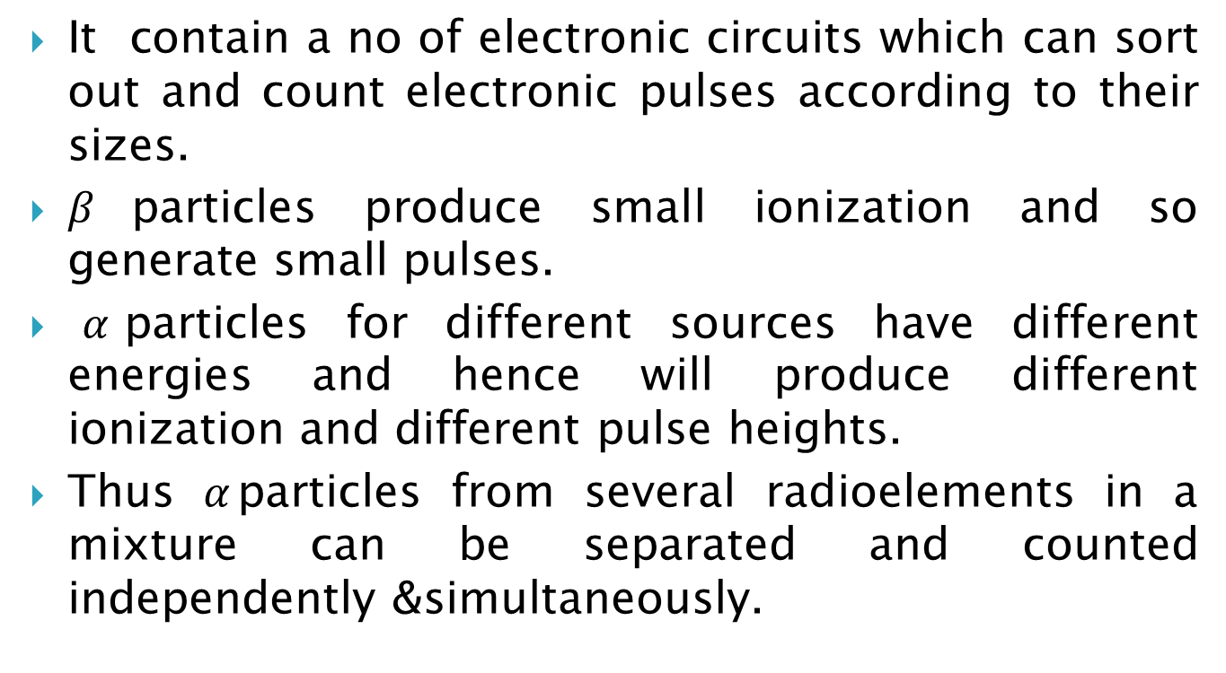
PULSE -HEIGHT ANALYSER
It contain a no of electronic circuits which can sort out and count electronic pulses according to their sizes.
$β$particles produce small ionization and so generate small pulses.
$α$particles for different sources have different energies and hence will produce different ionization and different pulse heights.
Thus $α$particles from several radioelements in a mixture can be separated and counted independently &simultaneously.

Slide 39
Geiger-Muller counter
Here the operational voltage is set somewhat midway between Vs & V_{A} rather slightly left towards the mid-point (V₀).There are many designs.
End-window counter
A thin tungsten wire is stretched along the axis of a metal or graphite coated glass cylinder.
Its bottom is covered with a thin foil of Al of 1 mg /cm2 thickness. Source absorbers are placed on a stand beneath a 20-25 thick lead castle surround the counter. Tube is filled with Ar

Slide 40
The liquid counter
Used to find the activity of liquids.
Two co-axial glass tubes are sealed at the bottom.
The inner tube ids filled with Ar and a halogen.
A tungsten wire is stretched along the axis of the inner tube.
The inner wall of gas-filled tube is silvered and serves as cathode which is earthed.
The annulus is filled with 5-10cm3 of liquid whose activity is to be measured.

Slide 41
Scintillation counter
Scintillation counting is an effective method of counting.
Certain compound which produce scintillation when exposed ionizing radiation are transparent to the light they emit. So large quantities of scintillators can be used which ensures higher interaction an d higher efficiency.
The light produced from a single scintillation is too feeble to measure .Hence a photomultiplier tube can be used.

Slide 42
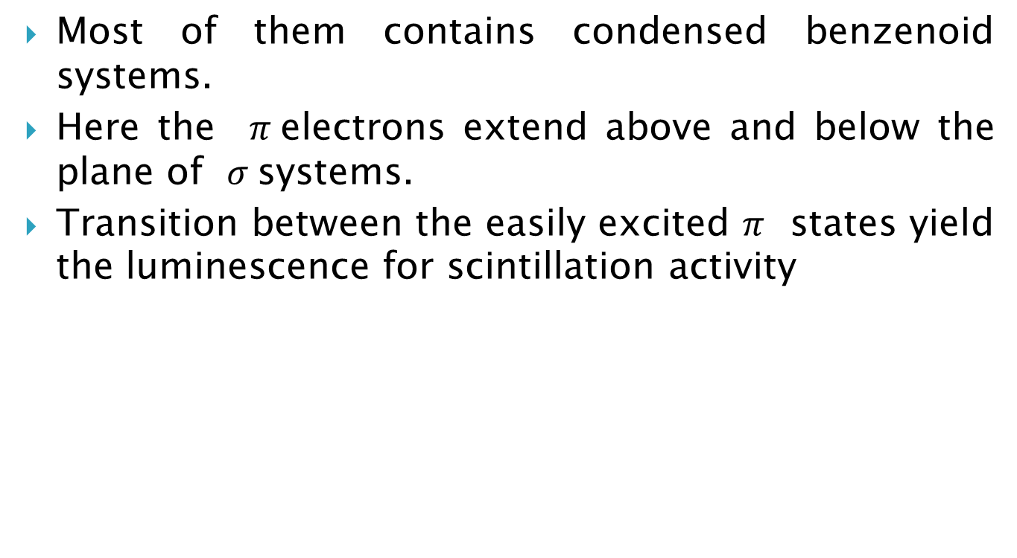
Organic scintillators
Most of them contains condensed benzenoid systems.
Here the $π$electrons extend above and below the plane of $σ$systems.
Transition between the easily excited $π$ states yield the luminescence for scintillation activity

Slide 43
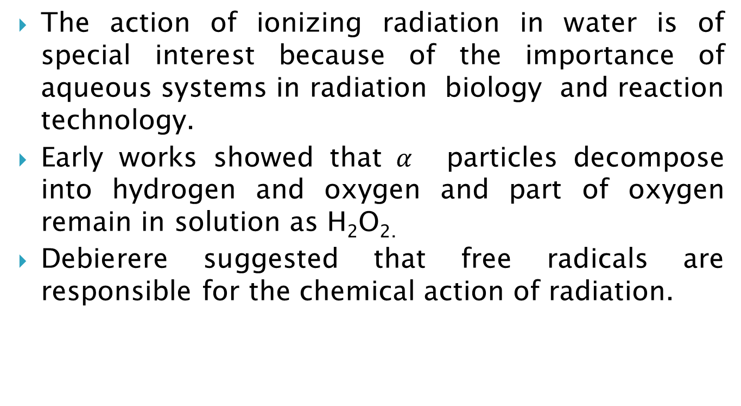
RADIOLYSIS OF WATER AND AQUEOUS SOLUTIONS.
The action of ionizing radiation in water is of special interest because of the importance of aqueous systems in radiation biology and reaction technology.
Early works showed that$α$ particles decompose into hydrogen and oxygen and part of oxygen remain in solution as H₂O_{2.}
Debierere suggested that free radicals are responsible for the chemical action of radiation.

Slide 44
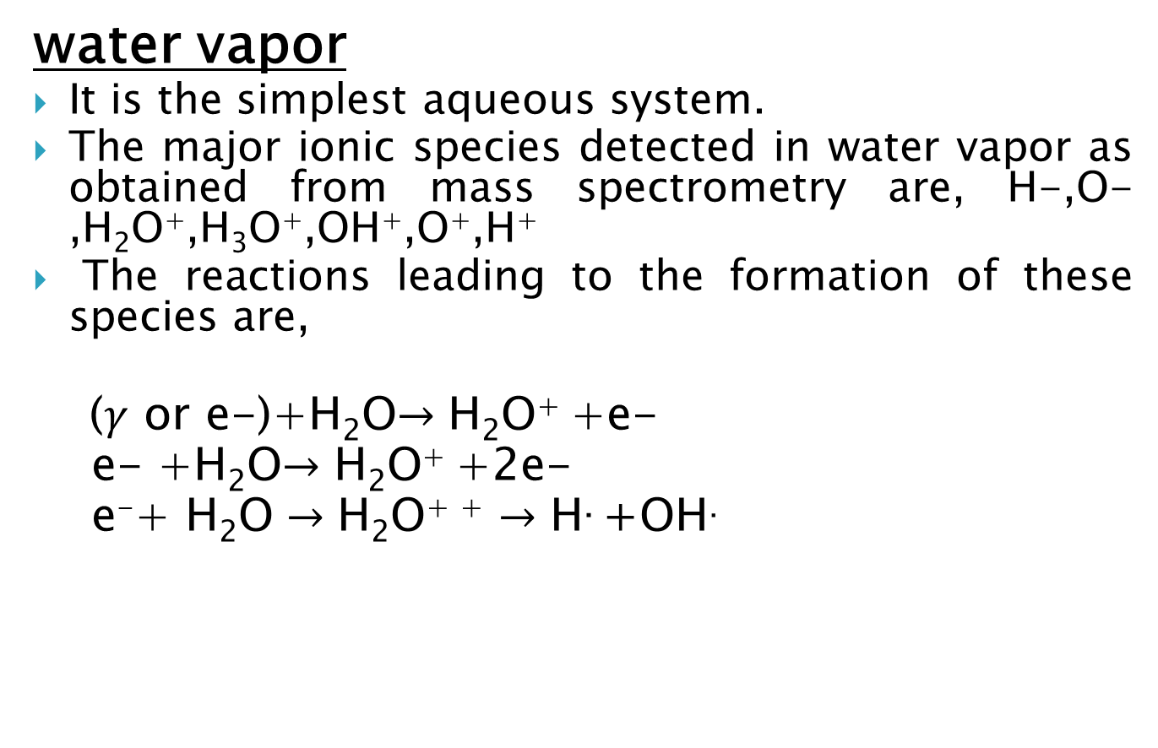
water vapor
It is the simplest aqueous system.
The major ionic species detected in water vapor as obtained from mass spectrometry are, H-,O-,H₂O⁺,H₃O⁺,OH⁺,O⁺,H⁺
The reactions leading to the formation of these species are,
($γ$ or e-)+H₂O$→\text{H}\text{2}\text{O}$⁺ +e-
e- +H₂O$→\text{H}\text{2}\text{O}$⁺ +2e-
$\text{e}\text{−}\text{+ }\text{H}\text{2}\text{O}→\text{H}\text{2}\text{O}$⁺ ⁺ $→\text{H}\text{.}$ +OH.

Slide 45
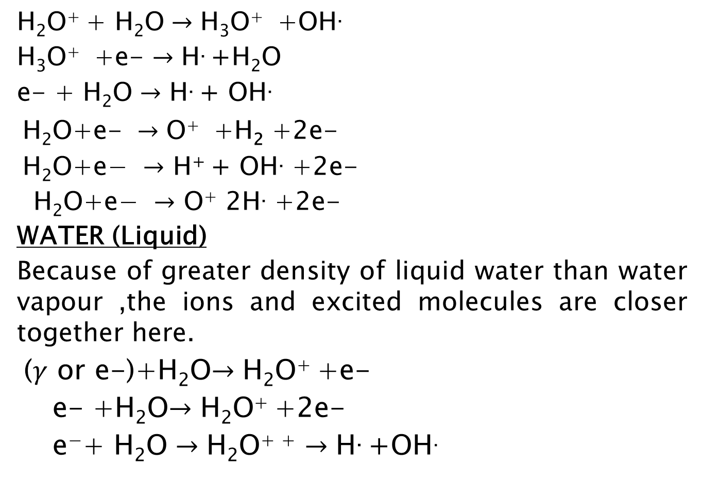
$\text{H}\text{2}\text{O}$⁺ + $\text{H}\text{2}\text{O}→\text{H}\text{3}\text{O}$⁺ +OH.
$\text{H}\text{3}\text{O}$⁺ +e- $→\text{H}\text{.}$ +H₂O
e- + $\text{H}\text{2}\text{O}→$ $\text{H}\text{.}$ + OH.
$\text{H}\text{2}\text{O}\text{+}\text{e}\text{− }→\text{O}$⁺ +H₂ +2e-
$\text{H}\text{2}\text{O}\text{+}\text{e}\text{− }→$ $\text{H}\text{+}$ + OH. +2e-
$\text{H}\text{2}\text{O}\text{+}\text{e}\text{− }→$ $\text{O}$⁺ 2H. +2e-
WATER (Liquid)
Because of greater density of liquid water than water vapour ,the ions and excited molecules are closer together here.
($γ$ or e-)+H₂O$→\text{H}\text{2}\text{O}$⁺ +e-
e- +H₂O$→\text{H}\text{2}\text{O}$⁺ +2e-
$\text{e}\text{−}\text{+ }\text{H}\text{2}\text{O}→\text{H}\text{2}\text{O}$⁺ ⁺ $→\text{H}\text{.}$ +OH.

Slide 46
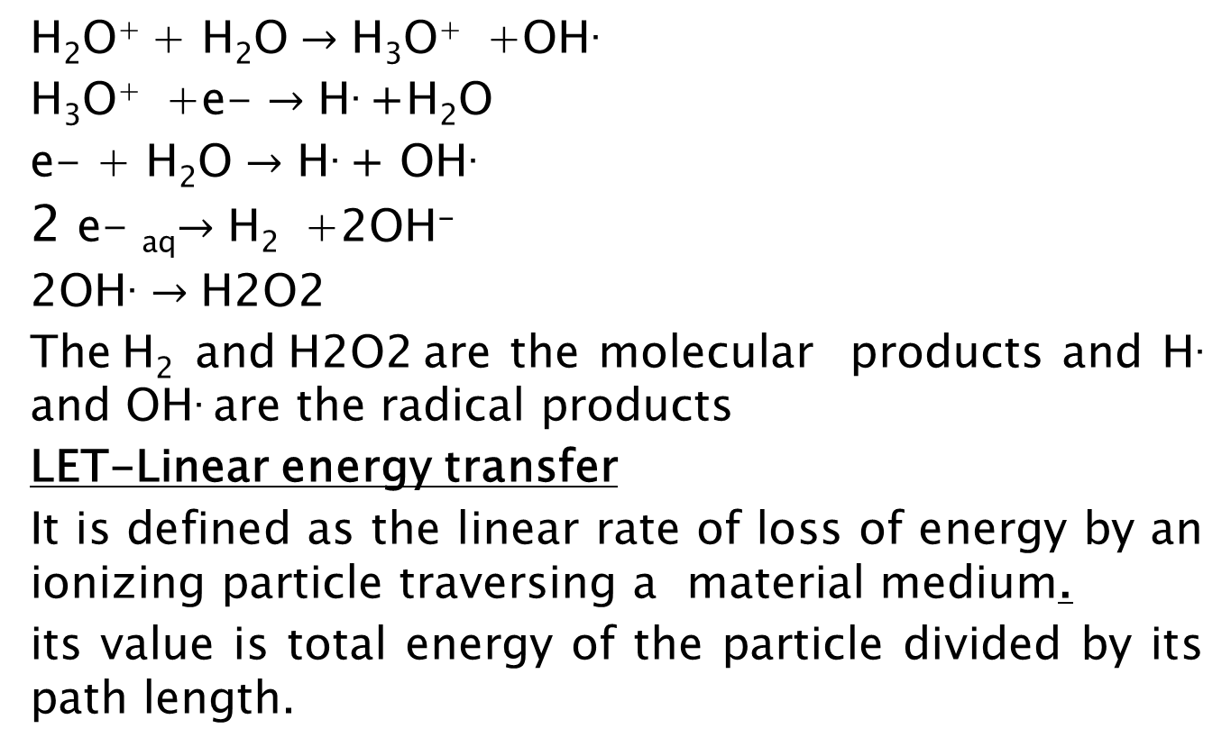
$\text{H}\text{2}\text{O}$⁺ + $\text{H}\text{2}\text{O}→\text{H}\text{3}\text{O}$⁺ +OH.
$\text{H}\text{3}\text{O}$⁺ +e- $→\text{H}\text{.}$ +H₂O
e- + $\text{H}\text{2}\text{O}→$ $\text{H}\text{.}$ + OH.
2 e- _{aq}$→\text{H}\text{2}$ +2OH⁻
2OH. $→\text{H}\text{2}\text{O}\text{2}$
The $\text{H}\text{2}$ and $\text{H}\text{2}\text{O}\text{2}$ are the molecular products and $\text{H}\text{.}$ and OH. are the radical products
LET-Linear energy transfer
It is defined as the linear rate of loss of energy by an ionizing particle traversing a material medium.
its value is total energy of the particle divided by its path length.

Slide 47
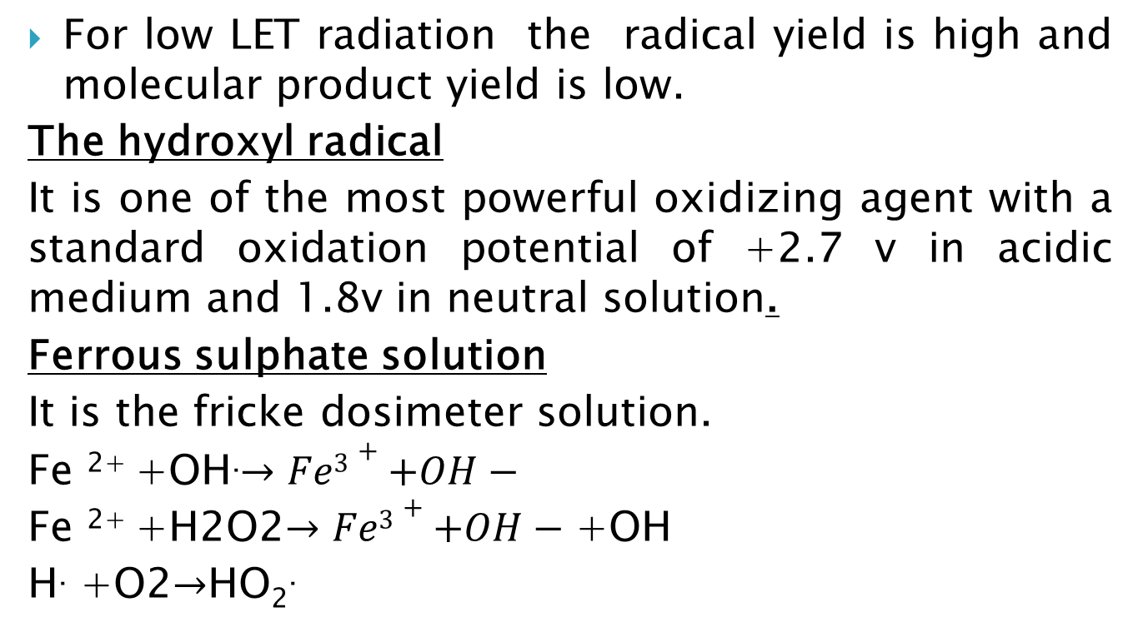
For low LET radiation the radical yield is high and molecular product yield is low.
The hydroxyl radical
It is one of the most powerful oxidizing agent with a standard oxidation potential of +2.7 v in acidic medium and 1.8v in neutral solution.
Ferrous sulphate solution
It is the fricke dosimeter solution.
Fe ²⁺ +OH.$→Fe3++OH−$
Fe ²⁺ +H2O2$→Fe3++OH−$ +OH
H. +O2$→$HO₂.

Slide 48
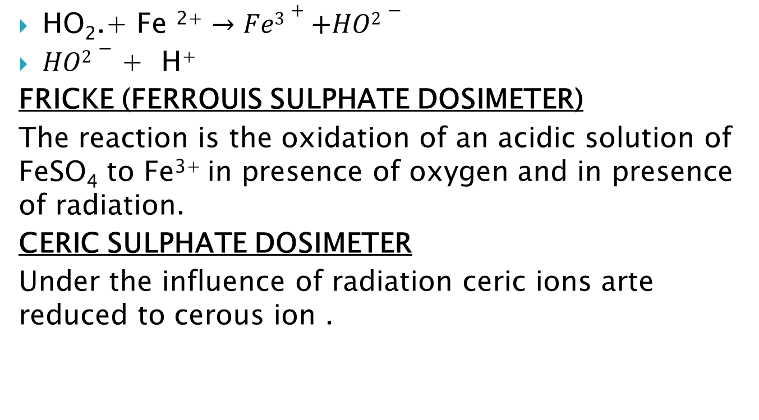
HO₂.+ Fe ²⁺ $→Fe3++HO2−$
$HO2−$ + H⁺
FRICKE (FERROUIS SULPHATE DOSIMETER)
The reaction is the oxidation of an acidic solution of FeSO₄ to Fe³⁺ in presence of oxygen and in presence of radiation.
CERIC SULPHATE DOSIMETER
Under the influence of radiation ceric ions arte reduced to cerous ion .

Slide 49
Thanks………

